Slide 1
General course
2022-2023
Programming 2
Dictionaries, iterables & Comprehension Expressions
Serhat Erdogan

Slide 2
Last week
Repetition of what we saw last week

Slide 3
Goals of this lesson
Student can work with a dictionary data structure
Student can use the enumerate function and understands the benefit of using it.
Student understand the benefit of Comprehension Expressions.
Student understands and can use the Filter(), Zip() & Map() functions.

Slide 4
Content table
Data structure: dictionary
Filter, Zip & Map
Iterables
Generators & Comprehension Expressions

Slide 5
Data structure: Dictionary

Slide 6
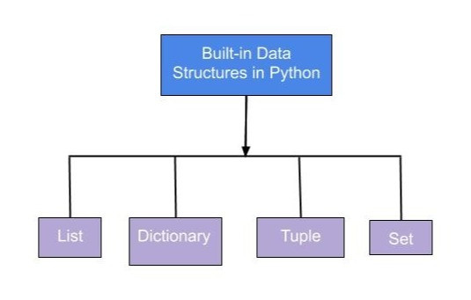
Data structure
A data structure models a collection of data, such as a list of number, a row in a spreadsheet, or a record in a database. Modeling the data that your program interacts with using the right data structure is often the key to writing simple and effective code

Slide 7
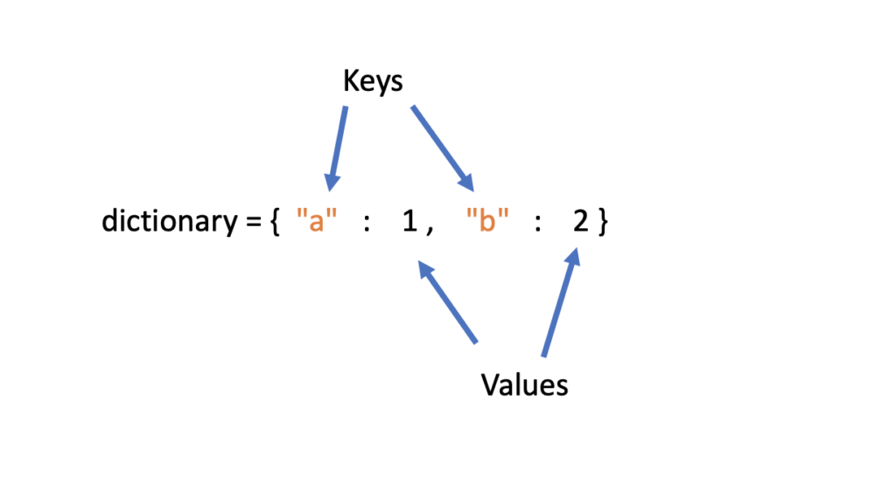
Dictionary
Dictionaries are Python’s implementation of a data structure that is more generally known as a map. A dictionary consists of a collection of key-value pairs. Each key-value pair maps the key to its associated value. The key in a key-value pair is a unique name that identifies the value of the pair.
d = {
<key>: <value>,
<key>: <value>,
.
.
.
<key>: <value>
}

Slide 8
Dictionary states/capitals example
You could use a dictionary to store the names of states and their capitals:
Key | Value
“California” | “Sacramento”
“New York” | “Albany”
“Texas” | “Austin”
dict_states = {
'California': 'Sacramento',
'New York': 'Albany',
'Texas': 'Austin'
}

Slide 9
Accessing dictionary values
Of course, dictionary elements must be accessible somehow. If you don’t get them by index, then how do you get them? A value is retrieved from a dictionary by specifying its corresponding key in square brackets ([]):
dict_baseball = {
'Colorado': 'Rockies',
'Boston': 'Red Sox',
'Minnesota': 'Twins',
'Milwaukee': 'Brewers',
'Seattle': 'Mariners'
}
print(dict_baseball['Minnesota'])
print(dict_baseball['Colorado'])
dict_baseball['Minnesota'] = "Barca"
dict_baseball['Colorado'] = "Madrid"
print(dict_baseball['Minnesota'])
print(dict_baseball['Colorado'])
Output:
Twins
Rockies
Output:
Barca
Madrid

Slide 10
Relationship key an value
In a Python dictionart, the relationship between a key and its value is completely arbitrary. Any key can be assigned to any value.
Valid Dictionary Key types
Integers
floats
Strings
Booleans
tuples
Key | Value
1 | “Sunday”
“red” | 12:45pm
17 | True

Slide 11
Adding & removing dictionary values
dict_states = {
'California': 'Sacramento',
'New York': 'Albany',
'Texas': 'Austin'
}
dict_states['Colorado'] = 'Denver'
print(dict_states)
dict_states = {
'California': 'Sacramento',
'New York': 'Albany',
'Texas': 'Austin’
}
del dict_states['California']
print(dict_states)
Adding to dictionary
Remove item from dictionary
Output:
{'California': 'Sacramento', 'New York': 'Albany', 'Texas': 'Austin', 'Colorado': 'Denver'}
Output:
{'New York': 'Albany', 'Texas': 'Austin'}

Slide 12
Checking for keys & Iterating over dictionary
dict_states = {
'California': 'Sacramento',
'New York': 'Albany',
'Texas': 'Austin’
}
#Checking if the key exist in the dictionary
if "Belgium" in dict_states:
print("True")
#You can use “else” also ofcourse
if "Belgium" not in dict_states:
print("False")
dict_states = {
'California': 'Sacramento',
'New York': 'Albany',
'Texas': 'Austin’
}
#Items() returns a list-like object containing tuples of key-value pairs
for state, capital in dict_states.items():
print(f'the capital of {state} is {capital}')
Output:
False
Output: the capital of California is Sacramento
the capital of New York is Albany
the capital of Texas is Austin

Slide 13
Checking keys & values
dictionary = {
1: “A”,
2: “B”,
3: “C”
}
#Getting the keys
print(list(dictionary.keys()))
#Getting the values
print(list(dictionary.values()))
Output:
[1, 2, 3]
['A', 'B', 'C']

Slide 14
Exercise dictionary
Create an empty dictionary named captains.
Using square bracket notation, enter the following data into the dictionary one item at the time:
'Enterprise': 'Picard'
'Voyager': 'Janeway'
'Defiant': 'Sisko’
Write two if statements that check if “Enterprise” and “Discovery” exist as keys in the dictionary. Set their values to “unknown” if the key does not exist.
Write a for loop to display the ship and captain names contained in the dictionary. For example, the ouput should look something like:
The enterprise is captained by Picard
Delete “Discovery” from the dictionary.
Notes:
Small exercise so that the students understand it better and we can go further with the theory

Slide 15
How to pick a data structure
Use a list when the following are true:
The data has a natural order.
The primary purpose of the data structure is iteration.
Use a dictionary when the following are true:
The data is unordered, or the order does not matter.
You need a key-value relationship.
The primary purpose of the data structure is looking up values.

Slide 16
Filter, Zip & Map

Slide 17
Filter function
In Python, the `filter()` function is a built-in function that is used to filter elements from a sequence (such as a list, tuple, or string) based on a certain condition. The function takes two arguments: a function and an iterable (e.g. a list). The function is applied to each element in the iterable, and if the function returns True for an element, that element is included in the output.
In this example, `filter()` is being used to filter out even numbers from the numbers list. The function passed to filter() is lambda x: x % 2 == 0, which checks if a number is even (i.e. if it is divisible by 2 with no remainder).
# Using filter() to filter out even numbers from a list
numbers = [1, 2, 3, 4, 5, 6, 7, 8, 9, 10]
even_numbers = list(filter(lambda x: x % 2 == 0, numbers))
print(even_numbers) # prints [2, 4, 6, 8, 10]

Slide 18
Filter function
You can also use `filter()` function with normal function instead of lambda function.
def is_even(x):
return x % 2 == 0
numbers = [1, 2, 3, 4, 5, 6, 7, 8, 9, 10]
even_numbers = list(filter(is_even, numbers))
print(even_numbers) # prints [2, 4, 6, 8, 10]

Slide 19
Zip function
The `zip()` function in Python combines two or more iterables (such as lists, tuples, or strings) into a single iterable of tuples. Each tuple contains an element from each of the input iterables, and the number of tuples in the output iterable is equal to the length of the shortest input iterable.
In this example, `zip()` is being used to combine the names and ages lists into a single list of tuples. Each tuple contains the corresponding name and age from the two lists.
# Using zip() to combine two lists
names = ['Alice', 'Bob', 'Charlie']
ages = [22, 20, 21]
combined = list(zip(names, ages))
print(combined) # prints [('Alice', 22), ('Bob', 20), ('Charlie', 21)]

Slide 20
Zip function
You can also use the zip() function with more than two iterables:
You can also unzip the zipped iterable using the zip() method again with the * operator,
# Using zip() to combine two lists
names = ['Alice', 'Bob', 'Charlie']
gender = ['F', 'M', 'M']
ages = [22, 20, 21]
combined = list(zip(names, ages, gender))
print(combined) # prints [('Alice', 22, 'F'), ('Bob', 20, 'M'), ('Charlie', 21, 'M')]
names, ages, gender = zip(*combined)

Slide 21
Map function
The `map()` function applies a given function to each item of an iterable (e.g. list, tuple, set, etc.) and returns an iterator of the results.
def double(x):
return x*2
# list of numbers
numbers = [1, 2, 3, 4]
# use map to apply double function to each number in the list
doubled_numbers = map(double, numbers)
# the map object can be converted to a list or tuple
print(list(doubled_numbers)) # Output: [2, 4, 6, 8]
Notes:
Small exercise so that the students understand it better and we can go further with the theory

Slide 22
Iterable/Iterator

Slide 23
Iterable/Iterator
Iterators are methods that iterate collections like lists, tuples, dictionaries, etc. Using an iterator method, we can loop through an object and return its elements.
Iterable examples:
Lists
Tuples
Strings
Dictionaries
Sets
Generators

Slide 24
Enumerate function
The `enumerate` function accepts an iterable as an input, and returns a new iterable that produces a tuple of the iteration-count and the corresponding item from the original iterable.
# track which entries of an iterable store the value `None`
none_indices = []
iter_cnt = 0 # manually track iteration-count
for item in [2, None, -10, None, 4, 8]:
if item is None:
none_indices.append(iter_cnt)
iter_cnt = iter_cnt + 1
# `none_indices` now stores: [1, 3]

Slide 25
Enumerate function
We can simplify this code and avoid having to initialize or increment the iter_cnt variable, by utilizing enumerate along with tuple-unpacking.
# using the `enumerate` function to keep iteration-count
none_indices = []
for iter_cnt, item in enumerate([2, None, -10, None, 4, 8]):
if item is None:
none_indices.append(iter_cnt)
# `none_indices` now stores: [1, 3]
! Takeaway:
The built-in enumerate function should be used (in conjunction with iterator unpacking) whenever it is necessary to track the iteration count of a for-loop. It is valuable to use this in conjunction with tuple unpacking.
Notes:
C3 superclass linearization is an algorithm used primarily to obtain the order in which methods should be inherited in the presence of multiple inheritance.

Slide 26
Generators & Comprehension Expressions

Slide 27
Problem
Imagine having a list in Python of integers from 0 till 2.000.000.000:
The problem we are having is that we store this all-in memory, and this could affect performance.
Solution? => Generators
# large list
my_list= [0, 1, 2, 3, 4, …, 2000000000]
Notes:
https://www.dataquest.io/blog/python-generators-tutorial/

Slide 28
Generators
Now we introduce an important type of object called a generator, which allows us to generate arbitrarily-many items in a series, without having to store them all in memory at once.
A generator does not store any items. Instead, it stores the instructions for generating each of its members and stores its iteration state; this means that the generator will know if it has generated its second member and will thus generate its third member the next time it is iterated on.
# Regular function
def function_a():
return "a"
# Generator function
def generator_a():
yield "a"
function_a()
>>> "a"
generator_a()
>>> <generator object a at 0x000001565469DA98>
Notes:
https://www.dataquest.io/blog/python-generators-tutorial/

Slide 29
Yield vs Return
The yield statement pauses the execution of the function and sends a value back to the caller, but retains enough state to enable the function to resume where it left off. When the function resumes, it continues execution immediately after the last yield run. This allows its code to produce a series of values over time, rather than computing them at once and sending them back like a list. The next() function is a special function that asks, “What’s the next item in the iteration?” In fact, next() is the precise function that is called when you run a for loop!
def multi_generate():
yield "a"
yield "b"
mg = multi_generate()
next(mg)
>>> "a"
next(mg)
>>> "b"
next(mg)
>>> StopIteration:
mg = multi_generate()
for i in mg:
print(i)
>>> "a"
>>> "b"
Notes:
https://www.dataquest.io/blog/python-generators-tutorial/

Slide 30
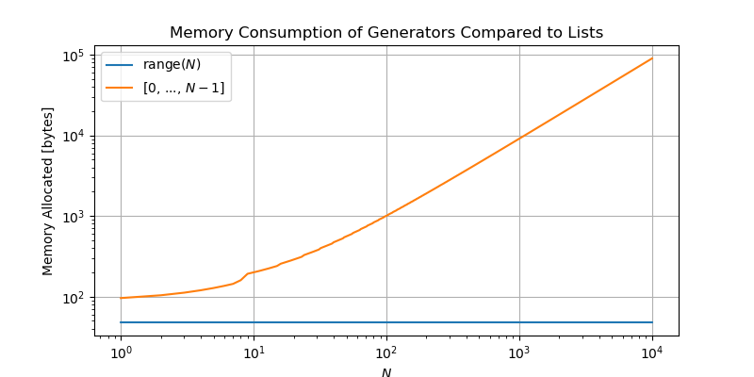
Example range generator
Because range is a generator, the command range(5) will simply store the instructions needed to produce the sequence of numbers 0-4, whereas the list [0, 1, 2, 3, 4] stores all of these items in memory at once.

Slide 31
Infinity sequence example
Here, we are generating an infinite sequence of numbers with yield, yield returns the number and increments the num by + 1.
def inf_sequence():
num = 0
while True:
yield num
num += 1
for i in inf_sequence():
print(i, end=" ")
0 1 2 3 4 5 6 7 8 9 10 11 12 13 14 15 16 17 18 19 20 21 22 23 24 25 26 27 28 29 30 31 32 33 34 35 36 37 38 39 40 41 42 43 44 45 46 47 48 49 50 51 52 53 54 55 56 57 58 59 60 61 62 63 64 65 66 67 68 69 70 71 72 73 74 75 76 77 78.......

Slide 32
Example comprehension expression
Here, we are generating an even sequence of numbers from 0 to 99 in two ways:
# generator to print even numbers
def even_gen_100():
for i in range(100):
if i % 2 == 0:
yield i
The following expression defines a generator for all the even numbers in 0-99
even_gen = (i for i in range(100) if i%2 == 0)
The syntax (<expression> for <var> in <iterable> [if <condition>]) specifies the general form for a generator comprehension.

Slide 33
Example comprehension expression
Here, we are generating an even sequence of numbers from 0 to 99 in two ways:
(("apple" if i < 3 else "pie") for i in range(6))
# will generate:
# 'apple'..
# 'apple'..
# 'apple’..
#...
((i, i**2, i**3) for i in range(10))
# will generate:
# (0, 0, 0)
# (1, 1, 1)
#...

Slide 34
Storing generators
Defining a generator using a comprehension does not perform any computations or consume any memory beyond defining the rules for producing the sequence of data. See what happens when we try to print this generator:
# will generate 0, 1, 4, 9, 25, ..., 9801
>>> gen = (i**2 for i in range(100))
>>> print(gen)
<generator object <genexpr> at 0x000001E768FE8A40>
This output simply indicates that gen stores a generator-expression at the memory address 0x000001E768FE8A40; this is simply where the instructions for generating our sequence of squared numbers is stored.
len(gen) or gen[2] will not work. => so how do we consume our generators?

Slide 35
Consuming generators
We can feed this to any function that accepts iterables. For instance, we can feed gen to the built-in sum function, which sums the contents of an iterable:
gen = (i**2 for i in range(100))
sum(gen) # computes the sum 0 + 1 + 4 + 9 + 25 + ... + 9801
>>328350
What happens if we run this command a second time:
! Takeaway:
A generator can only be iterated over once, after which it is exhausted and must be re-defined in order to be iterated over again.
# computes the sum of ... nothing!
# `gen` has already been consumed!
sum(gen)
>>0

Slide 36
List comprehension
A list comprehension is a syntax for constructing a list, which exactly mirrors the generator comprehension syntax:
[<expression> for <var> in <iterable> {if <condition}]
The difference lies in the square brackets!
# computes the sum of ... nothing!
# `gen` has already been consumed!
>> [i**2 for i in range(10)]
>> [0, 1, 4, 9, 16, 25, 36, 49, 64, 81]

Slide 37
List comprehension
words_with_o = []
word_collection = ['Python', 'Like', 'You', 'Mean', 'It']
for word in word_collection:
if "o" in word.lower():
words_with_o.append(word)
! Takeaway:
The comprehensions-statement is an extremely useful syntax for creating simple and complicated lists and tuples alike.
Using List comprehension:
>>> word_collection = ['Python', 'Like', 'You', 'Mean', 'It’]
>>> words_with_o = [word for word in word_collection if "o" in word.lower()]
>>> words_with_o
['Python', 'You']

Slide 38
Repetition of this lesson
What is the definition of a dictionary in Python?
Describe the relationship between a key and its associated value in a Python dictionary.
What is the method used to retrieve a value from a Python dictionary?
In Python, what is the technique used to determine if a key is present in a dictionary?
How can you add a new key-value pair to an existing Python dictionary?
What is the process used to remove a key-value pair from a Python dictionary?
How can you implement filtering in Python? Provide an example.
What is the functionality of the Zip function in Python?
How are generators useful in Python?
What is the syntax for writing a comprehension expression in Python?

