Slide 1
Abdulmalik Suliman AL-Ghaith

Slide 2
What is the project about
Learning Management System is a software application that helps you create, manage, and deliver online courses or training programs.

Slide 3
Used technologies
mongoose
express
ejs
HTML & CSS
bootstrap

Slide 4
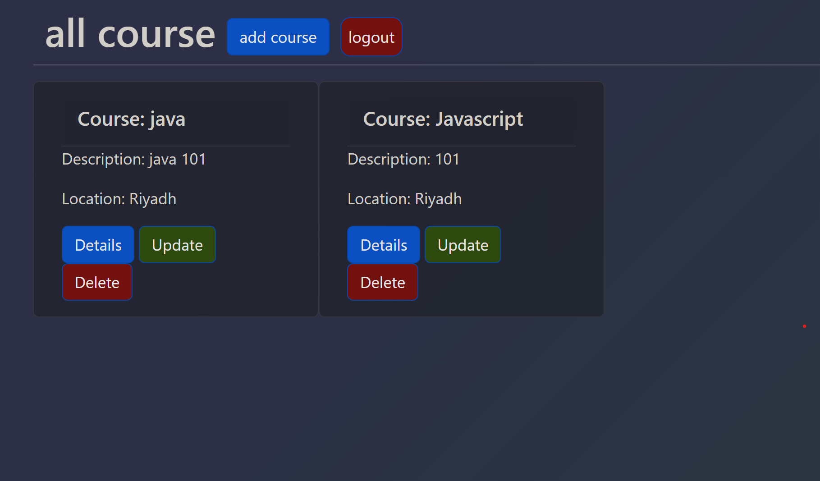
DEMO

