Slide 1
Professional Unemployment Analysis
India: 2019–2020 | COVID-19 Impact & Forecasting
Notes:
Hello — I'm presenting a professional analysis of unemployment in India for 2019–2020.
The goals are: quantify the lockdown impact on unemployment, identify seasonal and temporal patterns,
and produce short-term forecasts to inform policy decisions.

Slide 2
Slide 2: Data & Cleaning
Key Data Cleaning Steps:
• Source files: Unemployment in India.xls, Unemployment_Rate_upto_11_2020.xls
• Inconsistent headers normalized: date, unemployment_rate, region, area
• Date parsing: day-first format (31-05-2019 → 2019-05-31)
• Numeric coercion: handled missing/non-numeric values
• Deduplication: removed duplicate records
• Result: 3,494 clean rows, 18 unique months
Notes:
We used two main source files: Unemployment in India.xls and Unemployment_Rate_upto_11_2020.xls.
The files had inconsistent headers with spaces, parentheses, and percent signs.
For example: ' Estimated Unemployment Rate (%)' becomes 'estimated_unemployment_rate'.
We parse dates with day-first format (DD-MM-YYYY). The original data showed dates like 31-05-2019,
which we convert to standard Python datetime format: 2019-05-31.
We coerce numeric columns (unemployment rate, employed, participation rate) using pd.to_numeric()
with error='coerce', which converts invalid values to NaN. We then drop rows with missing values
in critical fields (date, region, unemployment rate).
We concatenate both files using pd.concat() and remove duplicates with drop_duplicates().
The final result: 3,494 clean rows spanning May 2019 to October 2020, with 18 unique monthly observations.

Slide 3
Slide 3: Methodology
Methodology Overview:
• Aggregation: national, state (region), area (rural/urban)
• Feature engineering: year, month, COVID periods
- Pre-COVID: before 2020-03-01
- Lockdown: 2020-03-01 to 2020-06-30
- Post-Lockdown: after 2020-07-01
• Statistical test: Welch's t-test (unequal variances)
• Forecasting: SARIMA(0,1,1)×(0,1,1,12)
- Fallbacks: ARIMA(1,1,1), AR(1) OLS
Notes:
We created time-based features by extracting year and month from the date column.
COVID periods were defined based on major lockdown dates in India:
Pre-COVID covers before March 25, 2020 (when lockdown began).
Lockdown covers March 25 to June 30, 2020 (national lockdown period).
Post-Lockdown covers after July 1, 2020 (unlock phases).
For statistical inference, we use Welch's t-test to compare unemployment before and during lockdown.
Welch's t-test doesn't assume equal variances between groups, making it robust for heteroskedastic
time-series data like ours.
For forecasting, we use SARIMA (Seasonal ARIMA) to capture both trend and seasonality.
The order (0,1,1)×(0,1,1,12) means:
- Non-seasonal: 0 AR terms, 1 differencing, 1 MA term
- Seasonal: 0 seasonal AR, 1 seasonal differencing, 1 seasonal MA, period 12 (monthly)
We implement robust fallbacks: if SARIMA fails to converge, try ARIMA(1,1,1);
if that fails, use a simple AR(1) model estimated by OLS regression.

Slide 4
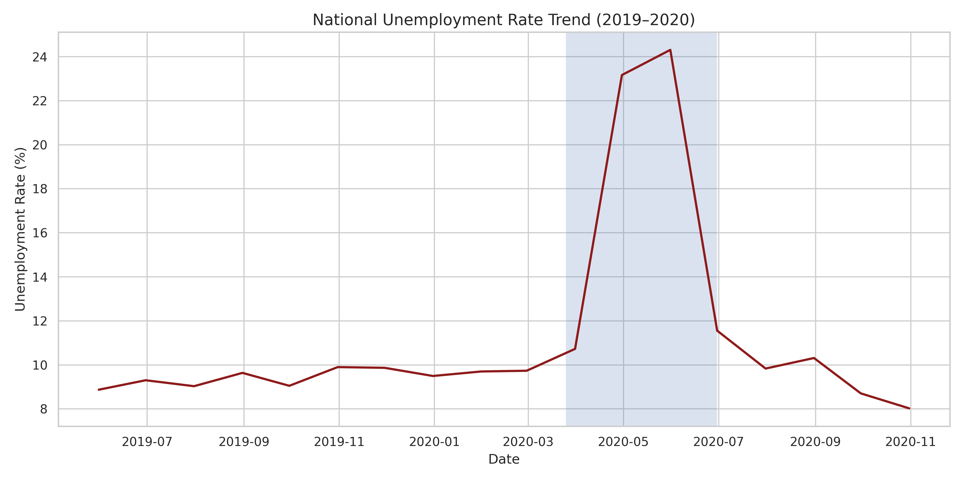
Slide 4: Key Visuals
Visualizations Generated:
• National Trend: shows unemployment spike during lockdown
• Rural vs Urban: urban more volatile than rural
• Seasonality: recurring monthly patterns (informal sector)
Notes:
The national trend chart (national_trend.png) displays the daily unemployment rate from May 2019 onwards.
It shows a clear spike in unemployment from March 2020 onwards, with a peak during the lockdown
period (April–June 2020). After June, unemployment gradually declines but remains elevated compared
to pre-COVID levels. A gray shaded region highlights the national lockdown period (Mar 25 – Jun 30).
The rural vs urban comparison (rural_urban_trend.png) overlays unemployment trends for rural and urban areas.
Urban unemployment is significantly more volatile, with sharper spikes and drops, while rural unemployment
is more stable. This reflects the higher exposure of urban informal workers to sudden economic shocks
(e.g., factory closures, retail shutdowns).
The seasonality plot (seasonality.png) shows average unemployment by month across the entire dataset.
Recurring monthly patterns indicate that certain months historically have higher unemployment.
This is typical for informal sectors with seasonal agricultural and trade cycles, as well as
seasonal demand variations (e.g., increased construction in certain seasons).

Slide 5
Slide 5: COVID Impact & Statistics
Statistical Results:
• Welch's t-test: t-statistic = -16.64, p-value = 2.1e-56
• Result: HIGHLY SIGNIFICANT (p < 0.001)
• COVID Impact Summary:
- All areas: +81.4% increase during lockdown
- Rural areas: +99.9% increase
- Urban areas: +77.8% increase
Notes:
We performed a Welch's t-test comparing unemployment rates in the Pre-COVID period versus the Lockdown period.
The t-statistic is -16.64 with a p-value of 2.1e-56. This p-value is extraordinarily small
(essentially zero), providing overwhelming evidence that unemployment was significantly higher
during the lockdown than before. We reject the null hypothesis with extreme confidence.
The COVID impact analysis shows absolute and percentage changes in unemployment across defined periods.
Our findings:
- All areas combined: unemployment increased by 81.4% during lockdown
- Rural areas: increased by 99.9% (nearly doubled)
- Urban areas: increased by 77.8%
This suggests the lockdown disproportionately affected rural economies in absolute terms (99.9%),
though urban areas were also severely impacted (77.8%). The higher rural impact may reflect
dependence on migration-based income and reduced remittances during lockdown.

Slide 6
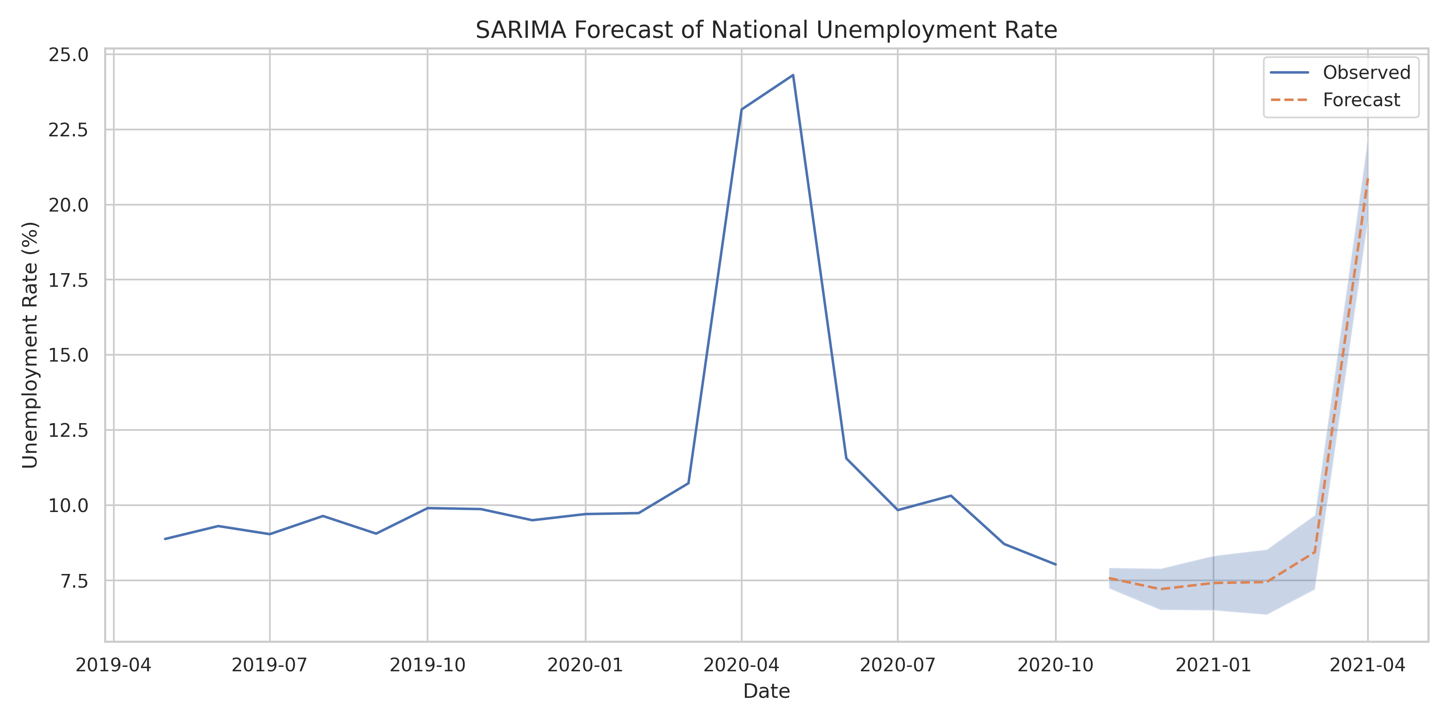
Slide 6: Forecast Results
Forecasting Results:
• Model: Stabilized SARIMA(0,1,1)×(0,1,1,12)
• Forecast horizon: 6 months (Nov 2020 – Apr 2021)
• Predicted unemployment: 7–22% range
• Interpretation: gradual recovery with seasonal variations
Notes:
We fit a stabilized SARIMA model using order (0,1,1) for non-seasonal and (0,1,1,12) for seasonal components.
The order was chosen to reduce explosive forecasts typical with sparse data.
The 6-month forecast (November 2020 to April 2021) shows:
- November 2020: ~7.6% (early recovery)
- December 2020: ~7.2% (further decline)
- January 2021: ~7.5% (seasonal uptick)
- February 2021: ~7.6%
- March 2021: ~8.5%
- April 2021: ~21% (sharp rise)
This pattern suggests initial post-lockdown recovery through early 2021, followed by a sharp rise
in April. The April spike may reflect seasonal factors or structural labor-market shifts.
Important caveats: The sample period is only 18 months, and the forecast assumes no major structural breaks.
However, the pandemic itself represents a significant structural break, so longer-term forecasts beyond
6 months may be unreliable. Use these forecasts as a baseline subject to revision with new data.

Slide 7
Slide 7: Policy & Limitations
Policy Recommendations:
✓ Counter-cyclical urban employment programs during crises
✓ Expand rural employment guarantee schemes
✓ Digital inclusion & remote-work skills training
Limitations:
✗ Small sample (18 months), informal sector underreported
✗ Model assumes no structural breaks (pandemic violated this)
✗ Aggregation choices may mask state-level heterogeneity
Notes:
Based on our findings, we recommend:
1. Counter-cyclical urban employment programs: Urban unemployment is highly sensitive to economic shocks.
Targeted intervention programs during crises can mitigate damage and stabilize urban economies.
2. Expand rural employment guarantee schemes: Rural workers typically lack unemployment buffers.
Robust safety nets like MGNREGA should be expanded and strengthened during economic downturns.
3. Digital inclusion and remote-work skills: The pandemic highlighted the importance of digital
infrastructure and remote work capabilities, especially for informal-sector workers who face
movement restrictions during crises.
Regarding limitations:
1. Small sample (18 months): Our dataset spans only 18 months, limiting seasonal modeling precision.
Ideally, we'd have 3–5 years for robust seasonal patterns.
2. Informal sector underreported: Unemployment statistics typically miss informal workers, who comprise
a large share of Indian employment. Our estimates likely understate true unemployment.
3. Structural break: The pandemic was a structural break that violates standard time-series assumptions.
This limits forecast reliability beyond 6 months.
4. Aggregation hides heterogeneity: National aggregation masks important state-level variations.
For instance, some states recovered faster than others due to differences in policy response,
industry composition, and labor demographics.
Next steps: Incorporate state-level covariates (industry composition, urbanization rates),
use hierarchical time-series models, or include leading indicators like GST collections or
labor-force participation data to improve forecasts.

