Slide 1
FP-growth algorithm
Association Rule

Slide 2
Overview
FP-growth algorithm is a tree-based algorithm for frequent itemset mining or frequent-pattern mining used for market basket analysis. The algorithm represents the data in a tree structure known as FP-tree, responsible for maintaining the association information between the frequent items.
The algorithm compresses frequent items into an FP-tree from the database while retaining association rules. Then it splits the database data into a set of conditional databases (a special kind of projected database), each of which is associated with one frequent data item.

Slide 3
FP-tree
FP-tree is the core concept of the FP-growth algorithm. The FP-tree is a compressed representation of the database itemset, storing the DB itemset in memory and keeping track of the association between items.
The tree is constructed by taking each itemset and adding it as a subtree. The FP-tree’s whole idea is that items that occur more frequently will be more likely to be shared.

Slide 4
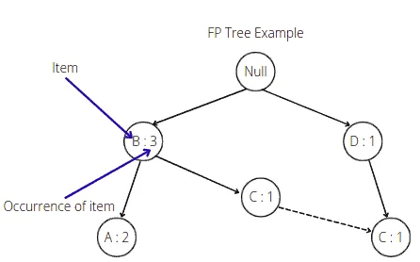
FP-tree
The root node in the FP-tree is null. Each node of the subtree stores at least the item name and the support (or item occurrence) number. Additionally, the node may contain a link to the node with the same name from another subtree (represents another itemset from the database).

Slide 5
Building FP-tree
Scan itemsets from the database for the first time
Find frequent items (single item patterns) and order them into a list L in frequency descending order. For example, L = {A:5, C:3, D;2, B:1}
For each transaction order its frequent items according to the order in L
Scan the database the second time and construct FP-tree by putting each frequency ordered transaction onto it

Slide 6
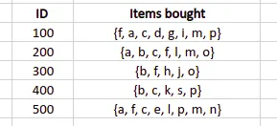
Example
To illustrate algorithm steps, let’s take a sample database and create an FP-tree out of it:

Slide 7
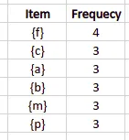

Example cont.
The first step is to scan the dataset, create a frequency table containing each item from the database, and arrange them in descending order. We also need to specify the minimum support (number of item occurrences). The algorithm will not put items with a support value less than the minimum support into the frequency table. For example, let’s set up the minimum support value equal to 3. In that case, we will get the following frequency table:
Note: The algorithm did not include all items with frequency more minor than the minimum support value in the frequency table.

Slide 8
Example cont.
The first step is to scan the dataset, create a frequency table containing each item from the database, and arrange them in descending order. We also need to specify the minimum support (number of item occurrences). The algorithm will not put items with a support value less than the minimum support into the frequency table. For example, let’s set up the minimum support value equal to 3. In that case, we will get the following frequency table:
Note: The algorithm did not include all items with frequency more minor than the minimum support value in the frequency table.

Slide 9
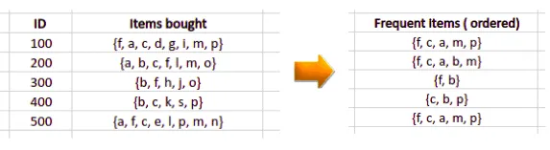
The next step is to scan the database the second time and arrange elements based on the frequency table:
items with higher a frequency number will come first
if two items have the same frequency number they will be arranged in alphabetical order

Slide 10
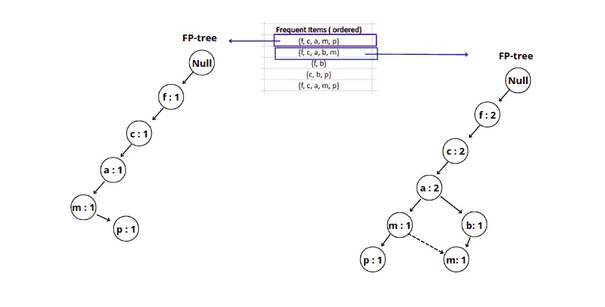
Similarly, the next step will add the following item from the list to the FP-tree as shown above:
Note: As we add the same element to the tree, we increment the support. But after item a we created a new node for item b because there was no item b in our initial tree after item a. And we have linked items m together because this is the same element located in different subtrees .

Slide 11
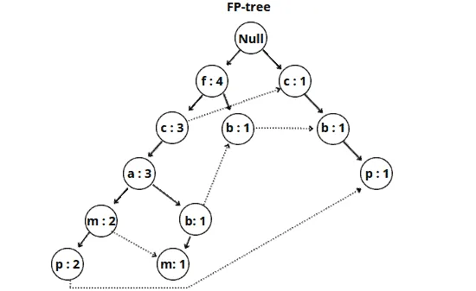
Similarly, we add other items from the frequent items table to the FP-tree.
The FP tree is ready. Based on this tree, the FP-growth algorithm can create different association rules.

Slide 12
Building association rules
Once the FP-growth algorithm constructed the FP-tree, it can build different associations rules based on the minimum support value. It will take the item with the minor support count and trace that item through the FP-tree to achieve that goal.

Slide 13
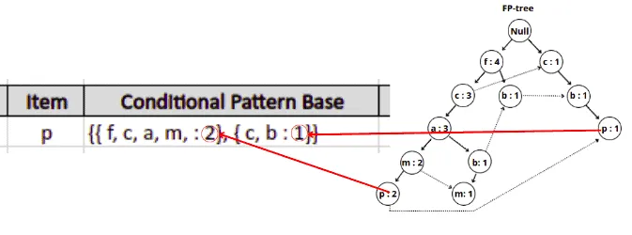
In our example, the item p has the lowest support count, and the FP-growth algorithm will produce the following paths: { {f, c, a, m, p : 2}, {c, b : 1} }.
Note: The item p is located in two different subtrees of the FP-tree, so the algorithm traced both paths and added the minimum support value for every path.

Slide 14
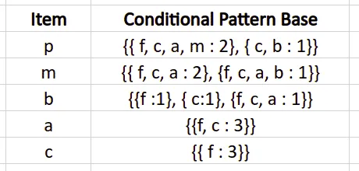
Conditional pattern base table
Similarly, the FP-growth will build the conditional pattern base table for all of the items from the FP-tree.
The final conditional pattern base table for all elements in our example:

Slide 15
Let’s calculate elements’ occurrences for the p item:
{ f, c, a, m : 2 }, { c, b : 1 } - > { f: 2, c:3, a:2, m:2, b:1 }
Only item c appears three times and satisfies the minimum support requirement. That means the algorithm will remove all other items except c.

Slide 16
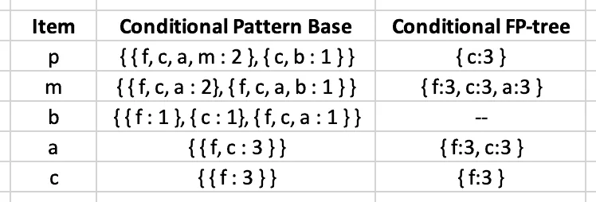
After removing items that do not meet the minimum support requirement, the algorithm will construct the following table:

Slide 17
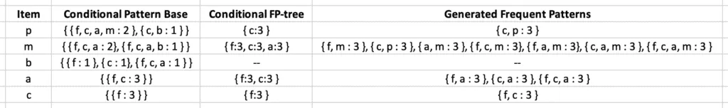
Creating association rules
The final step of creating association rules is to generate frequent patterns by pairing the items of the Conditional FP-tree column with the corresponding item from the Item column.
For example, for the first row, the algorithm needs to take { c:3 } from the Conditional FP-tree column, create its combination with the p element and add the support count value. Similarly, the FP-growth algorithm will generate frequent patterns (or association rules):

Slide 18
The Advantages and Disadvantages of the FP-Growth algorithm
Advantages
Disadvantages
Efficiency: Can handle large datasets with many transactions and items.
Scalability: Can handle datasets with millions of transactions.
Memory efficiency: The algorithm uses a frequent pattern tree (FP-tree), which is memory-efficient and reduces the need for multiple scans of the transaction database.
Flexibility: Can be applied to different data types, such as categorical or numerical data.
Fast performance: Can quickly generate frequent itemsets and association rules.
It requires a lot of preprocessing: To build the FP-tree data structure before mining frequent itemsets and association rules.
Limited to categorical data: Such as products purchased in a store. It may not be effective for continuous or mixed data.
It may generate many itemsets: Making interpreting and applying the results challenging.
It requires domain knowledge: To interpret and apply the results effectively.
It may not work well with sparse data: The algorithm may not work well with datasets with many missing values or sparse data, where transactions have only a few items.

Slide 19
Difference between Apriori and FP Growth.
Apriori
FP Growth
It is an array based algorithm.
It uses Join and Prune technique.
Apriori uses a breadth-first search
Apriori utilizes a level-wise approach where it generates patterns containing 1 item, then 2 items, then 3 items, and so on.
Candidate generation is extremely slow. Runtime increases exponentially depending on the number of different items.
Candidate generation is very parallelizable.
It requires large memory space due to large number of candidate generation.
It scans the database multiple times for generating candidate sets.
It is a tree based algorithm.
It constructs conditional frequent pattern tree and conditional pattern base from database which satisfy minimum support.
FP Growth uses a depth-first search
FP Growth utilizes a pattern-growth approach means that, it only considers patterns actually existing in the database.
Runtime increases linearly, depending on the number of transactions and items
Data are very interdependent, each node needs the root.
It requires less memory space due to compact structure and no candidate generation.
It scans the database only twice for constructing frequent pattern tree.

