Slide 1
Support Vector Machines SVM

Slide 2
What are Support Vector Machines in Machine Learning?
Support Vector Machine (SVM) is a powerful machine learning algorithm used for linear or nonlinear classification, regression, and even outlier detection tasks. SVMs can be used for a variety of tasks, such as text classification, image classification, spam detection, handwriting identification, gene expression analysis, face detection, and anomaly detection. SVMs are adaptable and efficient in a variety of applications because they can manage high-dimensional data and nonlinear relationships.
SVM algorithms are very effective as we try to find the maximum separating hyperplane between the different classes available in the target feature.

Slide 3
Support Vector Machines with Linearly Separatable Data
Data that are linearly separable means that we can separate the data into distinct classes using a linear model, such as a line.
To better illustrate this, as well as how the SVM algorithm works, let’s take a look at some data. We’ll plot two-dimensional data along the x and y axis.

Slide 4
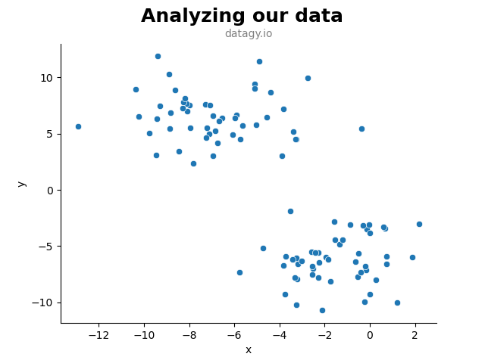
Support Vector Machines with Linearly Separatable Data
In the scatter plot above we visualized our data along two dimensions. Visually, it’s quite clear that we have two distinct clusters of data. Thankfully, our data came pre-labeled and we can map in these target features into our visualization!

Slide 5
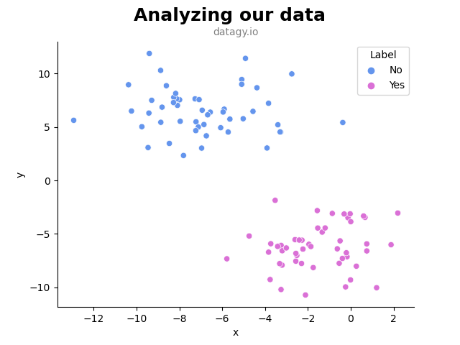
Support Vector Machines with Linearly Separatable Data
Let’s see what this looks like this classes mapped into it:
Awesome! We can see that we have two clusters: those belonging to 'No' and those belonging to 'Yes'. The support vector machines algorithm seeks to separate these two clusters of data by using a hyper-plane. In this case, our hyper-plane would be a line that splits the data into two.

Slide 6
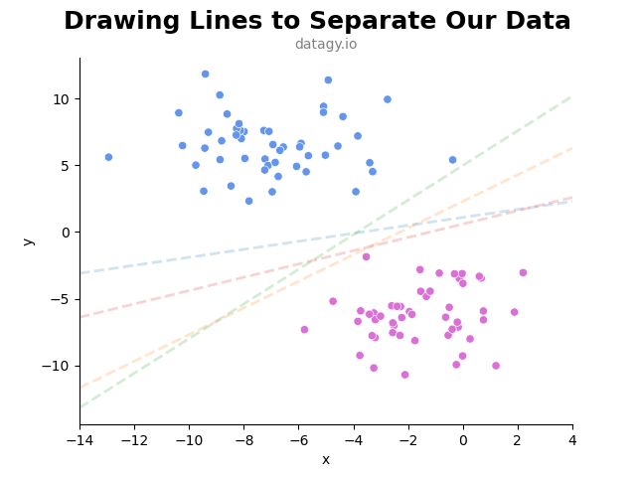
Support Vector Machines with Linearly Separatable Data
Let’s see how we can draw a few lines that all separate the data perfectly:
All of the lines above separate the data perfectly. So, how do we choose a single line to use as our algorithm’s hyperplane? The idea behind choosing the line is the one that best separates the data. SVM algorithms do this process iteratively. They will try a line, then another, and another, until they find the best one. In this case, the best line is the one shown below

Slide 7
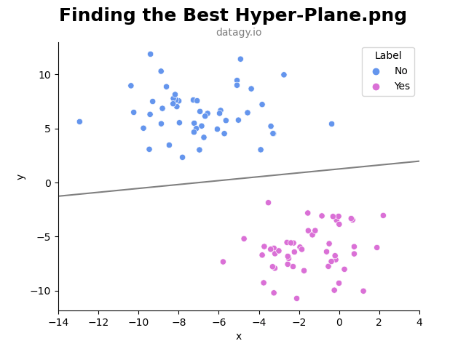
Support Vector Machines with Linearly Separatable Data
Why is this the best hyperplane to use? In short, this line maximizes the margins between the line and the closest data points. The margins are the gaps between the line and the nearest data points of either class.
This gap is measured as the perpendicular distance between the hyperplane and the data point. In practice, the larger the margin better, and a smaller margin is worse.

Slide 8
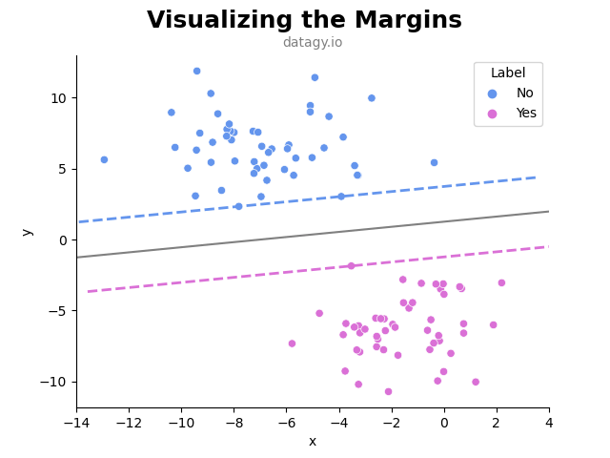
Let’s visualize what these margins look like, based on the line that we’ve drawn above:
We can see that we have drawn two margins here. Intuitively, we can imagine that the margins of this line are larger than the margins of the other lines would have been.
If you look closely, you’ll notice that the two margins actually touch some of the data points of both classes.

Slide 9
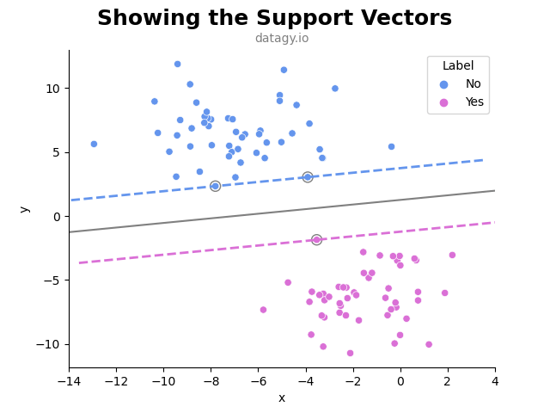
Let’s visualize what these margins look like, based on the line that we’ve drawn above:
These points have a special purpose in SVM algorithms. They are known as the support vectors of our model. They’re called support vectors because they’re the data points that define the boundary that divides our two classes of data.
In fact, they’re the only points that influence the data, as the data currently stands. Adding additional points on either side of the margin (as long as they’re classified properly) has no impact on the hyperplane of the supporting margins.
In a later section, you’ll learn how to build these SVM models in Scikit-Learn. In the next section, however, you’ll learn some additional mechanics behind the SVM algorithm.

Slide 10
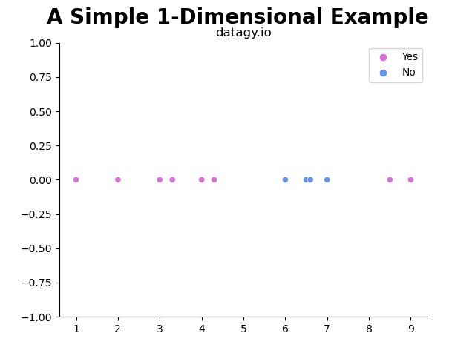
Transforming Data to Produce Linearly Separatable Data
To better understand this, let’s take a look at an example of one-dimensional data.
In the example above, we have three clusters, but only two labels. There’s no straight line that can effectively split the data appropriately. So, what can we do? One of the things things that SVM does particularly well is transform the data in order to allow a hyperplane to separate the data.

Slide 11
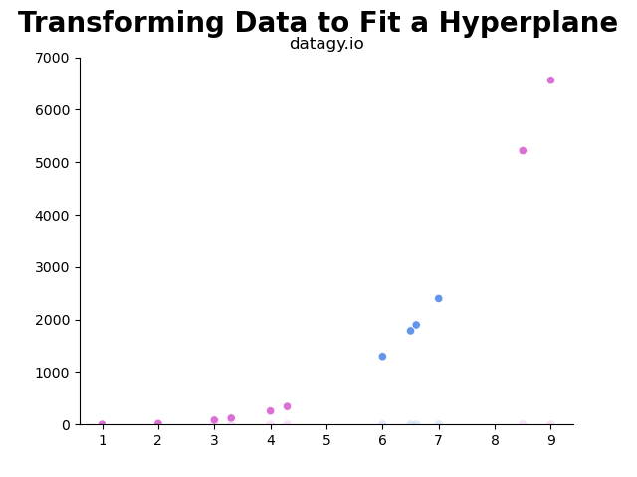
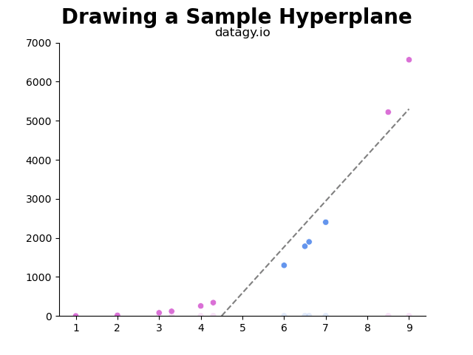
Transforming Data to Produce Linearly Separatable Data
Let’s try raising each value of x to the power of 4. This adds a second dimension, where we can plot the values as (x_{i}, x_{i}⁴). Let’s see what this looks like:
Let’s try raising each value of x to the power of 4. This adds a second dimension, where we can plot the values as (xi, xi4). Let’s see what this looks like:

Slide 12
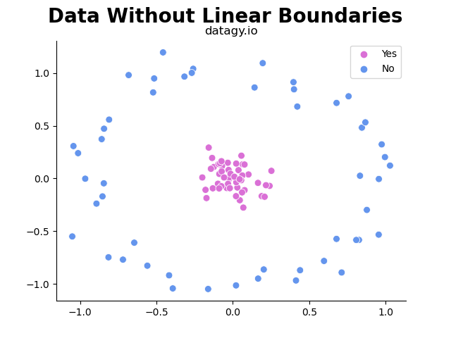
Transforming Non-Linear With Inseparable Planes
One thing we can do is apply the kernel trick to transform the data into a higher dimension.
The kernel trick is powerful because it allows us to operate in the original vector space without needing to compute the coordinates of data in a higher dimensional space. In short, it allows us to find the optimal function to apply, without needing to formally apply it.

Slide 13
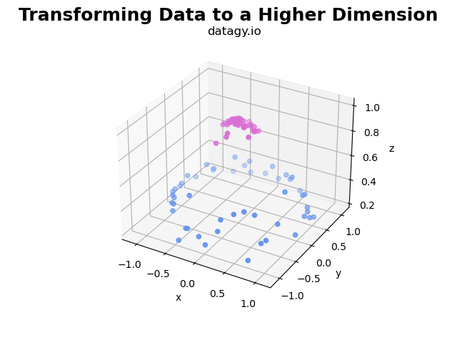
Transforming Non-Linear With Inseparable Planes
Let’s take a look at how we could, for example, transfer for the data above to a different dimension in order to find an appropriate hyperplane.
One thing you might note is that the inner circle is centred around the origin. By transforming these values to a higher dimension, these values will remain lower.
Let’s find the negative sum of the squares of the coordinates for each of these values and have that equal the third dimension of the data. Doing this results in the following visualization:

Slide 14
Transforming Non-Linear With Inseparable Planes
Let’s take a look at how we could, for example, transfer for the data above to a different dimension in order to find an appropriate hyperplane.
One thing you might note is that the inner circle is centred around the origin. By transforming these values to a higher dimension, these values will remain lower.
Let’s find the negative sum of the squares of the coordinates for each of these values and have that equal the third dimension of the data. Doing this results in the following visualization:

Slide 15
Kernel functions
Linear
These are commonly recommended for text classification because most of these types of classification problems are linearly separable.
The linear kernel works really well when there are a lot of features, and text classification problems have a lot of features. Linear kernel functions are faster than most of the others and you have fewer parameters to optimize.
Here's the function that defines the linear kernel: f(X) = w^T * X + b
In this equation, w is the weight vector that you want to minimize, X is the data that you're trying to classify, and b is the linear coefficient estimated from the training data. This equation defines the decision boundary that the SVM returns.

Slide 16
Kernel functions
Polynomial
The polynomial kernel isn't used in practice very often because it isn't as computationally efficient as other kernels and its predictions aren't as accurate.
Here's the function for a polynomial kernel: f(X1, X2) = (a + X1^T * X2) ^ b
This is one of the more simple polynomial kernel equations you can use. f(X1, X2) represents the polynomial decision boundary that will separate your data. X1 and X2 represent your data.

Slide 17
Kernel functions
Gaussian Radial Basis Function (RBF)
One of the most powerful and commonly used kernels in SVMs. Usually the choice for non-linear data.
Here's the equation for an RBF kernel: f(X1, X2) = exp(-gamma * ||X1 - X2||^2)
In this equation, gamma specifies how much a single training point has on the other data points around it. ||X1 - X2|| is the dot product between your features.

Slide 18
Kernel functions
Sigmoid
More useful in neural networks than in support vector machines, but there are occasional specific use cases.
Here's the function for a sigmoid kernel: f(X, y) = tanh(alpha * X^T * y + C)
In this function, alpha is a weight vector and C is an offset value to account for some mis-classification of data that can happen.

Slide 19
differences between SVM and Decision Trees:
Decision Trees:
Support Vector Machines (SVM)
Nature: Decision trees are non-linear models that create a tree-like structure to make decisions.
Decision Boundaries: Their decision boundaries are piece-wise linear, allowing them to capture complex relationships in the data.
Interpretability: Decision trees are highly interpretable, as you can visualize the tree structure and understand how decisions are made.
Prone to Overfitting: Decision trees can easily overfit the training data, especially if they grow too deep.
Nature: SVMs are linear and non-linear models used for classification and regression.
Decision Boundaries: SVMs aim to find a linear optimal hyperplane that maximizes the margin between classes. The decision boundary is always linear (even in kernel space).
Support Vectors: SVMs focus on the data points closest to the decision boundary (called support vectors).
Robustness: SVMs are less prone to outliers because they prioritize support vectors.
Kernel Trick: SVMs can use kernel functions (like polynomial or radial basis function) to handle non-linear data.
Complexity: SVMs can be computationally expensive, especially with large datasets.

Slide 20
Advantages and disadvantages of vsm
Advantages
Effective in high-dimensional spaces: SVMs are effective in high-dimensional spaces, making them suitable for scenarios where the number of features exceeds the number of samples. This property makes them popular in text classification and bioinformatics.
Effective with non-linear decision boundaries: By using different kernel functions such as polynomial, radial basis function (RBF), or sigmoid, SVMs can model complex decision boundaries effectively. This makes them versatile in handling data that cannot be separated linearly.
Works well with small datasets: SVMs are relatively memory-efficient and work well with small to medium-sized datasets. They are capable of finding the optimal separating hyperplane with fewer data points compared to other algorithms like k-nearest neighbors.
Global optimality: The solution provided by SVMs is guaranteed to be the global optimum, given certain conditions (e.g., convex optimization problem, no noise or outliers affecting the data severely).

Slide 21
Advantages and disadvantages of vsm
Advantages
Computationally expensive: Training an SVM model can be computationally expensive, especially for large datasets. The time complexity of training an SVM can be cubic in the size of the dataset in the worst-case scenario, making it less suitable for very large datasets.
Difficult to interpret: SVMs are black-box models, meaning that the decision process is not easily interpretable. Understanding the reasons behind the classifications made by SVMs can be challenging compared to more transparent models like decision trees or logistic regression.
Sensitive to choice of kernel and parameters: The performance of SVMs heavily depends on the choice of kernel function and tuning of hyperparameters such as the regularization parameter (C) and kernel parameters. Selecting the appropriate kernel and tuning these parameters can require extensive experimentation and domain knowledge.
Memory-intensive for large datasets: While SVMs are memory-efficient for small to medium-sized datasets, they can become memory-intensive for very large datasets, especially when using non-linear kernels or complex models.
Limited effectiveness with noisy datasets: SVMs are sensitive to noise in the data, as outliers can significantly affect the placement of the decision boundary. Outliers may cause the SVM to misclassify points or result in suboptimal performance.

