Slide 1
DBSCAN Clustering in ML | Density based clustering

Slide 2
DBSCAN Clustering
Clustering analysis or simply Clustering is basically an Unsupervised learning method that divides the data points into a number of specific batches or groups, such that the data points in the same groups have similar properties and data points in different groups have different properties in some sense. It comprises many different methods based on differential evolution. E.g. K-Means (distance between points), Affinity propagation (graph distance), Mean-shift (distance between points), DBSCAN (distance between nearest points), Gaussian mixtures (Mahalanobis distance to centers), Spectral clustering (graph distance), etc.
Fundamentally, all clustering methods use the same approach i.e. first we calculate similarities and then we use it to cluster the data points into groups or batches. Here we will focus on the Density-based spatial clustering of applications with noise (DBSCAN) clustering method.

Slide 3
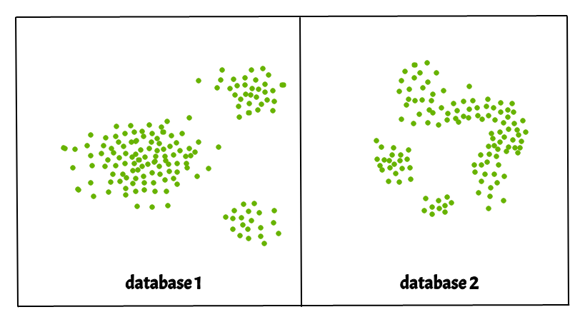
Density-Based Spatial Clustering Of Applications With Noise (DBSCAN)
Clusters are dense regions in the data space, separated by regions of the lower density of points. The DBSCAN algorithm is based on this intuitive notion of “clusters” and “noise”. The key idea is that for each point of a cluster, the neighbourhood of a given radius has to contain at least a minimum number of points. in at least a minimum number of points.

Slide 4
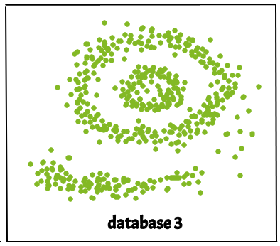
Why DBSCAN?
Partitioning methods (K-means, PAM clustering) and hierarchical clustering work for finding spherical-shaped clusters or convex clusters. In other words, they are suitable only for compact and well-separated clusters. Moreover, they are also severely affected by the presence of noise and outliers in the data.
Real-life data may contain irregularities, like:
Clusters can be of arbitrary shape such as those shown in the figure below.
Data may contain noise.
The figure above shows a data set containing non-convex shape clusters and outliers. Given such data, the k-means algorithm has difficulties in identifying these clusters with arbitrary shapes.

Slide 5
Parameters Required For DBSCAN Algorithm
eps: It defines the neighborhood around a data point i.e. if the distance between two points is lower or equal to ‘eps’ then they are considered neighbors. If the eps value is chosen too small then a large part of the data will be considered as an outlier. If it is chosen very large then the clusters will merge and the majority of the data points will be in the same clusters. One way to find the eps value is based on the k-distance graph.
MinPts: Minimum number of neighbors (data points) within eps radius. The larger the dataset, the larger value of MinPts must be chosen. As a general rule, the minimum MinPts can be derived from the number of dimensions D in the dataset as, MinPts >= D+1. The minimum value of MinPts must be chosen at least 3.

Slide 6
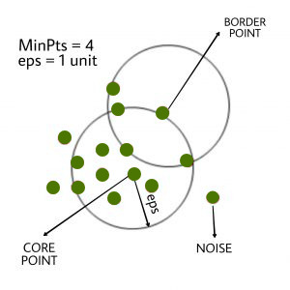
Types of data points.
In this algorithm, we have 3 types of data points. Core Point: A point is a core point if it has more than MinPts points within eps. Border Point: A point which has fewer than MinPts within eps but it is in the neighborhood of a core point. Noise or outlier: A point which is not a core point or border point.

Slide 7
Steps Used In DBSCAN Algorithm
Find all the neighbor points within eps and identify the core points or visited with more than MinPts neighbors.
For each core point if it is not already assigned to a cluster, create a new cluster.
Find recursively all its density-connected points and assign them to the same cluster as the core point. A point a and b are said to be density connected if there exists a point c which has a sufficient number of points in its neighbors and both points a and b are within the eps distance. This is a chaining process. So, if b is a neighbor of c, c is a neighbor of d, and d is a neighbor of e, which in turn is neighbor of a implying that b is a neighbor of a.
Iterate through the remaining unvisited points in the dataset. Those points that do not belong to any cluster are noise.

Slide 8
Difference Between DBSCAN and K-Means.
K-Means | DBSCAN
K-Means is very sensitive to the number of clusters so it need to specified | In DBSCAN we need not specify the number of clusters.
Clusters formed in K-Means are spherical or convex in shape | Clusters formed in DBSCAN can be of any arbitrary shape.
K-Means does not work well with outliers data. Outliers can skew the clusters in K-Means to a very large extent. | DBSCAN can work well with datasets having noise and outliers
In K-Means only one parameter is required is for training the model | DBSCAN has two parameters eps and min_samples

Slide 9
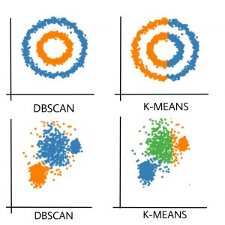
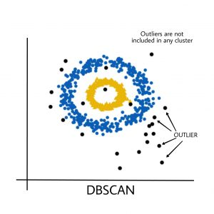
Difference Between DBSCAN and K-Means.

Slide 10
advantages and disadvantages of DBSCAN:
Advantages:
Handles clusters of arbitrary shape: Unlike k-means, which assumes clusters are spherical, DBSCAN can find clusters of any shape. It's effective in scenarios where clusters are irregularly shaped or have varying densities.
Robust to noise: DBSCAN can effectively identify noise points as outliers, as it doesn't force every point into a cluster. It can distinguish between dense regions and sparse regions, thus ignoring noise points or considering them as individual clusters.
Automatic determination of cluster numbers: DBSCAN does not require specifying the number of clusters beforehand, making it suitable for situations where the number of clusters is unknown or cannot be easily determined.
Efficient in time and space: While its worst-case time complexity is relatively high, in practice, it's often much faster than hierarchical clustering and can be more memory-efficient, especially for large datasets.

Slide 11
Con….
Disadvantages:
Sensitive to parameters: DBSCAN requires two parameters to be set: epsilon (ε) and the minimum number of points (MinPts). Choosing appropriate values for these parameters can be challenging, and suboptimal choices may lead to poor clustering results.
Difficulty with clusters of varying densities: While DBSCAN can effectively find clusters of different shapes, it may struggle with clusters of significantly varying densities. Choosing an appropriate epsilon value that works well for clusters of varying densities can be difficult.
Scalability issues with high-dimensional data: Like many clustering algorithms, DBSCAN can suffer from the "curse of dimensionality." As the number of dimensions increases, the data density becomes more sparse, making it harder for DBSCAN to identify meaningful clusters.
Cannot cluster data with varying densities and arbitrary shapes simultaneously: DBSCAN has difficulty when clusters in the dataset exhibit both varying densities and arbitrary shapes simultaneously. It may not perform optimally in such cases and might require additional preprocessing or parameter tuning.

