Slide 1

Presented By: Abdul Rehman Shoukat

Slide 2
Introduction
Microsoft is an American multinational corporation headquartered in Redmond, Washington
It develops, manufactures licenses, supports and sell computer software and personal computers and services.
Best known software is Microsoft Windows line of operating Systems
It dominated the personal computer operating system market
One of the worlds most valuable companies until early 2000 when Apple, Google , and Facebook came about

Slide 3
History of the Company
Microsoft was founded by Bill Gates and Paul Allen on April 4,1975
They were childhood friends with an interest in Computers in an era when they were hard to come by
Paul Gilbert, Gates and Allen ran their own company (Traf-O-Data) and sold a computer to the city of Seattle for counting City traffic
Impressed by Altair 8800 called MITS (Maker of Altair) to write new BASIC programming language for Altair impressing MITS
Started own software Company known as Microsoft in New Mexico home of MITS—with Gates as CEO
On July 29 1975 it was named Micro- Soft by Allen “Microcomputer and software”

Slide 4
History of Microsoft Products
Xenix first operating system released in 1980 running Multi tool Word initial model of Microsoft Word. Releasing Microsoft windows in 1986
Microsoft's mouse was released on May 2, 1983.
Microsoft Office was released in 1989
Internet Explorer in 1995 in Windows 95 to connect to the internet
In 2001 Xbox (Gaming Unit) was released a major competitor to Sony’s PlayStation but Xbox 360 was their Major Success

Slide 5
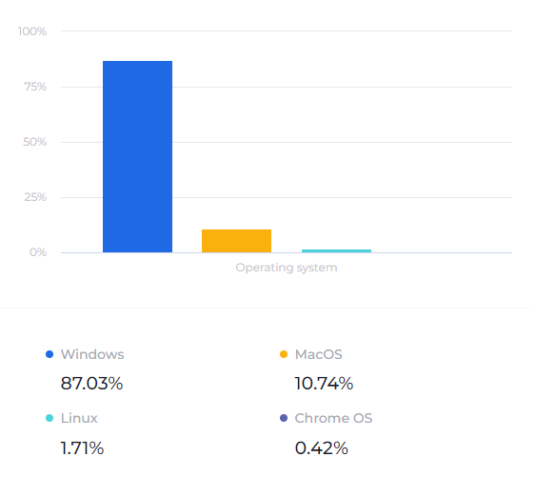
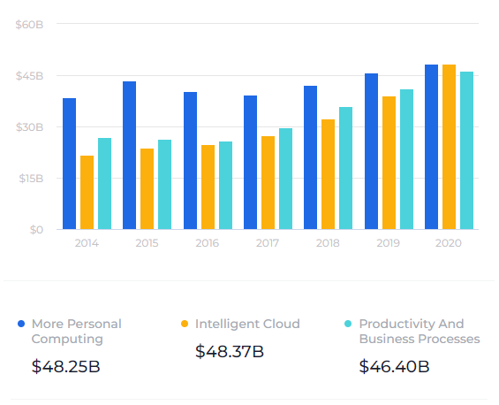
Statistics
Windows had an 87.03% share of the worldwide desktop operating system segment in October 2020.
$48.25 billion of Microsoft's $143.015 billion in 2020 revenue came from the More Personal Computing segment

Slide 6
Vision Statement
To empower every person and every organization on the Planet to achieve more

Slide 7
Marketing Strategy
Competitive Advantage: As they have a huge portfolio of products and services on almost all platforms (Xbox Console Games)
BCG Matrix: windows, online services, Xbox 360 and office suite are stars, Microsoft phones are Question Mark
Distribution: Products & services available to the end customer through large network of retail outlets, e-commerce sites & exclusive showrooms.
Pre Installed Windows in Dell and HP Computers
Target Market: Products and Services for every Age group Individual and Enterprises

Slide 8
Covid Impact
Before COVID-19, only 18% of US Microsoft employees worked remotely, by April 1, 2020, all non-essential workers were working from home full-time
More than 61000 MS Employees shifted to remote working leading to increased working weeks by 10%
Staff is collaborating less (less interconnected) which might lead to negative impact on innovation
Revenues Rose by an overall 43.08 billion from 36.91 Billion a year earlier

Slide 9
Recommendations for Future!
The Company can take the Gaming Industry to Developing Countries which have the potential to grow by offering online platform servers for lag free gaming
It can try to innovate the hardware products leading to exponential revenues from this segment as they are currently not much profitable
They can increase Cyber security on its operating systems as they are usually vulnerable to cybercrimes
Diversify into other Markets other than software business like Laptops (Chrome Book) and PC (Mac Competing products) Parts and not just providing software's to several products like Nokia Lumia (Failed Project)

Slide 10
Thank You

