Slide 1
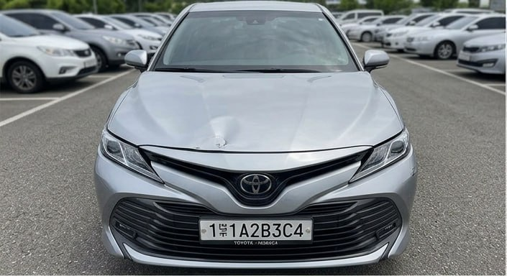
CarDoctor
COMPUTER VISION · MODE: STARTUP
See the damage. Know what to do.
Find who can fix it.
DA
Davlatyor Abduloxunov
Lead · app · deploy
MX
Muhammadjon Xalimov
Data · measurements
BX
Bexruz Xasanov
Knowledge base · training
Team MDB Vision · try it: abduloxunov-cardoctor.hf.space
Notes:
0:00–0:15. "We are MDB Vision. CarDoctor is a startup that turns photos of a car and the owner's own words into a decision: what is damaged, how urgent it is, and who can fix it."

Slide 2
Buyers and fleets decide on guesswork
9,364
~240k
2 of 3
road crashes in Uzbekistan in 2024. Each one needs a damage check
used cars sold in H1 2026, and parliament is now fining odometer fraud
drivers don't trust repair shops (unneeded services, overcharging)
Kun.uz, Feb 2025
Kun.uz, 2026
AAA survey
🚗
Used-car buyers and sellers
🚚
Truck and taxi fleets
Can't see hidden damage before the visit; the seller won't say.
A breakdown on the road: stop or keep driving? Who should we call?
Notes:
0:15–1:15. "When you buy a used car you can't see what's hidden, and the seller won't tell you. When a fleet truck breaks down, the manager doesn't know whether to stop it or who to call. Both run on guesswork and phone calls today. In 2024 Uzbekistan had 9,364 crashes, around 240 thousand used cars were sold in the first half of 2026, and two in three drivers don't trust repair shops."

Slide 3
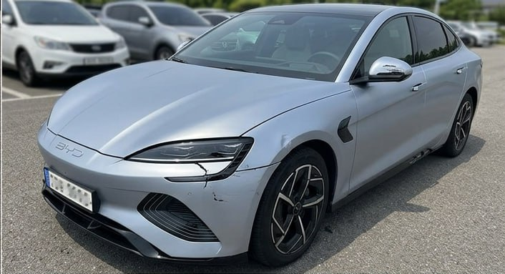
Live demo: pick a car, or use your own photo
1
Sell / Buy
Sample car → verdict, damage boxes on every photo, 3D car with red areas, report
2
Fleet & trucks
"Cobalt, engine overheating, steam" → 🔴 Stop and get help, with the manual source
3
Route
abduloxunov-cardoctor.hf.space
Use my location → nearest technician + route; real workshops on Google Maps
Open it on your phone. Sample 1, 2 or 3, or upload your own photos.
Notes:
1:15–3:15 (2 min). Switch to the browser. 1) Sell mode: Sample 1, Check the car: verdict, boxes, 3D car, download report (60 s). 2) Fleet mode: Chevrolet Cobalt, "engine overheating, steam": red Stop verdict with the Cobalt manual; Use my location: nearest technician, Route (45 s). 3) "Please try it on your phone with your own photo" (15 s). If the network fails, play the backup video immediately.

Slide 4
How the model and the LLM work together
Photos
① Our vision model
④ LLM explains
Many per car, tagged front / rear / left / right
RF-DETR Nano, fine-tuned: damage boxes + labels
Gemini Flash Lite: explains only retrieved records, cites each
③ Decision
damage label guides the search
Verdict = worst urgency in the sources. Not the LLM
Owner's words
② Retrieval
⑤ Output
Symptom, car model, engine and brake answers
BM25 + E5 vectors (Qdrant), scope checks, 28 sourced records
3D damage map, report, nearest technician
Vision
Knowledge base
LLM
sees what is visible
knows what it means and how urgent
puts it in plain words: it never decides, never sees photos
Notes:
3:15–4:15. "This is a system, not one prompt. Our own vision model finds the damage. Its label and the owner's words drive retrieval over 28 sourced records, filtered by car model, propulsion and safety answers like engine running. The verdict comes from the sources, not from the LLM. The LLM only explains the retrieved records in plain words and must cite each claim; it never sees the photos and never decides."

Slide 5
We trained it and measured it ourselves
0.735
mAP50 on our held-out test set
0.714
macro F1 (conf 0.35, IoU 0.5)
0.36 s
per photo on a laptop CPU, no GPU
Data: CarDD, 2,816 train / 810 validation images, 6 classes; trained on NVIDIA L4 (Hugging Face Jobs).
Known failure cases: cracks and small defects; not yet tested at night, in rain or on Uzbek cars; a photo cannot show hidden damage.
Notes:
4:15–5:15. "We fine-tuned RF-DETR Nano ourselves and tested on 374 images it never saw: mAP50 0.735, macro F1 0.714, up from 0.66 after our first pilot. It runs in 0.36 seconds per photo on a CPU. Weak points: cracks and small defects, and we haven't yet tested at night, in rain or on local cars. That is why the report says inspect, never guaranteed."

Slide 6
Why another team can't rebuild it in a weekend
1
Own detector
2
Local knowledge
Fine-tuned RF-DETR with our training and evaluation pipeline and per-class results
Sourced records for Cobalt, Lacetti, Nexia and Damas, with manual page references
3
Safety logic
4
Next data moat
Asks "engine running? parking brake released?" before model-specific advice
Our photos of Uzbek cars + confirmed repair outcomes from partner workshops
Notes:
5:15–5:45. "Another team with the same LLM gets a chatbot. They don't get our trained detector, our sourced local records or the safety checks, and every inspection we run grows our own data on Uzbek cars."

Slide 7
One report, three paying sides
Marketplaces
Fleets
Workshops
per condition report or per listing
per vehicle per month
per referred job
Cost per inspection
3-month pilot
CPU time (0.36 s × photos, measured)
+ one optional LLM call (text only)
No GPU needed to run it.
One marketplace or one fleet in Tashkent
Team of 3 + one CPU server
Collect local photos → per-condition accuracy
Measure: minutes saved per inspection
Notes:
5:45–6:30. "The same report has three buyers: marketplaces pay per report, fleets per vehicle per month, workshops per referred job. It runs on a CPU, so the cost per inspection is CPU seconds plus one optional LLM call. The pilot: one marketplace or one fleet in Tashkent for three months, where we measure minutes saved per inspection." (Only add prices you have taken from the Hugging Face and OpenRouter pricing pages.)

Slide 8
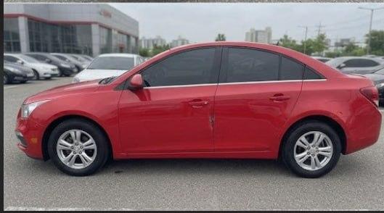
What comes next
Local cars, exact parts, real partners
1
Test set of Uzbek cars at night and in rain
2
Exact-part marking on the 3D car (part segmentation)
3
Verified partner workshops with prices
4
Uzbek and Russian interface
Thank you · abduloxunov-cardoctor.hf.space · github.com/Abduloxunov/mdb-vision-finals
Notes:
6:30–6:45. "Next: test on Uzbek cars at night and in rain, mark the exact part on the 3D car, and sign verified partner workshops. Thank you; please try it on your phone." Total ≈ 6:45, leaving 15 s buffer.

