Slide 1


ROS Case Study
AI-Based Object Following and Collaborative Delivery Robot
Group – 3

Slide 2
Problem Statement & Motivation
Mobile robots often lack robust AI to autonomously follow and deliver objects.
Challenges: tracking moving targets, re-identifying lost objects, obstacle avoidance.
Goal: Develop an AI-driven system capable of autonomous object following and delivery.
Motivation: Useful in logistics, healthcare, and smart service robots.

Slide 3
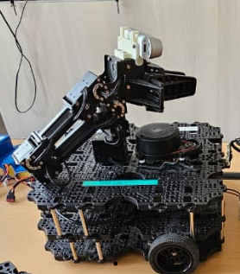
Project Objectives & Scope
Project Objectives & Scope
• Build a perception system using YOLOv8 + DeepSORT for robust object detection and tracking.
• Implement decision-making with Behavior Tree (py_trees_ros2).
• Integrate control via PID or MPC + LIDAR-based obstacle avoidance.
• Develop and test in Gazebo simulation, then deploy on real TurtleBot3 Waffle.
• Extend to collaborative multi-robot delivery scenarios.(optional)

Slide 4
Methodology / System Architecture
• Perception Node: YOLOv8 + DeepSORT detects and tracks target objects.
• Control Node: PID or RL-based movement control; LIDAR for obstacle avoidance.
• Behavior Tree Node: Logic controller for Follow → Search → Deliver → Return states.
• Collaboration: Multi-robot communication through ROS2 topics/services.
• Implementation: Phase 1 – Simulation | Phase 2 – Real robot testing.

Slide 5
Expected Outcomes & Applications
• TurtleBot3 autonomously follows and delivers objects in simulation and real world.
• Behavior Tree handles logical state transitions (Follow, Search, Deliver, Avoid).
• YOLOv8 + DeepSORT ensures robust re-identification after occlusion.
• Applications: warehouse logistics, hospital delivery, smart home assistants.

Slide 6
Project Plan & Team Roles
Phase 1 (Nov–Dec 2025): Simulation setup, vision + control integration.
Phase 2 (Jan 2026): Real robot testing on TurtleBot3 Waffle with camera.
Phase 3 (Feb 2026): Collaborative multi-robot delivery demo.
Team Roles: Vision Engineer, Control Engineer, AI/BT Developer, Integration Lead (Version Control, Simulations Env.) .
Who will do what we will decide later

Slide 7
Video
Need to check?

