Slide 1

Project : Hospital wait time
Made by : Abdulqader Asiri

Slide 2
Introduction
About the Project:
We got a lot of complaints about waiting outside the clinic so this project is about solving the clinic’s waiting time issue.
Problem Faced:
The problem we faced is the clinic has gotten several complaints regarding wait times
About the Data Gathered:
The data we have is from (2019-11-01) to (2019-11-13) , include (Post-Consultation_Time – Completion_Time ,and more)
The metric of good solution:
Decrease the wait time

Slide 3
Management requires
Does the patient type affect the waiting time?
Is there a specific type of patient waiting
a long time?
What days of the week are affected?
Are we too busy?
Do we have staffing issues?
How can we fix it?
How much the patients wait before the doctor can
see them?
What type of staff do we need or where do we need
them?

Slide 4
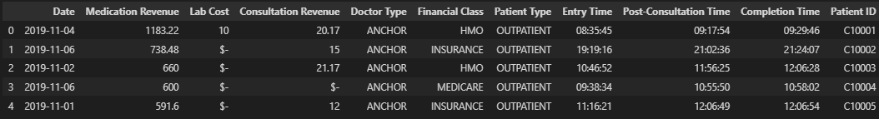
The Data
Breaking the variable down
(1) - Date = The date of the day the patient came
1
2
3
4
5
6
7
Above is the data we gonna use.
About the data used:
The data we have is the time when patients enter the clinic and when consultation begins, and when consultation is done, and it’s from (2019-11-01) to (2019-11-13), and it’s (11 Columns), (29998 Rows).
The step of cleaning the data:
There was no duplication in the data
There was no missing in the data
Change some column name
Change some DataType of some columns
(2) – Financial Class = Is the health insurance
(programs)
(3) – Patient Type = The clinic that patient are visiting
(4) – Entry Time = entered the hospital or the clinic
(5) - Post_consultation Time = It’s the time when the patients enter the clinic room or the clinic
(6) – Completion Time = when the patients exit the clinic room or the building
(7) – Patient ID = The ID of the patient in the clinic

Slide 5
Insights
Develop insights:
What are the business goals?
  Make money / Limit long wait times
What is our metric of success or failure?
  Wait time
What are the trends?
  Times of the day when wait times increase
  Days of the week when wait times increase
How can we fix the trends?
  Staffing?

Slide 6
The Project tools
The analysis tools:
- Python
          pandas
          numpy
          plotly.express
Data story:
- PowerPoint

Slide 7
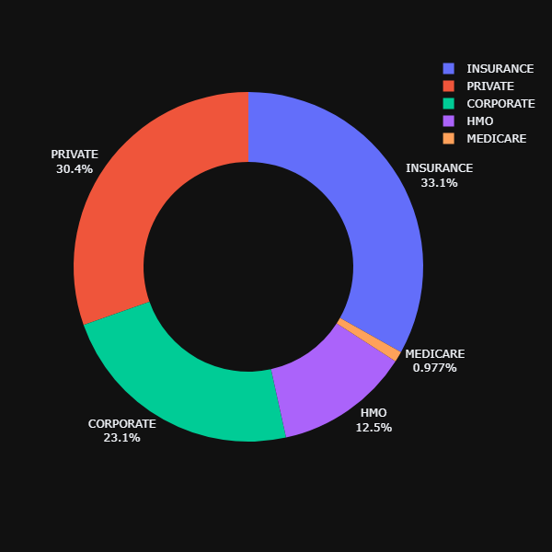
Does the patient type affect the waiting time? And is there a specific type of patient waiting a long time?
As we can see in the chart on the left, the patient typically does not affect the waiting time that big effect, BUT if you 'MEDICARE' type of patient your chance to wait long is higher.
40 M
44 M
YES there is a specific type of patient waiting a long time, and that type is MEDICARE and they wait (58 min) on average.
58 M
46 M
46 M

Slide 8
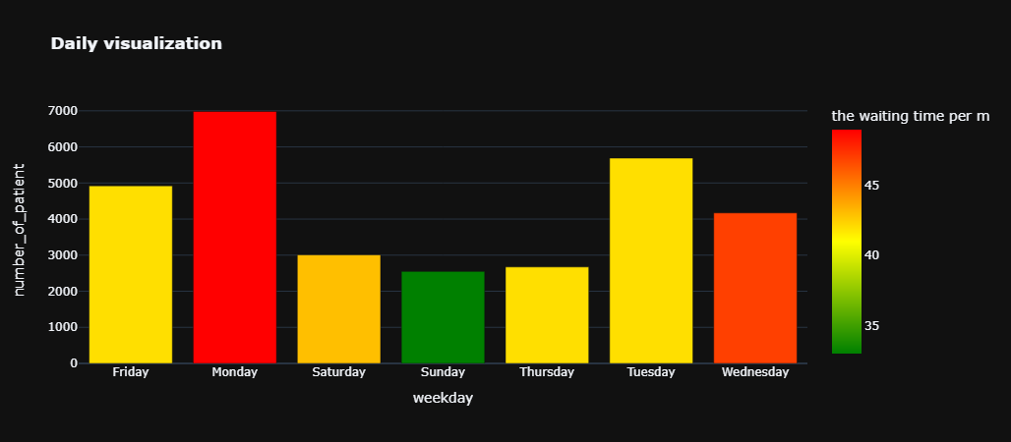
What days of the week are affected?
The chart is the average number of patients visiting the clinic Daily, and the more color get close to red the more wait time
The affected day is Monday and Wednesday.
6982
49m
5690
42m
4923
42m
'Monday' has a lot of patients(6982) and waiting time(49 min)
4171
47m
3010
43m
2549
43m
2673
42m
'Wednesday' has the average number of patients(4171) but high waiting time(47 min )

Slide 9
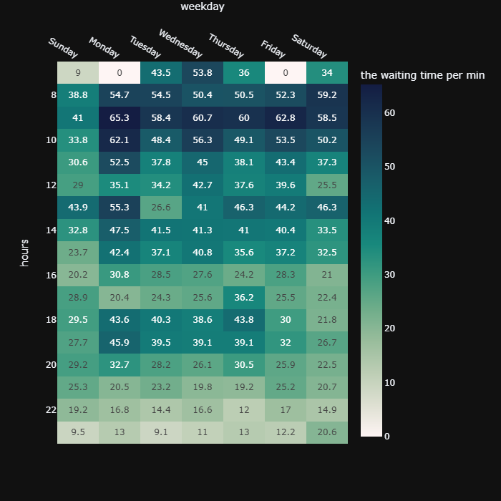
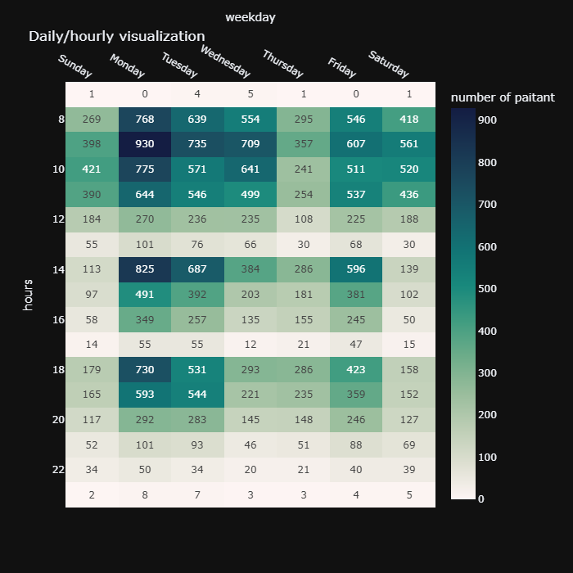
Are we too busy?
The chart on the Right is the number of a patient visiting the clinic daily, and the chart on the Left is the amount of time patients spend in the clinic daily
YES, we are too busy in the morning period, and at 13, and 18
Here we can see that there are times in the day when the wait time is too long, and these times are (8 - 11) and (13), and (18).
And Here we can see that there are times in the day when the number of patients is too high, and these times are (8 - 10) and (14) and (18).

Slide 10
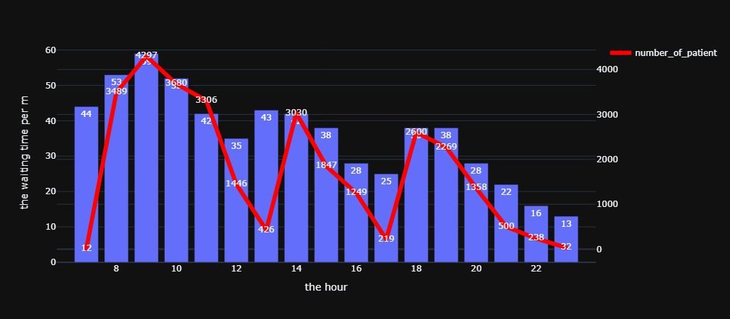
Do we have staffing issues?
This chart is the wait average time showing as BARS, and the number of patients showing as LINE
We can see that (13 and 17) have an average wait time even though we have a lower amount of patients, so YES it's a staffing issue, however, we need to address the (8 – 10 and 14 and 18) too because it’s the busiest hours

Slide 11
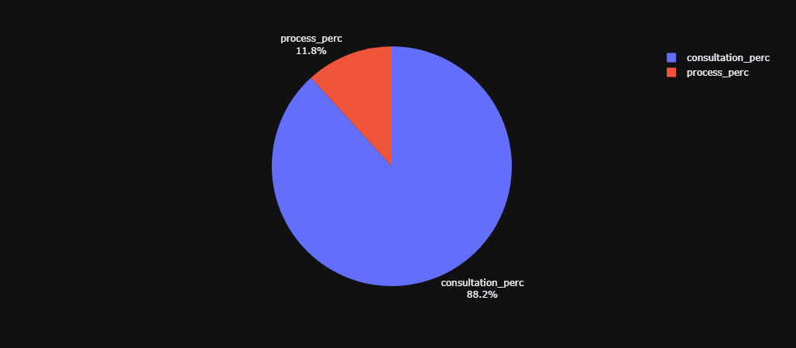
How much the patients wait before the doctor can see them? , And what type of staff do we need or where do we need them?
The patients wait before the doctor can see them (39min) on average.
5M
We should focus our efforts on the medical staff because we are assuming the time to wait to see the doctor is limited by the number of the available doctors
Our patients spend 88% (an average of 39 min)of their time waiting for the doctor and spend just 11% (an average of 5 min) talking to the doctor.
39M

Slide 12
Results & Conclusion
Summary
Based on the analysis, there may be a possibility to add more medical staff during these times ((8 and 9,13 and 14,18) of the days), and focus on Monday and Wednesday.
Recommendations
Determine if it makes financial sense to have additional medical staffing at these times in the summary section.

Slide 13
The End

