Slide 1
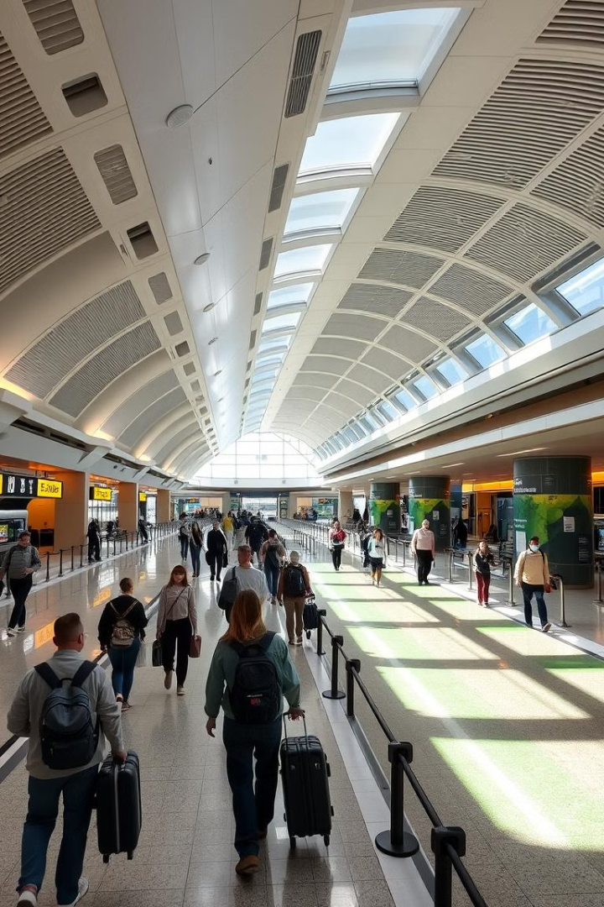

Web Scraping on British Airways
This presentation will showcase the potential of web scraping to enhance British Airways' operational efficiency, improve customer satisfaction, and stay ahead of the curve in a rapidly evolving industry.
by ABDUL RAFI SHAIK
British Airways

Slide 2
Enhancing Customer Satisfaction
Actionable Insights to Improve Customer Satisfaction
Enhance Communication: Provide real-time updates on flight delays and cancellations via SMS, email, or apps.
Streamline Airport Processes: Automate check-in, boarding, and baggage tracking to reduce wait times and improve transparency.
Upgrade Customer Service: Implement 24/7 support (chatbots/hotlines) and train staff for faster issue resolution.
Optimize Seating and Cabin Comfort: Improve seat design, legroom, and inflight entertainment across all classes.
Elevate Food Quality: Offer healthier, high-quality meals and accommodate dietary preferences based on passenger feedback.
Simplify Refund and Compensation Policies: Ensure transparency in payments, refunds, and compensation for delays or mishandled baggage.
British Airways

