Slide 1
Data Analysis On British Airways

Slide 2
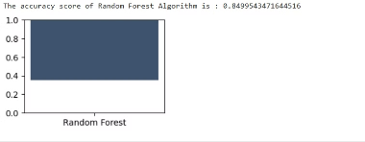
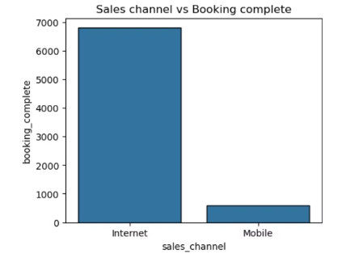
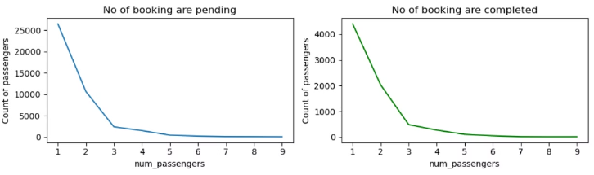
SOLELY FOR PURPOSES OF FORAGE WORK EXPERIENCE
Insights
Enhance mobile app usability for a more user-friendly experience, reducing the friction that leads to abandoned bookings.
Invest in SEO strategies to improve visibility and attract direct traffic to the airline's website, decreasing dependency on third-party platforms.
Provide special offers and discounts for one-way trips to increase their bookings and appeal to customers seeking flexibility.

Slide 3
