Slide 1
Image Classification using Convolutional Neural Networks (CNN) on Fashion-MNIST Dataset
Submitted By: Shaik Abdul Raheem
Roll No: 24924080008

Slide 2
Problem Statement
The objective of this project is to build an image classification model that can accurately classify images into different categories using Deep Learning techniques. The Fashion-MNIST dataset contains grayscale images of clothing items belonging to 10 different classes.

Slide 3
Dataset Description
Label | Class Name
0 | T-shirt/top
1 | Trouser
2 | Pullover
3 | Dress
4 | Coat
5 | Sandal
6 | Shirt
7 | Sneaker
8 | Bag
9 | Ankle boot
Dataset Name: Fashion-MNIST
Source: Keras built-in dataset
Total Images: 70,000
Training images: 60,000
Testing images: 10,000
Image Size: 28 × 28 pixels
Image Type: Grayscale
Number of Classes: 10

Slide 4
Tools & Technologies Used
Python
NumPy
Matplotlib
TensorFlow
Keras
Jupyter Notebook / Google Colab

Slide 5

Project Workflow
Import Libraries
Load Dataset
Data Preprocessing
Exploratory Data Analysis
Build CNN Model
Compile Model
Train Model
Evaluate Model
Make Predictions
Result Visualization

Slide 6
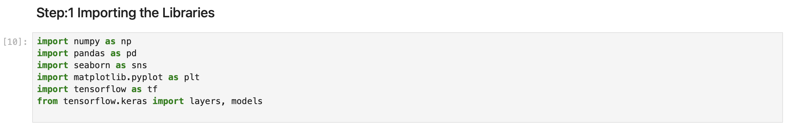
Step 1: Importing Libraries

Slide 7
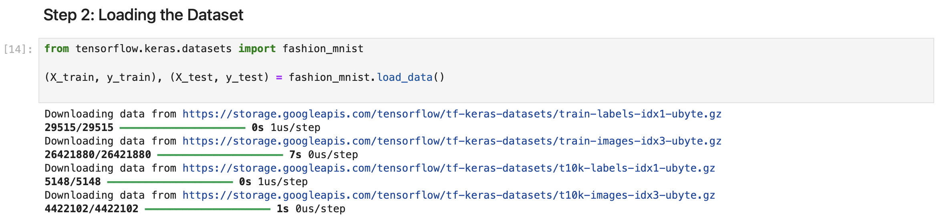
Step 2: Load the dataset

Slide 8
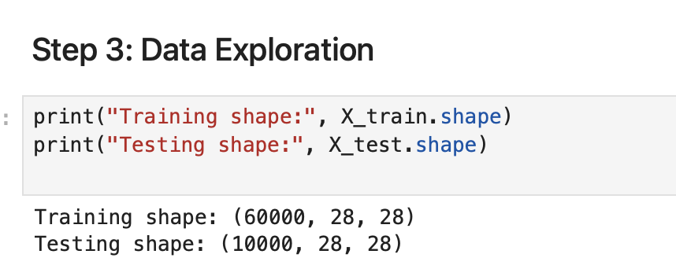
Step 3: Data Exploration

Slide 9
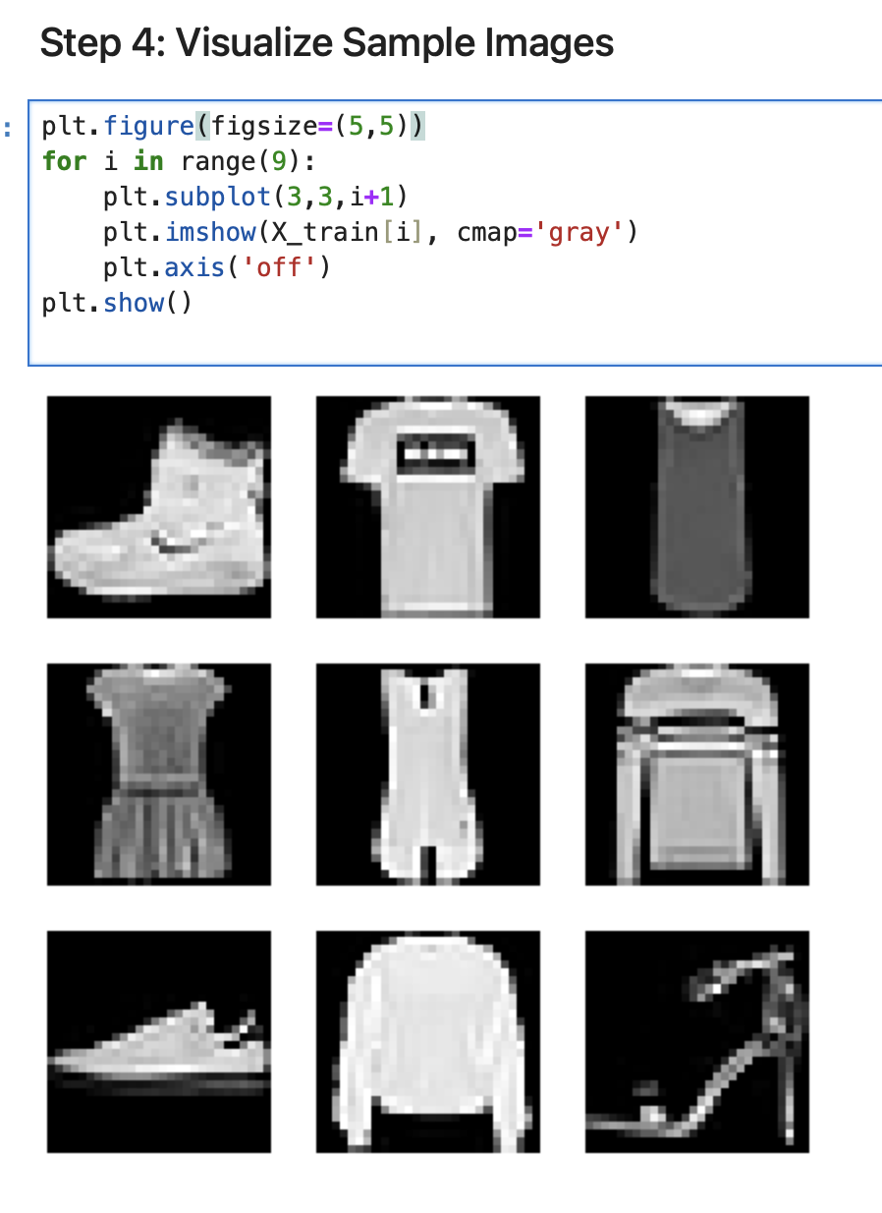
Step 4: Visualize Sample Images

Slide 10
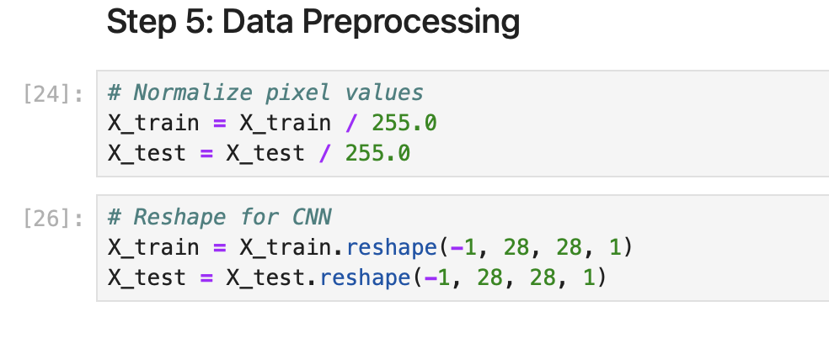
Step 5: Data Preprocessing

Slide 11
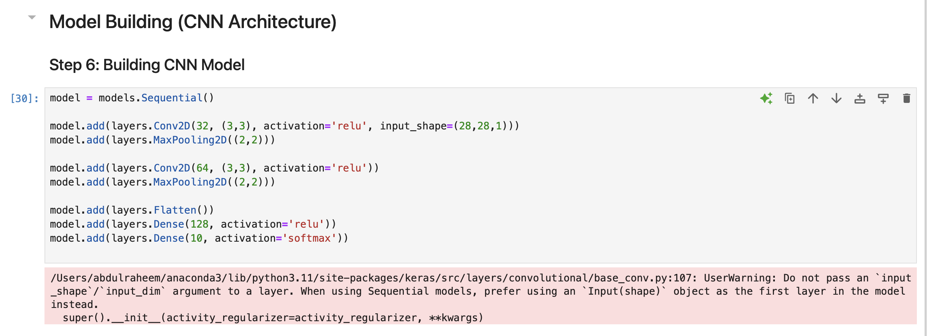
Step 6: Building CNN Model
Model Building

Slide 12
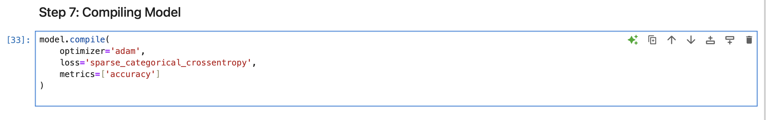
Step 7: Compiling Model

Slide 13
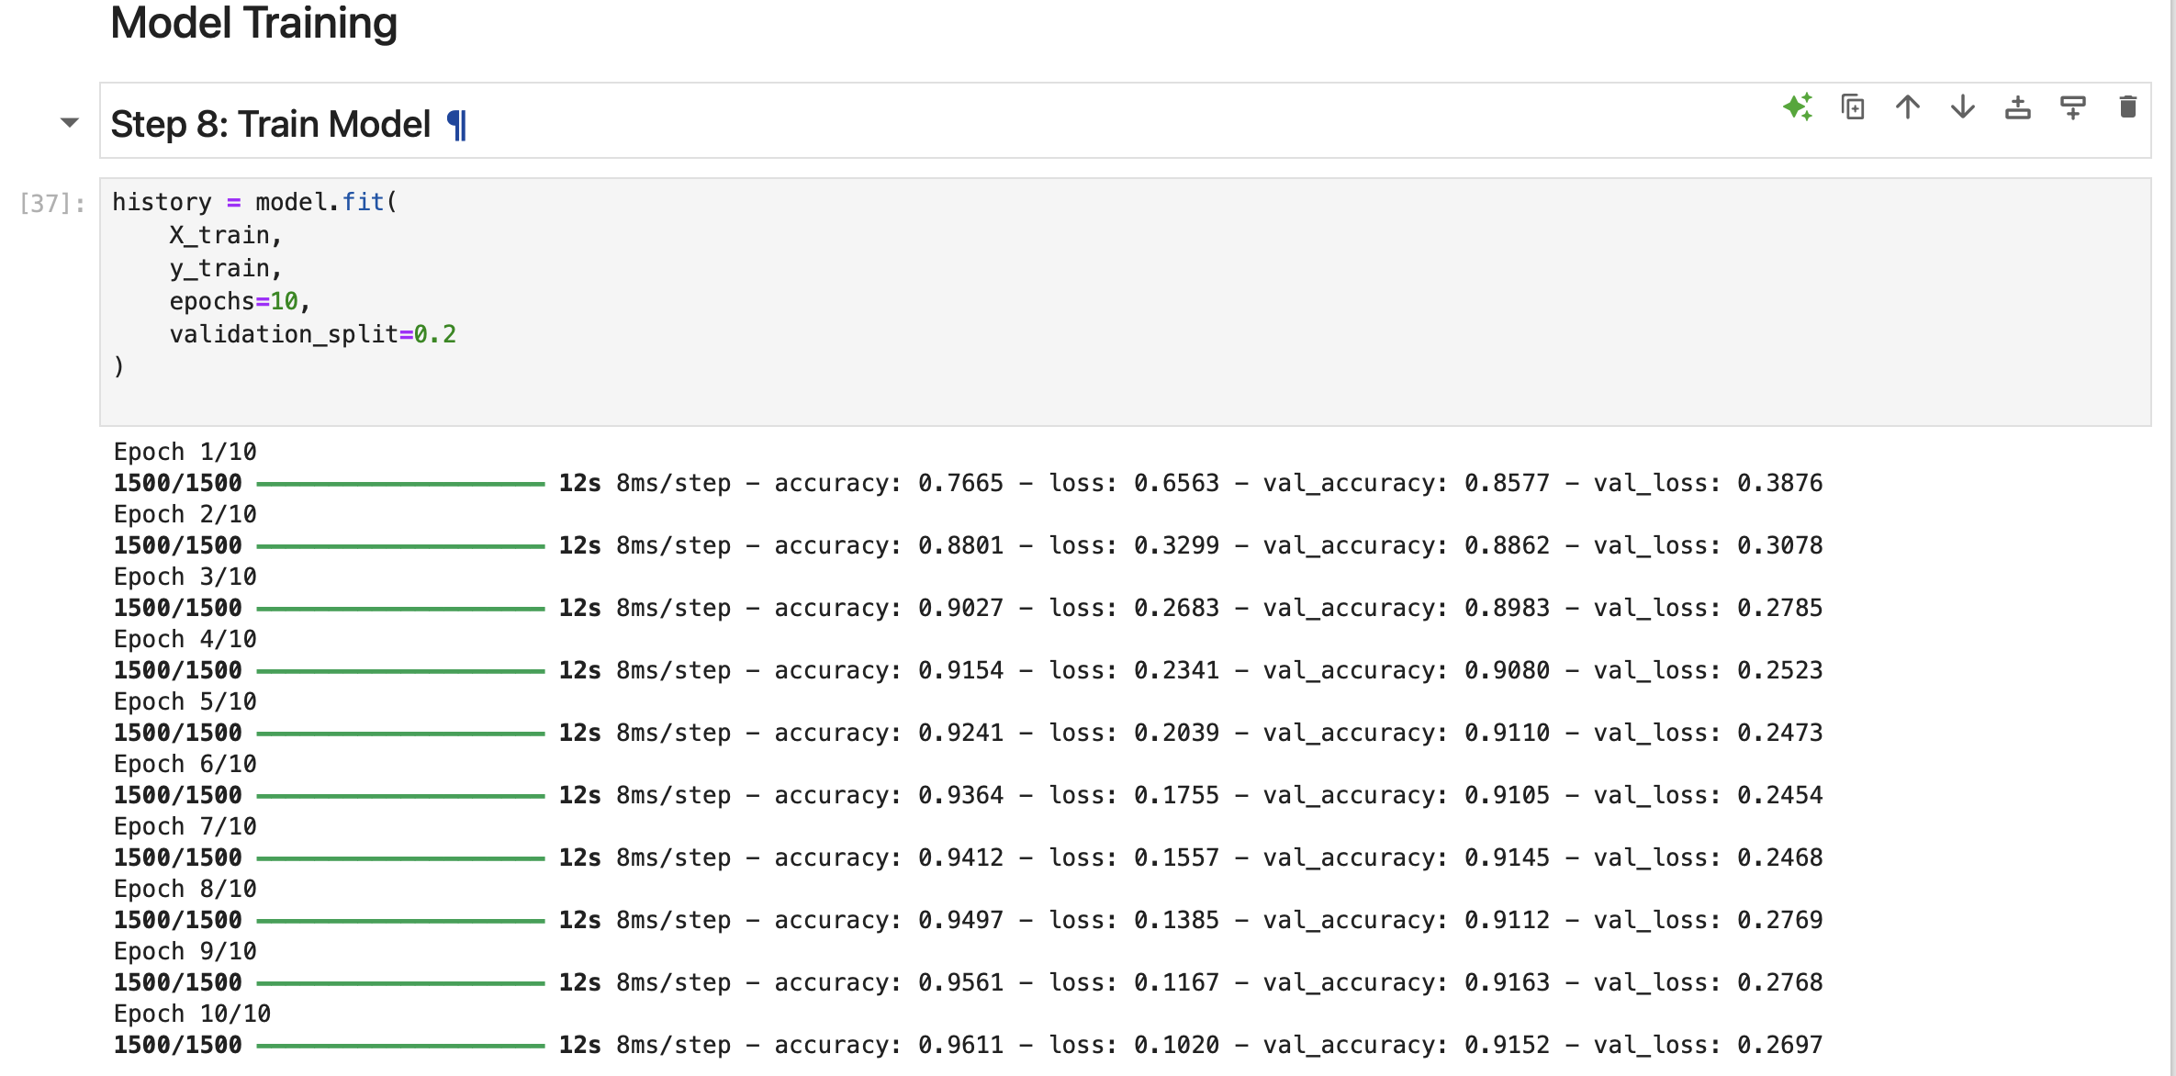
Model Training
Step 8: Train Model

Slide 14
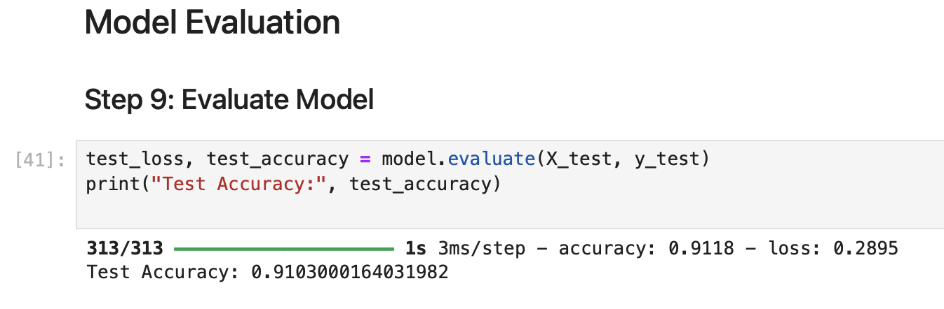
Model Evaluation
Step 9: Evaluate Model

Slide 15
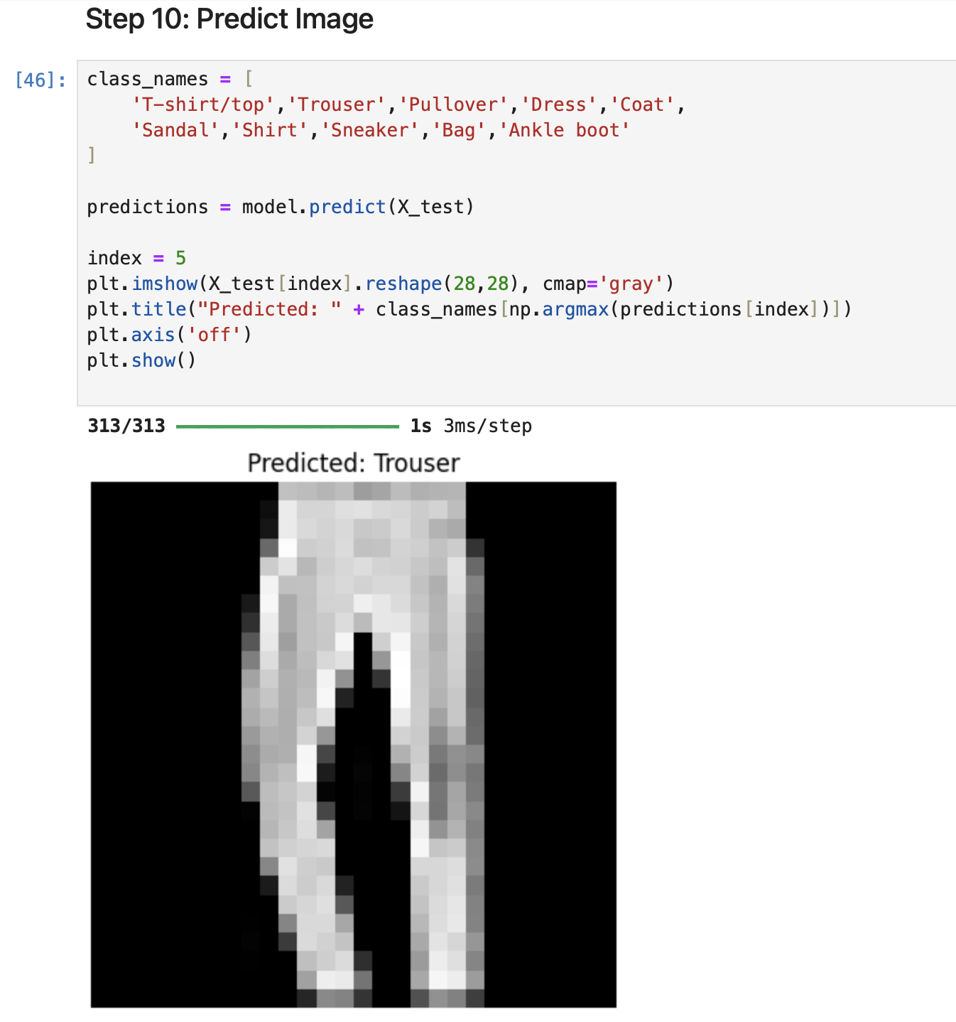
Prediction & Output
Step 10: Predict Image

Slide 16
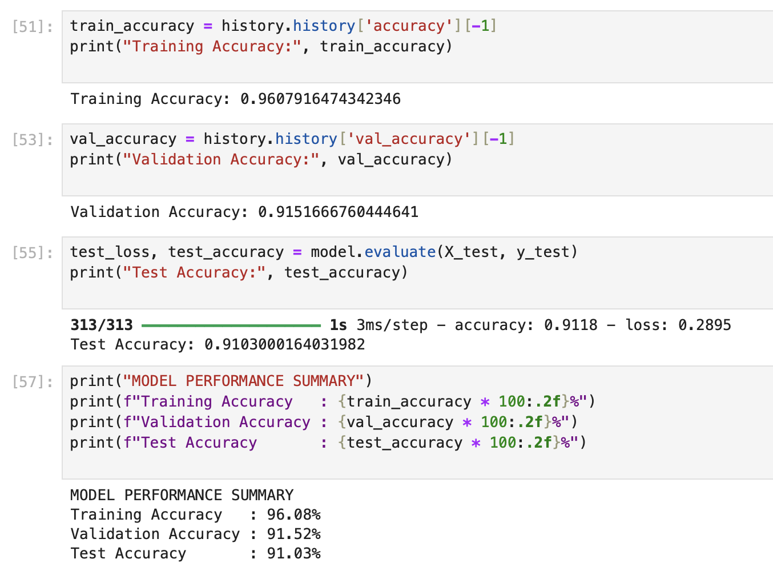
Model Performance Summary

Slide 17
Advantages of CNN
Automatically extracts features
Better accuracy for image data
Reduces manual feature engineering

Slide 18
Applications
Fashion product classification
E-commerce recommendation systems
Image recognition systems
Retail analytics

Slide 19
Project Links (GitHub & Google Colab)
GitHub Repository:
https://github.com/Abdulraheem098/IMAGE-CLASSIFICATION-USING-CNN
Google Colab Notebook:
https://colab.research.google.com/drive/your-notebook-id

Slide 20
Conclusion
In this project, a CNN-based image classification model was successfully developed using the Fashion-MNIST dataset. The model achieved good accuracy and demonstrated the effectiveness of deep learning in image recognition tasks.

Slide 21
THANK YOU

