Slide 1
General course
2022-2023
Programming 2
Comprehension Expressions
Serhat Erdogan

Slide 2
Goals of this lesson
Student understand the benefit of comprehension expressions.
Student can write comprehension expressions.
Student understands what a generator is and how to use it.

Slide 3
Content table
Generators
Comprehension Expressions

Slide 4
Generators

Slide 5
Problem
Imagine having a list in Python of integers from 0 till 2.000.000.000:
The problem we are having is that we store this all-in memory, and this could affect performance.
Solution? => Generators
# large list
my_list= [0, 1, 2, 3, 4, …, 2000000000]
Notes:
https://www.dataquest.io/blog/python-generators-tutorial/

Slide 6
Generators
Now we introduce an important type of object called a generator, which allows us to generate arbitrarily-many items in a series, without having to store them all in memory at once.
A generator does not store any items. Instead, it stores the instructions for generating each of its members and stores its iteration state; this means that the generator will know if it has generated its second member and will thus generate its third member the next time it is iterated on.
# Regular function
def function_a():
return "a"
# Generator function
def generator_a():
yield "a"
function_a()
>>> "a"
generator_a()
>>> <generator object a at 0x000001565469DA98>
Notes:
https://www.dataquest.io/blog/python-generators-tutorial/

Slide 7
Yield vs Return
The yield statement pauses the execution of the function and sends a value back to the caller, but retains enough state to enable the function to resume where it left off. When the function resumes, it continues execution immediately after the last yield run. This allows its code to produce a series of values over time, rather than computing them at once and sending them back like a list. The next() function is a special function that asks, “What’s the next item in the iteration?” In fact, next() is the precise function that is called when you run a for loop!
def multi_generate():
yield "a"
yield "b"
mg = multi_generate()
next(mg)
>>> "a"
next(mg)
>>> "b"
next(mg)
>>> StopIteration:
mg = multi_generate()
for i in mg:
print(i)
>>> "a"
>>> "b"
Notes:
https://www.dataquest.io/blog/python-generators-tutorial/

Slide 8
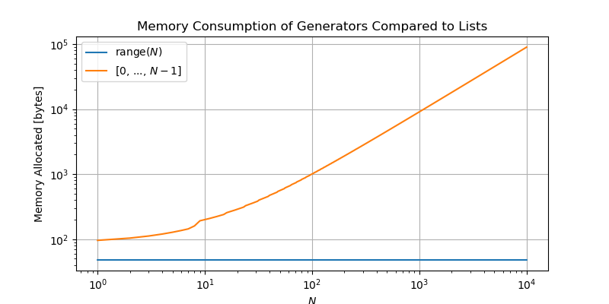
Example range generator
Because range is a generator, the command range(5) will simply store the instructions needed to produce the sequence of numbers 0-4, whereas the list [0, 1, 2, 3, 4] stores all of these items in memory at once.

Slide 9
Infinity sequence example
Here, we are generating an infinite sequence of numbers with yield, yield returns the number and increments the num by + 1.
def inf_sequence():
num = 0
while True:
yield num
num += 1
for i in inf_sequence():
print(i, end=" ")
0 1 2 3 4 5 6 7 8 9 10 11 12 13 14 15 16 17 18 19 20 21 22 23 24 25 26 27 28 29 30 31 32 33 34 35 36 37 38 39 40 41 42 43 44 45 46 47 48 49 50 51 52 53 54 55 56 57 58 59 60 61 62 63 64 65 66 67 68 69 70 71 72 73 74 75 76 77 78.......

Slide 10
Comprehension

Slide 11
Example comprehension expression
Here, we are generating an even sequence of numbers from 0 to 99 in two ways:
# generator to print even numbers
def even_gen_100():
for i in range(100):
if i % 2 == 0:
yield i
The following expression defines a generator for all the even numbers in 0-99
even_gen = (i for i in range(100) if i%2 == 0)
The syntax (<expression> for <var> in <iterable> [if <condition>]) specifies the general form for a generator comprehension.

Slide 12
Example comprehension expression
Here, we are generating an even sequence of numbers from 0 to 99 in two ways:
(("apple" if i < 3 else "pie") for i in range(6))
# will generate:
# 'apple'..
# 'apple'..
# 'apple’..
#...
((i, i**2, i**3) for i in range(10))
# will generate:
# (0, 0, 0)
# (1, 1, 1)
#...

Slide 13
Storing generators
Defining a generator using a comprehension does not perform any computations or consume any memory beyond defining the rules for producing the sequence of data. See what happens when we try to print this generator:
# will generate 0, 1, 4, 9, 25, ..., 9801
>>> gen = (i**2 for i in range(100))
>>> print(gen)
<generator object <genexpr> at 0x000001E768FE8A40>
This output simply indicates that gen stores a generator-expression at the memory address 0x000001E768FE8A40; this is simply where the instructions for generating our sequence of squared numbers is stored.
len(gen) or gen[2] will not work. => so how do we consume our generators?

Slide 14
Consuming generators
We can feed this to any function that accepts iterables. For instance, we can feed gen to the built-in sum function, which sums the contents of an iterable:
gen = (i**2 for i in range(100))
sum(gen) # computes the sum 0 + 1 + 4 + 9 + 25 + ... + 9801
>>328350
What happens if we run this command a second time:
! Takeaway:
A generator can only be iterated over once, after which it is exhausted and must be re-defined in order to be iterated over again.
# computes the sum of ... nothing!
# `gen` has already been consumed!
sum(gen)
>>0

Slide 15
List comprehension
A list comprehension is a syntax for constructing a list, which exactly mirrors the generator comprehension syntax:
[<expression> for <var> in <iterable> {if <condition}]
The difference lies in the square brackets!
# computes the sum of ... nothing!
# `gen` has already been consumed!
>> [i**2 for i in range(10)]
>> [0, 1, 4, 9, 16, 25, 36, 49, 64, 81]

Slide 16
List comprehension
words_with_o = []
word_collection = ['Python', 'Like', 'You', 'Mean', 'It']
for word in word_collection:
if "o" in word.lower():
words_with_o.append(word)
! Takeaway:
The comprehensions-statement is an extremely useful syntax for creating simple and complicated lists and tuples alike.
Using List comprehension:
>>> word_collection = ['Python', 'Like', 'You', 'Mean', 'It’]
>>> words_with_o = [word for word in word_collection if "o" in word.lower()]
>>> words_with_o
['Python', 'You']

Slide 17
Repetition of this lesson
Why are generators useful?
How do you write a comprehension expression?

