Slide 1
General course
2022-2023
Programming 2
Dictionaries
Serhat Erdogan

Slide 2
Goals of this lesson
Student can work with a dictionary data structure
Student can use the enumerate function and understands the benefit of using it.
Student understand the benefit of Comprehension Expressions.
Student understands and can use the filter, zip & map functions.

Slide 3
Content table
Dictionary structure
Access data dictionary
Adding/removing data dictionary
Iterating over dictionary

Slide 4
Data structure: Dictionary

Slide 5
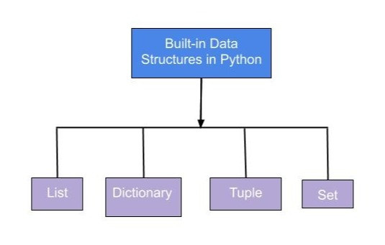
Data structure
A data structure models a collection of data, such as a list of numbers, a row in a spreadsheet, or a record in a database. Modeling the data that your program interacts with using the right data structure is often the key to writing simple and effective code

Slide 6
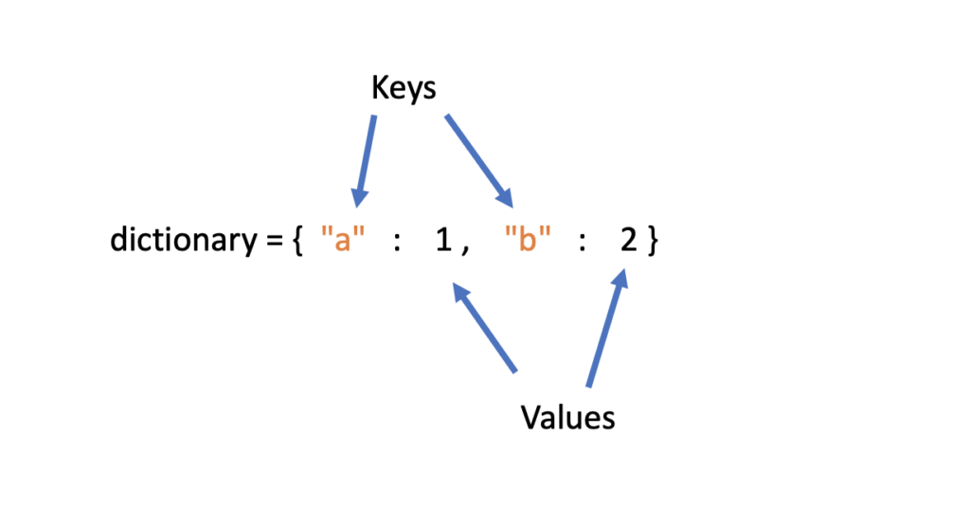
Dictionary
Dictionaries are Python’s implementation of a data structure that is more generally known as a map. A dictionary consists of a collection of key-value pairs. Each key-value pair maps the key to its associated value. The key in a key-value pair is a unique name that identifies the value of the pair.
d = {
<key>: <value>,
<key>: <value>,
.
.
.
<key>: <value>
}

Slide 7
Dictionary states/capitals example
You could use a dictionary to store the names of states and their capitals:
Key | Value
“Belgium” | Brussel
“France” | “Paris”
“Turkey” | “Ankara”
dict_states = {
‘Belgium’: ‘Brussel',
‘France': ‘Paris',
‘Turkey': ‘Ankara'
}

Slide 8
Accessing dictionary values
Of course, dictionary elements must be accessible somehow. If you don’t get them by index, then how do you get them? A value is retrieved from a dictionary by specifying its corresponding key in square brackets ([]):
dict_baseball = {
'Colorado': 'Rockies',
'Boston': 'Red Sox',
'Minnesota': 'Twins',
'Milwaukee': 'Brewers',
'Seattle': 'Mariners'
}
print(dict_baseball['Minnesota'])
print(dict_baseball['Colorado'])
dict_baseball['Minnesota'] = "Barca"
dict_baseball['Colorado'] = "Madrid"
print(dict_baseball['Minnesota'])
print(dict_baseball['Colorado'])
Output:
Twins
Rockies
Output:
Barca
Madrid

Slide 9
Relationship key and value
The relationship between a key and its value in a Python dictionary is well-defined and not arbitrary. Each key is associated with a specific value and cannot be changed once it is created.
Valid Dictionary Key types
Integers
floats
Strings
Booleans
tuples
Key | Value
1 | “Sunday”
“red” | 12:45pm
17 | True

Slide 10
Adding & removing dictionary values
dict_states = {
'California': 'Sacramento',
'New York': 'Albany',
'Texas': 'Austin'
}
dict_states['Colorado'] = 'Denver'
print(dict_states)
dict_states = {
'California': 'Sacramento',
'New York': 'Albany',
'Texas': 'Austin’
}
del dict_states['California']
print(dict_states)
Adding to dictionary
Remove item from dictionary
Output:
{'California': 'Sacramento', 'New York': 'Albany', 'Texas': 'Austin', 'Colorado': 'Denver'}
Output:
{'New York': 'Albany', 'Texas': 'Austin'}

Slide 11
Checking for keys & Iterating over dictionary
dict_states = {
'California': 'Sacramento',
'New York': 'Albany',
'Texas': 'Austin’
}
#Checking if the key exist in the dictionary
if "Belgium" in dict_states:
print("True")
if "Belgium" not in dict_states:
print("False")
dict_states = {
'California': 'Sacramento',
'New York': 'Albany',
'Texas': 'Austin’
}
#items() returns a list-like object containing tuples of key-value pairs
for state, capital in dict_states.items():
print(f'the capital of {state} is {capital}')
Output:
False
Output: the capital of California is Sacramento
the capital of New York is Albany
the capital of Texas is Austin

Slide 12
Exercise dictionary
Create an empty dictionary named captains.
Using square bracket notation, enter the following data into the dictionary one item at the time:
'Enterprise': 'Picard'
'Voyager': 'Janeway'
'Defiant': 'Sisko’
Write two if statements that check if “Enterprise” and “Discovery” exist as keys in the dictionary. Set their values to “unknown” if the key does not exist.
Write a for loop to display the ship and captain names contained in the dictionary. For example, the ouput should look something like:
The enterprise is captained by Picard
Delete “Discovery” from the dictionary.
Notes:
Small exercise so that the students understand it better and we can go further with the theory

Slide 13
Repetition of this lesson
What is a dictionary?
Define the relationship between a key and its value.
How can you get a value out of a dictionary?
How can you check if a key is within a dictionary
How can you add a value to a dictionary?
How can you delete a value to a dictionary?

