Slide 1
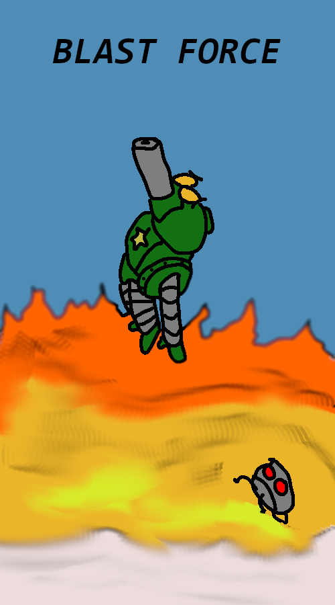
Game Requirements and Storyboards
Team members:
Jordan Arevalos, Abdul Al-Sabri,
Todd St. Onge, Alsalt Al-Fahdi,
Jinyang Dong, Homero Garza.

Slide 2
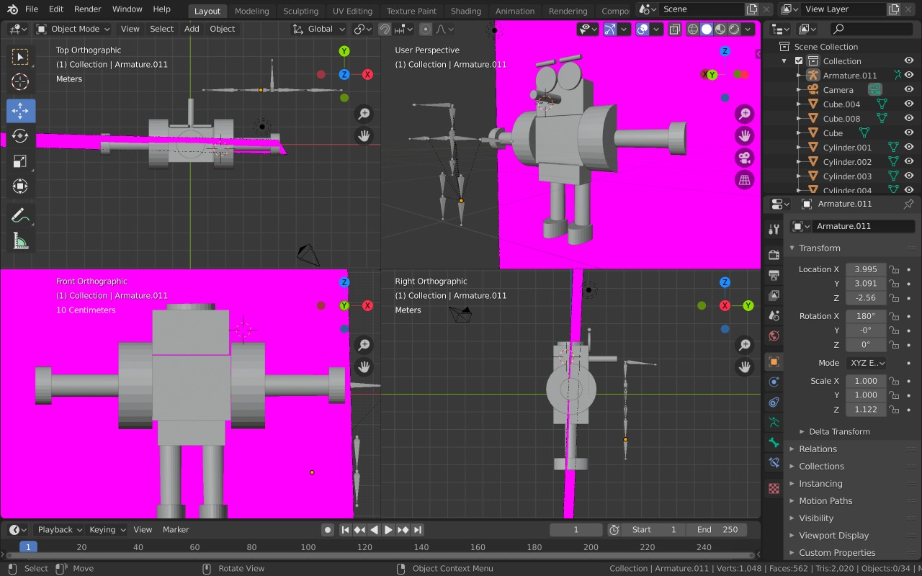
Requirements
The digital game shall have at least one 3D object that moves/interacts with other scenes and objects.

Slide 3
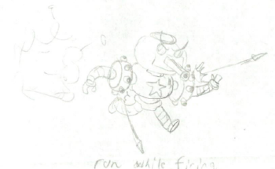
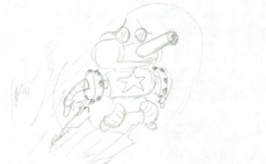
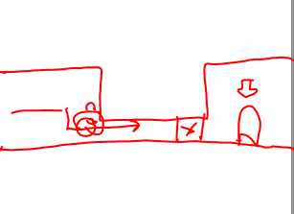
Requirements
The digital game shall have challenges with at least 3 game mechanics with clearly defined level objectives such as hitting targets with weapons or tools to become a next level wizard.
Shooting rockets
Rocket Jumping
Crouching

Slide 4
Requirements
The digital game shall have theatrics for each challenge or mechanic such as sounds, visual effects, rewards, or camera sophistication. Theatrics should be designed in with the team’s storyboards.
The digital game shall have a design level flow diagram, class diagram, and storyboards for team understanding.
The digital game shall introduce at least one novel design concept that focuses on levels of immersion.

Slide 5
Background Story
Sherman, the hero of our story, has just had his memory erased by the evil Dr. Francis as a part of his sinister plan. Sherman has now become a test subject under Dr. Francis, and as a result, not only can he not remember who he is, but has also been transformed into an indestructible tank. Sherman will have to use newfound abilities inflicted upon him to complete a dangerous journey. As the player, you will help Sherman gain back his memories and defeat Dr. Francis.

Slide 6
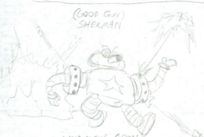
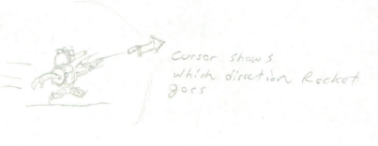
Requirements - Continue
The game shall support the player character shooting rockets at targets.
The game shall support a 360-degree aiming function while shooting rockets.

Slide 7
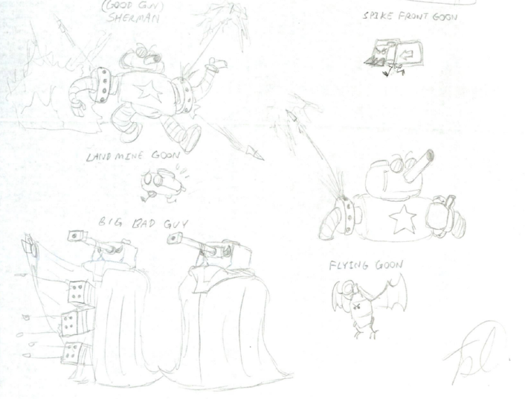
Requirements - Continue
The game shall support the player character jumping over obstacles or enemies.
The game shall support enemies with abilities (shooting, flying, chasing).

Slide 8
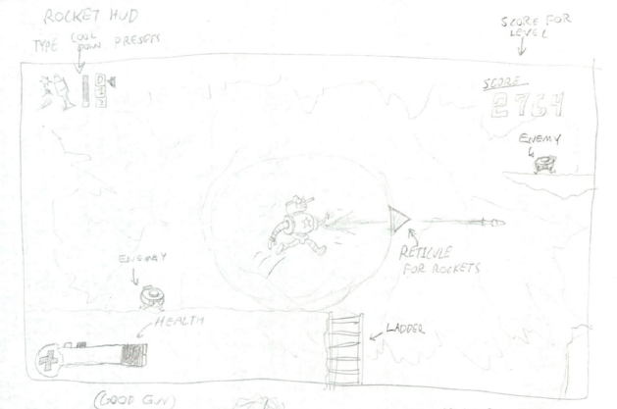
Requirements - Continue
The game shall display the player’s score.

Slide 9
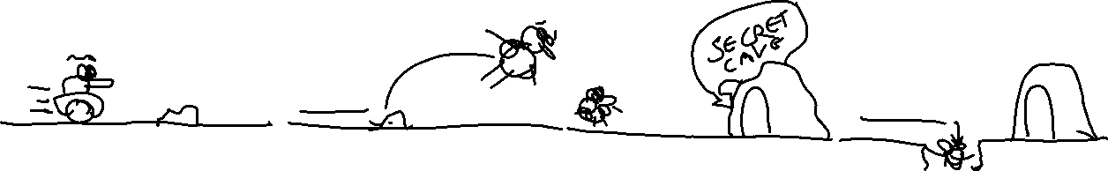
Storyboard Design: Blast Force Story: Pre-Tutorial Scene
02/23/2020
Jordan Arevalos, Abdul Al-Sabri
Todd St. Onge, Alsalt Al-Fahdi
Jinyang Dong, Homero Garza
Game Level / Objectives & Mechanics: Walking right
Skills and Controls Needed: No skills needed/Movement controls only
Window title
Window title
Window title
Window title
Time: 00:00:00, Duration: 2 seconds
Time: about 00:00:02, Duration: 3 seconds
Time: about 00:00:05, Duration: 2 seconds
Time: about 00:00:07, Duration: 3 seconds
Driving across a field
Trips on a rock
Walking to secret cave
Falls through false floor
Cutscene
Cutscene
Giving all control to character, free movement
Gravity taking its course
Start to calm music
Hitting a rock
Calm music
Ground crumbling

Slide 10
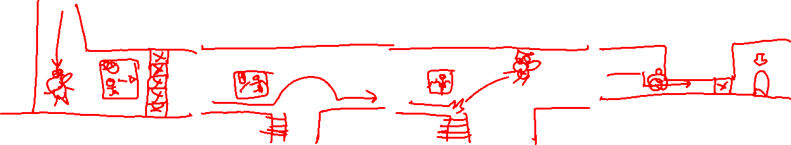
Storyboard Design: Blast Force Story: Tutorial Scene
02/23/2020
Jordan Arevalos, Abdul Al-Sabri
Todd St. Onge, Alsalt Al-Fahdi
Jinyang Dong, Homero Garza
Game Level / Objectives & Mechanics: Getting familiar with mechanics
Skills and Controls Needed: Shooting rockets, jumping, rocket jumping and crouching
Window title
Window title
Window title
Window title
Time: 00:00:10, Duration: 5 seconds
Time: 00:00:15, Duration: 5 seconds
Time: 00:00:20, Duration: 5 seconds
Time: 00:00:25, Duration: 5 seconds
Shooting rockets at “weak” blocks
Jumping
Rocket Jumping
Crouching
Destroying weak blocks with rockets
Climb a ladder if jump fails
The ability to rocket shoot yourself and ladder climbing if the jump fails
Hitting the block
Gym music – rockets firing
Jumping sound effect
Cutting through air sound effect
Calm music

Slide 11
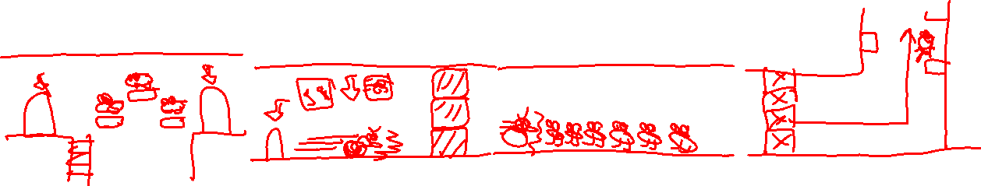
Storyboard Design: Blast Force Story: Tutorial Scene
02/23/2020
Jordan Arevalos, Abdul Al-Sabri
Todd St. Onge, Alsalt Al-Fahdi
Jinyang Dong, Homero Garza
Game Level / Objectives & Mechanics: Getting familiar with mechanics
Skills and Controls Needed: Shooting rockets, Charging
Window title
Window title
Window title
Window title
Time: 00:00:30, Duration: 10 seconds
Time: 00:00:40, Duration: 5 seconds
Time: 00:00:45, Duration: 5 seconds
Time: 00:00:50, Duration: 10 seconds
Shooting rockets
Charging towards destroyable blocks
Charging towards small enemies
Cutscene showing Sherman jumping to get to surface
Killing enemies with rockets
Hitting blocks using charging force
Killing Enemies using Charging Force
Cutscene
Battle sound ☺
Destruction sound
Charging sound
Charging sound
Calm music
Jumping sound

Slide 12
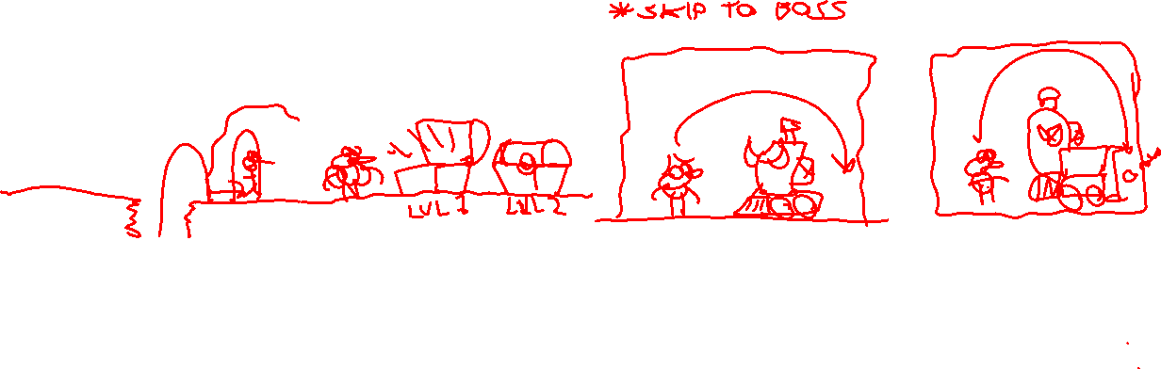
Storyboard Design: Blast Force Story: Level Hub - Exploring level and fighting boss scene
02/23/2020
Jordan Arevalos, Abdul Al-Sabri
Todd St. Onge, Alsalt Al-Fahdi
Jinyang Dong, Homero Garza
Game Level / Objectives & Mechanics: Fighting level boss
Skills and Controls Needed: All skills
Window title
Window title
Window title
Window title
Time: 00:01:00, Duration: 5 seconds
Time: 00:01:05, Duration: -
Time: -, Duration: -
Time: -, Duration: -
Cutscene showing Sherman arriving at the surface and entering the cave
Choosing level
Fighting a Boss
The boss is getting bigger to increase the difficulty
Cutscene
Cutscene
Trying to defeat the boss
Cutscene
Calm music
Calm music / Box opening sound
Battle music to get you hyped about the fight
And to let the adrenalin pump to your brave heart ☺
Being surprised sound

Slide 13
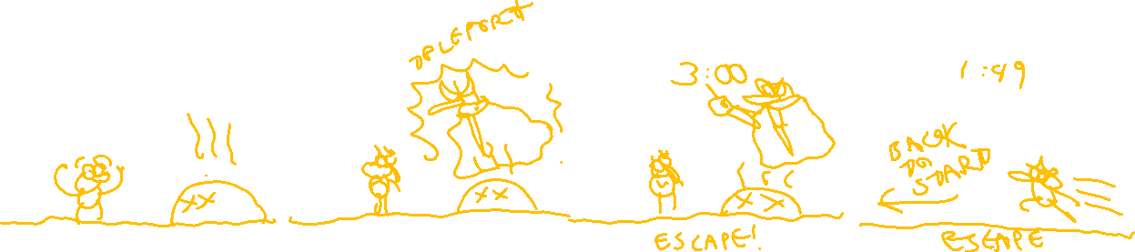
Storyboard Design: Blast Force Story: Escaping Scene
02/23/2020
Jordan Arevalos, Abdul Al-Sabri
Todd St. Onge, Alsalt Al-Fahdi
Jinyang Dong, Homero Garza
Game Level / Objectives & Mechanics: Racing back to start.
Skills and Controls Needed: Movement controls
Window title
Window title
Window title
Window title
Time: -, Duration: 2 seconds
Time: -, Duration: 2 seconds
Time: -, Duration: 7 seconds
Time: -, Duration: -
Cutscene before Big Bad shows
Big Bad coming into existence
Big Bad saying that you have this much time before he denotate the bomb
Racing back to the starting point
Cutscene
Cutscene
Cutscene
Killing enemies
Destroying blockages
Port opening sound
Boom sound
Gibberish but terrifying sound
Fast paced music

Slide 14
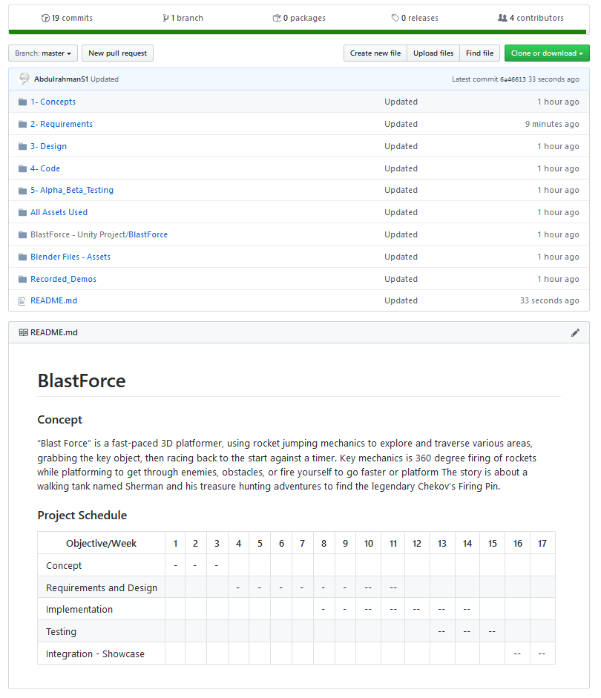
CM Repository

Slide 15
Team Contributions (Roles)
Jordan: Player/Gameplay Programmer
Todd: Project Lead - Concept Art Design - Level Design
Jinyang: Level Design - Sound Design
Alsalt: Level/Environment Programmer - Sound Design
Abdul: Level/Environment Programmer
Homero: Player/Gameplay Programmer

Slide 16
Project Schedule
Month | January | February | March | April | May
Objective / Week | 1 | 2 | 3 | 4 | 5 | 6 | 7 | 8 | 9 | 10 | 11 | 12 | 13 | 14 | 15 | 16 | 17
Concept
Requirements and Design
Implementation
Testing
Integration - Showcase

