Slide 1
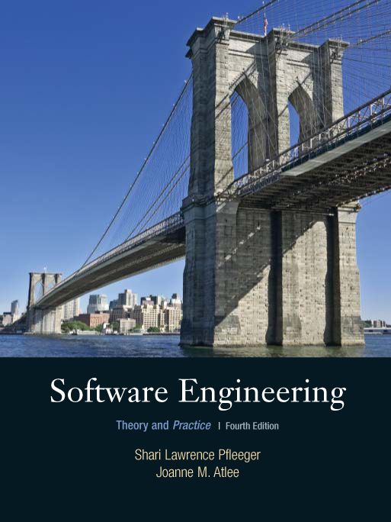
Chapter 14
The Future of
Software
Engineering
Shari L. Pfleeger
Joann M. Atlee
4th Edition
4th Edition

Slide 2
Contents
14.1 How have we done?
14.2 Technology transfer
14.3 Decision making in software engineering
14.4 The professionalization of software engineering: licensing, certification and ethics

Slide 3
Chapter 14 Objectives
The Wasserman principles and how we have done
Technology transfer
How researchers provide evidence for technology adoption
Decision making in software engineering
Next step in research and practice

Slide 4
14.1 How Have We Done?
Use complex languages
Use patterns and abstractions
Apply formal methods
Build a vast array of tools

Slide 5
14.1 How Have We Done?
Challenges Ahead
Provide great accuracy in the large: we can tell
  when a space vehicle will reach Mars
  when a chemical reaction will reach a critical stage
Do not have accuracy in small: we cannot tell
  precisely when a software product will fail again
  exactly how a user will exercise system’s function

Slide 6
14.1 How Have We Done?
Wasserman’s Steps to Maturity
Abstraction
Analysis and design notations
User interface prototyping
Software architecture
Software process
Reuse
Measurement
Tools and integrated environments

Slide 7
14.1 How Have We Done?
What Now?
Should consider how well we move the new software engineering ideas into practice
Must consider how well our research and practice support decision making about processes, resources, and products

Slide 8
14.2 Technology Transfer
Producers: create and use new technologies
Consumers: adopt and use new technologies in new products and services

Slide 9
14.2 Technology Transfer
How We Make Technology Transfer Decision Now
In the 1960s and 1970s, it took an average of 7.5 years for new technology to become widely available
Because of time-to-market pressure, new technologies must prove themselves quickly

Slide 10
14.2 Technology Transfer
Adopter Types
Innovators
Early adopters
Early majority
Late majority
Laggards

Slide 11
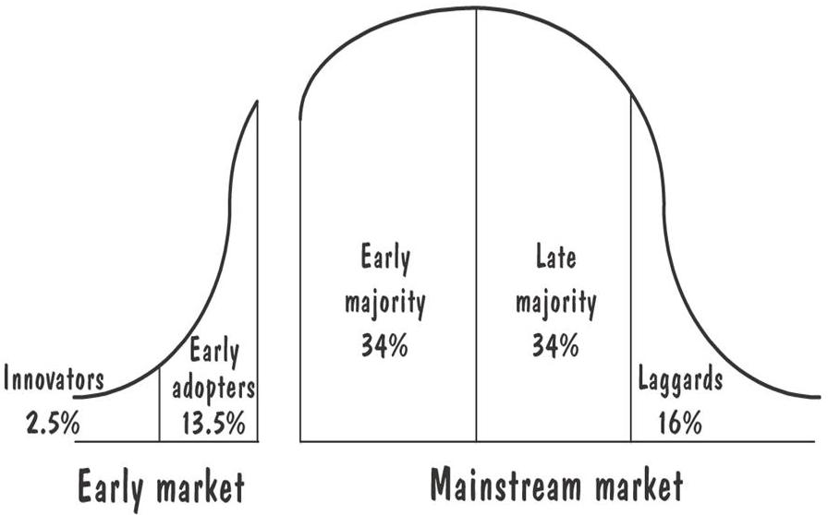
14.2 Technology Transfer
Adopter Types and the Chasm between the Early and Mainstream Market

Slide 12
14.2 Technology Transfer
Evidence Supporting Technology Decisions
Researchers: reproducible validation methods
  theoretical proof, static analysis, and simulation
Practitioners: methods relevant to their environment
  case studies, field studies, and replicated controlled experiments

Slide 13
14.2 Technology Transfer
Types of Evidence
Tangible evidence
Testimonial evidence
Equivocal testimonial evidence
Missing evidence
Accepted facts

Slide 14
14.2 Technology Transfer
Factors Influence Speed of Technology Transfer
The nature of the communication channels used to increase awareness and knowledge of the technology
The nature of the social system in which the potential user operates
The extent of efforts to diffuse the technology throughout an organization
The technology’s attributes
  relative advantage
  compatibility
  complexity
  trialability
  observability

Slide 15
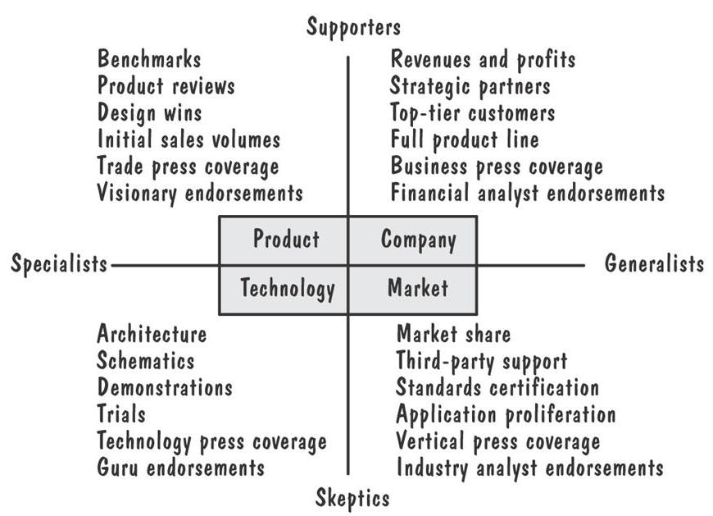
14.2 Technology Transfer
Types of Evidence and Their Audiences

Slide 16
14.2 Technology Transfer
New Model of Technology Transfer
Preliminary evaluation of a new technology
Identify promoters and inhibitors
Evaluate the evidence
  compare the old ways to the new ways
  whether the evidence is conflicting, consistent and objective
Evaluate the supportive infrastructure

Slide 17
14.3 Decision-Making in Software Engineering
Two points of view of decision-making
  Descriptive: provides evidence about how decisions are actually made
  Prescriptive: provides frameworks and methods to help decision-makers

Slide 18
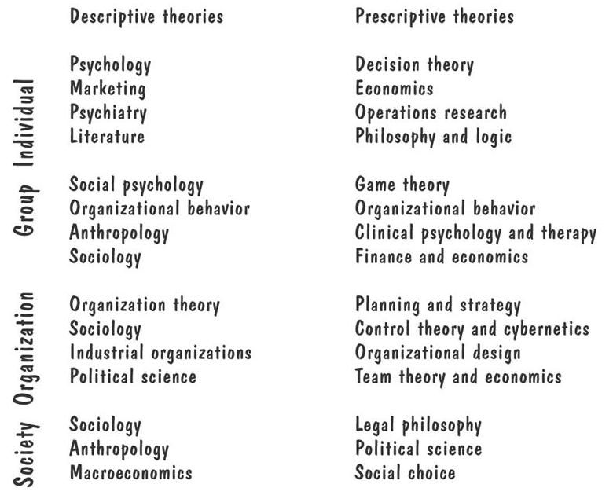
14.3 Decision-Making in Software Engineering
Roots of Decision Science

Slide 19
14.4 The Professionalization of Software Engineering: Licensing, Certification and Ethics
Improve software engineering education
Licensing or certification to improve process and product

Slide 20
14.4 The Professionalization of Software Engineering
Software Engineering Education
Specializing in software engineering as part of a computer science major
Specializing in software engineering as part of a computer engineering major
Specializing in software engineering as part of an engineering major
Specializing in software engineering as a separate degree from computer science r computer engineering

Slide 21
14.4 The Professionalization of Software Engineering
Software Engineering Involves Both Computer Science and Engineering
Computer science | Engineering
Data management | Disciplined processes
Data patterns | Large, integrated systems
Data transformation | Coordinated teams
Algorithm paradigms | Nonfunctional properties (e.g., performance, reliability, maintainability, ease of use)
Programming language
Human-computer interaction

Slide 22
14.4 The Professionalization of Software Engineering
Software Engineering and Engineering’ Principles and Practices
Software engineering borrows and adapts principles and practices from engineering
  Early planning and development activities
  Systematic, predictable design and development properties
  Consideration of nonfunctional properties

Slide 23
14.4 The Professionalization of Software Engineering
Software Engineering vs. Computer Science
Computer science
  Focuses on data, data transformation, and algorithm
  Advance courses present designs and programming techniques for specific application domain
Software engineering
  Focuses on building software products
  Looks at all activities involved in developing a software system from initial idea to final product
  Designs concept tend to focus on general-purpose design principles, patterns, and criteria
  Advance courses present design and analysis techniques that scale to large software system

Slide 24
14.4 The Professionalization of Software Engineering
Software Engineering Body of Knowledge
Computing curricula-software engineering (SE2004), IEEE-CS and ACM 2004
Software engineering body of knowledge (SWEBOK), IEEE-CS 2004
Software engineering syllabus (CEQB 1998)

Slide 25
14.4 The Professionalization of Software Engineering
Sidebar 14.2 ACME/IEEE SE Code of Ethics and Professional Practice
Software engineers shall act consistently with the public interest
Software engineers shall act in a manner that is in the best interests of their client and employer, consistent with the public interest
Software engineers shall ensure hat their products and related modifications meet the highest professional standards possible
Software engineers shall maintain integrity and independence in their professional judgment
Software engineering managers and leaders shall subscribe to and promote an ethical approach to the management of software development maintenance
Software engineers shall advance the integrity and reputation of the profession, consistent with the public interest
Software engineers shall be fair to and supportive of their colleagues
Software engineers shall participate in lifelong learning regarding the practice of their profession and shall promote an ethical approach to the practice of the profession

