Slide 1

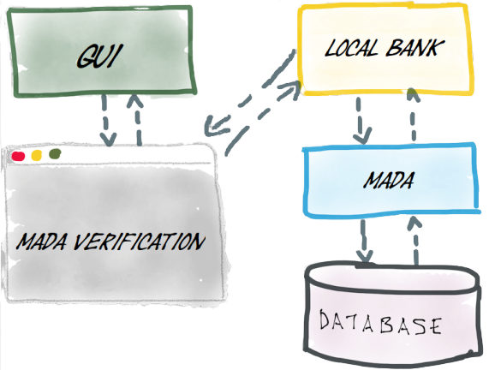

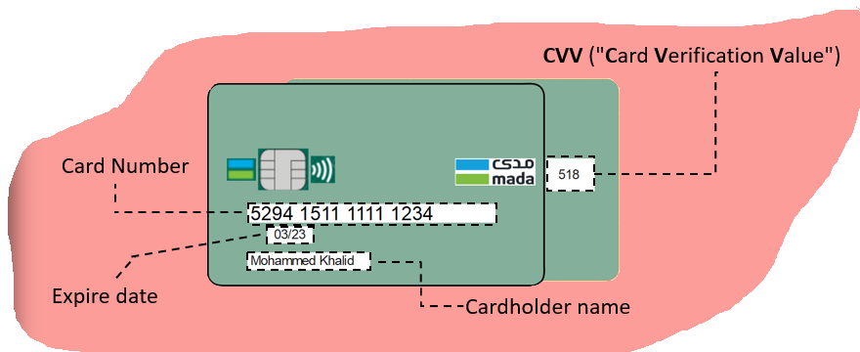

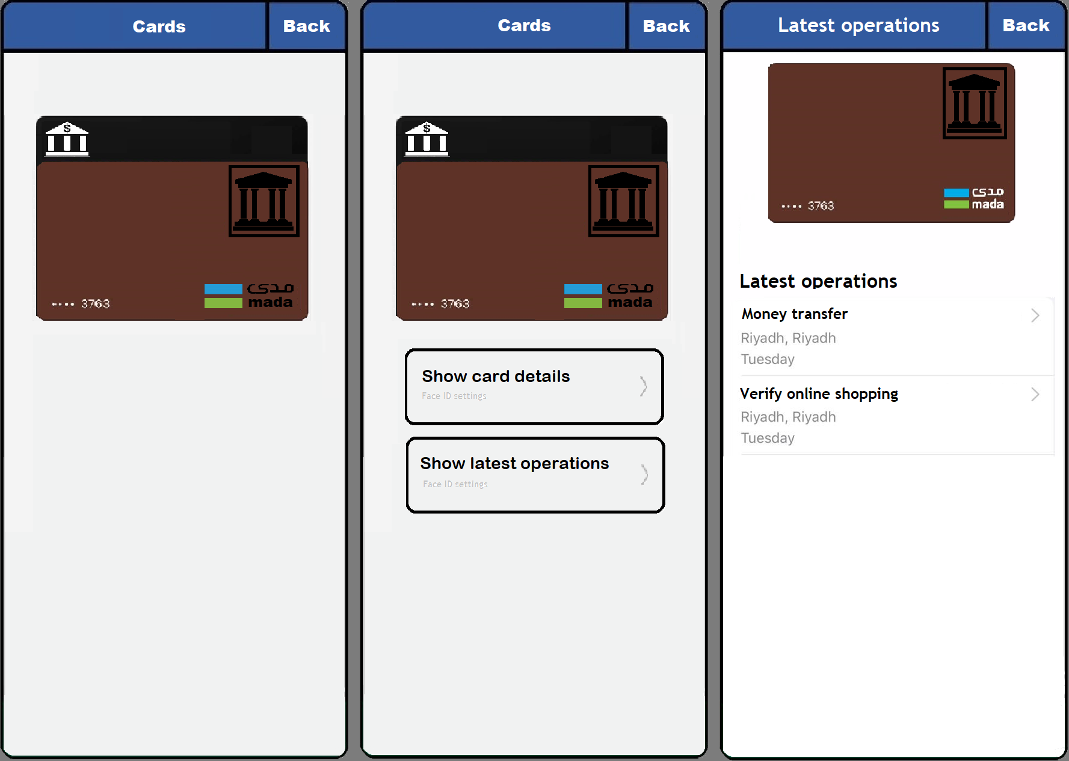
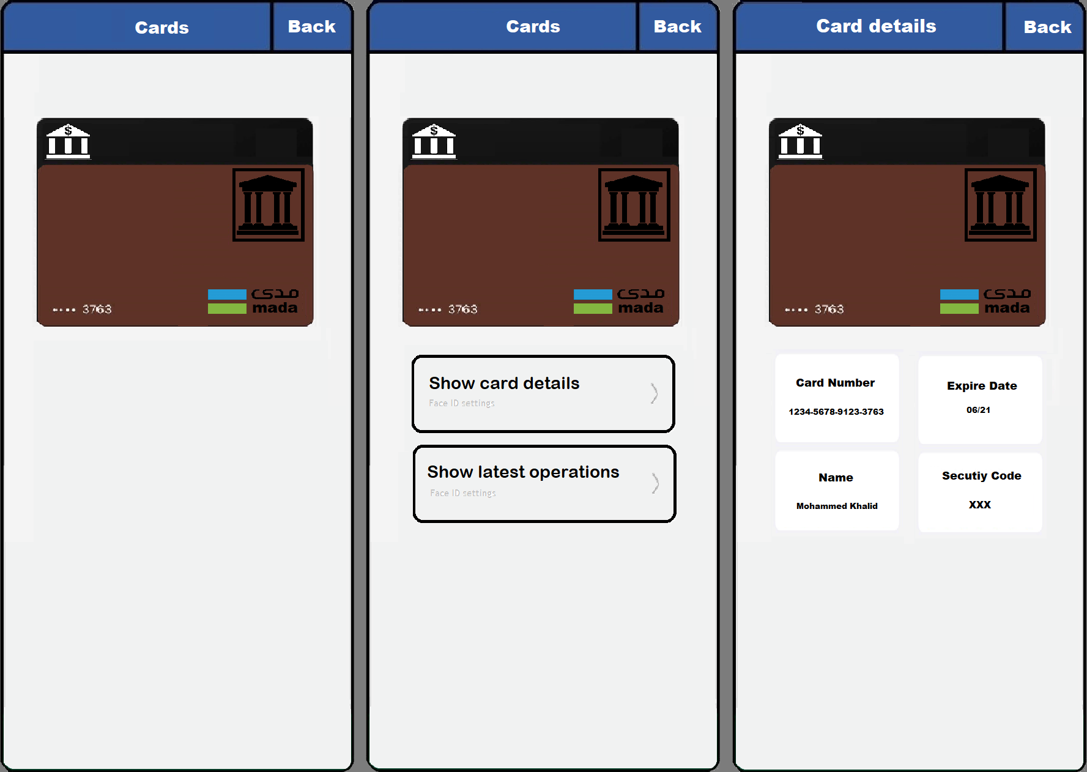
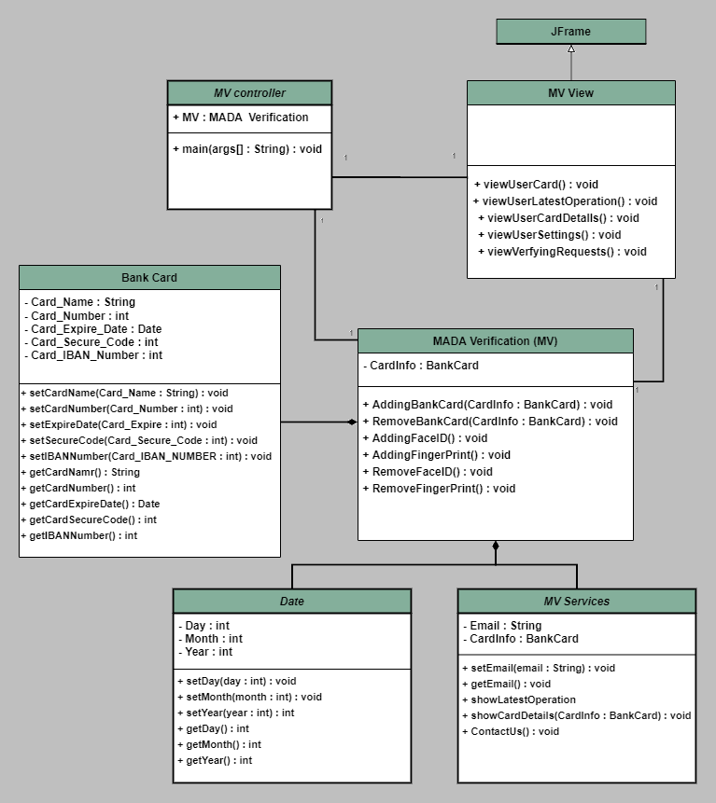
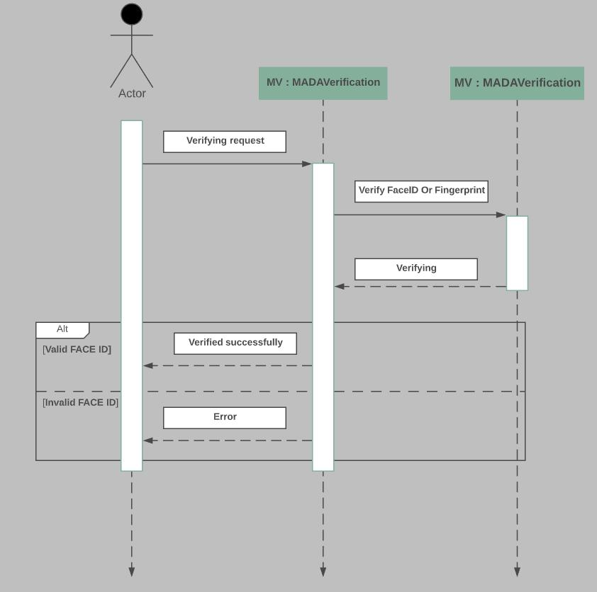
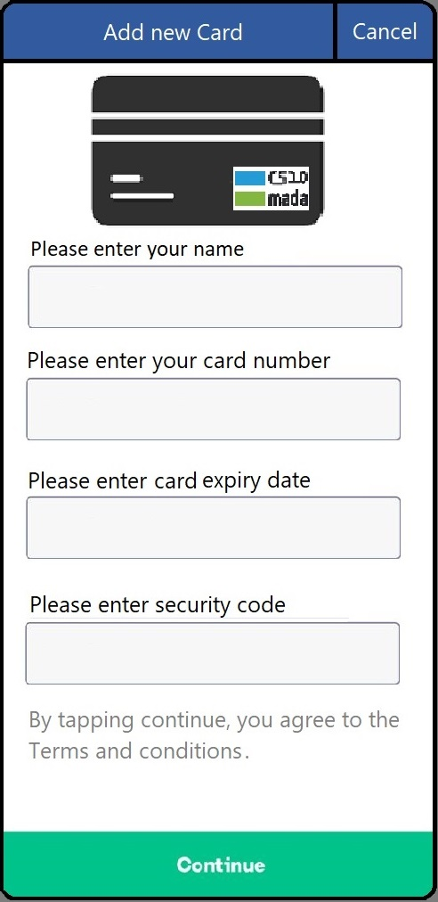
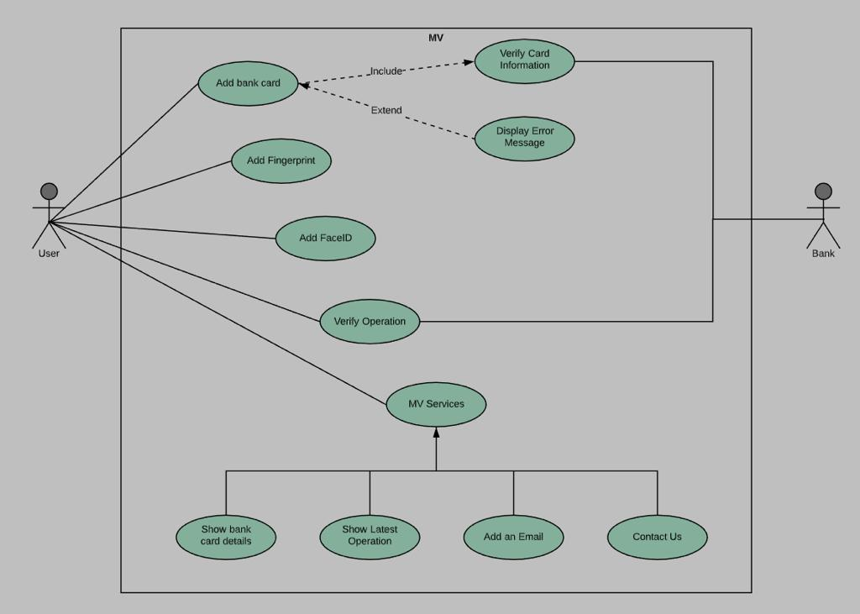
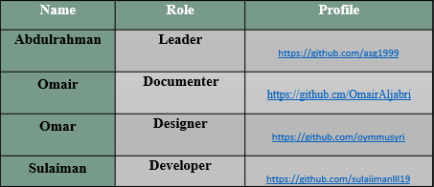



High-Level Design
Verify card information:
Conclusion
This step to ensure that the card information which entered by the user to add his bank card as shown in the figure is already exists in database.
MV
MADA-Verification
Show latest operation
Conclusion
Adding Bank Card
Interface
Mohammed
Mohammed
MV is new software to replace the old methodologies of verifying bank operations to a new modern method.
MV will have a secure environment to protect all the data and transactions of the users.
The app will be flexible to use, anyone who can use smartphones will understand the application within the first time.
Introduction:
MADA-Verification
1234-56789110-
1234-5678-9101-1121
Design
“MADA Verification” is a mobile application that helps the user to verify his bank operations smoother and quicker by using Face ID or fingerprint feature.
DEMO - PRESENTATION
Function-Requirements
01/23
01/23
Non-Function
CGF123
235
Functions
interface
Show card details
Introduction
Challenges
Team Members
Goals and Objective
Finally
Show latest operations
Show Card Details
Adding bank card
Why MV is important?
UML-Diagram
Show latest operation
UseCase-Diaram
Sequence-Diagram
Show card details
Adding bank card
Goals and objective
Team Members:
MV Controller:
The MV Controller Class is the class
who is responsible to run all the
tasks as a driver.
MV View: The MV View Class is the class who will displays the user actions.
1
2
3
Thank you for your attention
Any Questions?
We create MV to develop methods of verifying bank operations of local banks by using more advanced and fast methodologies, which are face ID and fingerprint.
Challenges and future work:
Bank Card:
The bank card class is the class who is responsible for create a new Card for user.
MADA Verification:
The MADA Verification Class is the class who is responsible for obtaining and arranging data from the database and using it on the program.
Date:
The Date Class is the class who is hold date settings.
MV Services:
The MV Services Class is the class
who is providing application services.
Adding bank card:
This function allows user to add his bank card into the application, then he will be able to use app features.
Show latest operation:
This function let you see your previous operations and its makes you aware of what verified.
Show card details:
This function allows you to see your card information except the CVV code for security issue
Develop the application on IOS and windows operating systems.
Expand the vision to make the software work with global banks
Raise the level of privacy for verifying banks operations.
Find an easy way to verify bank transactions.
Save time.
Repository of project:
https://github.com/asg1999/MV-verification.git

