Slide 1
Capstone Project - The Battle of Neighborhoods
Abdulrahman Falyoun

Slide 2
Introduction
Background: The most important thing that people concerns is their lives and their safety, so when moving to a new city, country you need to check if it's safe or not to live in.
Problem: This project aims to build a system where the citizen is able to select the safest borough in Chicago based on the total crimes between 2010 and 2018. The system also allows to explore the neighborhoods of that borough and find the 10 most common venues in each neighborhood and finally cluster the neighborhoods using k-mean clustering. This report will be targeted to people who are looking to relocate to Chicago We will focus on the safest borough so that any person can choose best neighborhood suited to him.
Interest: People who are looking to relocate to Chicago will be the targeted people, they will be able to identify the safest borough in Chicago and explore its neighborhoods and common venues around each neighborhood

Slide 3
Data Acquisition and cleaning
Acquiring data: The data used for this project is available through:
A scrapped wikipedia page that contains Chicago boroughs and some related information
List of neighborhoods acquired using foursquare for least crime rate borough
The Chicago crimes dataset from ibm box:
Https://ibm.box.com/shared/static/svflyugsr9zbqy5bmowgswqemfpm1x7f.csv.

Slide 4
Data cleaning: for each source there is a separate process of cleaning the data
For scrapped wiki page, we're gonna use the Beautiful Soup library in python.
For generating the location of neighborhoods around least crime borough rate, we're gonna use Forsquare API and Folium module to visualize the data within a map, as well as we're gonna use k means clustering algorithm to cluster similar neighborhoods together
For data available from ibm box, we're gonna use Panda, Numpy to get the needed table of crimes information, as well as we will use matplotlib for visualizaion process

Slide 5
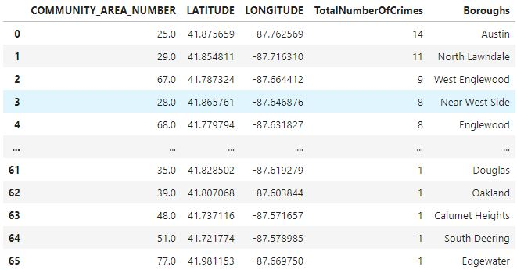
Methodology
Statical summary of crimes

Slide 6
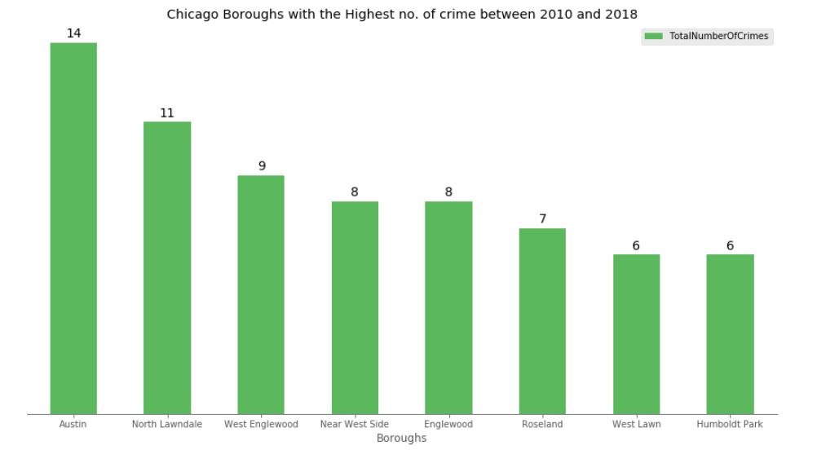
Boroughs with highest number of crime between 2010 and 2018

Slide 7
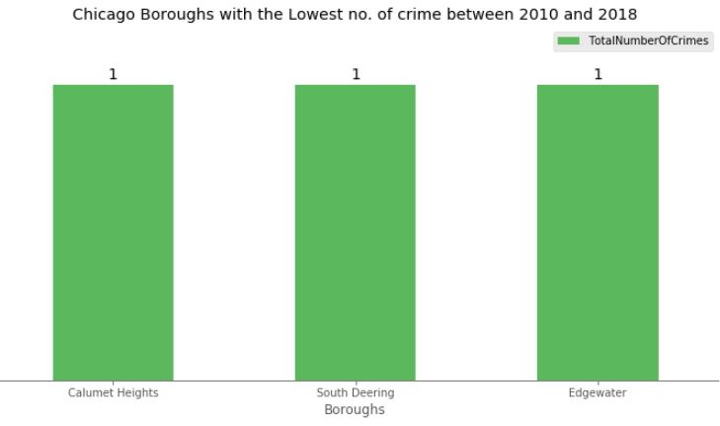
Boroughs with lowest number of crime between 2010 and 2018

Slide 8
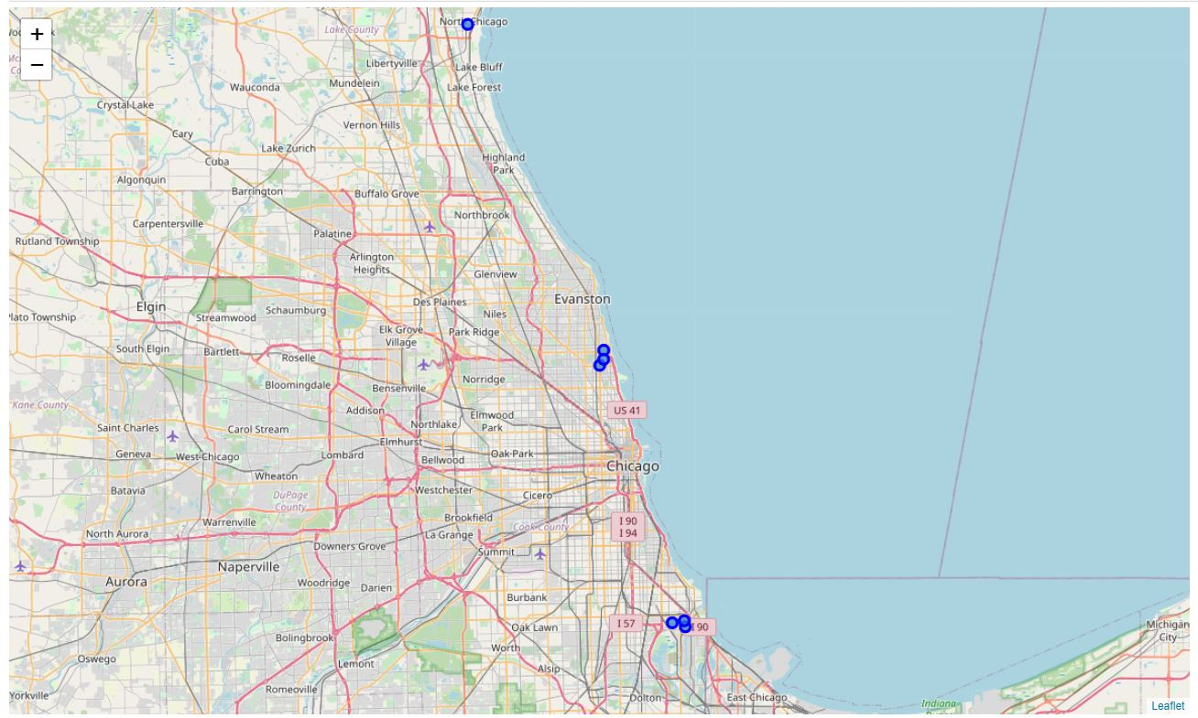
Neighborhoods around the least crime rate borough

Slide 9
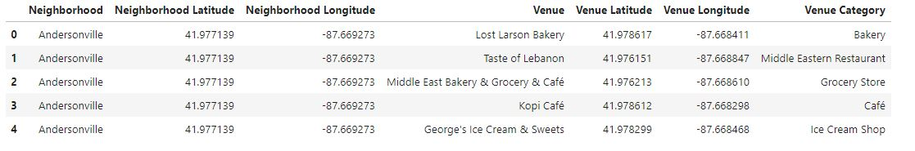
Modeling: After we obtained the safest neighborhoods, we can find all the venues within 500 meters radius of each neighborhood on its own by using Foursquare API.

Slide 10
One hot encoding is done on the venues data shown above in the table, the venues then are grouped by the neighborhood and the mean of the venues calculated, finally the 10 most common venues are calculated for each neighborhood.
K-Means is used to find similar neighborhoods in the safest borough, then clusters will be constructed

Slide 11
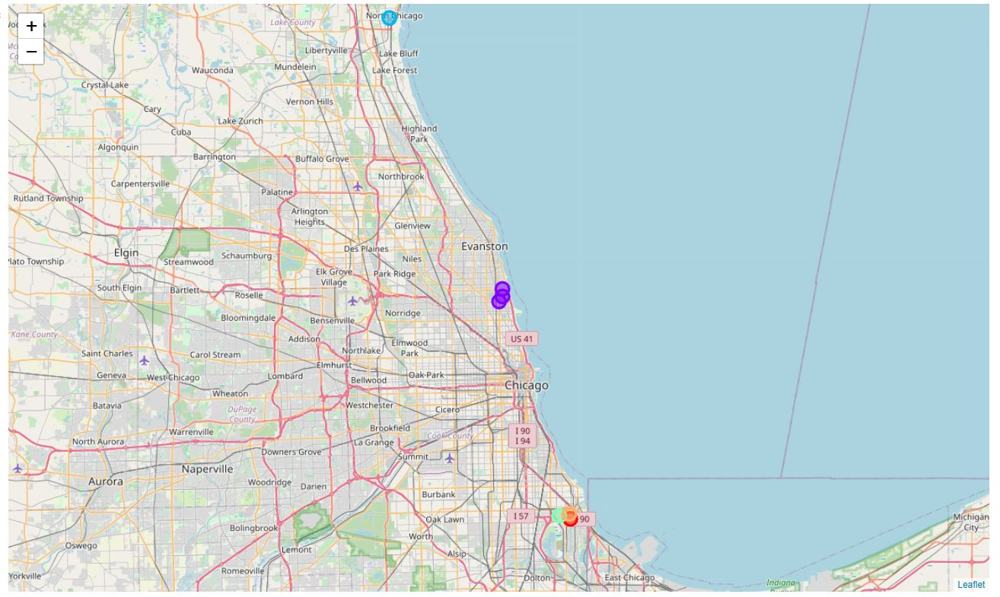
Result

Slide 12
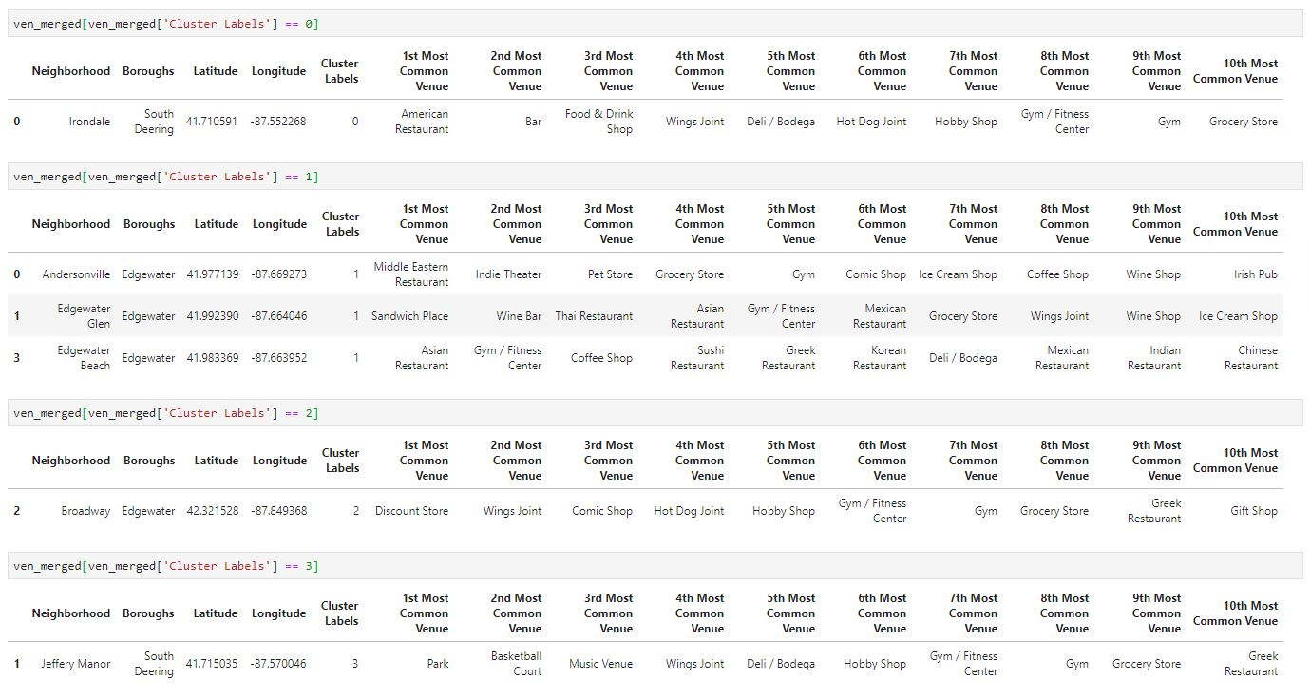
First three clusteres

Slide 13
Discussion
The system aims to help people who are looking to relocate to on of Chicago boroughs, so they can pick the safest borough, as well as they are able to pick the best venue fits to their needs, so people will look for each cluster and pick what they needs, for example:
If the person is looking for American restaurant he might pick the cluster with label 0
If the person is looking for sandwich place or Asian restaurant he might pick the cluster with label 1, etc...

Slide 14
Conclusion
The system enables people want to relocate to pick the safest borough in Chicago to live in, taking into consideration the top common venues in the safest areas.
The system was build using the factor as the total number of crimes happened in Chicage neighborhood between 2010 and 2018.

