Slide 1
PROJECT 06 · HEALTHCARE OPERATIONS ANALYTICS
Hospital Operations & Bed Utilisation
Where the beds go, why the emergency department waits, and who comes back — a SQL analysis of a 15-hospital network, calendar year 2025
15
1,178
85,198
174,761
hospitals
staffed inpatient beds
admissions
ED attendances
Synthetic data generated for this portfolio project · PostgreSQL-compatible schema, SQLite database, 10 SQL queries, Python notebook
Notes:
Project 06 of the health-analytics portfolio. Everything in this deck is produced from the ten SQL queries in sql/ run against a synthetic 15-hospital network. The data is synthetic but the operational mechanics (seasonality, escalation beds, weekend discharge slippage, exit block) are modelled so the patterns behave like a real extract.

Slide 2
02
NETWORK AT A GLANCE
The network sits on its 85% planning line — the pressure is concentrated
Five headline measures, 2025. Each is produced by one of the project's SQL queries.
85%
93%
4.4 d
80.2%
10.6%
inpatient bed occupancy
(planning target 85%)
General Medicine occupancy —
the largest specialty
average length of stay
(P90 9.3 days)
ED attendances completed
within 4 hours
30-day unplanned
readmission rate
Capacity
34% of ward-days at ≥95% occupancy; 5 hospitals run Medicine at ≥95% for the whole year.
Flow
Stays of 7+ days are 16% of discharges but 46% of bed-days; weekends discharge 37% fewer patients.
Emergency care
ED boarding rises from 18 to 176 minutes as hospital occupancy passes 95% — ward congestion is an ED problem.
Sources: queries 01, 03, 05, 07 (sql/sqlite, sql/postgres) · synthetic 15-hospital network, 2025
Notes:
Occupancy is the midnight census divided by staffed beds (query 01). LOS on 2025 discharges (query 03). ED four-hour rate from query 05. Readmissions: emergency re-admission within 30 days of a Jan–Nov discharge, excluding deaths and transfers (query 07).

Slide 3
03
BED OCCUPANCY · QUERY 01
Occupancy hugs 85% all year; winter and November push it towards 95%
Network inpatient occupancy, 7-day average (weekly points) · midnight census ÷ staffed beds
34%
of ward-days at or above the 95% no-slack line
22%
of ward-days with more patients than staffed beds
96.3%
network peak on 21 Dec, in the pre-Christmas flu surge
Query 01 · movement-based census: +1 on admission, −1 on discharge, running SUM() OVER (ORDER BY date); staffed beds from the slowly-changing bed_capacity table
Notes:
The network average looks healthy, but it averages over 108 wards. A third of ward-days are at or above 95% and over a fifth are above staffed capacity, meaning patients are in escalation spaces or outlying on other wards.

Slide 4
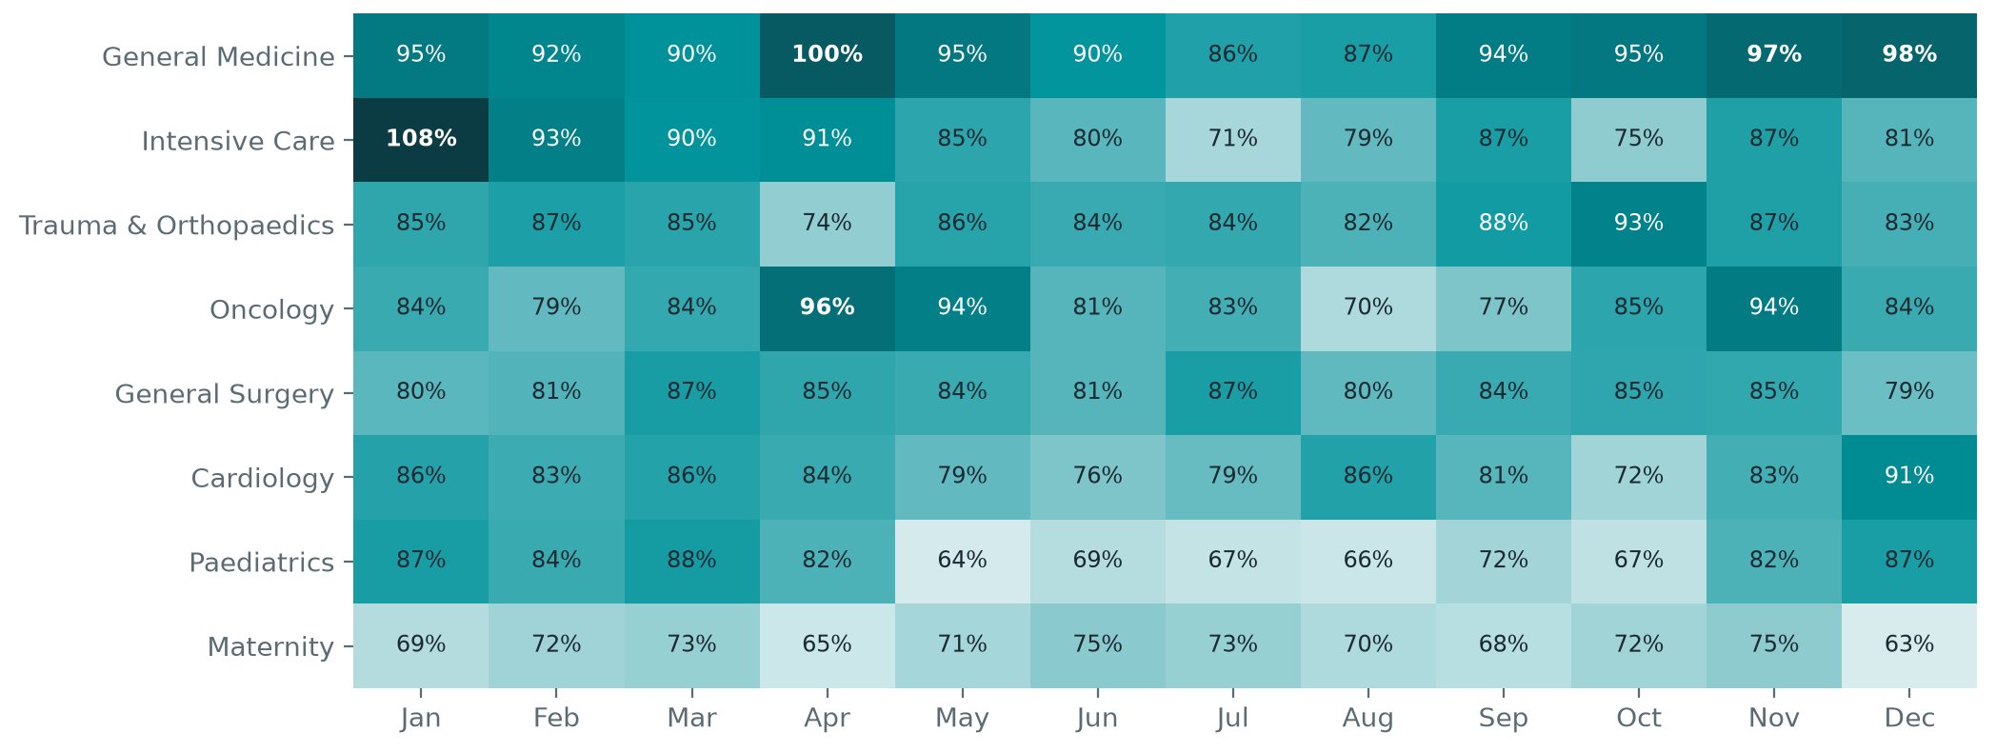
04
OCCUPANCY BY DEPARTMENT · QUERY 02
Medicine runs hot every month; capacity decisions show up in the data
Monthly bed occupancy by department, network total (bed-day weighted)
General Medicine
never below 86% in any month, and 5 hospitals average ≥95% across the year.
Escalation beds
closed on 31 March: Medicine jumped from 90% in March to 100% in April — demand had not fallen yet.
Intensive care
ran at 108% of staffed beds in the January flu surge.
Maternity and Paediatrics have seasonal slack that could flex to Medicine in summer.
Query 02 · RANK() within month, LAG() for month-on-month change, share of ward-days ≥85% / ≥95%
Notes:
The April jump is the clearest capacity-planning signal in the dataset: escalation beds were funded to 30 March, but the medical bed base needed them for several more weeks.

Slide 5
05
LENGTH OF STAY & DISCHARGE · QUERIES 03–04
Long stays fill the beds, and discharge stops at weekends
Left: mean vs P90 length of stay by department · right: average discharges per day of week, network
46%
9,230
37%
1.49×
of bed-days used by stays of 7+ days (16% of patients)
excess bed-days at QET and SAU vs specialty benchmark ≈ 25 beds
fewer discharges per weekend day than per weekday
Monday catch-up vs the Tue–Fri average
Query 03 · P90 via ROW_NUMBER()/COUNT() nearest rank (portable to SQLite) · Query 04 · stranded ≥7 days, super-stranded ≥21 days, PERCENT_RANK()
Notes:
P90 is roughly twice the mean in every specialty — the long tail, not the typical stay, drives bed demand. Excess bed-days are not case-mix adjusted; teaching hospitals take more complex patients, so treat this as where to look, not a verdict.

Slide 6
06
EMERGENCY DEPARTMENT · QUERIES 05–06
Harbourview's redesign moved its ED from +4% to −23% vs the network wait
Left: door-to-provider minutes, 4-week moving average (HBV rapid-assessment model live from 1 June) · right: share within 4 hours
Query 05 · 4-week AVG() OVER, LAG() week-on-week, FIRST_VALUE() baseline · Query 06 · waits for triage 3–5 peak at 18:00, hours after arrivals plateau
Notes:
Comparing Harbourview with the network week by week controls for the seasonal swing every ED shares. Before June it ran about 4% slower than the network; after the rapid-assessment model it ran about 23% faster. The three hospitals below the 78% four-hour standard are also the three fullest inpatient sites.

Slide 7
07
CAPACITY BOTTLENECKS · QUERY 09
Full wards back up into the ED: boarding is 10× longer at 95%+ occupancy
Left: median ED boarding (decision to admit → departure) by same-day hospital occupancy · right: tightest pinch points
Ward | Occupancy | Days ≥95% | Longest run | ED boarders >4h | Trolley waits >12h
CLR · MED | 99% | 220 | 27 days | 9.8% | 18
QET · MED | 97% | 214 | 26 days | 8.4% | 9
SLC · MED | 100% | 204 | 42 days | 9.0% | 12
WBG · ICU | 97% | 199 | 24 days | 3.2% | 0
CLR · ONC | 95% | 189 | 32 days | 7.7% | 0
RVG · MED | 95% | 188 | 24 days | 7.3% | 13
Ranked by bottleneck score = share of days at ≥95% × (1 + share of ED boarders waiting over 4 hours). Longest run found with gaps-and-islands (day number − ROW_NUMBER()).
Query 09 · critical-occupancy episodes via gaps-and-islands, DENSE_RANK() bottleneck order · boarding joined from er_visits to the admitting ward
Notes:
Four of the six tightest pinch points are Medicine wards. Every point of hospital occupancy above 90% adds sharply to boarding, which is why ED performance cannot be fixed inside the ED alone.

Slide 8
08
READMISSIONS · QUERIES 07–08
10.6% return as an emergency within 30 days — and the risk is predictable
Left: 30-day unplanned readmission rate by discharging hospital · right: highest-risk groups (relative risk vs network)
Left against medical advice
2.35×
Heart failure
2.17×
COPD exacerbation
1.88×
Hip fracture
1.87×
Chemotherapy complication
1.63×
Bowel obstruction
1.58×
12%
of readmissions land at a different hospital — invisible to single-site reporting
Query 07 · LEAD() over each patient's admissions across all hospitals · Query 08 · relative risk = level rate ÷ overall rate via window SUM()
Notes:
Community hospitals have the highest rates and teaching hospitals the lowest. Self-discharge, heart failure, COPD and hip fracture are the obvious targets for transitional-care calls, virtual wards and early follow-up clinics.

Slide 9
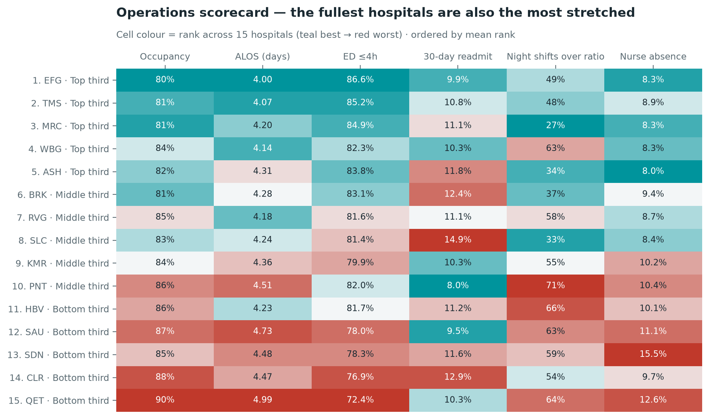
09
STAFFING & SCORECARD · QUERY 10
The fullest hospitals are the most stretched — rosters don't flex
Hospital operations scorecard: five KPIs ranked across 15 hospitals, NTILE(3) tiers
0.71
correlation between occupancy and night shifts over safe-staffing ratio
15.5%
nurse absence at SDN after second-half attrition — highest in the network
SDN · CLR · QET
bottom tier: high occupancy, long stays, ED below standard
Query 10 · night-shift patients per nurse = midnight census ÷ nurses on duty · RANK() per KPI, mean rank, NTILE(3)
Notes:
Rosters are built for planned occupancy, so every point of occupancy above plan lands on the same number of nurses. The scorecard ranks occupancy, ALOS, ED four-hour rate, readmission and staffing breaches; top tier: EFG, TMS, MRC.

Slide 10
10
RECOMMENDATIONS
Five moves to release beds and protect the front door
1
Plan Medicine capacity to demand, not the calendar
Hold winter escalation beds until the census falls below 90% instead of a fixed 31 March close; flex summer slack from Maternity and Paediatrics.
2
Make discharge a seven-day service
Weekend discharge teams and criteria-led discharge to lift the weekend ratio from 0.63 towards 0.85 and flatten the Monday surge.
3
Run long-stay reviews where the excess sits
Weekly 7+ day reviews at QET and SAU target ~25 beds of excess stay against specialty benchmarks.
4
Scale Harbourview's rapid-assessment model
Pilot at the three hospitals below the 78% four-hour standard; track door-to-provider weekly against the network, not the prior month.
5
Target transitional care and staff to the census
Follow-up within 72 hours for heart failure, COPD, hip fracture and self-discharge; report readmissions network-wide; set rosters from forecast census.
Next steps: case-mix adjusted LOS (expected LOS by diagnosis and age), daily census forecasting, and a live version of this scorecard on the warehouse.
Notes:
Each recommendation maps to a query: 1 → queries 01/02, 2 → query 04, 3 → query 03, 4 → queries 05/06/09, 5 → queries 07/08/10.

