Slide 1
PROJECT 05 · HEALTH INSURANCE ANALYTICS
Health Insurance Claims
& Fraud Signals
Payer efficiency, cost containment and claims integrity across two years of claims — SQL (SQLite) + Python
199,195
$116.4M
$50.8M
13.8%
claims, Jan 2024 – Dec 2025
billed charges
approved (allowed) amount
initial rejection rate
Synthetic dataset — 10,000 members · 1,200 providers · 19,854 policies. Built for portfolio demonstration.

Slide 2
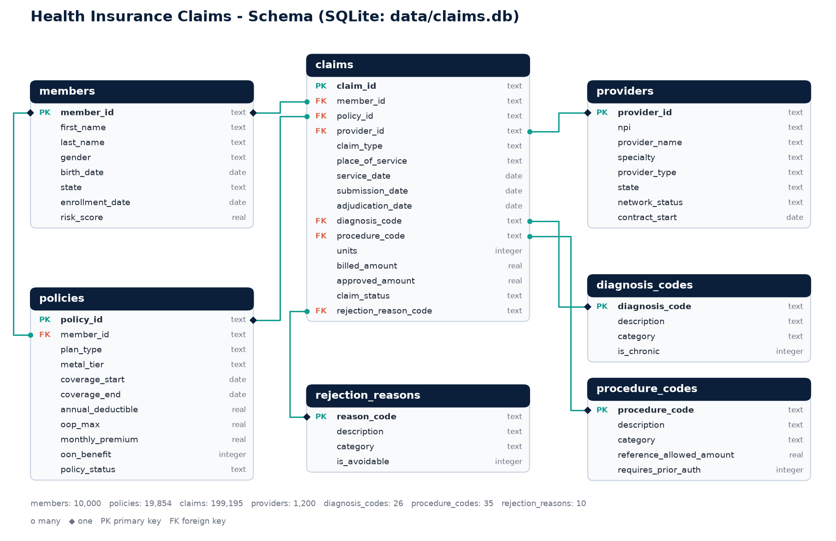
DATA & APPROACH
A 7-table claims warehouse and 12 SQL queries
Claims grain: one line per claim with ICD-10 dx, CPT/HCPCS px, billed vs approved, status, reason.
Dimensions: members, annual policies (HMO/PPO/EPO/HDHP), providers, code lookups, 10 denial reasons.
SQL toolkit: multi-step CTEs, joins, RANK / NTILE / PERCENT_RANK, LAG / rolling windows, window medians, recursive calendar.
Pipeline: Python generator → SQLite → .sql files → notebook charts → this deck.
2

Slide 3
PAYER EFFICIENCY · DENIALS
89% of denials were avoidable up front
27,412
claims rejected (13.8% of all claims)
89%
network, coding, missing info, duplicates, filing & eligibility — preventable
69%
of denials come from the top 3 reasons alone
3

Slide 4
PAYER EFFICIENCY · PROVIDERS
Network gaps and prior auth drive specialty denials
What the provider ranking shows
Network, not behaviour: all of the 25 providers furthest above their specialty rate are out-of-network, billing HMO/EPO members with no OON benefit.
Prior auth: drives 35% of General Surgery and 31% of Oncology denials.
Coding: the top driver for Cardiology, Behavioral Health, Neurology and Nephrology — a provider-education target.
4

Slide 5
PAYER EFFICIENCY · TURNAROUND
Adjudication time fell from 4.9 to 3.3 days
3d vs 15d
median days, approved claims: auto-adjudicated vs manual review
53%
of manual-review claims decided within 15 days — the bottleneck
98.0%
of all claims decided within 15 days (Nov 2025)
5

Slide 6
COST CONTAINMENT · CONDITIONS
Surgical and maternity episodes set cost per claim
Largest total spend
$8.9M
Gallstones
$7.8M
Tibia fracture
$4.3M
Knee osteoarthritis
$3.5M
Coronary artery disease
$3.2M
Concussion
Mean far above median (e.g. gallstones, tibia fracture) = cost driven by a few surgical episodes → site-of-care and prior-auth levers.
6

Slide 7
COST CONTAINMENT · MEMBERS & TREND
Top 10% of members drive 52% of spend
$28K
avg 2-yr spend, top-decile member
5
chronic dx (median) for top-50 members, median age 63
Jan
peak month: winter respiratory season + deductible reset
7

Slide 8
CLAIMS INTEGRITY · DUPLICATES & OUTLIERS
Near-duplicates slip past edits at 3x the rate
Billed-amount outliers
985
claims with |z| > 3 and ≥ 3x the procedure median, billing $6.7M
Fee schedule works: approved outliers paid only $111K — allowed amounts cap exposure in-network.
Real risk: outliers cluster in E&M codes at a few providers — a behavioural signal, not a typo.
11% vs 38%
$217K
paid-through rate: exact vs near duplicates
paid on exact + near duplicates — recoverable
8

Slide 9
CLAIMS INTEGRITY · PROVIDER SCORECARD
20 providers show 3+ red flags vs. peers
Provider | Specialty | Markup | % 99215 | Dup % | Flags | Score
Horizon Cardiology Assoc. | Cardiology | 3.2x | 70% | 12.3% | 4 | 99
Oakwood Endocrinology Assoc. | Endocrinology | 4.4x | 55% | 11.3% | 4 | 98
Dr. Nancy Wilson | Cardiology | 4.7x | 61% | 9.4% | 3 | 97
Unity Behavioral Health Assoc. | Behavioral Health | 5.3x | 68% | 10.0% | 4 | 96
Riverside Orthopedics Assoc. | Orthopedics | 5.0x | 54% | 9.8% | 4 | 96
Valley Internal Medicine Assoc. | Internal Medicine | 5.4x | 62% | 10.4% | 4 | 95
Horizon Internal Medicine Assoc. | Internal Medicine | 4.3x | 62% | 9.6% | 4 | 95
Dr. Barbara Young | Family Medicine | 4.8x | 67% | 9.5% | 4 | 94
4.4x
avg billed-to-reference markup (book ≈ 1.95x)
52%
of E&M visits coded 99215 (book ≈ 5%) — upcoding
$1.6M
approved to flagged providers — SIU review scope
Score = within-specialty PERCENT_RANK of markup (30%), duplicates (25%), 99215 share (20%), outliers (15%), claims per member (10%).
9

Slide 10
RECOMMENDATIONS
Three levers, sized from the data
1
Payer efficiency
2
Cost containment
3
Claims integrity
Front-end claim scrubber for coding & missing-info edits (40% of denials)
Steer HMO/EPO members to in-network care; fix directory accuracy
Gold-card high-approval providers to shrink the manual-review queue
Case management for the top decile (52% of spend), prioritising multi-morbid members
Site-of-care & prior-auth review for surgical episodes
Monthly PMPM trend monitoring with run-out-adjusted months
Add a ±5% tolerance band to the duplicate edit; recover paid duplicates
Refer the 20 flagged providers to SIU; pre-payment review on 99215
Productionise the scorecard as a monthly refresh
All figures from synthetic data; methods transfer directly to production claims warehouses.
10

