Slide 1
NILES 2026 · NILE UNIVERSITY, EGYPT
Edge-Efficient WiFi Indoor Localization via Lightweight Deep Learning and Knowledge Distillation
Abdulrahman M. A. Ebrahim · Ahmed E. A. Haggag · Fadwa Y. K. Mahmoud · Ehab H. Elshazly
Egypt-Japan University of Science and Technology (E-JUST), Alexandria, Egypt
Paper ID 1571324247
Notes:
Good morning. I'm presenting our paper on edge-efficient WiFi indoor localization: compressing the DLoc network into a model small enough for edge devices, without losing accuracy. I'll cover the problem, our method and data, then the results and what they mean. (~20 s)

Slide 2
OVERVIEW
Accurate indoor localization — light enough to deploy
01
Why it matters
02
The problem
03
Our approach
Hospitals, warehouses, and robots need indoor location. GPS fails indoors, and WiFi is already installed.
The most accurate WiFi localizers are large and computationally heavy — too heavy for the small everyday devices where localization is needed.
Build much smaller models and train them to imitate the large, accurate one — keep the accuracy, shed the weight.
The goal Keep accurate indoor localization, but make it light enough to run where it is needed — without giving up accuracy, reliability, or the ability to work in new environments.
NILES 2026 · Edge-Efficient WiFi Indoor Localization
Overview · 2
Notes:
Hospitals, warehouses and robots need indoor location. GPS fails indoors, and WiFi is already installed. The catch: the most accurate WiFi localizers are large and heavy — too heavy for the small everyday devices where we actually want localization. Our approach is to build much smaller models and train them to imitate the large, accurate one — keeping the accuracy while shedding the weight. (~40 s)

Slide 3
PART 1
The Problem & DLoc
Why indoor localization is hard — and how DLoc solves it, at a cost.
Notes:
Presenter handoff point. Part 1: the problem and the DLoc baseline.

Slide 4
INTRODUCTION
From a WiFi signal to a location
Each access point measures Channel State Information (CSI) — the complex channel per subcarrier and antenna. Phase carries the geometric cues:
Phase across antennas
Phase across subcarriers
→ angle of arrival (AoA)
→ time of flight (ToF)
Indoors the signal bounces: multipath & non-line-of-sight (NLOS) break classical geometry.
Unsynced clocks add an unknown ToF offset that shifts each AP's estimate by 10–15 m.
The four APs therefore disagree — a learned model has to reconcile them.
NILES 2026 · Edge-Efficient WiFi Indoor Localization
Introduction · 4
Notes:
How do you get location from a WiFi signal? The CSI encodes angle through phase across antennas, and travel time through phase across frequencies. The hard part: indoor multipath and non-line-of-sight, plus an unknown clock offset that moves each AP's estimate by up to 15 meters. So the four APs disagree, and a learned model reconciles them where classical geometry fails. (~50 s)

Slide 5
DLOC
DLoc: localization as image translation
Turn each AP's CSI into a 2-D heatmap over the floor, then learn to translate the 4-channel image into one clean location heatmap. The brightest pixel is the answer.
Raw CSI
4 APs
AoA–ToF
profiles
4-channel image
4×161×361
Neural
network
Location heatmap
1×161×361
arg max
→ (x, y)
Grid: 0.1 m / pixel (16.1 m × 36.1 m floor). Target: a Gaussian bump at the true location. Output: peak of the predicted heatmap.
NILES 2026 · Edge-Efficient WiFi Indoor Localization
DLoc · 5
Notes:
DLoc's key idea is to treat this as image-to-image translation. Each AP's signal becomes a heatmap over the floor; stack four of them into an image; the network outputs one clean heatmap; the peak is the predicted location at 0.1-meter resolution. This framing is central — four of our five models accept it, and the one that doesn't, fails. (~45 s)

Slide 6
DLOC
One encoder, two decoders
Shared ResNet encoder
The location decoder produces the heatmap we read at inference.
The consistency (offset) decoder forces the four APs to agree — its job at training time.
In doing so it removes the clock offset, resolves multipath (picks the direct path) and sharpens low-bandwidth inputs.
One AP can't fix itself; four mutually consistent APs can.
Res ×2 · 64
Location decoder
↓ Res · 128
heatmap · read at inference
Input
4×161×361
↓ Res · 256
↓ Res · 512
features
Consistency decoder
4 AP maps · training only
NILES 2026 · Edge-Efficient WiFi Indoor Localization
DLoc · 6
Notes:
Architecturally DLoc is an encoder with two decoders. A shared ResNet encoder feeds a location decoder — that's the heatmap we use — and a consistency decoder, which is DLoc's clever bit: it forces the four AP maps to agree, and in doing so it learns to remove the clock offset, resolve multipath and sharpen low-bandwidth inputs. One AP can't fix itself; four mutually consistent APs can. Remember the consistency decoder — it comes back with the reflector session. (~50 s)

Slide 7
DLOC
Accurate — but too heavy for the edge
16.5M
81 G
271 ms
0.71 m
parameters
FLOPs / inference
CPU latency
median error (our teacher;
paper: 0.64 m)
Our central question
Is this cost inherent to the problem — or is DLoc simply over-parameterized?
NILES 2026 · Edge-Efficient WiFi Indoor Localization
DLoc · 7
Notes:
DLoc is accurate — sub-meter — but it's 16.5 million parameters and a quarter-second per prediction on a CPU. The 0.71 m here is our own reproduction of DLoc, the checkpoint we use as the teacher; the original paper reports 0.64 m. Either way, that cost is a non-starter for edge devices. So our central question: is that cost inherent to the problem, or is DLoc simply over-parameterized? (~40 s)

Slide 8
OUR METHOD
Two levers: architecture & distillation
DLoc teacher
(frozen, 16.5M)
Soft heatmap y_T
cached once
distilled only
Input
4 AoA–ToF maps
L = 0.7·MSE(ŷ, y)
+ 0.3·MSE(ŷ, y_T)
Student
(lightweight)
Prediction ŷ
Ground truth y
Standalone: β = 0 — ground truth only. Distilled: α = 0.7, β = 0.3. Deployed: the student alone.
NILES 2026 · Edge-Efficient WiFi Indoor Localization
Our method · 8
Notes:
Our two levers are architecture and knowledge distillation. The frozen DLoc teacher sees the same input as the student; we run it once over the whole dataset and cache its soft heatmaps, so it never runs while students train. Each student is trained two ways: standalone, on the ground truth only, and distilled, where 30% of the loss pulls it toward the teacher's heatmap. The teacher's heatmap is already soft — probability spread around the location — so distillation acts as spatial label smoothing. As you'll see, that buys robustness in specific cases, not clean accuracy. (~50 s)

Slide 9
PART 2
Our Models
Four lightweight students — from a sequence model to a U-Net — each a different bet on architecture.
Notes:
Presenter handoff. Part 2: the four student architectures we built, from the simplest to our best.

Slide 10
MODEL 1 / 4
Mamba — a selective state-space model (0.65M)
ENCODE
SSM CORE
DECODE
Decoder
Head
Stem
Tokenize
Core ×4
Reshape
Conv(4→32)
Conv(32→64, s=2)
Conv(64→128, s=2)
flatten spatial
→ sequence
LayerNorm →
Mamba (S6) →
residual
sequence
→ spatial
interpolate →
Conv(128→64)
Conv(64→32)
Conv 1×1 (32→1)
sigmoid
[128,41,91]
[3731,128]
[3731,128]
[128,41,91]
[32,161,361]
[1,161,361]
h_{t} = Ā h_{t−1} + B̄ x_{t} y_{t} = C h_{t}
The catch
h_{t} memory (keeps updating) · x_{t} token · y_{t} output · Ā forget/remember matrix · B̄ input matrix (how important the input is)
Flattening the 2-D map into a 1-D scan destroys spatial locality — floor neighbours end up far apart in a 3,731-token sequence. Training and test error rise together from epoch 1 — it never fits, so not overfitting. 2-D multi-direction scans (VMamba) untested.
NILES 2026 · Edge-Efficient WiFi Indoor Localization
Models · 10
Notes:
Our first student is Mamba. A convolutional stem downsamples the 4-channel input to 128 channels on a 41 by 91 grid. We flatten that grid into a sequence of 3,731 tokens and pass it through four blocks of LayerNorm, a Mamba selective-scan layer and a residual, then reshape and decode to the full heatmap. Inside each Mamba layer the state h is a memory that keeps updating: A-bar decides what to forget or remember, B-bar how much the new token matters, and C reads the output. The catch: we flatten with a single raster scan, so floor neighbours end up far apart in the sequence. Its training and test error both rise from the first epoch — it never fits the training set — so this is a mismatch, not overfitting. We did not try 2-D multi-direction scans like VMamba; that's the obvious next test. (~55 s)

Slide 11
MODEL 2 / 4
TinyCNN — the minimal baseline (47K)
ENCODER
DECODER
Dec 2
Head
Enc 1
Enc 2
Enc 3
Dec 1
Conv(4→16), BN, ReLU
DWS(16→16)
MaxPool ×2
DWS(16→32)
DWS(32→32)
MaxPool ×2
DWS(32→64)
ConvTranspose
(64→32, s=2)
ConvTranspose
(32→16, s=2)
Conv 1×1
(16→1)
[16,H/2,W/2]
[32,H/4,W/4]
[64,H/4,W/4]
[32,H/2,W/2]
[16,H,W]
[1,161,361]
The design
Why we tried it
DWS = depthwise-separable convolution: a per-channel 3×3 conv followed by a 1×1 conv — far fewer weights than a full conv.
A deliberate floor probe: how small can the network get before it stops working? By far the lowest capacity.
NILES 2026 · Edge-Efficient WiFi Indoor Localization
Models · 11
Notes:
Second student, TinyCNN — the smallest network we could build that still maps the input to a heatmap. Three encoder stages use depthwise-separable convolutions, DWS, with two max-pools, taking the input down to a quarter resolution with 64 channels. Two transposed convolutions bring it back to full resolution, and a 1×1 convolution gives the heatmap. Block heights here show the spatial resolution. It's a deliberate floor probe: how small can the network get before accuracy falls apart? (~40 s)

Slide 12
MODEL 3 / 4
MobileNetV2 — an efficient encoder–decoder (2.27M)
ENCODER
DECODER
OUTPUT
Input
Decoder 3
Head
Resize
Decoder 1
Decoder 2
Encoder
4-channel
heatmap
MobileNetV2
backbone
(4→320)
Upsample, Conv
BN, ReLU
Upsample, Conv
BN, ReLU
Upsample, Conv
BN, ReLU
Conv 1×1
sigmoid
bilinear
interpolation
[4,161,361]
320 ch
320→128
128→64
64→32
32→1
[1,161,361]
Inverted residual: narrow → wide → narrow
The catch
1×1 expand
3×3 depthwise
1×1 project
No skip connections — every bit of spatial detail must squeeze through the bottleneck. The next model fixes exactly this.
NILES 2026 · Edge-Efficient WiFi Indoor Localization
Models · 12
Notes:
Third student, MobileNetV2. The encoder is a MobileNetV2 backbone with its first layer adapted to the 4-channel input, going from 4 to 320 channels. Its inverted residual blocks go narrow, wide, narrow: expand with a 1×1, filter with a cheap depthwise 3×3, then project back down. Three decoder blocks — each upsample, convolution, batch-norm, ReLU — go 320 to 128 to 64 to 32, a 1×1 convolution with sigmoid gives one channel, and a bilinear resize returns the full 161 by 361 heatmap. The catch: no skip connections, so all the spatial detail must pass through the narrow bottleneck. (~45 s)

Slide 13
MODEL 4 / 4 · OUR MAIN MODEL
MobileNetV2-UNet — the same encoder, plus skips (2.41M)
Input 4×161×361
Output 1×161×361
The design
inc 4→32 /2
head 32→1
sigmoid
Same encoder, plus U-Net skips that concatenate encoder features into the decoder: 416 = 320+96, 160 = 128+32, 88 = 64+24.
enc1 · 24
skip 24
dec3 88→32
enc2 · 32
skip 32
dec2 160→64
Why it matters
enc3 · 96
skip 96
dec1 416→128
In localization the spatial detail is the answer — the skips carry it straight past the bottleneck. Our main model.
enc4 · 320 (bottleneck)
MobileNetV2 encoder (pretrained, 4-ch input)
U-Net decoder (upsample + skip concat)
NILES 2026 · Edge-Efficient WiFi Indoor Localization
Models · 13
Notes:
Our fourth student is the hero: the same MobileNetV2 encoder plus U-Net skip connections. The input stem halves the resolution and goes 4 to 32 channels; four encoder stages produce 24, 32, 96 and 320 channels. On the way up, each decoder stage upsamples and concatenates the matching encoder features — that's why decoder 1 takes 416 channels, 320 plus 96; decoder 2 takes 160, 128 plus 32; decoder 3 takes 88, 64 plus 24. A 1×1 head with sigmoid outputs the 161 by 361 heatmap. In localization the spatial detail is the answer, and the skips carry it straight past the bottleneck. (~50 s)

Slide 14
PART 3
Data, Experiments & Results
The dataset and setup behind every run — then what the models actually achieved.
Notes:
Presenter handoff. Part 3: the data, how we ran the experiments, and the results.

Slide 15
DATASET
WILD: real measurements with ground truth
WILD — the public dataset released with DLoc (UC San Diego).
Collected by MapFind, a TurtleBot2 robot with LIDAR, an RGB-D camera and a Quantenna WiFi card, driving at 15 cm/s.
Ground truth from SLAM (Simultaneous Localization and Mapping), RTAB-Map: median error ≈ 5.7 cm; CSI logged every 50 ms.
CSI + SLAM position = one labelled example; ~100k points in total.
The space we use
4-AP Jacobs Hall
1,500 sq ft. AP 4 is hidden behind a wall (strong NLOS), and a wall of plasma screens behind AP 3 creates rich multipath.
NILES 2026 · Edge-Efficient WiFi Indoor Localization
Dataset · 15
Notes:
The data is WILD, released with DLoc. It was collected by a robot called MapFind — a TurtleBot with LIDAR, a camera, and a WiFi card — that drives the space slowly while SLAM, simultaneous localization and mapping, gives it ground-truth position to about 5.7 centimeters. So every example is real CSI paired with an accurate label. We use the harder four-AP Jacobs Hall space, where one AP is behind a wall and plasma screens create heavy multipath. (~50 s)

Slide 16
DATASET
Five sessions — increasing difficulty
Session | Tag | Samples | Condition
1 | jacobs_Jul28 | 7,635 | training (reference conditions)
2 | jacobs_Jul28_2 | 9,939 train + 4,260 test | in-distribution test (1 h later, identical)
3 | jacobs_Aug16_1 | 11,201 | furniture rearrangement
4 | jacobs_Aug16_3 | 8,754 | different furniture configuration
5 | jacobs_Aug16_4_ref | 5,486 | aluminum reflector (specular multipath)
NILES 2026 · Edge-Efficient WiFi Indoor Localization
Dataset · 16
Notes:
There are five sessions. Sessions 1 and 2 are the same room an hour apart. Session 1 plus the training part of session 2 give 17,574 training samples; 4,260 samples of session 2 are held out for testing. Sessions 3 to 5 were collected three weeks later: furniture rearranged, a different furniture configuration, and in session 5 an aluminium reflector that creates specular multipath — the hardest case. (~40 s)

Slide 17
EXPERIMENTAL SETUP
The six experiments — and why each split
# | Experiment | Training data | Tested on | Why this split
1 | In-distribution accuracy | Sess 1 + 2-train (17,574) | Sess 2 held-out (4,260) | accuracy of every model
2 | Robustness | same as #1 | Sess 2, corrupted at test time | deployed robustness — no retraining
3 | Cross-session (LOSO) | 3 setups (leave one Aug out) | held-out Aug session | DLoc's own protocol — fair comparison
4 | Zero-shot | July sessions | Aug sessions 3–5 | harder shift — internal ablation
5 | Multi-seed stability | DLoc ×3 seeds (same as #1) | Sess 2 held-out | how much seeds move the median
6 | Efficiency | — (trained models) | batch-1 FLOPs & latency | edge-deployment cost
NILES 2026 · Edge-Efficient WiFi Indoor Localization
Setup · 17
Notes:
These are the six experiments in the results, in order. In-distribution accuracy and robustness both use the session-1-plus-2 split; robustness just corrupts the input at test time, no retraining. Cross-session uses leave-one-session-out — DLoc's own published protocol, so the comparison is fair — standalone only, because distilling would need a new teacher per fold. Zero-shot trains on the July sessions only and tests on August — an internal ablation. Multi-seed retrains DLoc three times to measure seed noise. Efficiency is measured at batch size 1. (~50 s)

Slide 18
RESULTS
All five, side by side
Model | Params | Compr. | Median (m)
DLoc (teacher, our repro) | 16.5M | 1× | 0.707
MobileNetV2 | 2.27M | 7.2× | 0.707
TinyCNN | 47K | 351× | 3.922
MobileNetV2-UNet | 2.41M | 6.8× | 0.640
Mamba | 0.65M | 25× | 10.56
NILES 2026 · Edge-Efficient WiFi Indoor Localization
Results · 18
Notes:
All five together. Both axes are logarithmic, which spreads the five models out instead of collapsing into one blob. Lower-left is better. MobileNetV2 and the U-Net nearly overlap (same size class, near-identical accuracy), far from DLoc. Going from DLoc to MobileNetV2 removes 86% of the parameters without moving the median; TinyCNN strips too much; the U-Net adds the right structure and is the best of all; Mamba changes the framing and breaks despite being mid-sized. (~40 s)

Slide 19
RESULTS · EXPERIMENT 1 / 6
In-distribution accuracy
Model | Params | Mode | Median (m) | P90 (m) | P99 (m)
DLoc (published) | 16.5M | — | 0.640 | 1.6 | 3.2
DLoc teacher (our reproduction) | 16.5M | — | 0.707 | — | —
MobileNetV2 | 2.27M | Standalone | 0.707 | 1.616 | 3.992
MobileNetV2 | 2.27M | Distilled | 0.707 | 1.612 | 4.003
TinyCNN | 47K | Standalone | 3.922 | 13.919 | 23.244
TinyCNN | 47K | Distilled | 3.706 | 14.784 | 25.101
MobileNetV2-UNet | 2.41M | Standalone (Cosine) | 0.640 | 1.523 | 2.750
MobileNetV2-UNet | 2.41M | Standalone (Step) | 0.640 | 1.552 | 2.918
MobileNetV2-UNet | 2.41M | Distilled (Cosine) | 0.640 | 1.513 | 2.587
Mamba | 0.65M | Standalone | 10.56 | 20.0 | 28.3
NILES 2026 · Edge-Efficient WiFi Indoor Localization
Results · 19
Notes:
Experiment one, on the held-out session. Two DLoc rows: the published result, 0.64 m, and our own 50-epoch reproduction, 0.707 m, which is the checkpoint we use as the teacher. MobileNetV2 lands on the same median as our teacher at 7 times fewer parameters. TinyCNN at 47K is five times worse. The U-Net reaches 0.640 — level with the published DLoc and three grid steps below our teacher — and distillation trims its P99 from 2.750 to 2.587. Mamba fails at 10.56 m. One caveat on the identical medians — next slide. (~45 s)

Slide 20
RESULTS · EXPERIMENT 1 / 6
Read the medians on a 0.1 m grid
The prediction is the arg-max pixel on a 0.1 m grid, so every error is 0.1 · √n m for an integer n. Near our results, a median can only be:
U-Net 0.640
DLoc teacher · MobileNetV2 0.707
0.600
0.608
0.632
0.640
0.671
0.700
0.707
0.721
0.728
Identical medians = same grid value, not identical models — MobileNetV2 vs teacher, cosine vs step, standalone vs distilled.
U-Net vs our teacher: 3 grid steps (0.067 m). That is why we also report P90 / P99.
Mean error is continuous: normal-condition mean 0.851 m (U-Net) vs 0.900 m (MobileNetV2). No mean is available for the DLoc teacher.
NILES 2026 · Edge-Efficient WiFi Indoor Localization
Results · 20
Notes:
One honest caveat about every median in this talk. The prediction is the arg-max pixel, and pixels are 0.1 m apart, so every error is 0.1 times the square root of an integer. These are the only values a median can take near our results: 0.640, 0.671, 0.700, 0.707. So 'MobileNetV2 equals DLoc', 'both schedulers give the same median' and 'standalone equals distilled' mean the same grid value — not identical models. The U-Net's gain over our teacher is three grid steps, 0.067 m. That's why we always show P90 and P99 too, and why mean error — which is continuous — is useful: in the robustness runs the U-Net's mean under normal conditions is 0.851 m versus 0.900 m for MobileNetV2. We don't have a mean for the DLoc teacher, and sub-pixel peak refinement is on our list. (~50 s)

Slide 21
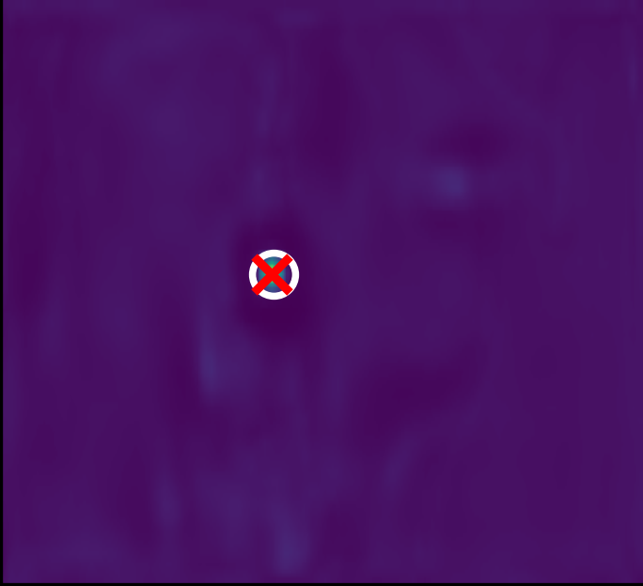
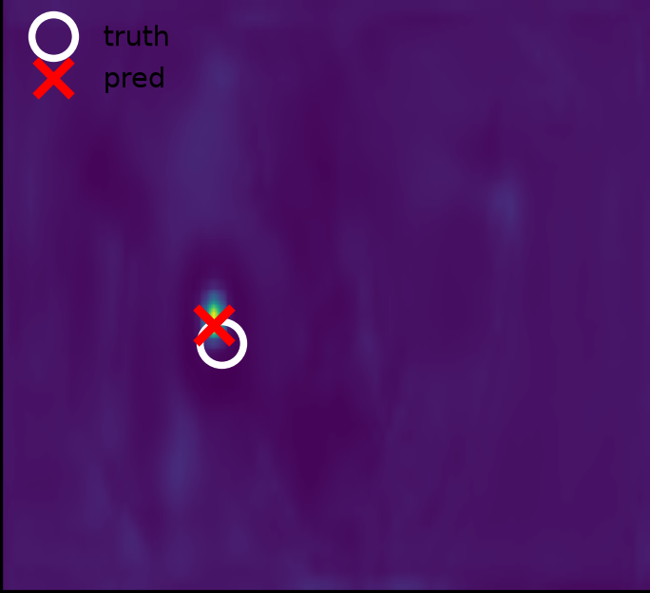
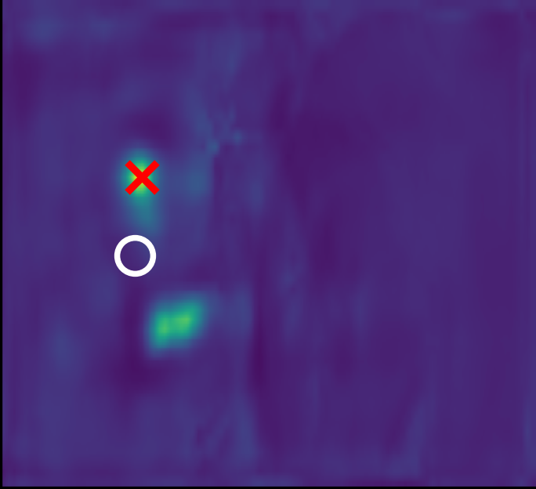
RESULTS · EXPERIMENT 1 / 6
What the U-Net predicts — in distribution
Best · err = 0.10 m
Median · err = 0.64 m
Failure · err = 2.65 m
○ truth ✕ prediction. One tight peak in most samples; large errors come from a second bright region winning the arg-max.
NILES 2026 · Edge-Efficient WiFi Indoor Localization
Results · 21
Notes:
Actual predicted heatmaps from the U-Net on the held-out session: a near-perfect sample, a typical one at the median, and a failure. White circle is the truth, red cross the prediction. Most heatmaps have one tight peak. The large errors happen when a second bright region wins the arg-max — you can see it in the right-hand tile. (~30 s)

Slide 22
RESULTS · EXPERIMENT 1 / 6
Learning-rate scheduler study
Scheduler | Mode | Median (m) | P90 (m) | P99 (m)
Cosine annealing | Standalone | 0.640 | 1.523 | 2.750
Step decay | Standalone | 0.640 | 1.552 | 2.918
Both land on the same 0.640 m grid value — not proof of the same model.
Cosine only trims the tail: P90 1.523 vs 1.552 m, P99 2.750 vs 2.918 m.
Architecture dominates, not the scheduler.
NILES 2026 · Edge-Efficient WiFi Indoor Localization
Results · 22
Notes:
The scheduler study — this one's quick. Cosine and step both reach the exact same 0.640 median — the same 0.1 m grid value, which is not proof they're identical; cosine gives a slightly tighter tail. The scheduler is a second-order knob; architecture is what moves the needle. (~20 s — can skip under time pressure)

Slide 23
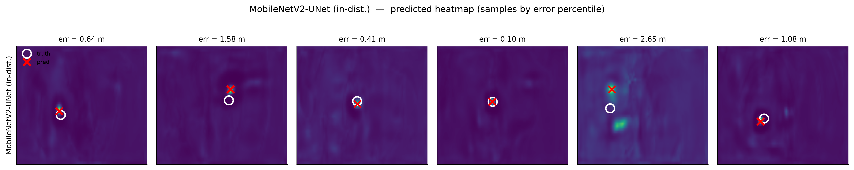
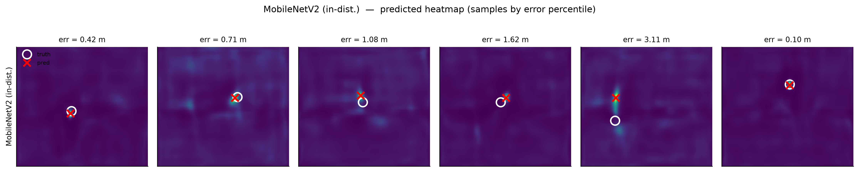
RESULTS · EXPERIMENT 1 / 6
Predicted heatmaps — full strips, in distribution
MobileNetV2-UNet (white circle = truth, red cross = prediction).
MobileNetV2.
NILES 2026 · Edge-Efficient WiFi Indoor Localization
Results · 23
Notes:
Backup: six samples per model across the error percentiles. U-Net and MobileNetV2 both produce single, tight peaks in distribution.

Slide 24
RESULTS · EXPERIMENT 2 / 6
Robustness under signal degradation
Model | Mode | Median (m) | P90 (m)
MobileNetV2 | Standalone | 16.368 | 20.939
MobileNetV2 | Distilled | 4.769 | 12.310
TinyCNN | Standalone | 9.457 | 17.049
TinyCNN | Distilled | 9.439 | 16.568
MobileNetV2-UNet | Standalone | 3.000 | 8.310
MobileNetV2-UNet | Distilled | 3.469 | 10.473
Skips and distillation are two different mechanisms — complementary, not additive.
3.4×
distillation rescues MobileNetV2
5.5×
skips alone vs. plain MobileNetV2
NILES 2026 · Edge-Efficient WiFi Indoor Localization
Results · 24
Notes:
Experiment two, robustness — we corrupt the input at test time, no retraining, to mimic deployment. This is the Gaussian-noise summary. Plain MobileNetV2 collapses to 16.4 m; distillation holds it at 4.8 — 3.4 times better. The U-Net's skips hold it at 3.0 on their own — 5.5 times better. TinyCNN is around 9.4 m either way: distillation doesn't help a model this small. The next slide gives the full U-Net table; MobileNetV2's is in the backup. (~45 s)

Slide 25
RESULTS · EXPERIMENT 2 / 6
Robustness — MobileNetV2-UNet (2.41M)
Condition | Standalone (Cosine) |  |  |  | Distilled (Cosine)
 | Med. | P90 | P99 | Mean | Med. | P90 | P99 | Mean
Normal | 0.640 | 1.581 | 3.651 | 0.851 | 0.640 | 1.513 | 3.587 | 0.829
Noise σ=0.1 | 3.000 | 8.310 | 13.873 | 3.878 | 3.469 | 10.473 | 18.261 | 4.678
Noise σ=0.2 | 5.741 | 10.645 | 18.137 | 6.050 | 5.320 | 12.003 | 17.948 | 6.135
Random 2-AP dropout | 3.324 | 13.012 | 22.080 | 5.228 | 2.730 | 8.203 | 13.396 | 3.711
Atten. 0.5× | 1.077 | 4.200 | 15.963 | 1.932 | 1.105 | 3.984 | 11.729 | 1.795
Blur k=5 | 0.671 | 1.603 | 3.716 | 0.859 | 0.656 | 1.526 | 3.943 | 0.841
Skips win noise (3.00 m standalone; distillation adds nothing). Distillation wins AP dropout (median 3.32 → 2.73 m, P99 22.1 → 13.4 m).
NILES 2026 · Edge-Efficient WiFi Indoor Localization
Results · 25
Notes:
Our U-Net in full. Three cells to look at. Its skips already give it the best noise robustness standalone — 3.0 m at sigma 0.1 — and distillation does not add to that; it actually gets a little worse, 3.47. But under random 2-AP dropout distillation is what helps: median 3.32 down to 2.73, and P99 from 22 down to 13.4 metres. Skips for noise, distillation for dropout. (~30 s)

Slide 26
RESULTS · EXPERIMENT 2 / 6
Robustness — MobileNetV2 (2.27M)
Condition | Standalone |  |  |  | Distilled
 | Med. | P90 | P99 | Mean | Med. | P90 | P99 | Mean
Normal | 0.707 | 1.616 | 3.992 | 0.900 | 0.707 | 1.612 | 4.003 | 0.896
Noise σ=0.1 | 16.368 | 20.939 | 25.196 | 16.557 | 4.769 | 12.310 | 21.122 | 5.953
Noise σ=0.2 | 16.307 | 20.748 | 25.188 | 16.503 | 5.369 | 20.508 | 26.014 | 7.896
Random 2-AP dropout | 2.402 | 11.691 | 22.997 | 4.468 | 2.516 | 11.631 | 21.091 | 4.434
Atten. 0.5× | 1.342 | 4.211 | 14.831 | 2.181 | 1.500 | 6.185 | 22.612 | 2.828
Blur k=5 | 0.849 | 2.121 | 12.033 | 1.281 | 0.854 | 1.924 | 5.839 | 1.125
NILES 2026 · Edge-Efficient WiFi Indoor Localization
Results · 26
Notes:
MobileNetV2 in full. Under noise the standalone model is effectively guessing within the floorplan — 16 metres — while the distilled one stays under 5.4. Distillation regularizes the features toward a more noise-robust representation, the spatial analogue of soft targets in classification. On dropout, attenuation and blur the two modes are close; distillation notably cuts the blur P99 from 12.0 to 5.8 m. (~30 s)

Slide 27
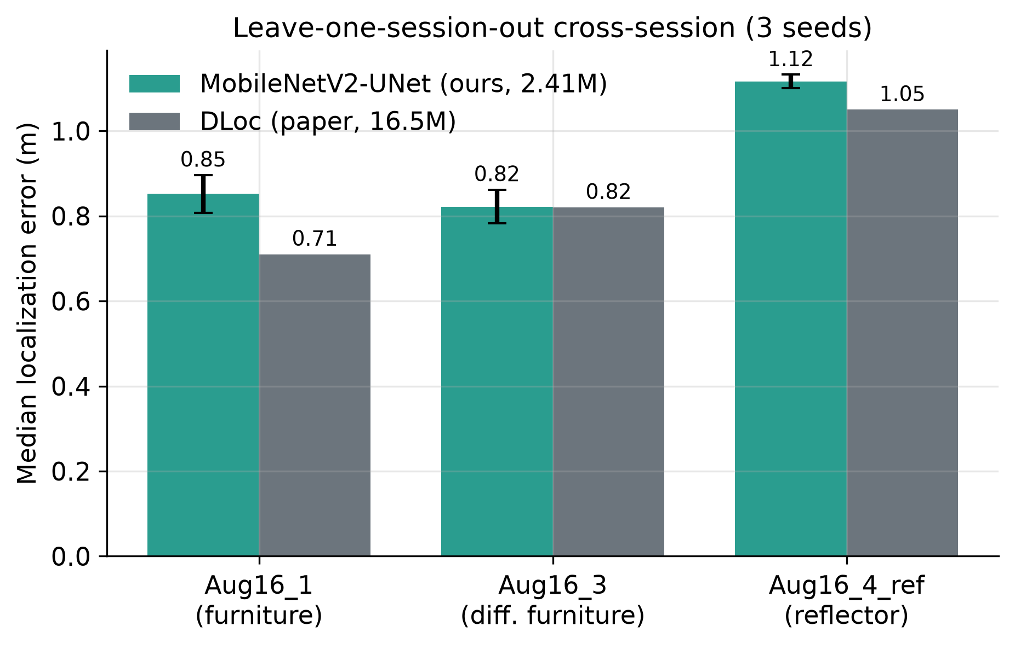
RESULTS · EXPERIMENT 3 / 6
Cross-session generalization (LOSO)
Held-out session | Median (ours) | Median (paper) | P90 (ours) | P90 (paper)
Aug16_1 (furniture) | 0.852 ± 0.044 | 0.71 | 1.839 ± 0.067 | 1.71
Aug16_3 (diff. furn.) | 0.822 ± 0.040 | 0.82 | 2.793 ± 0.140 | 2.52
Aug16_4_ref (reflector) | 1.116 ± 0.016 | 1.05 | 2.489 ± 0.030 | 2.77
Mean | 0.930 | 0.86 | 2.374 | 2.33
Leave-one-session-out, 3 seeds (mean ± std), vs published DLoc.
NILES 2026 · Edge-Efficient WiFi Indoor Localization
Results · 27
Notes:
Experiment three, the headline generalization result. Leave-one-session-out, standalone-only, three seeds — exactly DLoc's published protocol, so the comparison is fair. We average 0.93 against DLoc's 0.86, match on different-furniture, essentially tie on mean P90 — 2.374 versus 2.33 — and beat DLoc's P90 on the hardest reflector fold. Per fold we're within 0.14 m of DLoc, 0.07 m on average — at 6.8 times fewer parameters. (~45 s)

Slide 28
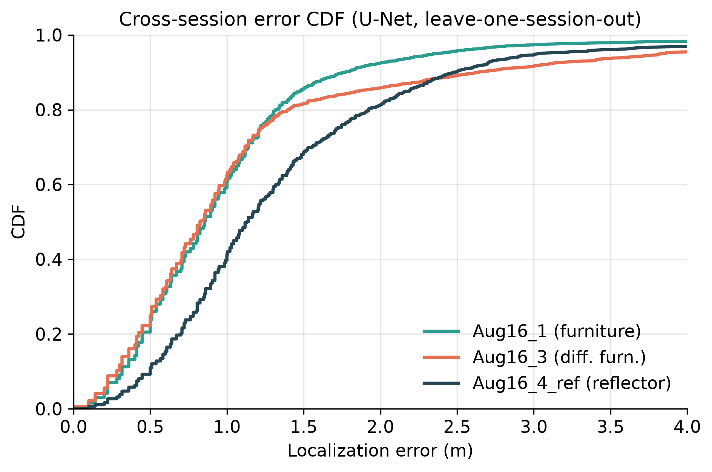
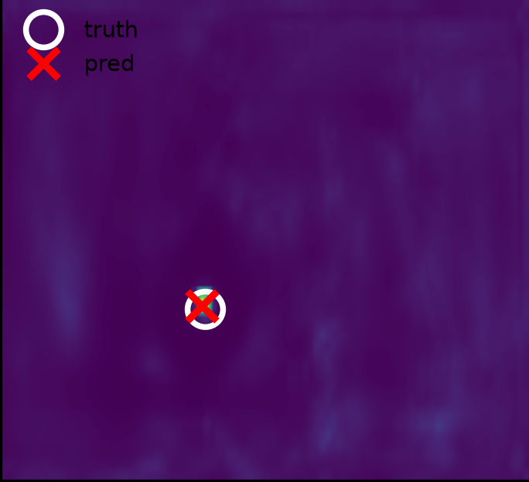
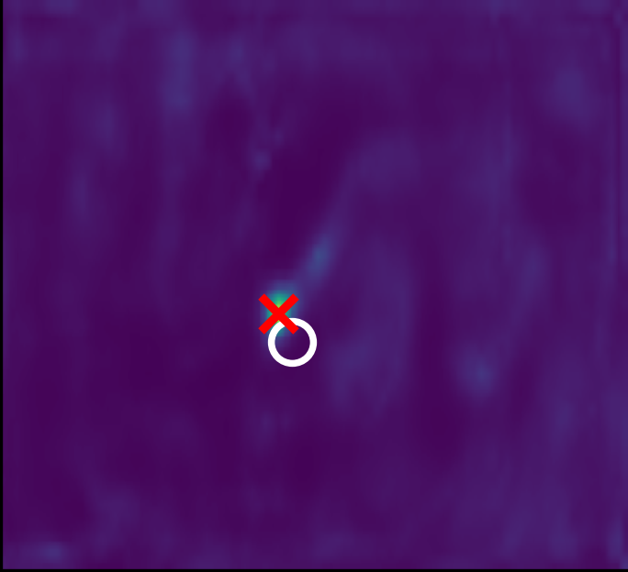
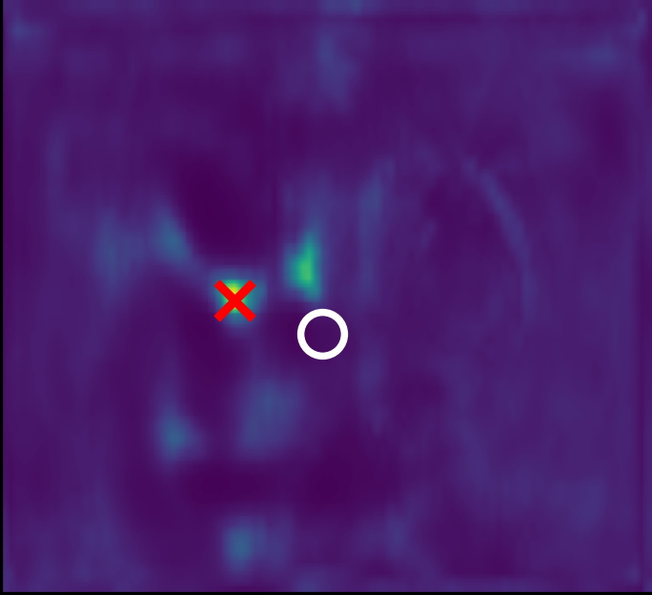
RESULTS · EXPERIMENT 3 / 6
Where the reflector hurts
The two furniture folds track closely; the reflector fold is shifted to larger errors.
Heatmaps show extra specular "phantom" peaks that can win the arg-max.
Hypothesis: DLoc's consistency decoder suppresses these; our single-decoder U-Net cannot. Not yet tested.
err = 0.22 m
err = 1.13 m
err = 4.98 m
○ truth ✕ prediction
NILES 2026 · Edge-Efficient WiFi Indoor Localization
Results · 28
Notes:
On the reflector fold the error curve shifts right, and the heatmaps suggest why: the aluminium panel adds specular 'phantom' peaks that can pull the prediction away — look at the right-hand tile. Our hypothesis is that DLoc's consistency decoder, which forces the four APs to agree, suppresses these, and our single-decoder U-Net can't. We haven't tested that yet; adding a training-only consistency decoder to the U-Net is the direct experiment, and it would cost nothing at inference. (~35 s)

Slide 29
RESULTS · EXPERIMENT 3 / 6
Per-seed leave-one-session-out results
Fold | Seed | Median (m) | P90 (m) | P99 (m)
Aug16_1 (furniture) | 42 | 0.854 | 1.769 | 5.445
 | 123 | 0.806 | 1.844 | 5.022
 | 777 | 0.894 | 1.903 | 5.124
Aug16_3 (diff. furn.) | 42 | 0.825 | 2.640 | 8.896
 | 123 | 0.781 | 2.915 | 9.986
 | 777 | 0.860 | 2.823 | 9.487
Aug16_4_ref (reflector) | 42 | 1.131 | 2.474 | 6.508
 | 123 | 1.100 | 2.524 | 7.101
 | 777 | 1.118 | 2.470 | 6.894
NILES 2026 · Edge-Efficient WiFi Indoor Localization
Results · 29
Notes:
The nine individual cross-session runs behind the LOSO table — three folds, three seeds each.

Slide 30
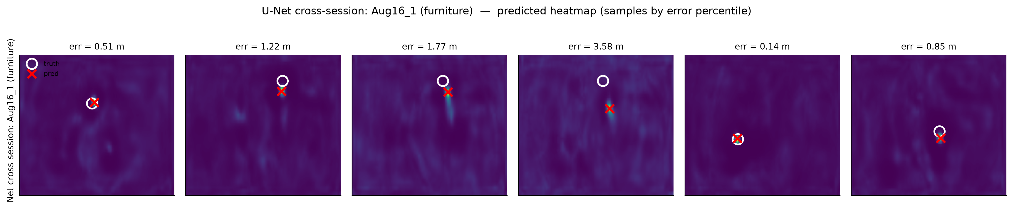
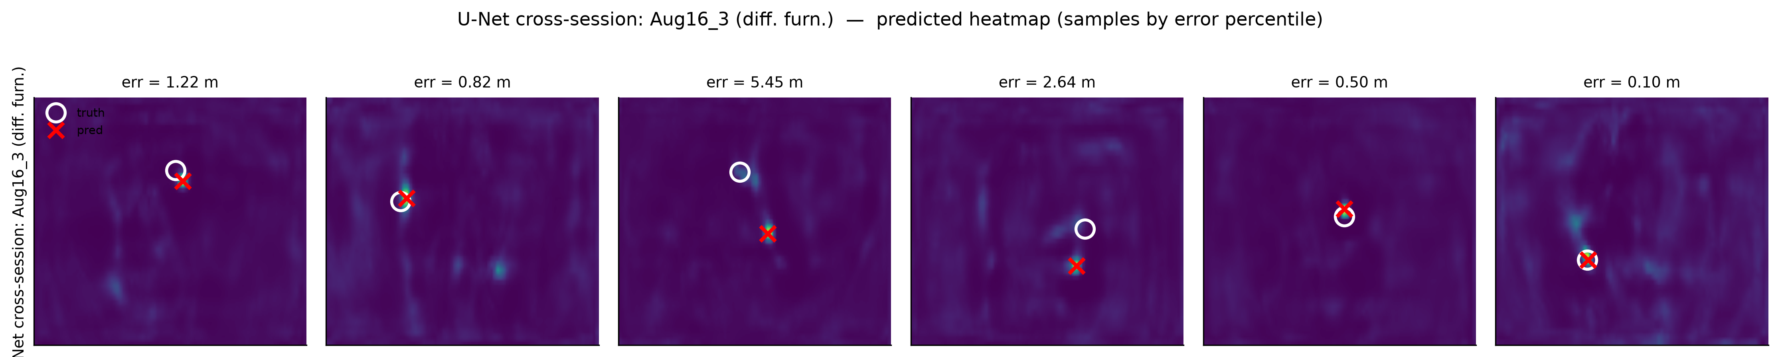
RESULTS · EXPERIMENT 3 / 6
What the U-Net predicts — cross-session
Held-out Aug16_1 (furniture rearranged).
Held-out Aug16_3 (different furniture).
NILES 2026 · Edge-Efficient WiFi Indoor Localization
Results · 30
Notes:
Predicted heatmaps on the two held-out furniture folds. The peaks stay sharp; most errors are a shifted peak rather than a scattered heatmap — the model has learned the geometry, and furniture moves it slightly. (~25 s)

Slide 31
RESULTS · EXPERIMENT 4 / 6
Zero-shot generalization (July-only training)
Model | Mode | Sess. 2 | Sess. 3 | Sess. 4 | Sess. 5
MobileNetV2 | Standalone | 0.707 | 1.118 | 1.204 | 1.500
MobileNetV2 | Distilled | 0.707 | 1.118 | 1.204 | 1.442
TinyCNN | Standalone | 3.922 | 5.964 | 6.327 | 6.605
UNet (Cosine) | Standalone | 0.640 | 1.063 | 1.005 | 1.334
UNet (Cosine) | Distilled | 0.640 | 1.020 | 1.005 | 1.281
NILES 2026 · Edge-Efficient WiFi Indoor Localization
Results · 31
Notes:
Experiment four, zero-shot — trained on the two July sessions only, tested on the August sessions. Not a DLoc comparison; an internal ablation. Errors grow from session 3 to 5 for every model. Distillation helps only on the hardest reflector session, for both MobileNetV2 and the U-Net.

Slide 32
RESULTS · EXPERIMENT 5 / 6
How much do seeds move the median?
DLoc seed (120 ep.) | Median (m) | P90 (m) | P99 (m)
42 | 0.825 | 2.402 | 22.672
123 | 0.906 | 2.335 | 7.714
777 | 0.894 | 2.102 | 8.694
Mean ± Std | 0.875 ± 0.036 | 2.280 ± 0.128 | 13.027 ± 6.832
Not the teacher: 120-epoch retrains (LR never decays to zero) — worse than the 50-epoch teacher.
Seed spread σ = 0.036 m. U-Net vs teacher: ≈ 1.9σ; vs these runs: 6.5σ.
U-Net in-distribution is a single run — three U-Net seeds would settle it.
NILES 2026 · Edge-Efficient WiFi Indoor Localization
Results · 32
Notes:
Experiment five measures seed noise. We retrained DLoc three times for 120 epochs. Important: these are not the teacher. They're worse than our 50-epoch teacher, 0.875 versus 0.707, because the StepLR schedule never decays the learning rate to zero in 120 epochs. What we take from them is the spread: the median moves by about 0.036 m between seeds, a 4% coefficient of variation. Measured in that unit, the U-Net's 0.640 is about two seed-standard-deviations below our teacher, and 6.5 below the 120-epoch runs. The U-Net in-distribution result is a single run; its three-seed cross-session runs vary by only 0.016 to 0.044 m, which is encouraging but not the same test. (~45 s)

Slide 33
RESULTS · EXPERIMENT 6 / 6
Computational efficiency (batch 1)
Model | Params | FLOPs | CPU (ms) | GPU (ms)
DLoc baseline | 16.5M | 81.06G | 270.9 | 16.2
MobileNetV2 | 2.27M | 1.28G | 17.9 | 6.3
TinyCNN | 47K | 0.66G | 9.1 | 1.5
MobileNetV2-UNet | 2.41M | 1.45G | 27.2 | 4.5
Scope Network inference only, on our desktop benchmark machine (Intel Core i7 11th-gen CPU, RTX 3060 GPU). The CSI → AoA–ToF heatmap preprocessing is not included and must be measured on-device.
56×
10×
6.8×
fewer FLOPs
lower CPU latency
fewer params
NILES 2026 · Edge-Efficient WiFi Indoor Localization
Results · 33
Notes:
Experiment six, efficiency at batch one, measured on our desktop benchmark machine. The U-Net needs 56 times fewer FLOPs than DLoc and runs ten times faster on the CPU — 27 milliseconds. One important scope note: this is network inference only. Turning raw CSI into the four AoA–ToF heatmaps is a separate preprocessing step, done in MATLAB in our pipeline, and it is not in these numbers; on a real edge device it may well dominate, so it's the first thing we'd measure when deploying. (~35 s)

Slide 34
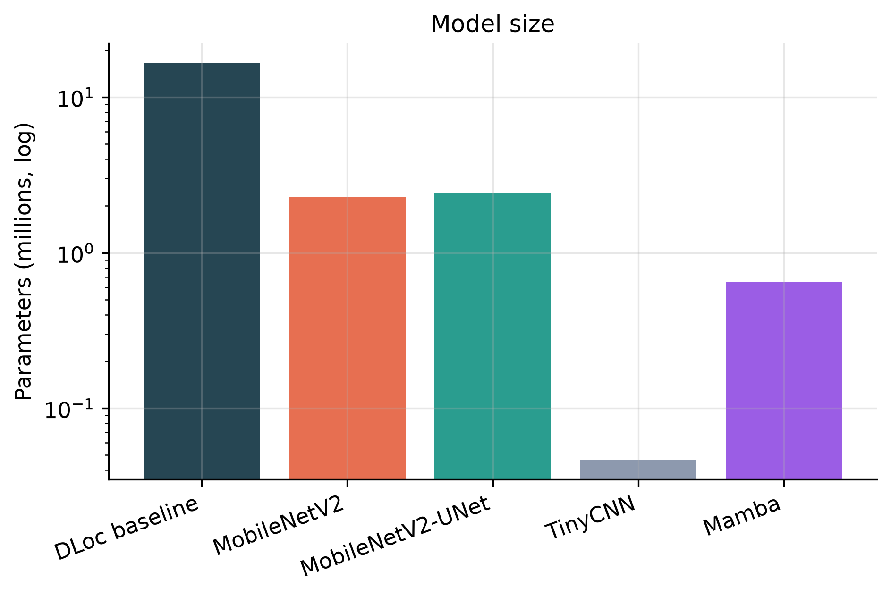
RESULTS · EXPERIMENT 6 / 6
Model size
16.5M
DLoc baseline
2.41M
MobileNetV2-UNet · 6.8×
2.27M
MobileNetV2 · 7.2×
0.65M
Mamba · 25×
47K
TinyCNN · 351×
Parameter counts of each model (millions, log scale).
NILES 2026 · Edge-Efficient WiFi Indoor Localization
Results · 34
Notes:
The parameter counts on a log scale. DLoc at 16.5 million; both MobileNetV2 variants around 2.3 to 2.4 million — about seven times smaller; Mamba at 0.65 million; and TinyCNN at 47 thousand, 351 times smaller. Size alone doesn't predict accuracy — Mamba is smaller than MobileNetV2 but fails because it drops the 2-D framing. (~25 s)

Slide 35
CONCLUSION
What we found
1
DLoc is over-parameterized — MobileNetV2 reaches the teacher's median at 7.2× fewer params.
2
Architecture beats parameters — U-Net skips give 0.640 m — level with published DLoc.
3
Distillation helps under AP dropout — and rescues models without skips — not a general robustness boost.
4
Two robustness mechanisms — Skips (noise) and distillation (AP dropout).
5
Competitive cross-session — Within 0.14 m per fold (0.07 m on average) at 6.8× fewer params, 56× less compute.
NILES 2026 · Edge-Efficient WiFi Indoor Localization
Conclusion · 35
Notes:
To conclude — five findings. One: DLoc is over-parameterized; MobileNetV2 reaches the same median as our teacher at 7.2 times fewer parameters. Two: architecture beats parameters; the U-Net's skips give 0.640 m, level with published DLoc. Three: distillation is not a general robustness boost — it helps under AP dropout and rescues models without skips, but on the U-Net it slightly hurts noise robustness. Four: two robustness mechanisms — skips for noise, distillation for AP dropout. Five: cross-session we're within 0.14 m of DLoc on every fold, 0.07 m on average, at 6.8 times fewer parameters and 56 times less compute. (~50 s)

Slide 36
FUTURE WORK
Where this goes next
Consistency decoder for the U-Net
Sub-pixel peak refinement
Training-only, zero inference cost — tests the reflector hypothesis.
Soft-argmax or parabolic fit — medians no longer tied to the 0.1 m grid.
Deploy on E-JUST edge devices
Collect a new CSI dataset at E-JUST
Measure end-to-end latency, including CSI → heatmap preprocessing.
Test transfer to a different building.
Train-time corruption augmentation
Architecture search
We only corrupt at test time today.
Attention on the skips; 2-D multi-direction Mamba scans (VMamba).
NILES 2026 · Edge-Efficient WiFi Indoor Localization
Future work · 36
Notes:
Future work. First, the experiment the reflector result asks for: add DLoc's consistency decoder to the U-Net. It's only used during training, so it costs nothing at inference, and it directly tests our hypothesis about the reflector gap. Second, sub-pixel peak refinement — a soft arg-max or parabolic fit — so medians are no longer tied to the 0.1 m grid. Then deployment on edge hardware including the preprocessing, a new CSI dataset at E-JUST, training-time corruption augmentation, and 2-D scan variants of Mamba. (~35 s)

Slide 37
THANK YOU
Matches or beats DLoc in distribution, within 0.14 m cross-session — 6.8× smaller, 56× cheaper.
Abdulrahman M. A. Ebrahim · Ahmed E. A. Haggag · Fadwa Y. K. Mahmoud · Ehab H. Elshazly
E-JUST, Alexandria, Egypt · NILES 2026
Notes:
Thank you — happy to take questions. Backup slides follow.

