Slide 1
Analysis of Uber Ride Data
This analysis uncovers patterns in Uber ride data, enhancing future predictive models.
Ali Jaber 202045080
Abdullah Al Muheef 202039000

Slide 2
Introduction
This presentation explores an Uber dataset from Kaggle
Analyzing ride details including distances, durations, and purposes.
Our goal is to uncover patterns and insights that can inform future ride classification and prediction models.

Slide 3
Table of contents
Dataset Overview
Data Preprocessing
Modeling Techniques
Findings from Statistical Analysis
Feature Importance
Model Evaluation and Performance
Limitations of the Study

Slide 4

Dataset Overview
The dataset consists of 1155 rows and 7 columns. Key features include ride type (Business or Personal), start and end locations, purpose, and the total distances.

Slide 5
Data Preprocessing
Handled missing data by filling in 'Not Provided' for the PURPOSE column. Corrected corrupted city names using fuzzy matching for location standardization. Encoded categorical variables using label encoding for modeling.

Slide 6
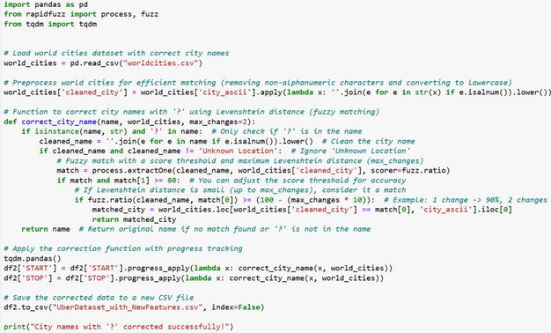

Slide 7
Findings from Statistical Analysis
Significant positive correlation found between ride duration and distance (0.9160). Data showed class imbalance, with 'Business' rides dominating the dataset. Missing values in the PURPOSE feature may impact the analysis.

Slide 8
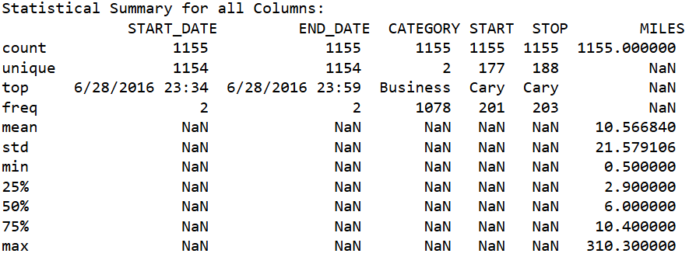
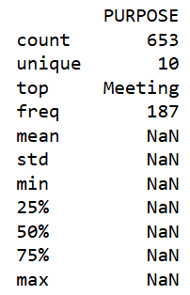
Findings from Statistical Analysis

Slide 9
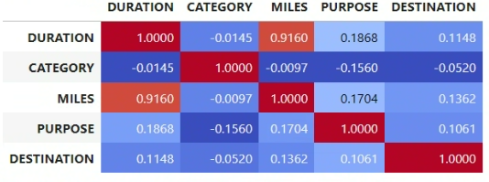
Findings from Statistical Analysis

Slide 10
Modeling Techniques
Used Decision Tree and Random Forest classifiers for classification tasks. The Random Forest was favored for its robustness and handling of overfitting. 70% of the data was allocated for training, 30% for testing.

Slide 11
Feature Importance
CATEGORY (Business or Personal) is the target.
MILES was identified as the most crucial feature influencing model predictions. DURATION also played a significant role but was secondary to MILES. DESTINATION was found to be the least impactful feature.

Slide 12
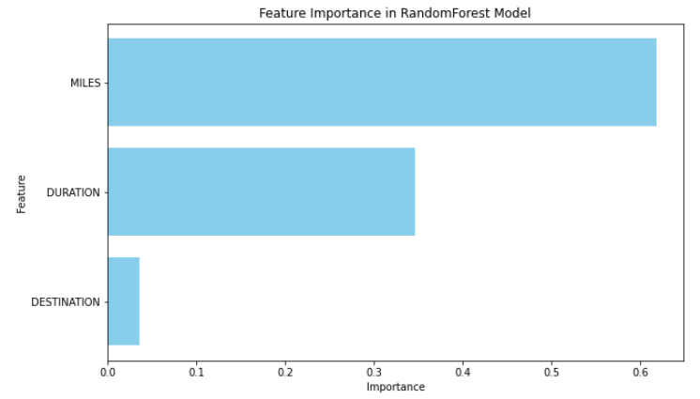
Feature Importance

Slide 13
Model Evaluation and Performance
Random Forest classifier significantly outperformed the Decision Tree on all metrics. F1 Score and accuracy were consistently high Hyperparameter tuning improved model performance significantly.

Slide 14
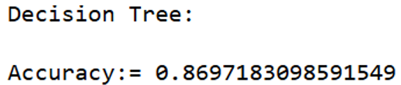
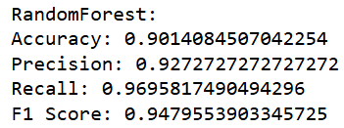
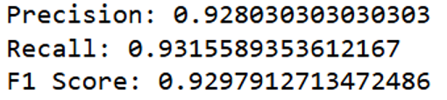
Model Evaluation and Performance

Slide 15
Limitations of the Study
Small dataset size limited generalizability and could lead to overfitting. High number of missing values in the PURPOSE feature reduced utility. Class imbalance challenges accurate predictions for minority classes.

Slide 16
Thank you!
Do you have any questions?

