Slide 1
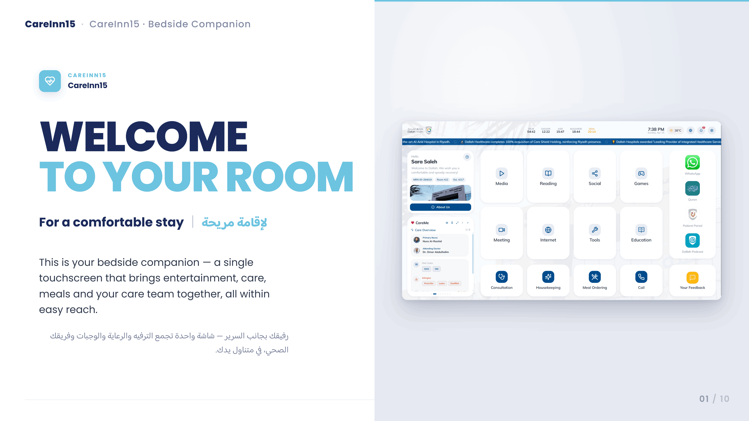
Notes:
Welcome to CareInn15 — this is what every patient sees on the 15-inch touchscreen at their bedside before they log in. The big idea: the screen is a companion, not a kiosk. It greets, it guides, and it gets out of the way.

Slide 2
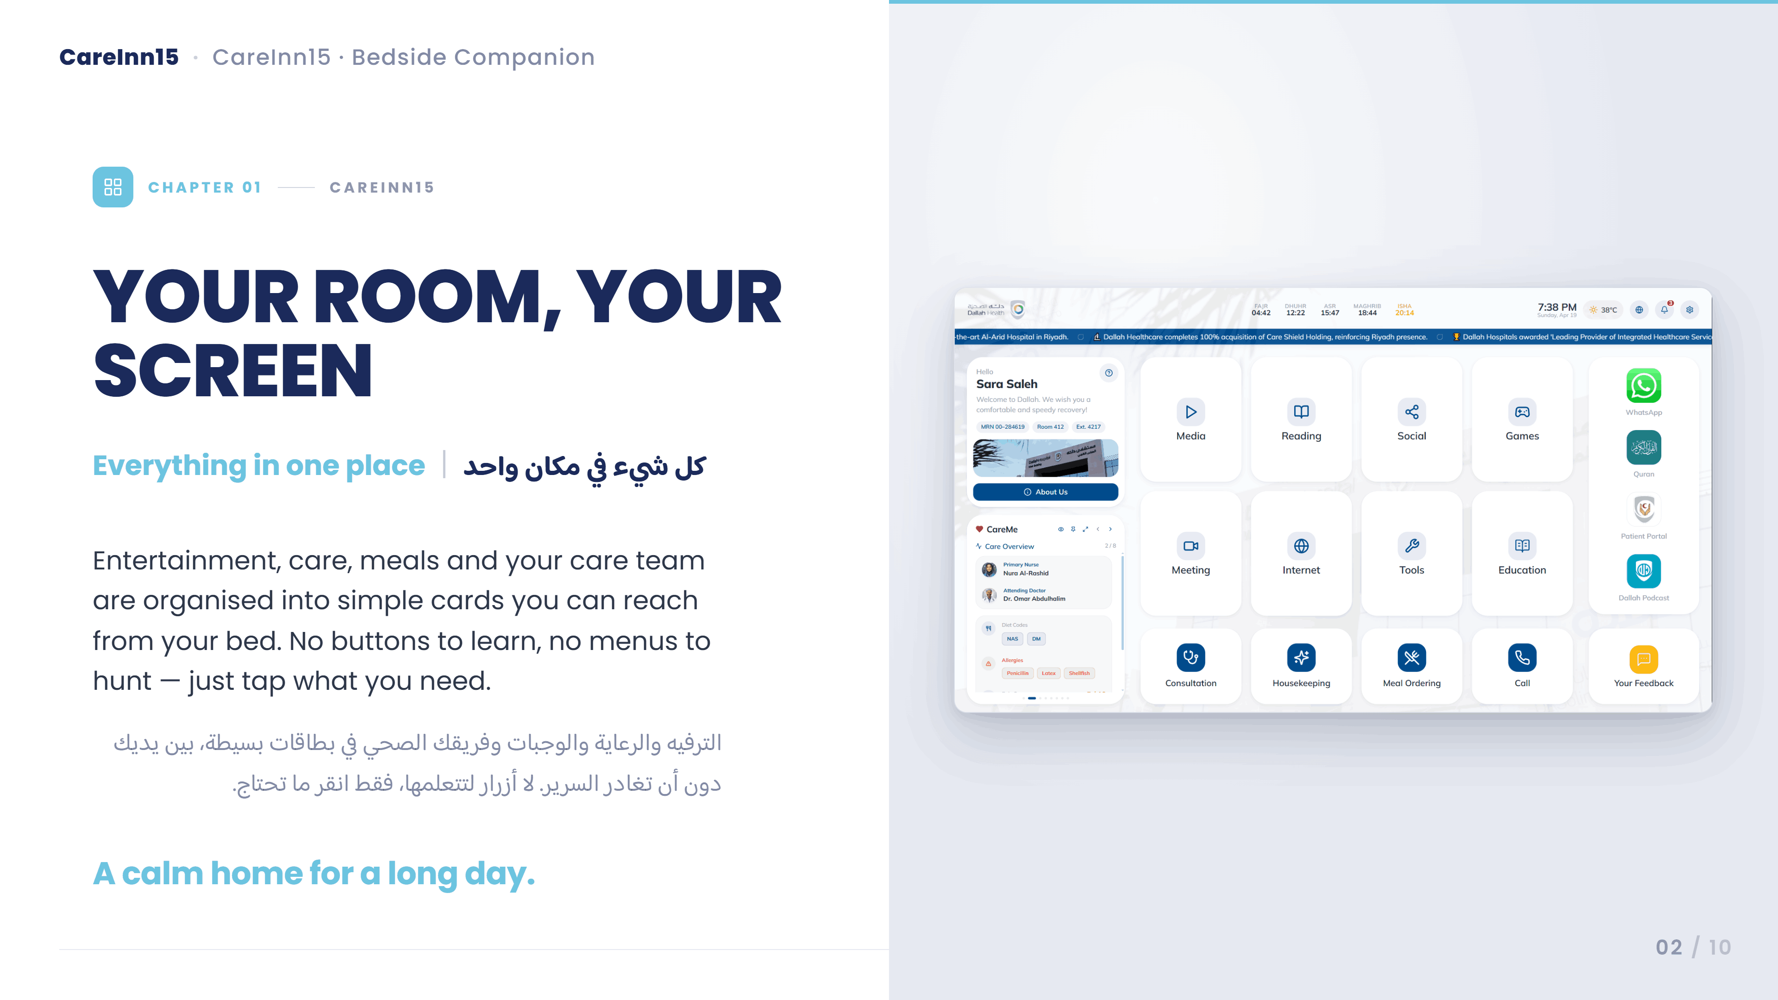
Notes:
This is the home base. Entertainment, care, meals and calls — all organized as big calm tiles you can reach from the bed. The left column keeps your patient info and care team always visible, and the prayer times and news are woven in quietly at the top.

Slide 3
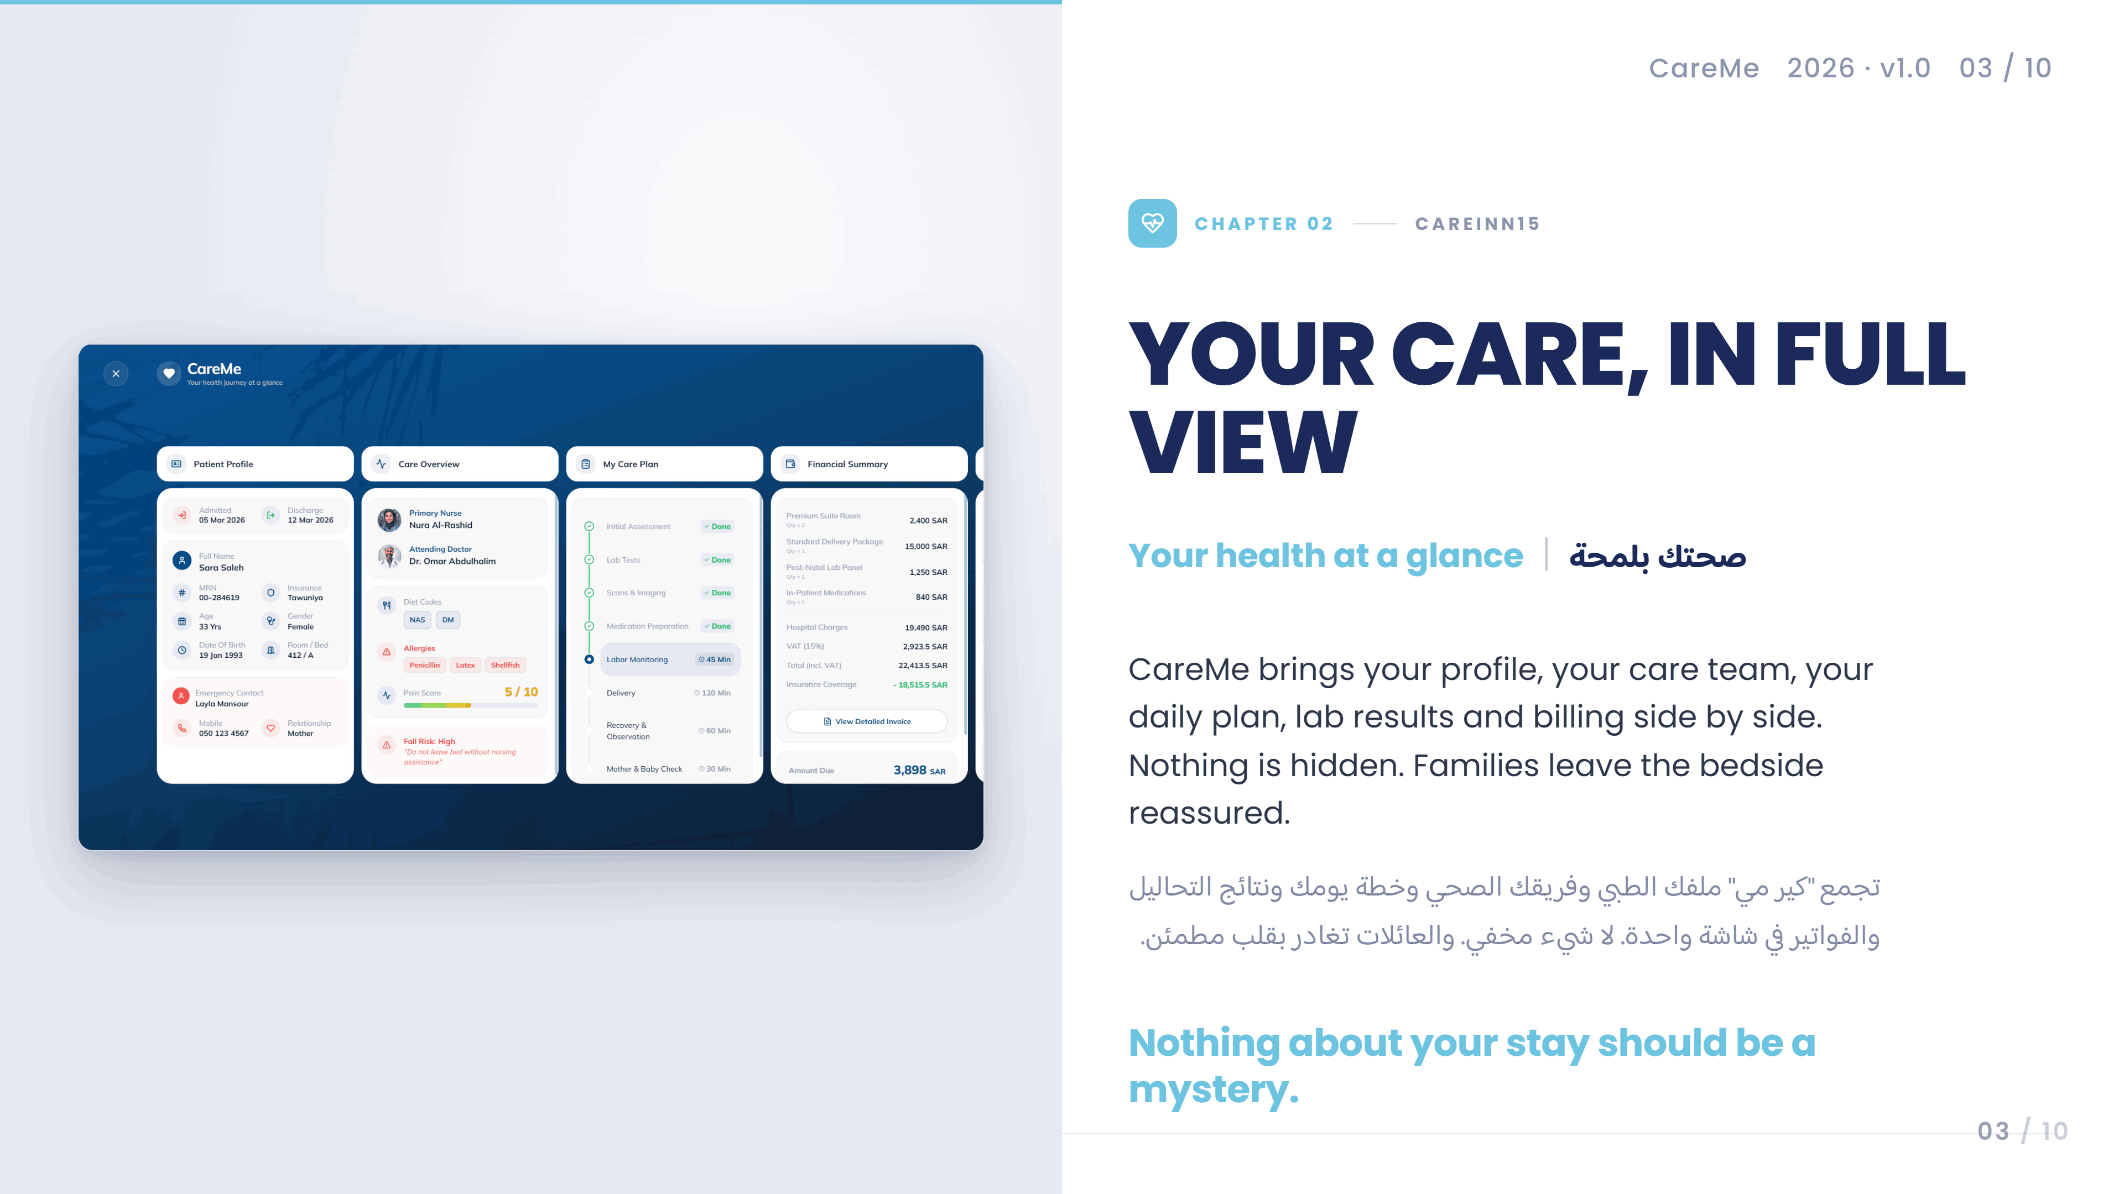
Notes:
CareMe is the health-at-a-glance panel. Your profile, your care team, your plan of the day, your labs, and your bill — side by side in horizontally scrolling columns. Patients and families love this because nothing is hidden.

Slide 4
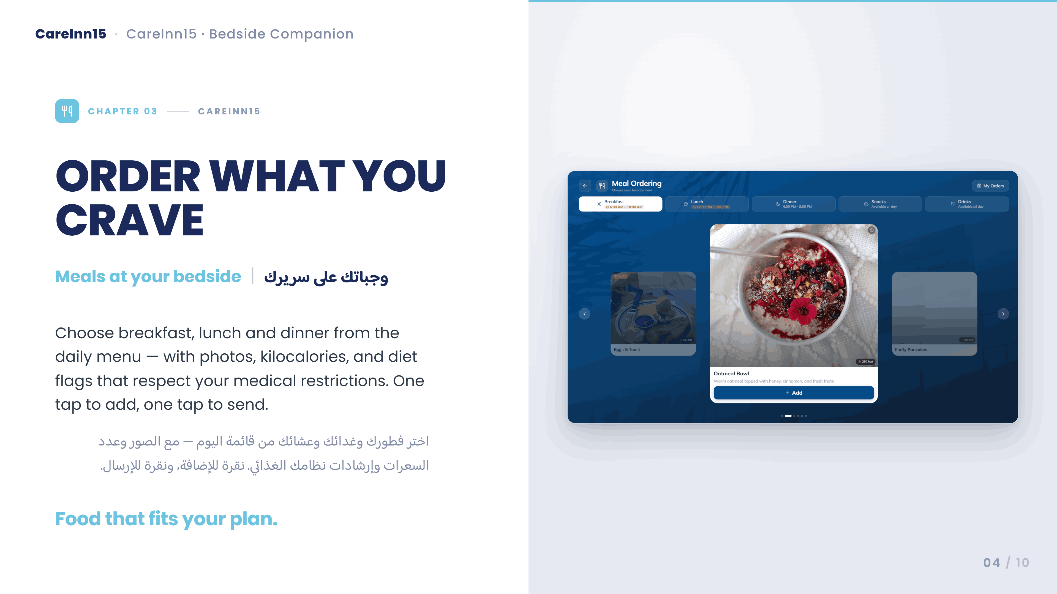
Notes:
Meal ordering. The daily menu, grouped by breakfast, lunch, dinner, snacks and drinks. Big photos, clear kcal counts, and diet flags that respect the patient's medical restrictions. One tap to add, one tap to review the order.

Slide 5
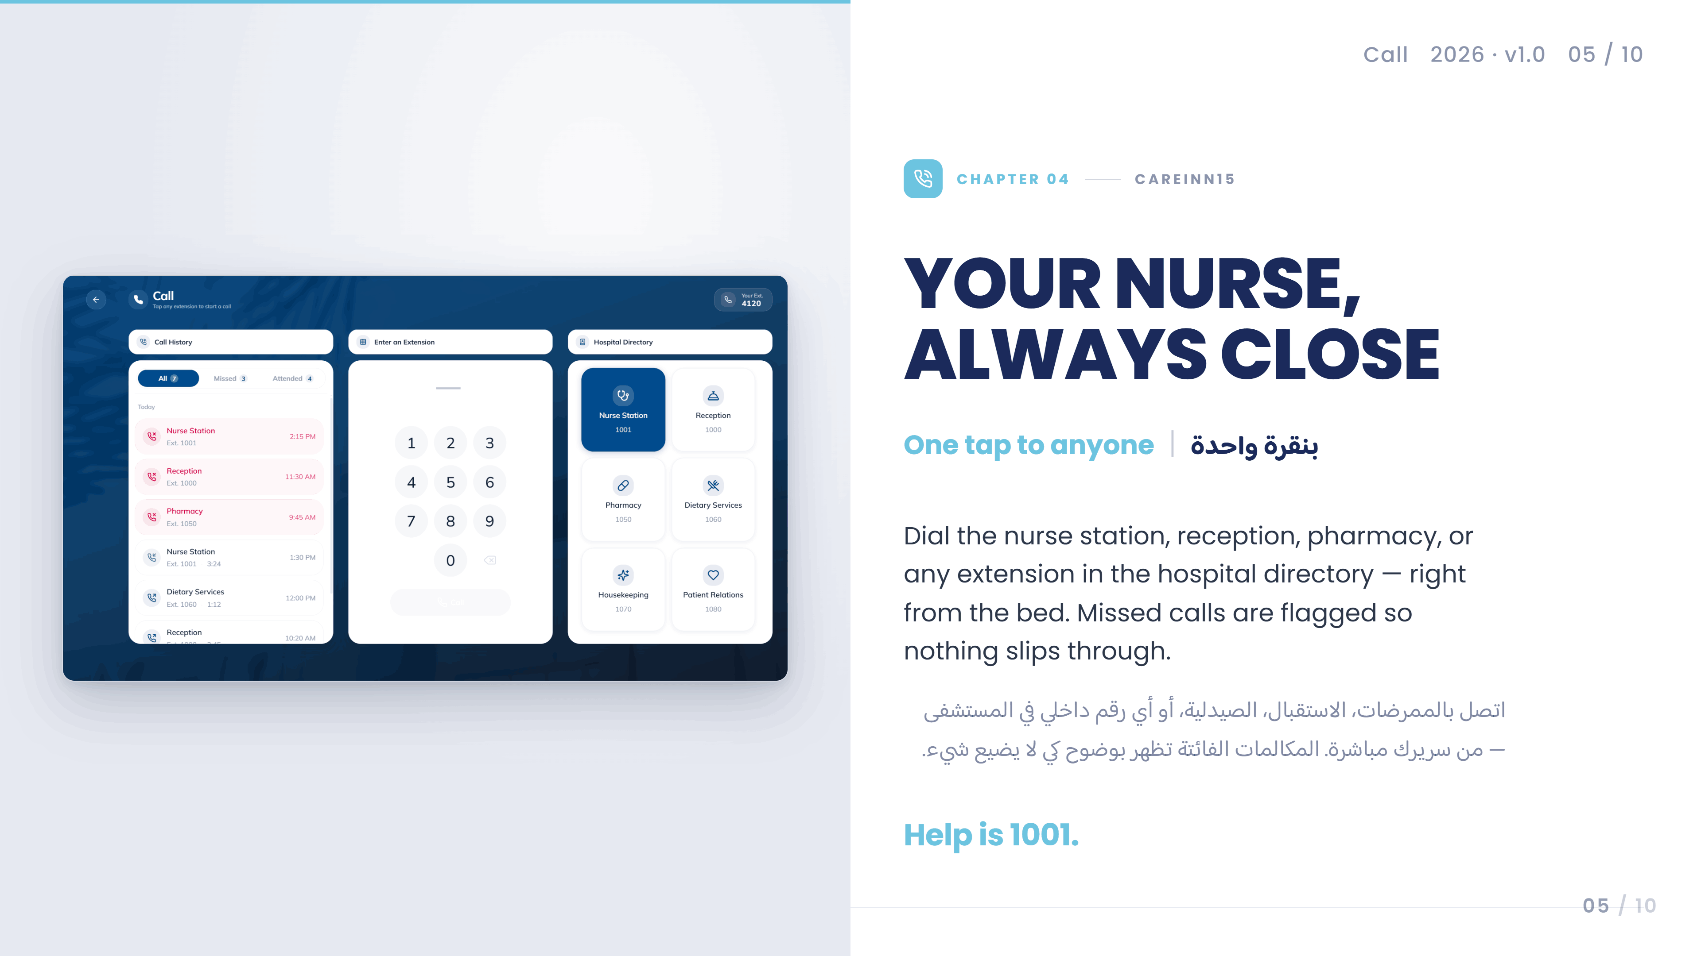
Notes:
The call screen doubles as a hospital directory. Patients can dial any extension, browse nurse station, pharmacy, dietary or patient relations, and see every call they've made today — missed calls stand out in red.

Slide 6
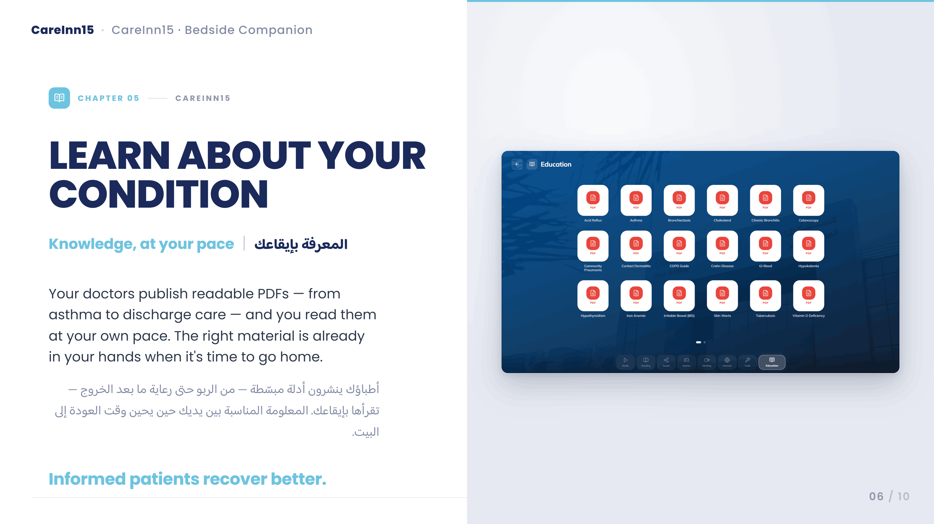
Notes:
Education is patient teaching made readable. Doctors publish PDFs — acid reflux, asthma, COPD — and patients can read them at their own pace. When it's time for discharge, the right material is already in their hands.

Slide 7
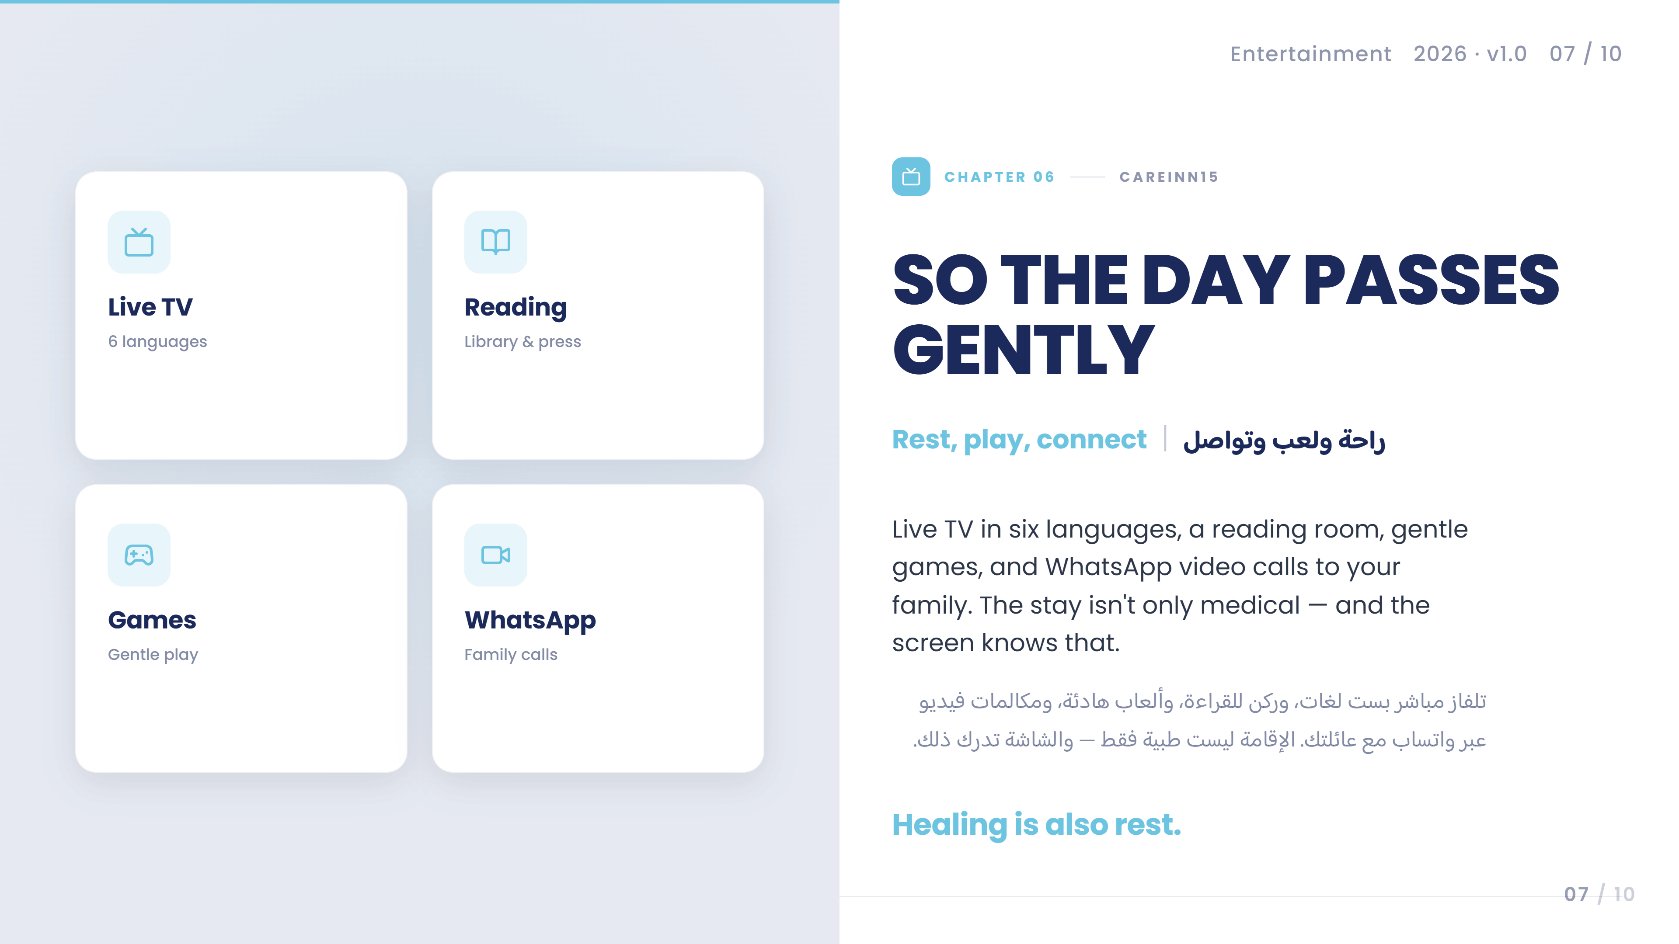
Notes:
Entertainment keeps the day from dragging. Live TV in six languages, reading, games, WhatsApp video calls to family. It's the part of the stay that isn't medical — and that matters just as much.

Slide 8
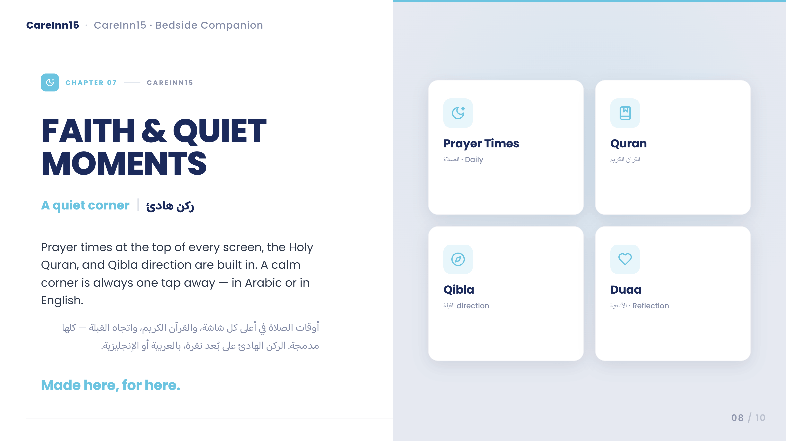
Notes:
For our Arabic-speaking patients: prayer times across the top, Quran on the side, Qibla direction built in. The whole interface flips to RTL with a tap. This is one of the reasons CareInn15 wins in this region.

Slide 9
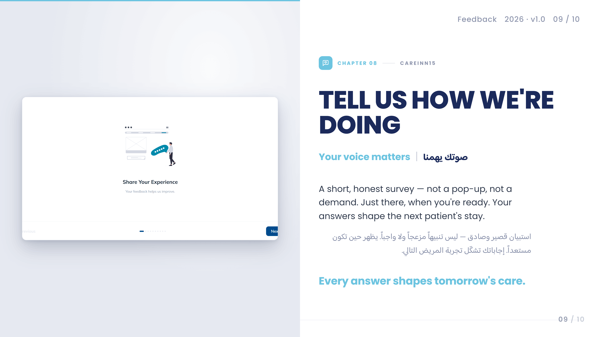
Notes:
A short, honest survey. Not a pop-up, not a mandatory thing — just there, when the patient is ready. The illustration and tone are deliberately gentle, because we don't want feedback from frustrated people; we want thoughtful feedback from people who've had time to reflect.

Slide 10
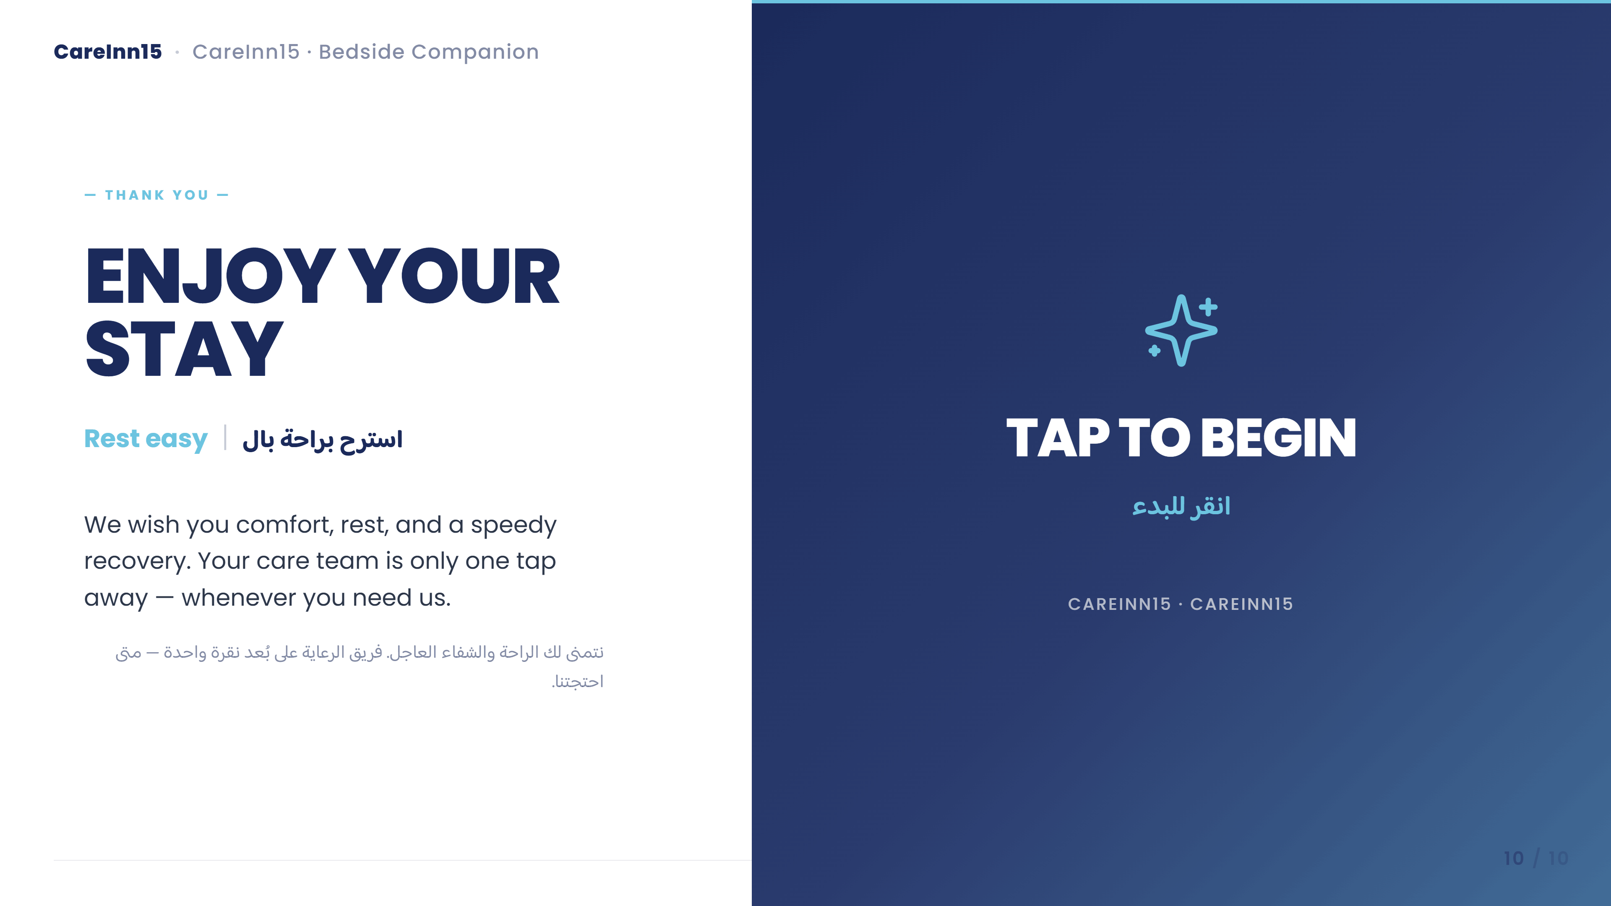
Notes:
And we close the loop where we opened it — a warm sign-off. Tap anywhere to get started. Enjoy your stay.

