Slide 1


A Hybrid Decomposition-Based Deep Learning Approach for Enhanced Wind Power Forecasting
Abdulrahman Almansoori, MSc Student in Machine Learning
Supervisor: Professor Fakhri Karray, Professor of Machine Learning

Slide 2
Introduction

Slide 3








Main Problem
Main Problems
Rapid industrialization and population growth have increased global energy demand.
Nonrenewable energy abuse leads to environmental degradation and unsustainable for future generations.
Shift toward renewable energy is crucial to
achieve sustainability and climate goals.

Slide 4
Wind Energy
Among renewables, wind energy stands out due to its widespread availability and low emissions.
Wind energy is a promising, clean alternative but highly variable and difficult to predict.

Slide 5


Current Solution
Physical Models (e.g., NWP): Depend heavily on meteorological data, and lacking historical trend analysis.
Statistical Models (e.g., ARIMA): Good for linear patterns but struggle with nonlinear, volatile wind dynamics.
Conventional
Methods
Traditional ML (e.g., SVM, KNN, RF): Performed well at high wind speeds, but accuracy dropped at low speeds and depend heavily on feature selection.
Deep Learning (e.g., RNN, LSTM): Handle complex patterns, but performance degrades with noise and non-stationarity.
Machine Learning Methods

Slide 6

Current Solution
Decomposition techniques break the signal into simpler, more stable
sub-series, improving deep learning performance.
Wavelet Decomposition (WD): Uses a series of high-pass and low-pass filters
to separate a signal into frequency components at multiple resolutions.
Can captures both high- and low-frequency patterns, but non-adaptive.
Empirical Mode Decomposition (EMD): Decomposes signals into Intrinsic
Mode Functions (IMFs) to handle nonlinear and non-stationary data.
Adaptive to local signal features but signals of different scales can
overlap across IMFs (mode mixing).
Decomposition Techniques

Slide 7
Research Gaps
1
2
DL models struggle with raw wind signals without robust preprocessing.
Few studies assess how input lengths & forecasting horizons affect model performance.
3
Limited studies have been conducted on combining the advanced decomposition and denoising techniques with DL models.

Slide 8
Proposed Methodology

Slide 9


To deal with the research gaps in the field of wind energy prediction, we propose the integration of three main components known as CEEMDAN, EWT, GRU
CEEMDAN
Complete Ensemble Empirical Mode Decomposition with Adaptive Noise
EWT
Empirical Wavelet Transform
GRU
Gated Recurrent Unit
Each one of these modules is detailed next, followed by experiments validating our proposed approach

Slide 10

CEEMDAN: Complete Ensemble Empirical Mode Decomposition with Adaptive Noise
CEEMDAN is an advanced decomposition techniques that solve limitations of previous techniques.
It uses adaptive noise at each stage to eliminate mode mixing.
It produces cleaner, non-overlapping IMFs.
Each IMF captures a distinct frequency, improving signal quality for forecasting.
Benefits of CEEMDAN:
Adaptive and noise-resistant decomposition
Enhances model learning by providing cleaner features

Slide 11
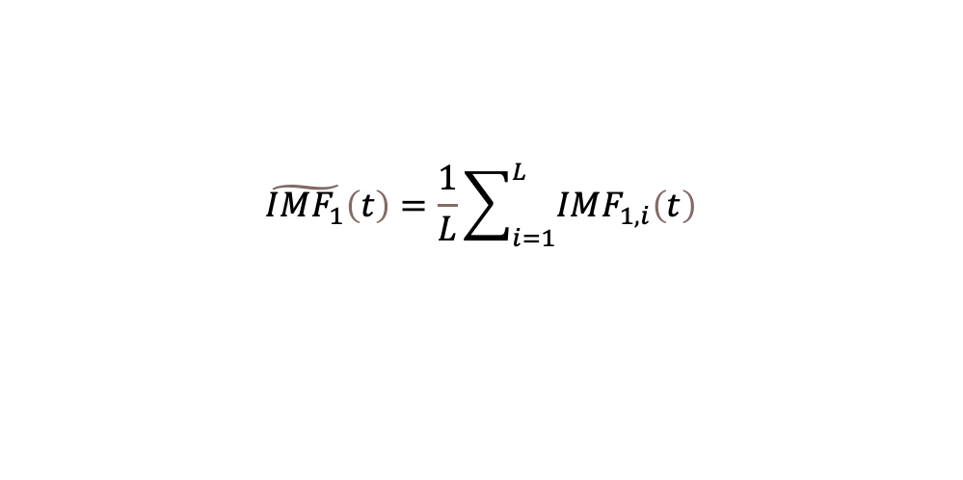
CEEMDAN: Complete Ensemble Empirical Mode Decomposition with Adaptive Noise
1. Add noise to the original signal: Construct multiple realizations of the signal by adding different Gaussian white noise series:
2. Extract the first IMF: Apply EMD to each realization and compute the average of the first mode:
3. Compute the first residual: Subtract the first IMF from the original signal:
$$x_{i}\left(t\right)=x\left(t\right)+ϵ_{0}w_{i}\left(t\right), i=1,2,…,L$$
$$\tilde{IMF_{1}}\left(t\right)=\frac{1}{L}\sum_{i=1}^{L}{IMF_{1,i}\left(t\right)}$$
$$r_{1}\left(t\right)=x\left(t\right)−\tilde{IMF_{1}}\left(t\right)$$

Slide 12
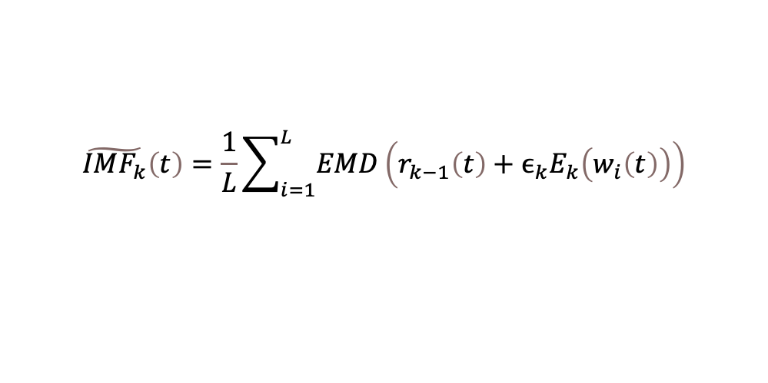
CEEMDAN: Complete Ensemble Empirical Mode Decomposition with Adaptive Noise
4. Iteratively extract subsequent IMFs: For k≥2, add scaled adaptive noise to the residual & apply EMD:
5. Update the residual:
6. Stop criterion: Repeat until residual becomes a monotonic function that EMD cannot decompose.
$$\tilde{IMF_{k}}\left(t\right)=\frac{1}{L}\sum_{i=1}^{L}{EMD}\left(r_{k−1}\left(t\right)+ϵ_{k}E_{k}\left(w_{i}\left(t\right)\right)\right)$$
$$r_{k}\left(t\right)=r_{k−1}\left(t\right)−\tilde{IMF_{k}}\left(t\right)$$

Slide 13
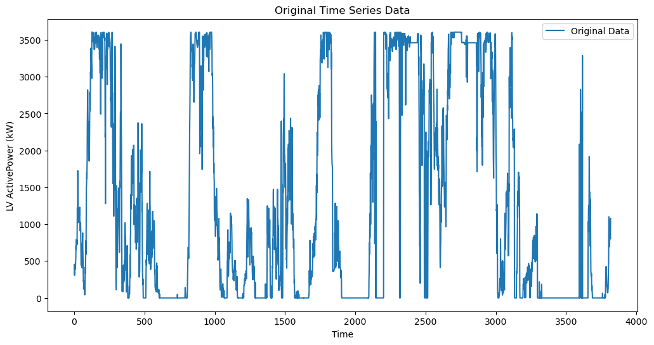
CEEMDAN: Complete Ensemble Empirical Mode Decomposition with Adaptive Noise
Wind Power Data in January

Slide 14
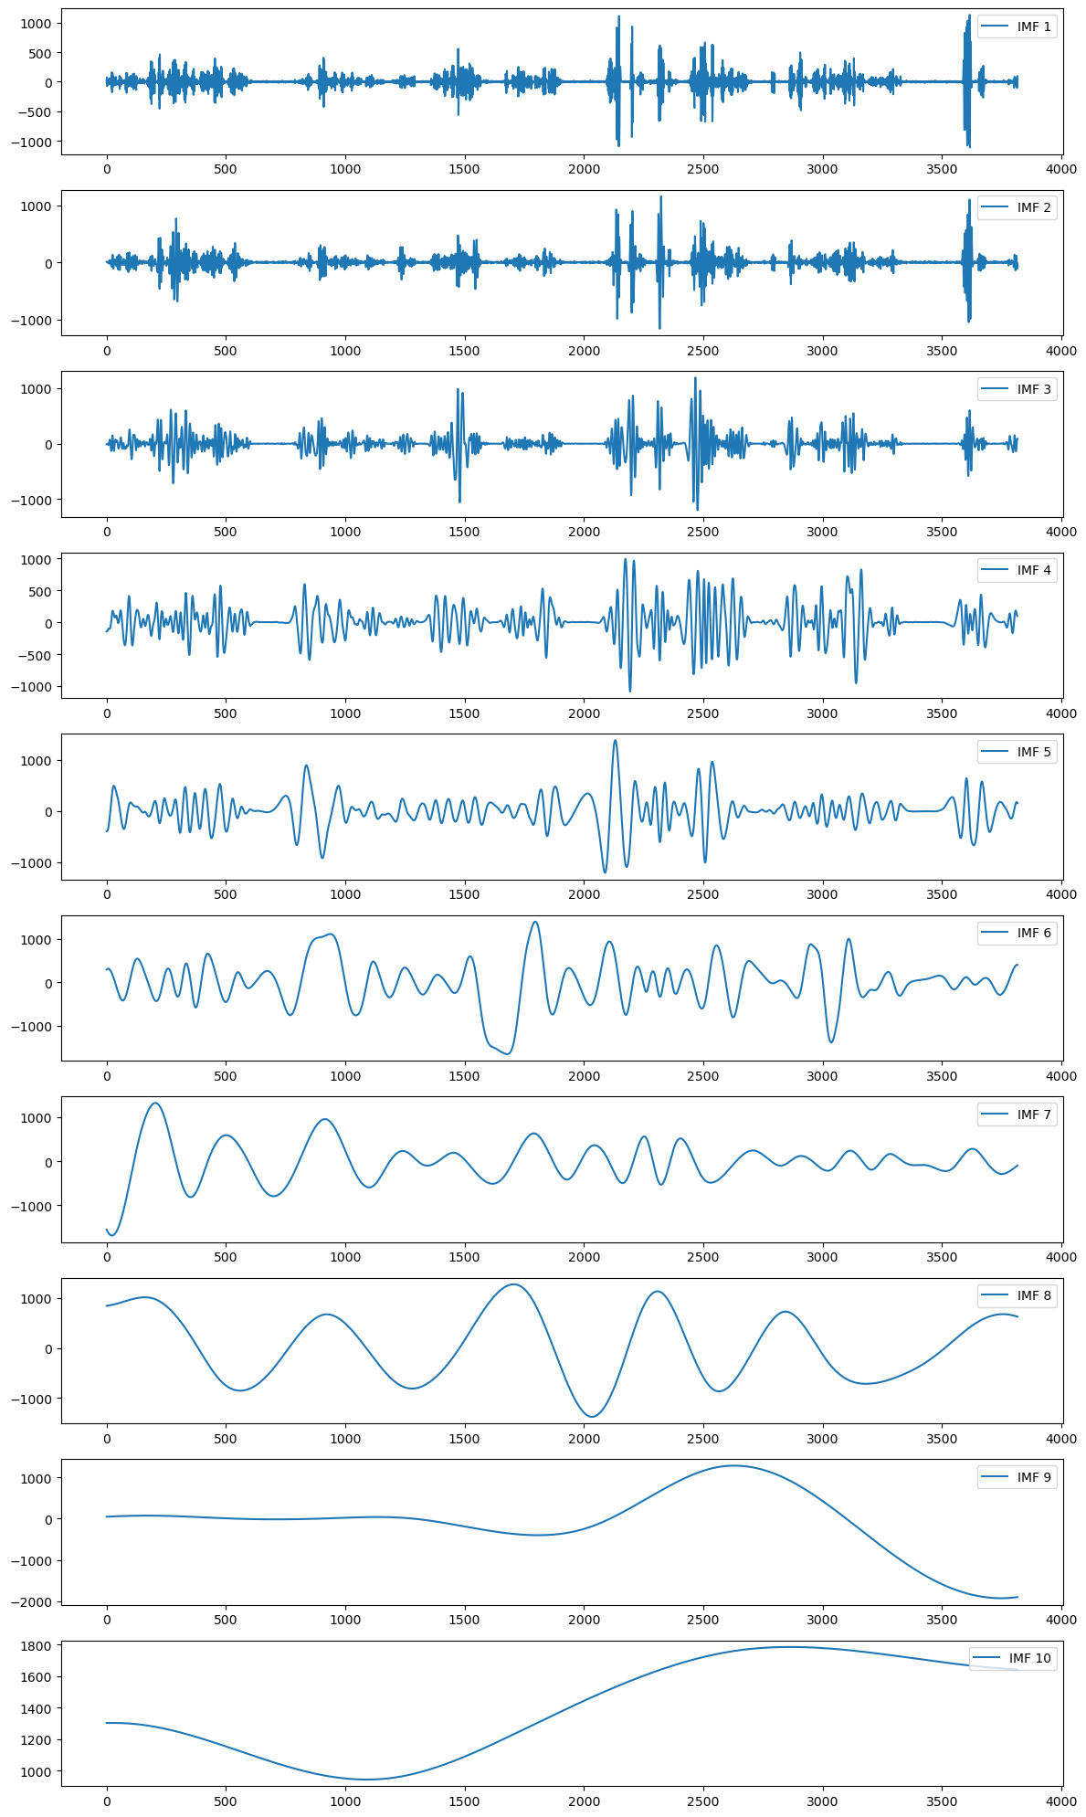
Decomposed IMFs of Wind Power
Data for January.

Slide 15
EWT: Empirical Wavelet Transform for High-Frequency Refinement
The first IMF from CEEMDAN often contains high-frequency noise.
=> Use EWT to refine the first IMF, preserving important features while suppressing noise.
EWT is an adaptive signal decomposition method.
It constructs custom filters based on the Fourier spectrum of the signal.
It is well-suited for nonstationary time series with varying frequency characteristics.
Benefits of EWT:
Enhances signal clarity before forecasting
Improves feature extraction from noisy components.

Slide 16

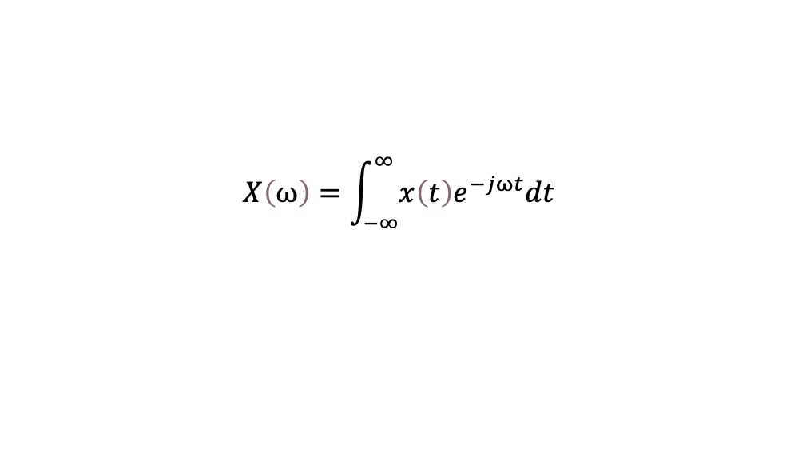
EWT: Empirical Wavelet Transform for High-Frequency Refinement
1. Compute the Fourier Transform (FT): Transform the signal into the frequency domain using the FT:
2. Identify Frequency Boundaries: Detect the local maxima in the Fourier spectrum and define boundaries that partition the frequency domain:
$$X\left(ω\right)=\int_{−∞}^{∞}{x\left(t\right)e^{−jωt}dt}$$
$$Ω_{i}=\frac{ω_{i}+ω_{i+1}}{2}, i=1,2,…,P−1$$

Slide 17

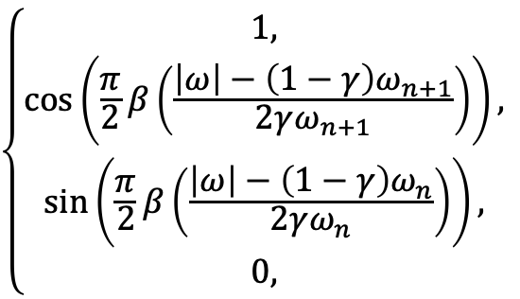




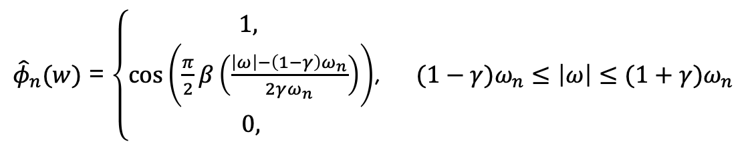

EWT: Empirical Wavelet Transform for High-Frequency Refinement
3. Construct adaptive wavelet filters: Define the empirical wavelet functions based on the segmented Fourier spectrum.
Scaling function (Low-pass filter):
Wavelet function (Band-pass filter)
${\hat{φ}}_{n}(w)$ = $\left\{\begin{aligned}1, \\ \cos\left(\frac{π}{2}β\left(\frac{\left|ω\right|−\left(1−γ\right)ω_{n}}{2γω_{n}}\right)\right) \\ 0,\end{aligned}\right.$, $(1−γ)ω_{n}≤\left|ω\right|≤(1+γ)ω_{n}$
$$\left|ω\right|≤(1−γ)ω_{n}$$
$$otherwise$$
$$\left\{\begin{aligned}{1, \atop \cos\left(\frac{π}{2}β\left(\frac{\left|ω\right|−\left(1−γ\right)ω_{n+1}}{2γω_{n+1}}\right)\right),} \\ {\sin\left(\frac{π}{2}β\left(\frac{\left|ω\right|−\left(1−γ\right)ω_{n}}{2γω_{n}}\right)\right), \atop 0,}\end{aligned}\right.$$
$$(1+γ)ω_{n}≤\left|ω\right|≤(1−γ)ω_{n+1}$$
$$(1−γ)ω_{n+1}≤\left|ω\right|≤(1+γ)ω_{n+1}$$
${\hat{ψ}}_{n}(w)$ =
$$(1−γ)ω_{n}≤\left|ω\right|≤(1+γ)ω_{n}$$
$$otherwise$$

Slide 18
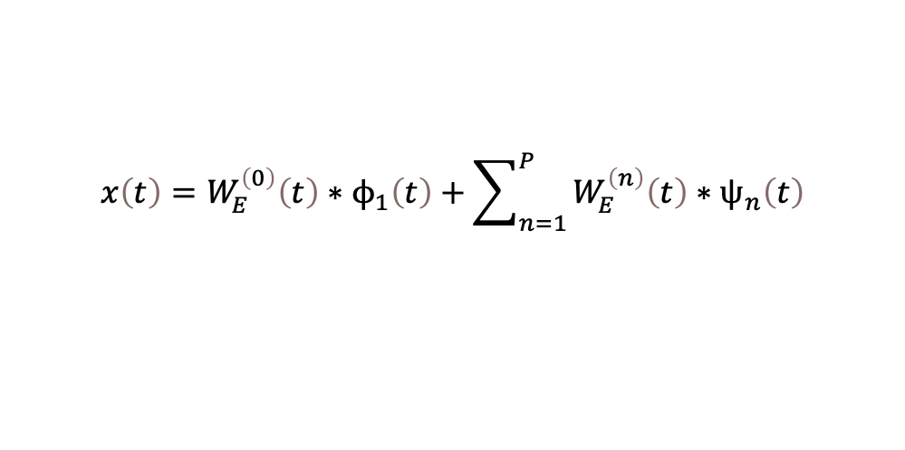
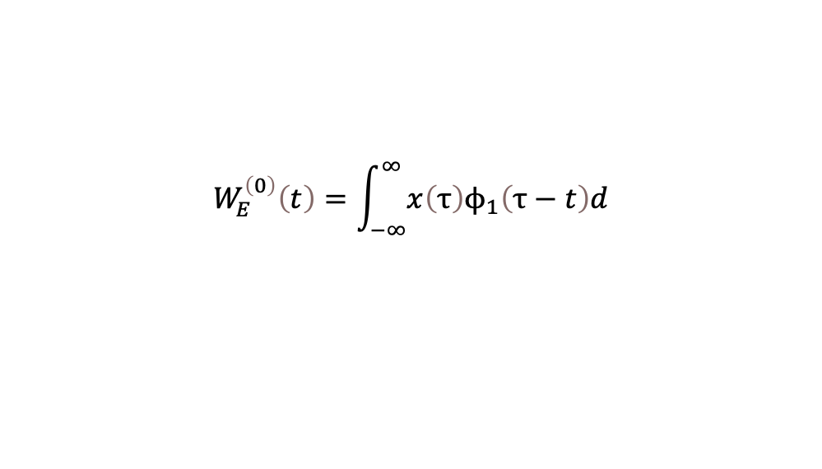
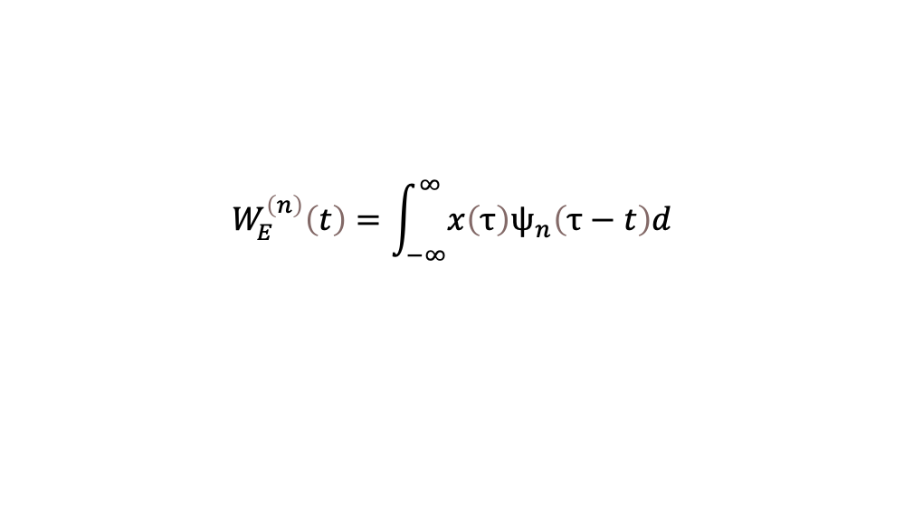
EWT: Empirical Wavelet Transform for High-Frequency Refinement
4. Perform the EWT: Once the wavelet filters are constructed, apply them to extract different frequency components. The wavelet coefficients are obtained by convolving the signal with the wavelet functions:
Similarly, the approximation coefficients using the scaling function are:
5. Reconstruct the signal: The first IMF is reconstructed from the wavelet coefficients using:
$$W_{E}^{\left(n\right)}\left(t\right)=\int_{−∞}^{∞}{x\left(τ\right)ψ_{n}\left(τ−t\right)d}$$
$$W_{E}^{\left(0\right)}\left(t\right)=\int_{−∞}^{∞}{x\left(τ\right)ϕ_{1}\left(τ−t\right)d}$$
$$x\left(t\right)=W_{E}^{\left(0\right)}\left(t\right)∗ϕ_{1}\left(t\right)+\sum_{n=1}^{P}{W_{E}^{\left(n\right)}\left(t\right)}∗ψ_{n}\left(t\right)$$

Slide 19
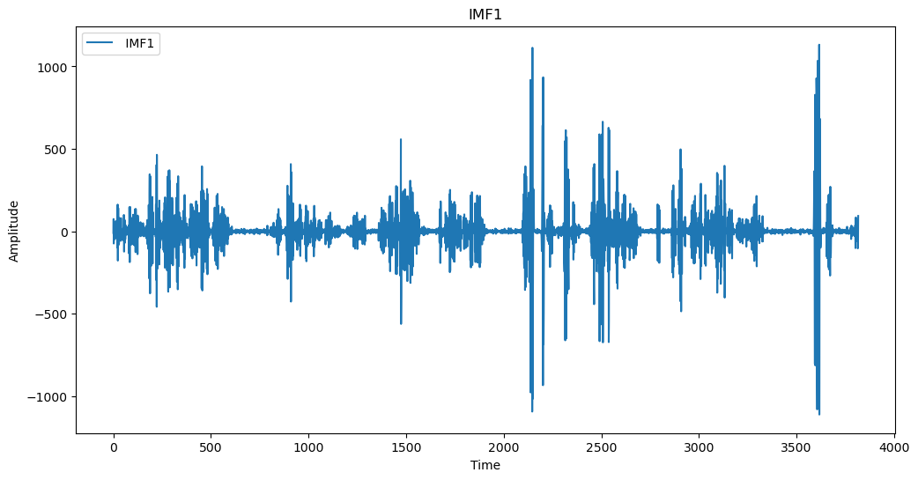
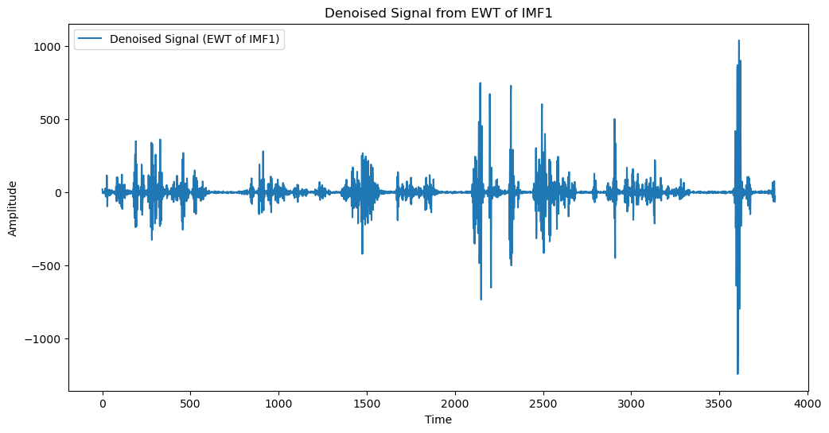
EWT: Empirical Wavelet Transform for High-Frequency Refinement
A sample of the first IMF.
Denoised Signal of the first IMF Using EWT

Slide 20

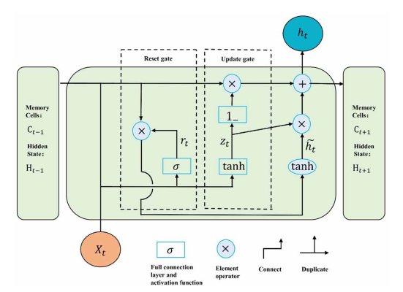
GRU: Gated Recurrent Unit
A simplified variant of RNN that addresses the vanishing gradient problem.
GRU architecture:
Update gate controls how much past information to carry forward.
Reset gate determines how to combine new input with previous memory.
Benefits of GRU
Effectively handles high-frequency signals [38].
Requires fewer parameters, reducing overfitting risks.
Faster training than LSTM but similar or better performance.
[38] Jiwei Zhao, Guangzheng Nie, Meng Yan, Yaowen Wang, and Luyao Wang. A novel approach to precipitation prediction using a coupled ceemdan-gru-transformer model with permutation entropy algorithm. Water Science & Technology, 88(4):1015–1038, 2023

Slide 21
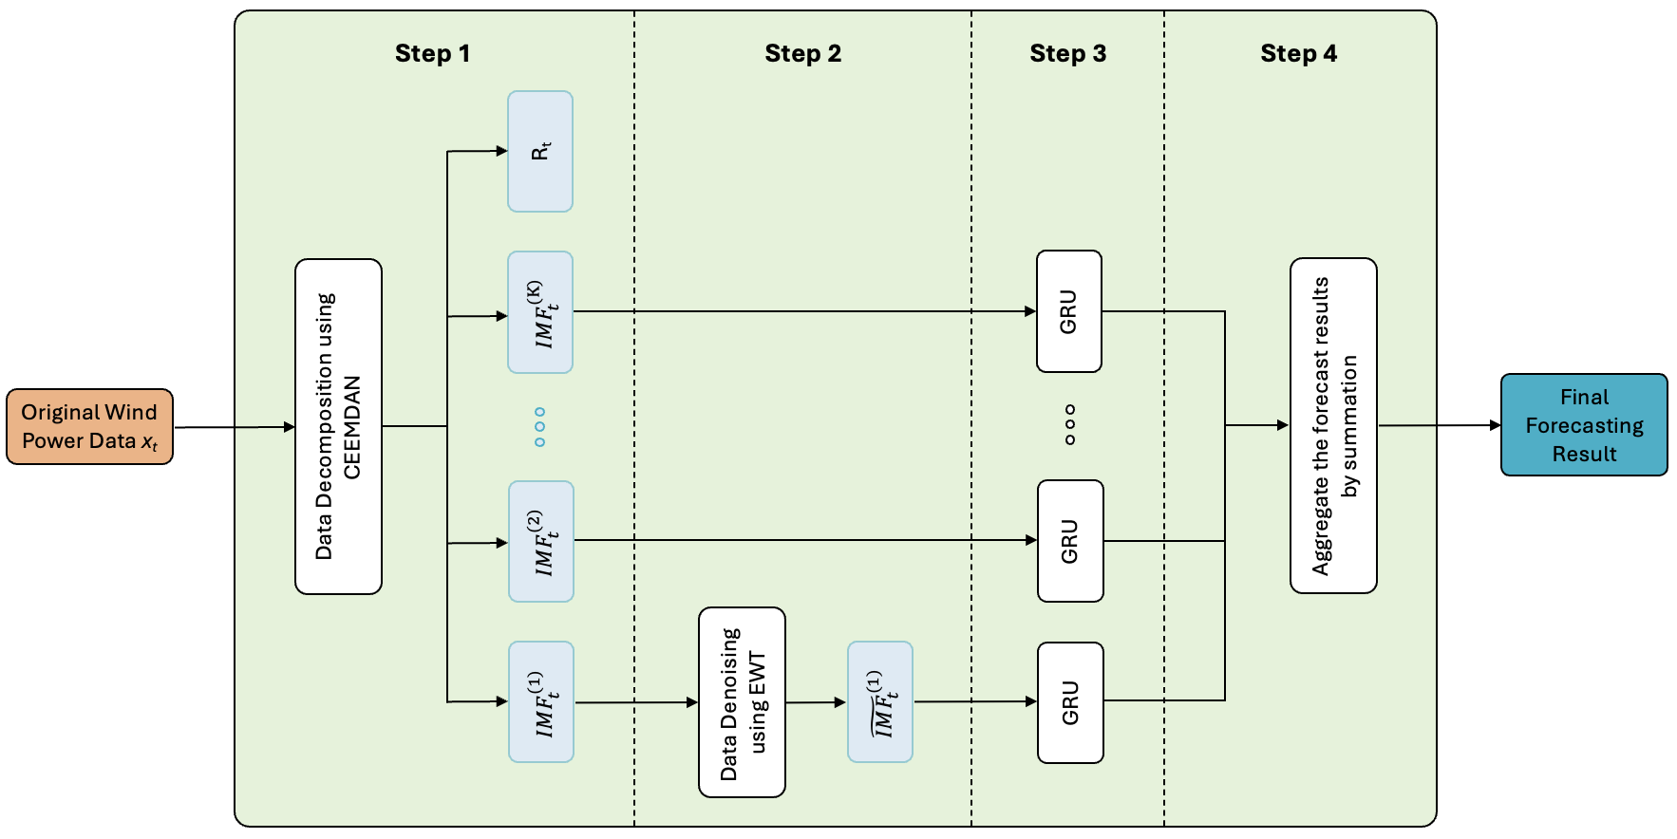
Proposed Framework Overview

Slide 22
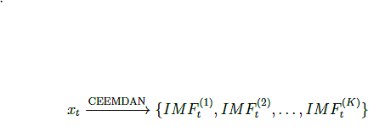

Mathematical Formulation of the Framework
Step 1: Decomposing the Feature Using CEEMDAN
Step 2: Processing IMF1 Using EWT
Step 3: Training GRU for Each IMF Independently
Step 4: Final Prediction Aggregation (The final output is the sum of GRU outputs)

Slide 23
Experiments and Analysis

Slide 24

Dataset Overview
Location: Turkey (2018)
Frequency: 10-minute intervals over one year
Features:
LV ActivePower (kW): Actual power output
Wind Speed (m/s): At turbine height
Wind Direction (°): At hub height
Theoretical Power Curve: Ideal output
based on turbine specs and wind speed

Slide 25
Experiment Settings
Model Training
Optimizer: Adam
Learning Rate: 0.001
Units per GRU Layer: 128
Batch Size: 64
Epochs: 30
Loss Function: Mean Squared Error (MSE)
Tools & Libraries Used
CEEMDAN: Implemented using pyEMD package.
EWT: Performed using ewtpy package.
DL Models: Built using Keras & TensorFlow.
Input-Output Configuration
Input Lengths: 1h, 1.5h, 2h, 4h.
Output Horizons: 10 min, 20 min, 30 min, 1h

Slide 26
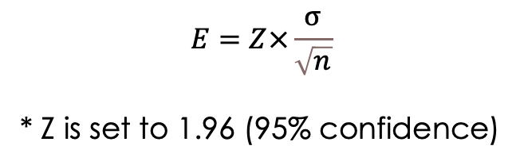
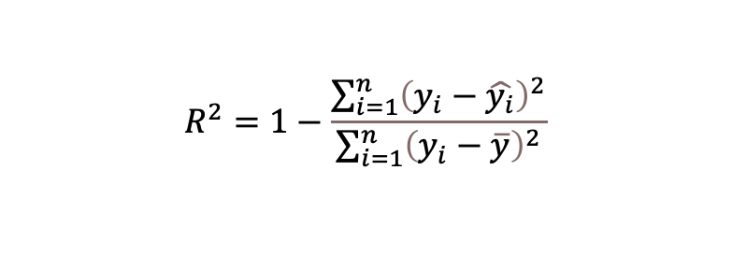
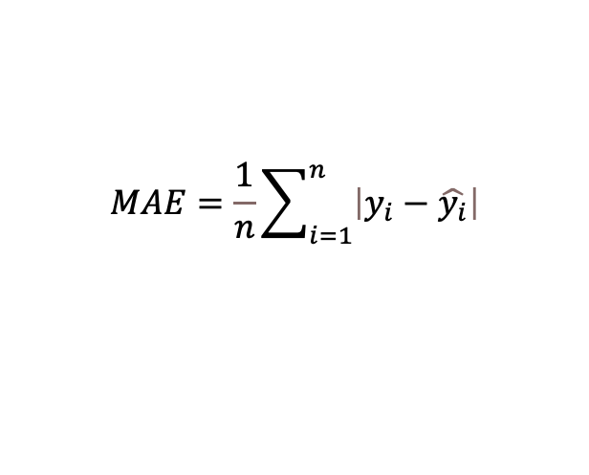
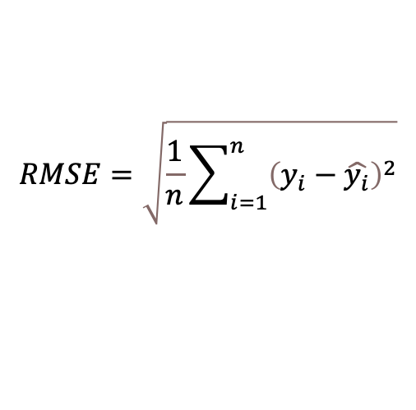
Evaluation Metrics
Root Mean Squared Error (RMSE)
Mean Absolute Error (MAE)
$$RMSE=\sqrt{\frac{1}{n}\sum_{i=1}^{n}{{\left(y_{i}−\hat{y_{i}}\right)}^{2}}}$$
$$MAE=\frac{1}{n}\sum_{i=1}^{n}{\left|y_{i}−\hat{y_{i}}\right|}$$
R-Squared (R² Score)
Margin of Error (ME)
$$R^{2}=1−\frac{\sum_{i=1}^{n}{{\left(y_{i}−\hat{y_{i}}\right)}^{2}}}{\sum_{i=1}^{n}{{\left(y_{i}−\overline{y}\right)}^{2}}}$$
$$E=Z×\frac{σ}{\sqrt{n}}$$
* Z is set to 1.96 (95% confidence)

Slide 27
Exp 1: Benchmarking the Proposed Method
Model | Metrics | Jan | Feb | March | April | May | June | July | August | Sept | Oct | Nov | Dec | Average | Sum
Transformer | RSME | 303.769 | 337.06 | 337.77 | 275.645 | 383.119 | 364.777 | 133.419 | 329.653 | 327.721 | 254.302 | 330.843 | 144.958 | 293.586 | 3523.036
 | MAE | 169.387 | 215.915 | 228.503 | 203.776 | 287.115 | 254.79 | 78.333 | 284.386 | 270.494 | 205.926 | 283.193 | 110.23 | 216.004 | 2592.048
 | R2 | 0.818 | 0.924 | 0.945 | 0.948 | 0.828 | 0.862 | 0.929 | 0.913 | 0.932 | 0.96 | 0.884 | 0.898 | 0.903 | 10.841
RNN | RSME | 306.116 | 309.844 | 340.632 | 182.063 | 378.39 | 387.04 | 146.304 | 433.305 | 277.605 | 660.569 | 255.5 | 193.325 | 322.558 | 3870.693
 | MAE | 125.373 | 237.603 | 262.925 | 122.658 | 281.454 | 280.922 | 75.711 | 388.814 | 217.617 | 493.573 | 201.612 | 177.783 | 238.837 | 2866.045
 | R2 | 0.815 | 0.935 | 0.944 | 0.977 | 0.833 | 0.844 | 0.915 | 0.85 | 0.951 | 0.729 | 0.931 | 0.818 | 0.879 | 10.542
LSTM | RSME | 284.606 | 321.078 | 523.171 | 224.114 | 437.65 | 390.345 | 143.354 | 536.128 | 424.752 | 469.072 | 317.835 | 187.92 | 355.002 | 4260.025
 | MAE | 162.914 | 238.959 | 448.153 | 165.147 | 330.957 | 284.547 | 77.384 | 422.277 | 355.027 | 361.581 | 205.464 | 163.88 | 268.024 | 3216.29
 | R2 | 0.84 | 0.931 | 0.867 | 0.965 | 0.776 | 0.841 | 0.918 | 0.77 | 0.886 | 0.863 | 0.893 | 0.828 | 0.865 | 10.378
GRU | RSME | 296.017 | 315.61 | 410.94 | 208.442 | 700.199 | 445.345 | 141.179 | 390.569 | 354.488 | 420.751 | 243.922 | 197.536 | 343.75 | 4124.998
 | MAE | 188.871 | 241.312 | 357.801 | 161.729 | 564.648 | 335.714 | 80.204 | 341.732 | 290.468 | 327.232 | 175.378 | 182.364 | 270.621 | 3247.453
 | R2 | 0.827 | 0.933 | 0.918 | 0.97 | 0.427 | 0.794 | 0.921 | 0.878 | 0.921 | 0.89 | 0.937 | 0.81 | 0.852 | 10.226
Bi-LSTM | RSME | 278.346 | 272.156 | 289.604 | 187.959 | 336.597 | 362.967 | 128.563 | 247.936 | 235.54 | 257.309 | 221.25 | 112.407 | 244.22 | 2930.634
 | MAE | 101.444 | 138.946 | 181.576 | 115.828 | 244.266 | 247.79 | 70.851 | 188.97 | 144.82 | 191.047 | 137.975 | 62.901 | 152.201 | 1826.414
 | R2 | 0.847 | 0.95 | 0.959 | 0.976 | 0.868 | 0.863 | 0.934 | 0.951 | 0.965 | 0.959 | 0.948 | 0.938 | 0.93 | 11.158
CEEDMAN-EWT-GRU (Proposed Method) | RSME | 159.848 | 104.645 | 115.854 | 65.954 | 120.018 | 129.677 | 44.944 | 80.535 | 96.789 | 64.776 | 85.281 | 36.311 | 92.053 | 1104.632
 | MAE | 113.258 | 62.112 | 67.037 | 41.752 | 81.743 | 94.476 | 25.51 | 54.866 | 70.223 | 45.104 | 40.109 | 21.787 | 59.831 | 717.977
 | R2 | 0.95 | 0.993 | 0.993 | 0.997 | 0.983 | 0.983 | 0.992 | 0.995 | 0.994 | 0.997 | 0.992 | 0.994 | 0.989 | 11.863
CEEDMAN-EWT-LSTM (Benchmark) | RSME | 202.458 | 108.26 | 121.099 | 67.965 | 124.621 | 132.089 | 45.811 | 81.868 | 151.252 | 72.272 | 84.338 | 36.726 | 102.397 | 1228.759
 | MAE | 146.862 | 68.415 | 70.416 | 42.866 | 84.172 | 97.61 | 26.578 | 56.907 | 120.283 | 52.647 | 42.483 | 22.549 | 69.316 | 831.788
 | R2 | 0.919 | 0.992 | 0.993 | 0.997 | 0.982 | 0.982 | 0.992 | 0.995 | 0.986 | 0.997 | 0.992 | 0.993 | 0.985 | 11.82
CEEDMAN-EWT-Bi-LSTM | RSME | 185.342 | 115.757 | 125.428 | 67.587 | 125.268 | 133.228 | 46.435 | 84.128 | 143.651 | 74.643 | 86.547 | 107.076 | 107.924 | 1295.09
 | MAE | 127.545 | 73.032 | 76.937 | 44.338 | 84.239 | 97.899 | 28.391 | 61.664 | 114.453 | 55.023 | 41.815 | 81.333 | 73.889 | 886.669
 | R2 | 0.932 | 0.991 | 0.992 | 0.997 | 0.982 | 0.982 | 0.991 | 0.994 | 0.987 | 0.997 | 0.992 | 0.944 | 0.982 | 11.781
CEEDMAN-EWT-Transformer | RSME | 382.646 | 173.029 | 241.975 | 109.585 | 210.966 | 208.302 | 66.362 | 132.306 | 370.888 | 148.649 | 123.775 | 150.738 | 193.268 | 2319.221
 | MAE | 278.782 | 102.245 | 149.807 | 63.986 | 149.908 | 150.169 | 35.895 | 88.671 | 298.668 | 115.095 | 58.034 | 110.931 | 133.516 | 1602.191
 | R2 | 0.756 | 0.98 | 0.97 | 0.992 | 0.95 | 0.955 | 0.981 | 0.983 | 0.906 | 0.986 | 0.961 | 0.881 | 0.942 | 11.301
Forecasting Performance of Different Methods for 1-Hour Input Length and 10-Minute Forecast Horizon.

Slide 28
Exp 1: Benchmarking the Proposed Method
Model | Metrics | 1 hr - 10 mins |  | 1.5 hr - 10 mins |  | 2 hr - 10 mins |  | 4 hr - 10 mins
 |  | Average | Sum | Average | Sum | Average | Sum | Average | Sum
Transformer | RSME | 293.586 | 3523.036 | 306.499 | 3677.992 | 307.823 | 3693.874 | 300.705 | 3608.454
 | MAE | 216.004 | 2592.048 | 225.276 | 2703.309 | 241.268 | 2895.218 | 225.75 | 2709.004
 | R2 | 0.903 | 10.841 | 0.889 | 10.665 | 0.89 | 10.674 | 0.891 | 10.697
RNN | RSME | 322.558 | 3870.693 | 387.413 | 4648.958 | 298.447 | 3581.359 | 330.023 | 3960.27
 | MAE | 238.837 | 2866.045 | 305.683 | 3668.192 | 211.489 | 2537.868 | 253.346 | 3040.147
 | R2 | 0.879 | 10.542 | 0.824 | 9.891 | 0.893 | 10.717 | 0.87 | 10.436
LSTM | RSME | 355.002 | 4260.025 | 323.174 | 3878.088 | 329.386 | 3952.631 | 333.623 | 4003.478
 | MAE | 268.024 | 3216.29 | 245.355 | 2944.258 | 249.855 | 2998.255 | 257.275 | 3087.296
 | R2 | 0.865 | 10.378 | 0.881 | 10.573 | 0.877 | 10.521 | 0.873 | 10.477
GRU | RSME | 343.75 | 4124.998 | 311.541 | 3738.497 | 319.265 | 3831.182 | 315.186 | 3782.227
 | MAE | 270.621 | 3247.453 | 238.154 | 2857.844 | 239.535 | 2874.417 | 243.419 | 2921.032
 | R2 | 0.852 | 10.226 | 0.889 | 10.662 | 0.881 | 10.569 | 0.88 | 10.559
Bi-LSTM | RSME | 244.22 | 2930.634 | 239.601 | 2875.213 | 236.6 | 2839.204 | 240.979 | 2891.744
 | MAE | 152.201 | 1826.414 | 148.458 | 1781.491 | 143.16 | 1717.922 | 149.053 | 1788.637
 | R2 | 0.93 | 11.158 | 0.932 | 11.189 | 0.934 | 11.204 | 0.931 | 11.177
CEEMDAN-EWT-GRU (Proposed Method) | RSME | 92.053 | 1104.632 | 95.485 | 1145.823 | 94.319 | 1131.832 | 93.716 | 1124.59
 | MAE | 59.831 | 717.977 | 63.54 | 762.48 | 63.108 | 757.295 | 61.491 | 737.893
 | R2 | 0.989 | 11.863 | 0.985 | 11.821 | 0.987 | 11.839 | 0.987 | 11.838
CEEMDAN-EWT-LSTM (Benchmark) | RSME | 102.397 | 1228.759 | 97.157 | 1165.887 | 112.135 | 1345.617 | 104.615 | 1255.377
 | MAE | 69.316 | 831.788 | 65.105 | 781.257 | 77.743 | 932.915 | 71.117 | 853.4
 | R2 | 0.985 | 11.82 | 0.985 | 11.818 | 0.972 | 11.662 | 0.983 | 11.792
CEEMDAN-EWT-Bi-LSTM | RSME | 107.924 | 1295.09 | 101.542 | 1218.5 | 108.461 | 1301.536 | 102.127 | 1225.519
 | MAE | 73.889 | 886.669 | 68.559 | 822.703 | 75.686 | 908.227 | 68.611 | 823.326
 | R2 | 0.982 | 11.781 | 0.986 | 11.836 | 0.978 | 11.73 | 0.984 | 11.805
CEEMDAN-EWT-Transformer | RSME | 193.268 | 2319.221 | 197.823 | 2373.878 | 202.456 | 2429.474 | 282.123 | 3385.481
 | MAE | 133.516 | 1602.191 | 134.874 | 1618.486 | 139.113 | 1669.359 | 182.674 | 2192.083
 | R2 | 0.942 | 11.301 | 0.942 | 11.299 | 0.94 | 11.282 | 0.896 | 10.755
Forecasting Performance of Different Methods for Varying Input Lengths with a Fixed 10-Minute Horizon.

Slide 29
Exp 1: Benchmarking the Proposed Method
Model | Metrics | 1 hr - 20 mins |  | 1.5 hr - 20 mins |  | 2 hr - 20 mins |  | 4 hr - 20 mins
 |  | Average | Sum | Average | Sum | Average | Sum | Average | Sum
Transformer | RSME | 368.291 | 4419.493 | 330.41 | 3964.922 | 339.472 | 4073.669 | 358.223 | 4298.677
 | MAE | 273.234 | 3278.812 | 235.107 | 2821.278 | 252.063 | 3024.754 | 259.97 | 3119.643
 | R2 | 0.833 | 9.998 | 0.872 | 10.459 | 0.861 | 10.333 | 0.845 | 10.143
RNN | RSME | 419.843 | 5038.112 | 362.925 | 4355.099 | 389.01 | 4668.114 | 415.999 | 4991.991
 | MAE | 322.454 | 3869.447 | 266.953 | 3203.437 | 290.467 | 3485.607 | 323.737 | 3884.845
 | R2 | 0.788 | 9.454 | 0.846 | 10.149 | 0.826 | 9.906 | 0.783 | 9.398
LSTM | RSME | 399.286 | 4791.427 | 393.873 | 4726.471 | 367.407 | 4408.888 | 382.61 | 4591.323
 | MAE | 302.661 | 3631.936 | 300.343 | 3604.111 | 275.057 | 3300.685 | 283.157 | 3397.886
 | R2 | 0.817 | 9.804 | 0.828 | 9.931 | 0.849 | 10.189 | 0.836 | 10.031
GRU | RSME | 361.857 | 4342.28 | 355.014 | 4260.169 | 353.052 | 4236.627 | 356.191 | 4274.286
 | MAE | 270.999 | 3251.985 | 265.462 | 3185.541 | 264.791 | 3177.492 | 264.641 | 3175.696
 | R2 | 0.847 | 10.169 | 0.846 | 10.155 | 0.856 | 10.273 | 0.854 | 10.244
Bi-LSTM | RSME | 295.176 | 3542.108 | 291.242 | 3494.907 | 289.605 | 3475.256 | 288.785 | 3465.42
 | MAE | 184.851 | 2218.208 | 182.629 | 2191.55 | 178.746 | 2144.955 | 175.219 | 2102.623
 | R2 | 0.898 | 10.779 | 0.901 | 10.808 | 0.902 | 10.824 | 0.903 | 10.832
CEEMDAN-EWT-GRU (Proposed Method) | RSME | 124.536 | 1494.432 | 118.795 | 1425.542 | 114.656 | 1375.873 | 114.426 | 1373.115
 | MAE | 80.137 | 961.648 | 76.893 | 922.714 | 71.414 | 856.967 | 72.315 | 867.777
 | R2 | 0.975 | 11.696 | 0.978 | 11.738 | 0.98 | 11.764 | 0.981 | 11.772
CEEMDAN-EWT-LSTM (Benchmark) | RSME | 134.258 | 1611.098 | 133.934 | 1607.206 | 144.748 | 1736.981 | 145.397 | 1744.758
 | MAE | 89.28 | 1071.362 | 90.319 | 1083.829 | 98.343 | 1180.116 | 98.796 | 1185.55
 | R2 | 0.972 | 11.658 | 0.96 | 11.523 | 0.956 | 11.468 | 0.959 | 11.504
CEEMDAN-EWT-Bi-LSTM | RSME | 144.397 | 1732.758 | 127.824 | 1533.892 | 130.238 | 1562.852 | 128.598 | 1543.171
 | MAE | 98.194 | 1178.333 | 85.302 | 1023.629 | 86.22 | 1034.639 | 83.277 | 999.327
 | R2 | 0.961 | 11.529 | 0.972 | 11.666 | 0.969 | 11.632 | 0.976 | 11.713
CEEMDAN-EWT-Transformer | RSME | 266.494 | 3197.928 | 272.242 | 3266.907 | 272.79 | 3273.479 | 367.161 | 4405.933
 | MAE | 194.28 | 2331.356 | 196.638 | 2359.654 | 196.451 | 2357.407 | 273.8 | 3285.596
 | R2 | 0.916 | 10.997 | 0.913 | 10.961 | 0.915 | 10.979 | 0.828 | 9.939
Forecasting Performance of Different Methods for Varying Input Lengths with a Fixed 20-Minute Horizon.

Slide 30
Exp 1: Benchmarking the Proposed Method
Model | Metrics | 1 hr - 30 mins |  | 1.5 hr - 30 mins |  | 2 hr - 30 mins |  | 4 hr - 30 mins
 |  | Average | Sum | Average | Sum | Average | Sum | Average | Sum
Transformer | RSME | 387.187 | 4646.246 | 391.37 | 4696.445 | 390.979 | 4691.751 | 412.026 | 4944.308
 | MAE | 278.64 | 3343.684 | 292.054 | 3504.649 | 292.543 | 3510.517 | 308.432 | 3701.179
 | R2 | 0.827 | 9.924 | 0.815 | 9.781 | 0.825 | 9.899 | 0.799 | 9.583
RNN | RSME | 420.421 | 5045.046 | 431.75 | 5181.002 | 414.75 | 4976.997 | 443.842 | 5326.108
 | MAE | 318.516 | 3822.194 | 332.502 | 3990.019 | 311.356 | 3736.277 | 332.323 | 3987.88
 | R2 | 0.792 | 9.508 | 0.782 | 9.378 | 0.804 | 9.648 | 0.768 | 9.21
LSTM | RSME | 459.679 | 5516.145 | 432.133 | 5185.599 | 408.496 | 4901.947 | 411.389 | 4936.67
 | MAE | 354.378 | 4252.531 | 326.598 | 3919.176 | 304.631 | 3655.567 | 301.294 | 3615.522
 | R2 | 0.765 | 9.176 | 0.793 | 9.516 | 0.81 | 9.716 | 0.808 | 9.699
GRU | RSME | 393.507 | 4722.089 | 381.812 | 4581.741 | 386.333 | 4635.997 | 385.283 | 4623.394
 | MAE | 293.63 | 3523.556 | 280.973 | 3371.675 | 288.609 | 3463.302 | 285.569 | 3426.823
 | R2 | 0.817 | 9.805 | 0.828 | 9.933 | 0.826 | 9.914 | 0.826 | 9.91
Bi-LSTM | RSME | 335.629 | 4027.552 | 326.777 | 3921.326 | 326.845 | 3922.144 | 326.68 | 3920.155
 | MAE | 217.087 | 2605.041 | 201.043 | 2412.521 | 200.346 | 2404.157 | 198.599 | 2383.191
 | R2 | 0.87 | 10.445 | 0.876 | 10.513 | 0.876 | 10.517 | 0.876 | 10.515
CEEMDAN-EWT-GRU (Proposed Method) | RSME | 139.198 | 1670.371 | 136.844 | 1642.126 | 132.036 | 1584.437 | 137.381 | 1648.574
 | MAE | 89.05 | 1068.605 | 88.694 | 1064.327 | 84.339 | 1012.067 | 88.542 | 1062.503
 | R2 | 0.971 | 11.655 | 0.97 | 11.64 | 0.972 | 11.669 | 0.972 | 11.663
CEEMDAN-EWT-LSTM (Benchmark) | RSME | 154.203 | 1850.436 | 151.214 | 1814.569 | 159.114 | 1909.362 | 162.702 | 1952.424
 | MAE | 104.191 | 1250.294 | 102.33 | 1227.956 | 107.294 | 1287.529 | 107.308 | 1287.691
 | R2 | 0.959 | 11.507 | 0.955 | 11.463 | 0.95 | 11.394 | 0.955 | 11.464
CEEMDAN-EWT-Bi-LSTM | RSME | 151.427 | 1817.125 | 150.957 | 1811.487 | 149.384 | 1792.609 | 179.811 | 2157.728
 | MAE | 99.676 | 1196.116 | 101.16 | 1213.921 | 99.631 | 1195.575 | 123.906 | 1486.87
 | R2 | 0.965 | 11.581 | 0.956 | 11.468 | 0.958 | 11.5 | 0.933 | 11.19
CEEMDAN-EWT-Transformer | RSME | 281.531 | 3378.368 | 279.807 | 3357.678 | 286.151 | 3433.811 | 369.661 | 4435.932
 | MAE | 205.216 | 2462.593 | 201.873 | 2422.47 | 211.082 | 2532.98 | 277.186 | 3326.231
 | R2 | 0.909 | 10.905 | 0.911 | 10.934 | 0.907 | 10.88 | 0.827 | 9.921
Forecasting Performance of Different Methods for Varying Input Lengths with a Fixed 30-Minute Horizon.

Slide 31
Exp 1: Benchmarking the Proposed Method
Model | Metrics | 1 hr - 1 hr |  | 1.5 hr - 1 hr |  | 2 hr - 1 hr |  | 4 hr - 1 hr
 |  | Average | Sum | Average | Sum | Average | Sum | Average | Sum
Transformer | RSME | 474.08 | 5688.962 | 495.556 | 5946.667 | 390.979 | 4691.751 | 495.998 | 5951.979
 | MAE | 358.824 | 4305.892 | 378.976 | 4547.712 | 292.543 | 3510.517 | 382.669 | 4592.024
 | R2 | 0.745 | 8.939 | 0.714 | 8.565 | 0.825 | 9.899 | 0.705 | 8.456
RNN | RSME | 482.649 | 5791.788 | 469.162 | 5629.939 | 414.75 | 4976.997 | 798.335 | 9580.017
 | MAE | 357.561 | 4290.73 | 346.509 | 4158.11 | 311.356 | 3736.277 | 410.813 | 4929.759
 | R2 | 0.735 | 8.82 | 0.741 | 8.893 | 0.804 | 9.648 | 0.648 | 7.774
LSTM | RSME | 502.833 | 6033.991 | 484.157 | 5809.887 | 408.496 | 4901.947 | 481.456 | 5777.471
 | MAE | 383.028 | 4596.335 | 359.989 | 4319.869 | 304.631 | 3655.567 | 357.571 | 4290.854
 | R2 | 0.714 | 8.568 | 0.738 | 8.855 | 0.81 | 9.716 | 0.739 | 8.862
GRU | RSME | 463.591 | 5563.094 | 450.976 | 5411.717 | 386.333 | 4635.997 | 448.137 | 5377.647
 | MAE | 339.115 | 4069.385 | 330.991 | 3971.895 | 288.609 | 3463.302 | 325.449 | 3905.389
 | R2 | 0.745 | 8.934 | 0.761 | 9.135 | 0.826 | 9.914 | 0.767 | 9.207
Bi-LSTM | RSME | 407.983 | 4895.793 | 407.479 | 4889.746 | 326.845 | 3922.144 | 409.367 | 4912.4
 | MAE | 256.9 | 3082.802 | 255.636 | 3067.636 | 200.346 | 2404.157 | 254.975 | 3059.697
 | R2 | 0.808 | 9.698 | 0.81 | 9.715 | 0.876 | 10.517 | 0.809 | 9.703
CEEMDAN-EWT-GRU (Proposed Method) | RSME | 188.074 | 2256.891 | 182.877 | 2194.526 | 132.036 | 1584.437 | 181.742 | 2180.905
 | MAE | 121.369 | 1456.425 | 117.507 | 1410.087 | 84.339 | 1012.067 | 116.222 | 1394.665
 | R2 | 0.951 | 11.408 | 0.952 | 11.424 | 0.972 | 11.669 | 0.958 | 11.494
CEEMDAN-EWT-LSTM (Benchmark) | RSME | 205.698 | 2468.378 | 216.75 | 2601.005 | 159.114 | 1909.362 | 217.527 | 2610.328
 | MAE | 140.196 | 1682.352 | 148.469 | 1781.633 | 107.294 | 1287.529 | 147.218 | 1766.614
 | R2 | 0.934 | 11.204 | 0.912 | 10.942 | 0.95 | 11.394 | 0.919 | 11.024
CEEMDAN-EWT-Bi-LSTM | RSME | 203.552 | 2442.623 | 207.312 | 2487.747 | 149.384 | 1792.609 | 222.171 | 2666.052
 | MAE | 137.051 | 1644.613 | 139.27 | 1671.239 | 99.631 | 1195.575 | 153.787 | 1845.441
 | R2 | 0.937 | 11.239 | 0.929 | 11.144 | 0.958 | 11.5 | 0.924 | 11.088
CEEMDAN-EWT-Transformer | RSME | 295.626 | 3547.513 | 336.074 | 4032.888 | 286.151 | 3433.811 | 416.765 | 5001.183
 | MAE | 212.008 | 2544.101 | 243.377 | 2920.522 | 211.082 | 2532.98 | 306.991 | 3683.897
 | R2 | 0.902 | 10.823 | 0.874 | 10.492 | 0.907 | 10.88 | 0.799 | 9.582
Forecasting Performance of Different Methods for Varying Input Lengths with a Fixed 1-Hour Horizon.

Slide 32

Exp 1: Benchmarking the Proposed Method
- Using CEEMDAN & EWT to preprocess data significantly boosts forecasting performance.
- CEEMDAN-EWT-GRU achieves the best accuracy, lowest error, and highest efficiency in all input lengths and forecast horizons.
Insights

Slide 33
Exp 2: Effect of Meteorological Features on Forecasting
Input-Output Configuration: The historical length of 1 hour and the forecast horizon of 10 minutes were chosen because this combination yielded the best performance in Experiment 1.
Features Considered: Wind Power, Wind Speed, Wind Direction, Theoretical Power Curve
Model Variants Tested:
Proposed (All Features)
Proposed (3 Features): Wind Power, Wind Speed, Theoretical Power
Proposed (2 Features): Wind Power + Theoretical Power
Proposed + MHA (2 Features): GRU enhanced with Multi-Head Attention

Slide 34
Exp 2: Effect of Meteorological Features on Forecasting
Model | Metrics | Jan | Feb | March | April | May | June | July | August | Sept | Oct | Nov | Dec | Average | Sum
CEEDMAN-EWT-GRU (Proposed Method) | RSME | 159.848 | 104.645 | 115.854 | 65.954 | 120.018 | 129.677 | 44.944 | 80.535 | 96.789 | 64.776 | 85.281 | 36.311 | 92.053 | 1104.632
 | MAE | 113.258 | 62.112 | 67.037 | 41.752 | 81.743 | 94.476 | 25.51 | 54.866 | 70.223 | 45.104 | 40.109 | 21.787 | 59.831 | 717.977
 | R2 | 0.95 | 0.993 | 0.993 | 0.997 | 0.983 | 0.983 | 0.992 | 0.995 | 0.994 | 0.997 | 0.992 | 0.994 | 0.989 | 11.863
CEEDMAN-EWT-GRU (Proposed Method - All Feature) | RSME | 220.351 | 414.72 | 1491.743 | 679.698 | 1131.281 | 1176.162 | 211.185 | 1259.943 | 1413.096 | 1107.175 | 1988.602 | 379.871 | 956.152 | 11473.83
 | MAE | 104.315 | 282.335 | 1188.315 | 520.971 | 1069.743 | 1073.969 | 129.809 | 1019.686 | 1311.468 | 931.744 | 1918.187 | 141.817 | 807.697 | 9692.359
 | R2 | 0.904 | 0.884 | -0.08 | 0.681 | -0.496 | -0.439 | 0.822 | -0.272 | -0.257 | -0.238 | -3.176 | 0.297 | -0.114 | -1.37
CEEDMAN-EWT-GRU (Proposed Method - 3 Feature) | RSME | 285.518 | 390.225 | 1485.191 | 695.611 | 1129.929 | 1198.496 | 201.165 | 1233.679 | 1452.335 | 1156.259 | 2048.36 | 377.559 | 971.194 | 11654.33
 | MAE | 174.101 | 266.761 | 1183.502 | 530.815 | 1068.44 | 1092.821 | 125.434 | 1002.032 | 1346.041 | 968.972 | 1976.164 | 141.306 | 823.032 | 9876.389
 | R2 | 0.839 | 0.898 | -0.07 | 0.666 | -0.492 | -0.495 | 0.839 | -0.22 | -0.328 | 0.169 | -3.431 | 0.306 | -0.11 | -1.319
CEEDMAN-EWT-GRU (Proposed Method - 2 Feature) | RSME | 212.009 | 163.802 | 186.19 | 92.857 | 191.646 | 180.967 | 71.852 | 100.883 | 153.447 | 126.395 | 120.295 | 84.537 | 140.407 | 1684.88
 | MAE | 82.71 | 104.13 | 111.074 | 58.194 | 127.486 | 127.681 | 48.117 | 66.742 | 108.805 | 85.062 | 55.376 | 53.457 | 85.736 | 1028.834
 | R2 | 0.911 | 0.982 | 0.983 | 0.994 | 0.957 | 0.966 | 0.979 | 0.992 | 0.985 | 0.99 | 0.965 | 0.965 | 0.972 | 11.669
CEEDMAN-EWT-GRU-MHA (2 Feature) | RSME | 271.12 | 414.595 | 1506.232 | 792.722 | 1174.452 | 1260.331 | 229.526 | 1302.368 | 2052.557 | 1090.491 | 2069.477 | 395.905 | 1046.648 | 12559.78
 | MAE | 179.773 | 281.311 | 1197.858 | 588.59 | 1105.397 | 1143.351 | 135.803 | 1047.421 | 1803.873 | 917.705 | 1996.327 | 145.228 | 878.553 | 10542.64
 | R2 | 0.855 | 0.884 | -0.101 | 0.566 | -0.612 | -0.653 | 0.79 | -0.359 | -1.653 | 0.261 | -3.523 | 0.237 | -0.276 | -3.308
Forecasting Performance of the Proposed Method with Varying Feature Counts for 1-Hour Input Length
and 10-Minute Forecasting Horizon.

Slide 35
Exp 2: Effect of Meteorological Features on Forecasting
- CEEMDAN-EWT-GRU is most effective when used with a single, well-targeted feature.
- Multi-feature setups introduce decomposition mismatches, reducing accuracy and model stability.
Insights

Slide 36
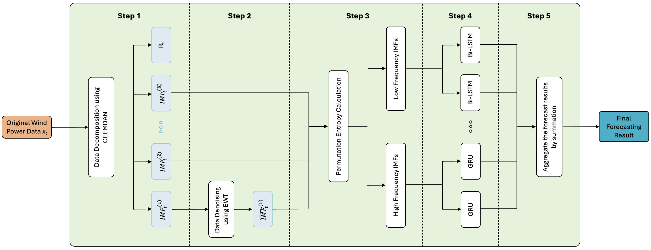
Exp 3: GRU-BiLSTM Based on Frequency Decomposition
The framework of hybrid GRU-BiLSTM based on frequency decomposition.
Inspried by the framework proposed in [38]
[38] Zhao, Jiwei and Nie, Guangzheng and Yan, Meng and Wang, Yaowen and Wang, Luyao. A novel approach to precipitation prediction using a coupled CEEMDAN-GRU-Transformer model with permutation entropy algorithm. Water Science & Technology, 88(4):1015-1038, 2023.

Slide 37
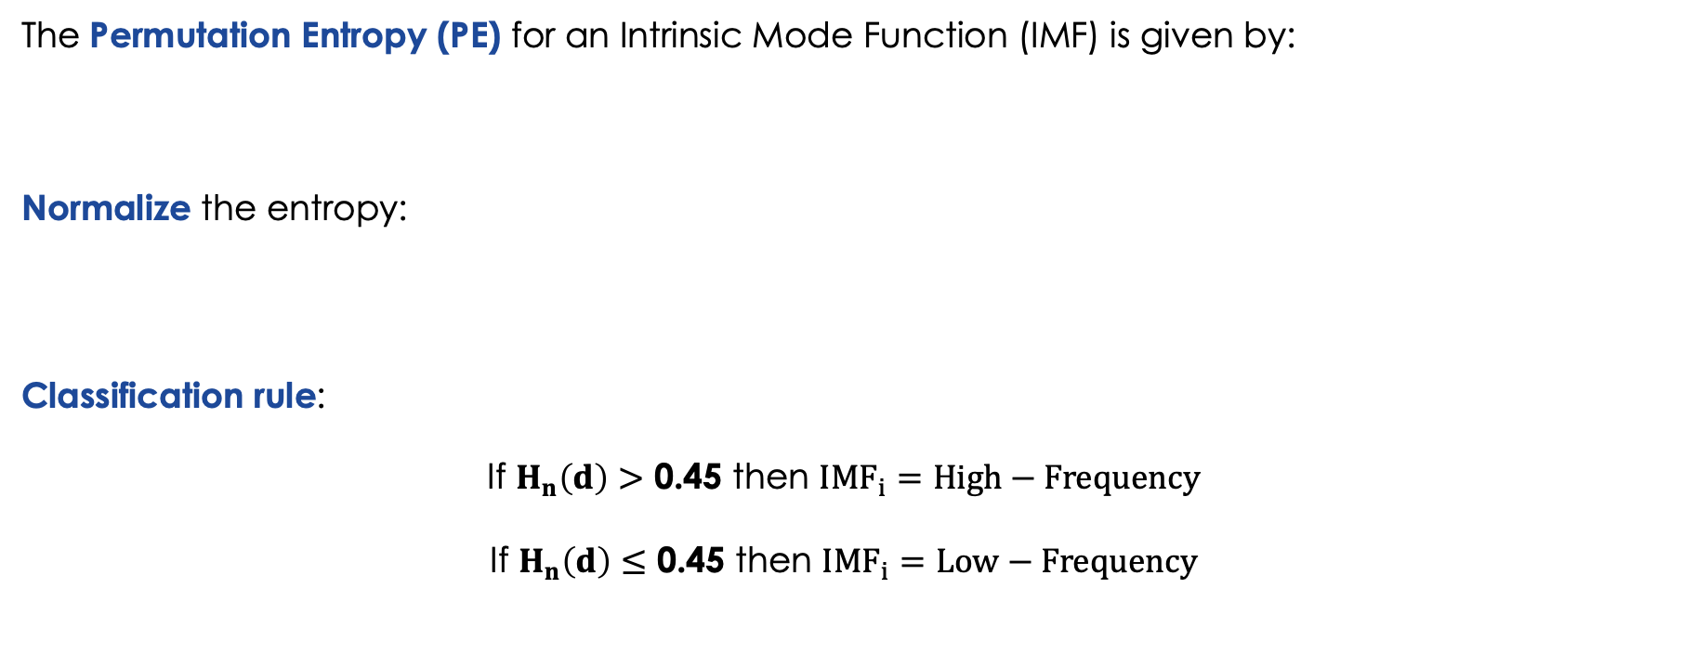

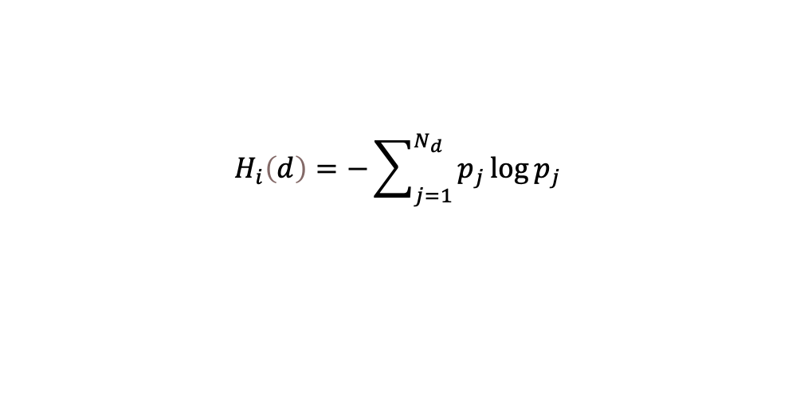
Exp 3: GRU-BiLSTM Based on Frequency Decomposition
Permutation Entropy (PE)
The Permutation Entropy (PE) for an Intrinsic Mode Function (IMF) is given by:
Normalize the entropy:
Classification rule:
If $H_{n}\left(d\right)$ $>$ 0.45 then ${IMF}_{i}=High−Frequency$
If $H_{n}\left(d\right)$ $≤$ 0.45 then ${IMF}_{i}=Low−Frequency$
$$H_{i}\left(d\right)=−\sum_{j=1}^{N_{d}}{p_{j}}\log{p_{j}}$$
$$H_{n}\left(d\right)=\frac{H_{i}\left(d\right)}{\log{N_{d}}}$$

Slide 38
Exp 3: GRU-BiLSTM Based on Frequency Decomposition
Model | Metrics | Jan | Feb | March | April | May | June | July | August | Sept | Oct | Nov | Dec | Average | Sum
CEEDMAN-EWT-GRU (Proposed Method) | RSME | 159.848 | 104.645 | 115.854 | 65.954 | 120.018 | 129.677 | 44.944 | 80.535 | 96.789 | 64.776 | 85.281 | 36.311 | 92.053 | 1104.632
 | MAE | 113.258 | 62.112 | 67.037 | 41.752 | 81.743 | 94.476 | 25.51 | 54.866 | 70.223 | 45.104 | 40.109 | 21.787 | 59.831 | 717.977
 | R2 | 0.95 | 0.993 | 0.993 | 0.997 | 0.983 | 0.983 | 0.992 | 0.995 | 0.994 | 0.997 | 0.992 | 0.994 | 0.989 | 11.863
 | ME | 9.559 | 7.226 | 7.592 | 4.356 | 7.874 | 8.754 | 2.924 | 5.314 | 6.298 | 4.367 | 6.077 | 2.293 | 6.053 | 72.634
CEEDMAN-EWT-Bi-LSTM | RSME | 185.342 | 115.757 | 125.428 | 67.587 | 125.268 | 133.228 | 46.435 | 84.128 | 143.651 | 74.643 | 86.547 | 107.076 | 107.924 | 1295.09
 | MAE | 127.545 | 73.032 | 76.937 | 44.338 | 84.239 | 97.899 | 28.391 | 61.664 | 114.453 | 55.023 | 41.815 | 81.333 | 73.889 | 886.669
 | R2 | 0.932 | 0.991 | 0.992 | 0.997 | 0.982 | 0.982 | 0.991 | 0.994 | 0.987 | 0.997 | 0.992 | 0.944 | 0.982 | 11.781
 | ME | 11.196 | 8.008 | 8.238 | 4.464 | 8.219 | 8.972 | 2.942 | 5.369 | 7.424 | 5.071 | 6.169 | 5.329 | 6.783 | 81.401
CEEDMAN-EWT-GRU-Bi-LSTM | RSME | 128.312 | 112.318 | 126.333 | 67.041 | 120.39 | 130.45 | 45.165 | 81.961 | 144.624 | 75.907 | 86.881 | 71.282 | 99.222 | 1190.664
 | MAE | 73.786 | 70.774 | 78.193 | 43.143 | 81.953 | 95.362 | 25.85 | 58.272 | 114.716 | 55.226 | 43.048 | 53.429 | 66.146 | 793.752
 | R2 | 0.967 | 0.992 | 0.992 | 0.997 | 0.983 | 0.982 | 0.992 | 0.995 | 0.987 | 0.996 | 0.992 | 0.975 | 0.988 | 11.85
 | ME | 8.762 | 7.743 | 8.314 | 4.468 | 7.921 | 8.805 | 2.93 | 5.34 | 7.506 | 4.808 | 6.2 | 3.701 | 6.375 | 76.498
CEEDMAN-EWT-LSTM (Benchmark) | RSME | 202.458 | 108.26 | 121.099 | 67.965 | 124.621 | 132.089 | 45.811 | 81.868 | 151.252 | 72.272 | 84.338 | 36.726 | 102.397 | 1228.759
 | MAE | 146.862 | 68.415 | 70.416 | 42.866 | 84.172 | 97.61 | 26.578 | 56.907 | 120.283 | 52.647 | 42.483 | 22.549 | 69.316 | 831.788
 | R2 | 0.919 | 0.992 | 0.993 | 0.997 | 0.982 | 0.982 | 0.992 | 0.995 | 0.986 | 0.997 | 0.992 | 0.993 | 0.985 | 11.82
 | ME | 11.404 | 7.414 | 7.937 | 4.549 | 8.155 | 8.915 | 2.959 | 5.363 | 7.775 | 4.859 | 6.015 | 2.355 | 6.475 | 77.7
Performance of Hybrid Methods for the 1-Hour Input Length and the 10-Minute Forecasting Horizon.

Slide 39
Exp 3: GRU-BiLSTM Based on Frequency Decomposition
Model | Metrics | 1 hr - 10 min |  | 1.5 hr - 10 min |  | 2 hr - 10 min |  | 4 hr - 10 min
 |  | Average | Sum | Average | Sum | Average | Sum | Average | Sum
CEEDMAN-EWT-GRU (Proposed Method) | RSME | 92.053 | 1104.632 | 95.485 | 1145.823 | 94.319 | 1131.832 | 93.716 | 1124.59
 | MAE | 59.831 | 717.977 | 63.54 | 762.48 | 63.108 | 757.295 | 61.491 | 737.893
 | R2 | 0.989 | 11.863 | 0.985 | 11.821 | 0.987 | 11.839 | 0.987 | 11.838
CEEDMAN-EWT-GRU-Bi-LSTM | RSME | 99.222 | 1190.664 | 98.532 | 1182.378 | 106.729 | 1280.746 | 106.049 | 1272.591
 | MAE | 66.146 | 793.752 | 66.674 | 800.091 | 73.404 | 880.853 | 73.297 | 879.565
 | R2 | 0.988 | 11.85 | 0.988 | 11.852 | 0.976 | 11.707 | 0.982 | 11.789
Model | Metrics | 1 hr - 20 min |  | 1.5 hr - 20 min |  | 2 hr - 20 min |  | 4 hr - 20 min
 |  | Average | Sum | Average | Sum | Average | Sum | Average | Sum
CEEDMAN-EWT-GRU (Proposed Method) | RSME | 124.536 | 1494.432 | 118.795 | 1425.542 | 114.656 | 1375.873 | 114.426 | 1373.115
 | MAE | 80.137 | 961.648 | 76.893 | 922.714 | 71.414 | 856.967 | 72.315 | 867.777
 | R2 | 0.975 | 11.696 | 0.978 | 11.738 | 0.98 | 11.764 | 0.981 | 11.772
CEEDMAN-EWT-GRU-Bi-LSTM | RSME | 138.915 | 1666.982 | 126.096 | 1513.157 | 138.688 | 1664.256 | 138.124 | 1657.489
 | MAE | 93.401 | 1120.81 | 84.871 | 1018.449 | 96.105 | 1153.265 | 93.199 | 1118.386
 | R2 | 0.967 | 11.604 | 0.973 | 11.679 | 0.96 | 11.521 | 0.965 | 11.584
Model | Metrics | 1 hr - 30 min |  | 1.5 hr - 30 min |  | 2 hr - 30 min |  | 4 hr - 30 min
 |  | Average | Sum | Average | Sum | Average | Sum | Average | Sum
CEEDMAN-EWT-GRU (Proposed Method) | RSME | 139.198 | 1670.371 | 136.844 | 1642.126 | 132.036 | 1584.437 | 137.381 | 1648.574
 | MAE | 89.05 | 1068.605 | 88.694 | 1064.327 | 84.339 | 1012.067 | 88.542 | 1062.503
 | R2 | 0.971 | 11.655 | 0.97 | 11.64 | 0.972 | 11.669 | 0.972 | 11.663
CEEDMAN-EWT-GRU-Bi-LSTM | RSME | 161.839 | 1942.069 | 146.122 | 1753.464 | 148.782 | 1785.378 | 162.457 | 1949.484
 | MAE | 111.592 | 1339.103 | 97.811 | 1173.726 | 99.895 | 1198.738 | 110.318 | 1323.821
 | R2 | 0.955 | 11.458 | 0.96 | 11.523 | 0.957 | 11.487 | 0.952 | 11.424
Model | Metrics | 1 hr - 1 hr |  | 1.5 hr - 1 hr |  | 2 hr - 1 hr |  | 4 hr - 1 hr
 |  | Average | Sum | Average | Sum | Average | Sum | Average | Sum
CEEDMAN-EWT-GRU (Proposed Method) | RSME | 188.074 | 2256.891 | 182.877 | 2194.526 | 132.036 | 1584.437 | 181.742 | 2180.905
 | MAE | 121.369 | 1456.425 | 117.507 | 1410.087 | 84.339 | 1012.067 | 116.222 | 1394.665
 | R2 | 0.951 | 11.408 | 0.952 | 11.424 | 0.972 | 11.669 | 0.958 | 11.494
CEEDMAN-EWT-GRU-Bi-LSTM | RSME | 197.182 | 2366.188 | 192.179 | 2306.142 | 196.204 | 2354.444 | 212.666 | 2551.994
 | MAE | 132.114 | 1585.368 | 127.568 | 1530.821 | 131.663 | 1579.961 | 142.97 | 1715.64
 | R2 | 0.942 | 11.302 | 0.942 | 11.304 | 0.935 | 11.217 | 0.934 | 11.208
Comparison of Performance Between the Hybrid Method & Proposed Method Across All Time Horizons.

Slide 40
Exp 3: GRU-BiLSTM Based on Frequency Decomposition
- The proposed CEEMDAN-EWT-GRU framework consistently outperforms the hybrid method across all forecast horizons.
- The hybrid GRU-BiLSTM framework adds complexity, does not improve accuracy and GRU alone is more stable, especially for high-frequency components
Insights

Slide 41
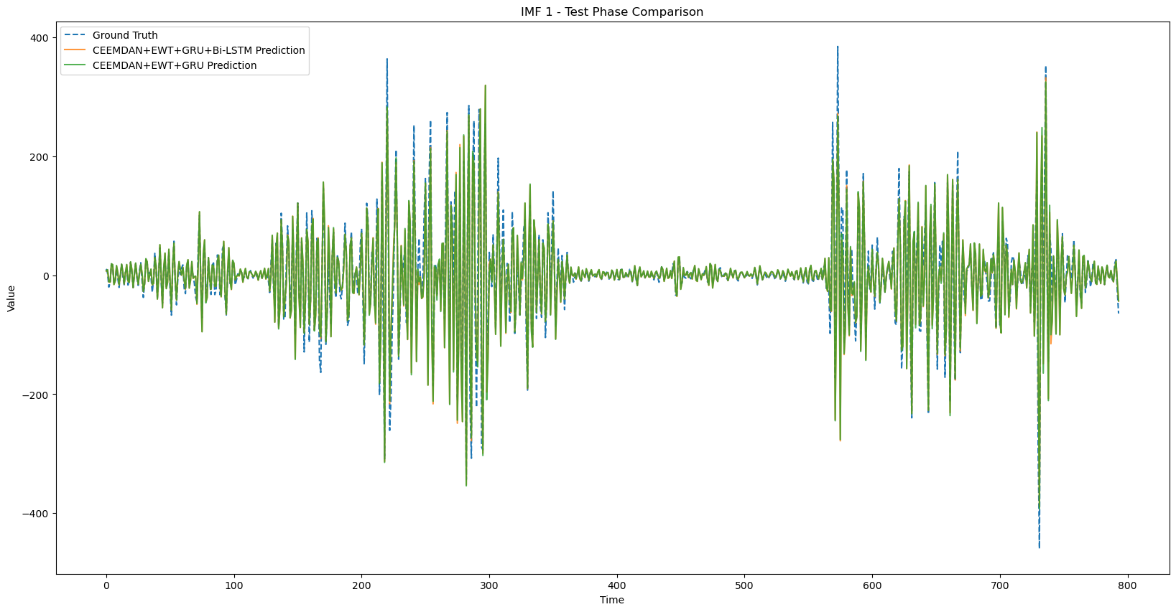
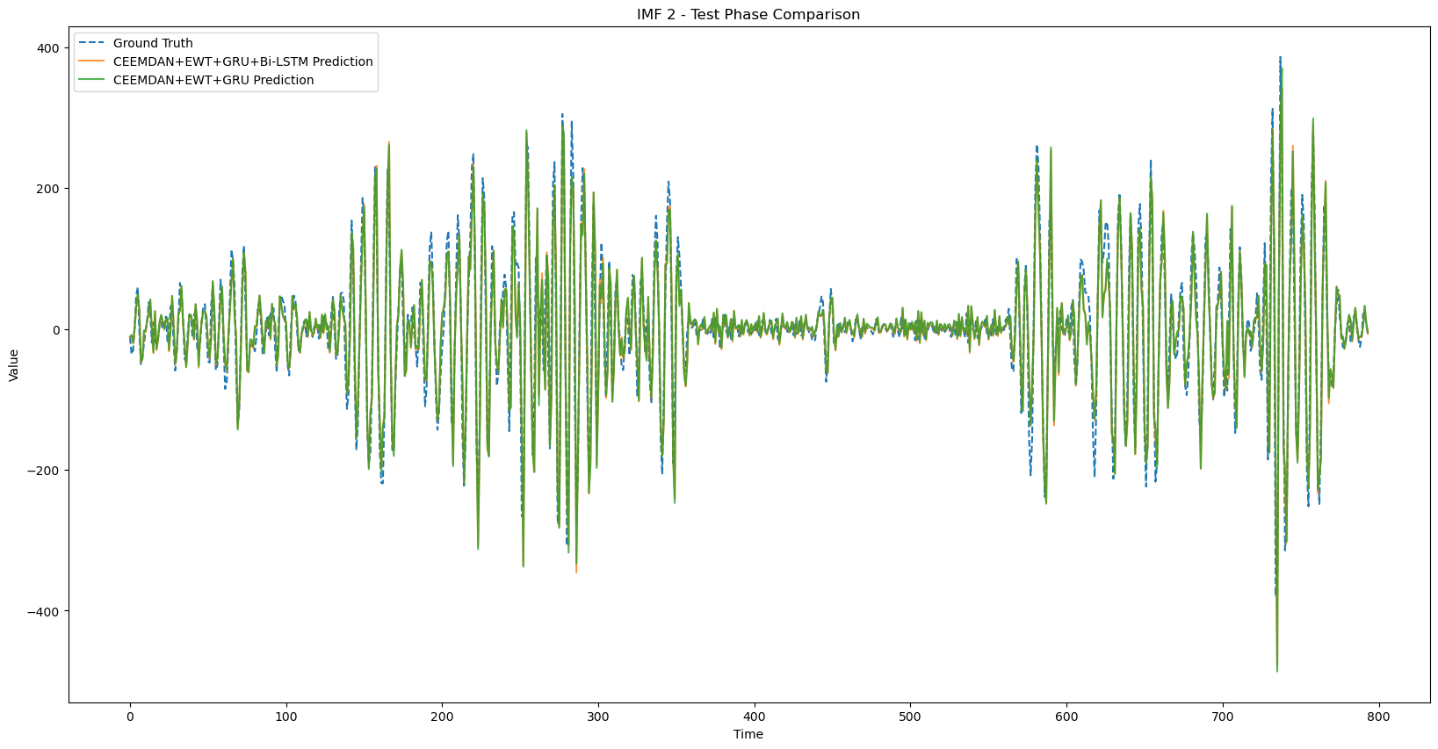
Exp 3: GRU-BiLSTM Based on Frequency Decomposition
IMF-Level Performance Analysis
IMF1: High-Frequency Component.
IMF2: High-Frequency Component.

Slide 42
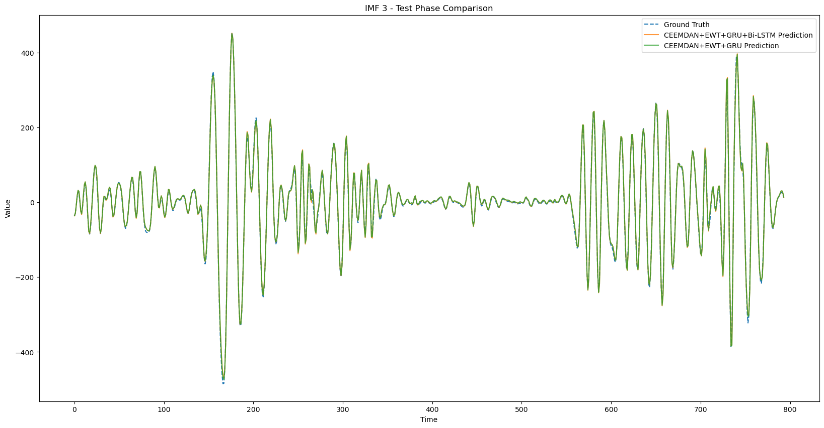
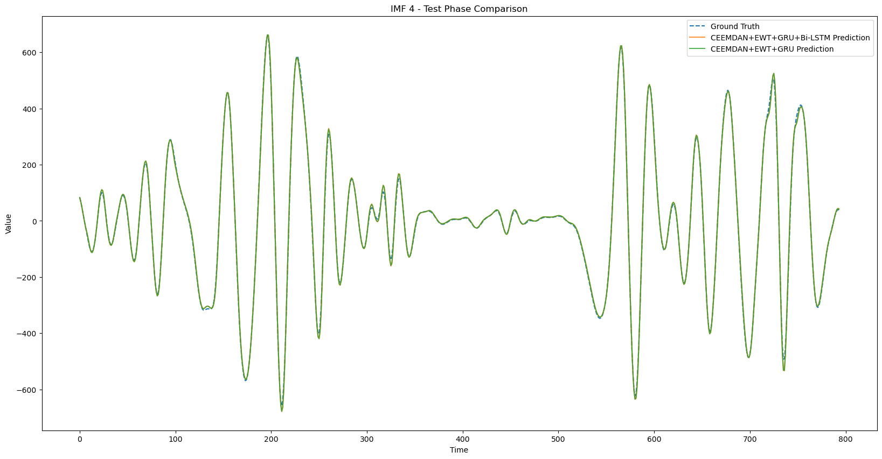
Exp 3: GRU-BiLSTM Based on Frequency Decomposition
IMF-Level Performance Analysis
IMF3: High-Frequency Component.
IMF4: High-Frequency Component.

Slide 43
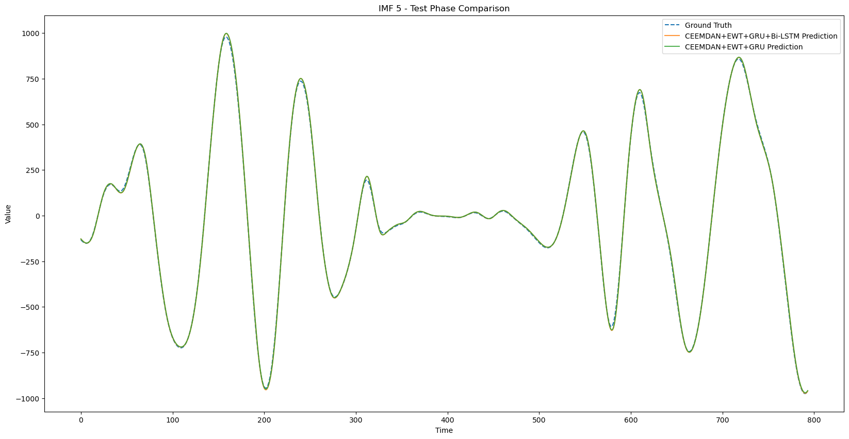
Exp 3: GRU-BiLSTM Based on Frequency Decomposition
IMF-Level Performance Analysis
IMF5: High-Frequency Component.
IMF6: Low-Frequency Component.

Slide 44
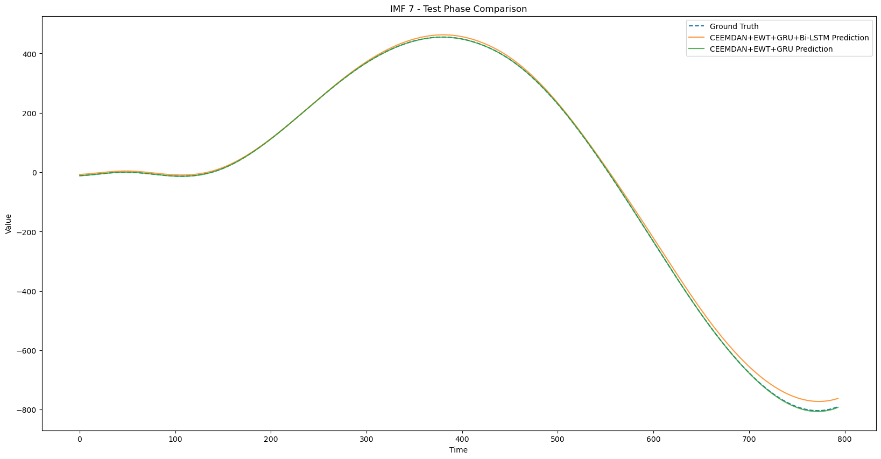
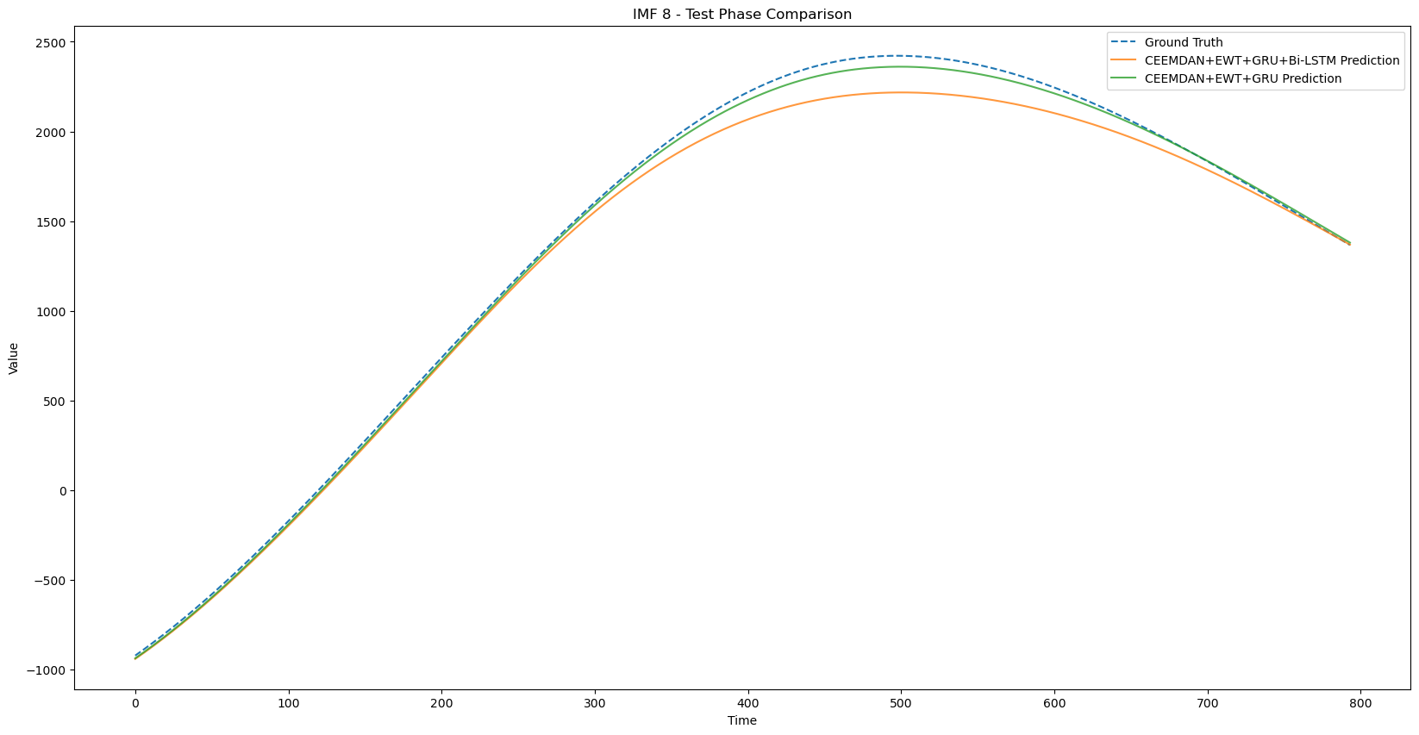
Exp 3: GRU-BiLSTM Based on Frequency Decomposition
IMF-Level Performance Analysis
IMF7: Low-Frequency Component.
IMF8: Low-Frequency Component.

Slide 45
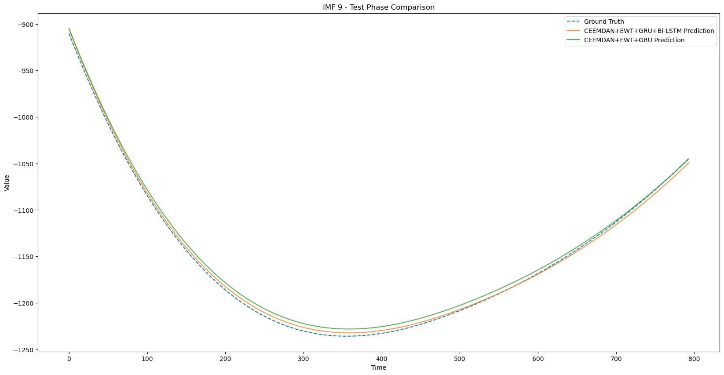
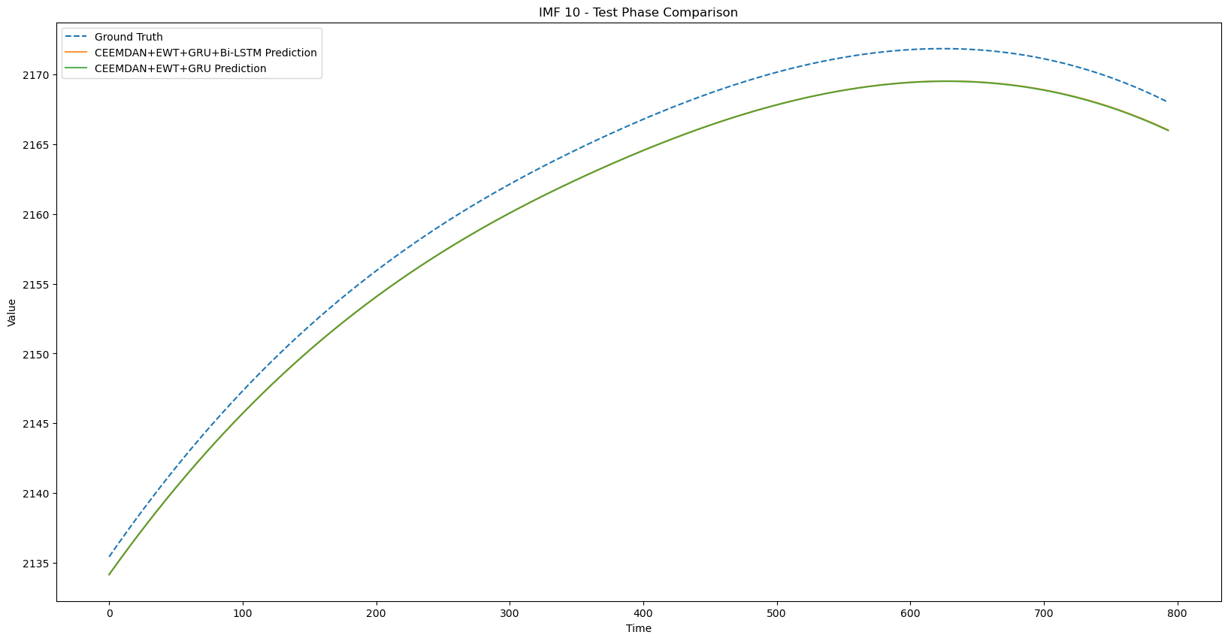
Exp 3: GRU-BiLSTM Based on Frequency Decomposition
IMF-Level Performance Analysis
IMF9: Low-Frequency Component.
IMF10: Low-Frequency Component.

Slide 46
Exp 3: GRU-BiLSTM Based on Frequency Decomposition
IMF-Level Performance Analysis
High-Frequency IMFs (IMF 1–5):
Both models closely match ground truth.
GRU shows superior alignment, confirming its strength in handling rapid signal changes.
Low-Frequency IMFs (IMF 6–10):
Proposed model (GRU) captures the trend effectively.
Bi-LSTM underperforms in the hybrid model fails to track trend accurately and introduces larger deviation from ground truth.

Slide 47
Exp 3: GRU-BiLSTM Based on Frequency Decomposition
IMF-Level Performance Analysis
- Bi-LSTM’s complexity could lead to overfitting or loss of temporal precision on smoothed IMFs.
- The GRU-based model alone offers more robust, reliable, and generalizable forecasting, making it a better fit for both high-
and low-frequency IMF predictions.
Insights

Slide 48
Conclusion

Slide 49
Experiment 1
Baseline comparison
Experiment 2
Additional Features
Experiment 3
GRU-BiLSTM Hybrid
The proposed CEEMDAN–EWT–GRU outperformed benchmark and baseline models (LSTM, GRU, Bi-LSTM, Transformer).
GRU offered:
- Fewer parameters
- Faster training
- Superior handling of high-frequency IMFs
Multi-feature variants degraded performance due to:
- CEEMDAN's univariate design
- Frequency misalignment across features.
- Introduction of noisy, mixed IMFs.
Best result still achieved with a single feature (Wind Power).
Bi-LSTM failed to improve low-frequency IMFs prediction because of its’ complexity, memory usage, redundancy.
GRU proved sufficient and efficient for both high- and low-frequency IMFs.

Slide 50
1
Multivariate Decomposition Approaches
2
Future Work
Longer-Term Forecasting
3
Test The Method on Diverse Wind Power Datasets

Slide 51
This thesis work has been submitted to and is under review by the 2025 IEEE International Conference on Systems, Man, and Cybernetics (SMC).

Slide 52
Thank you for listening
Abdulrahman Almansoori
MSc Student in Machine Learning
Abdulrahman.Almansoori@mbzuai.ac.ae
Supervisor: Professor Fakhri Karray
Professor of Machine Learning
Fakhri.Karray@mbzuai.ac.ae

