Slide 1
DATA SCIENCE HEART DESEIES PROJECT
SUPERVISER
ENG KAREM AHMED
Prepared By :Abdelrhman Mahmoud Hessien Ahmed

Slide 2
TABLE OF CONTENTS
01
02
03
About Dataset
Meta Data
Data Prepration
The data set include heartdiseasess factors such ptt ,spo2
Information About Data Type
Cleaning Dataset

Slide 3
TABLE OF CONTENTS
04
05
06
DashBoard
TARGET
Heart Desisase Analysis
Virtualization of data
Analysis Heart Deasises.
Apply machine learning

Slide 4
TABLE OF CONTENTS
07
08
09
Machine Learning
THANK YOU
STREAMLITE
Code
Predict and classify data

Slide 5
Introduction
01

Slide 6
About Dataset
Our Dataset is conceder a medical data set include insights of patient satutes such ptt ,spo2,hr an,d some patient information such age ,gender and diabites label of drunkness and sleepness and if smoking

Slide 7
MetaData
02

Slide 8
META DATE OF DATASET
STRINGS
FLOAT
Such :Patient name ,patient Address ,information
PTT, BMI, DiabetesPedigreeFunction

Slide 9
META DATE OF DATASET
INTEGER
BINARY
Such:SPO2,Pd,Ps,HR..
These values in the shape of numerical value
Outcome, Sleepiness label,
Drinking_label
It include 0 or 1

Slide 10
03
Prepration of data

Slide 11
Data Preparation
Missing Value
Preview the data
Validity
Duplicates
Checking for any missing value and deal with it
Over view of Dtaset
Check if Data Is Valid
Checking For Dablucate Data

Slide 12
DashBoard
04
Power BI

Slide 13
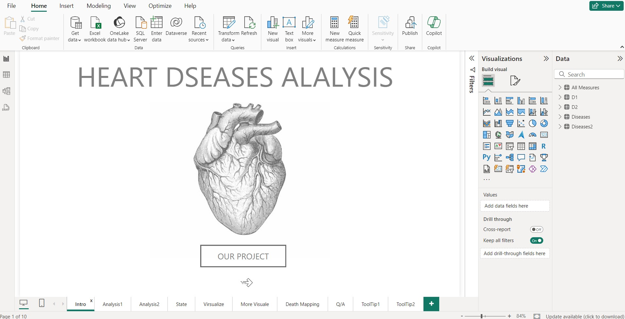

Slide 14
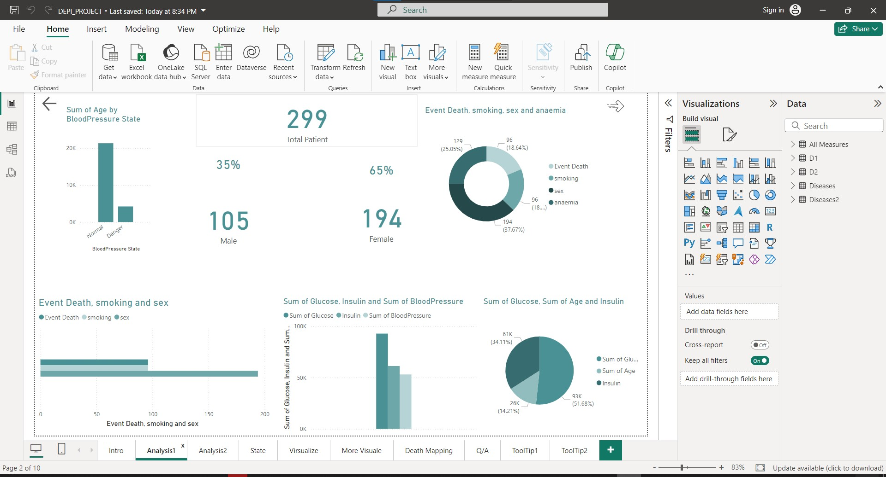

Slide 15
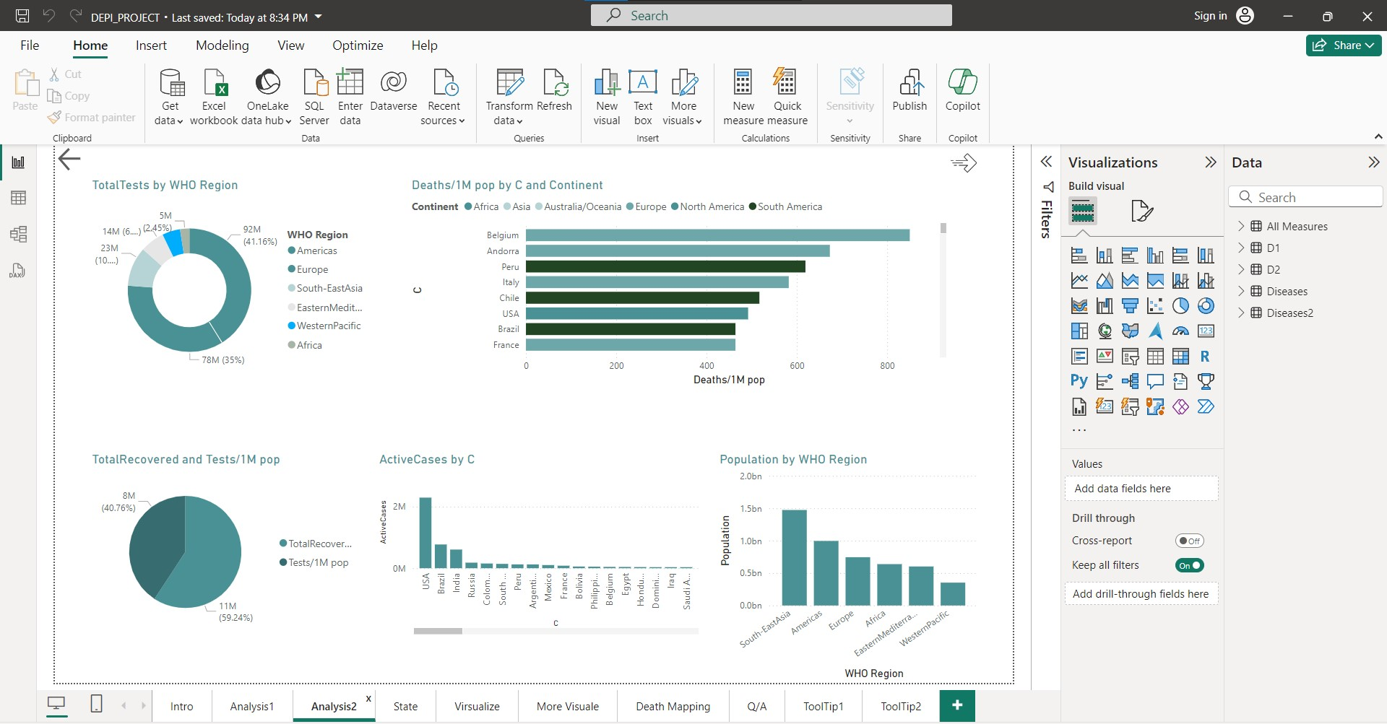

Slide 16
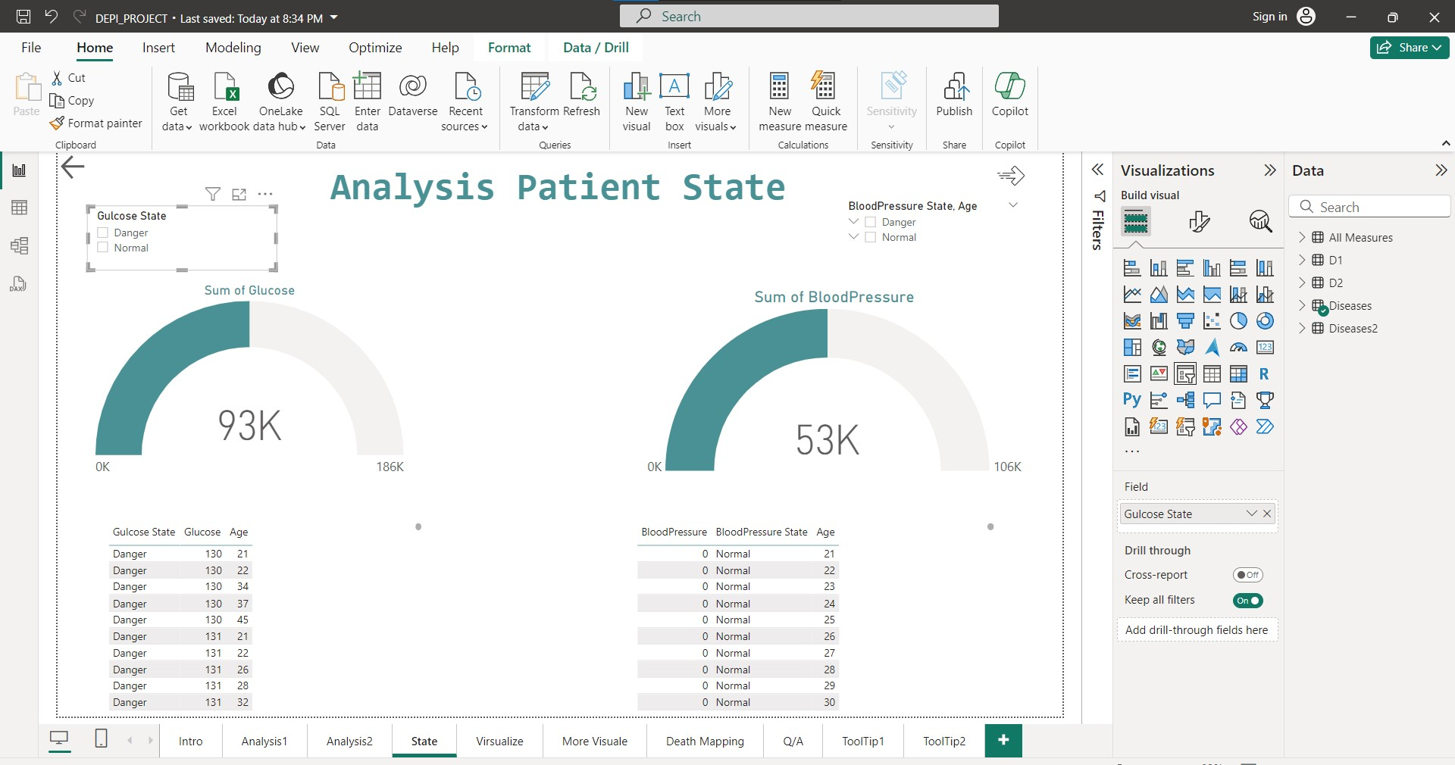

Slide 17
05
Heart Daisies Analysis

Slide 18
Machine Learning PROCESS
02
04
01
03
Load the Excel file
Check for missing data in each sheet
Iterate over the sheets and load them into a DataFrame
Information about table and describe each othere

Slide 19
05
MACHINE LEARNING

Slide 20
Machine Learning PROCESS
06
08
05
07
Visualize Mean Important Columns
Plot the heatmap
Calculate correlation matrix
Information about table and describe each othere

Slide 21
Machine Learning PROCESS
10
12
09
11
Select features and target variable
Scale the features to avoid outlire
Split the data set into train ,valid and test set
Information about table and describe each othere

Slide 22
Machine Learning PROCESS
14
16
13
15
Initialize the model and Train the model using Train set
Evaluate the model and optimize output
Make predictions using Random ForestRegressor
classification of the outpout of suger and insulin Using K-means

Slide 23
STREMLITE PROCESS
01
02
03
04
Load your trained model and scaler
import streamlit Library
Function to predict blood sugar and insulin
Classify the results

Slide 24
06
STREAMLIT

Slide 25
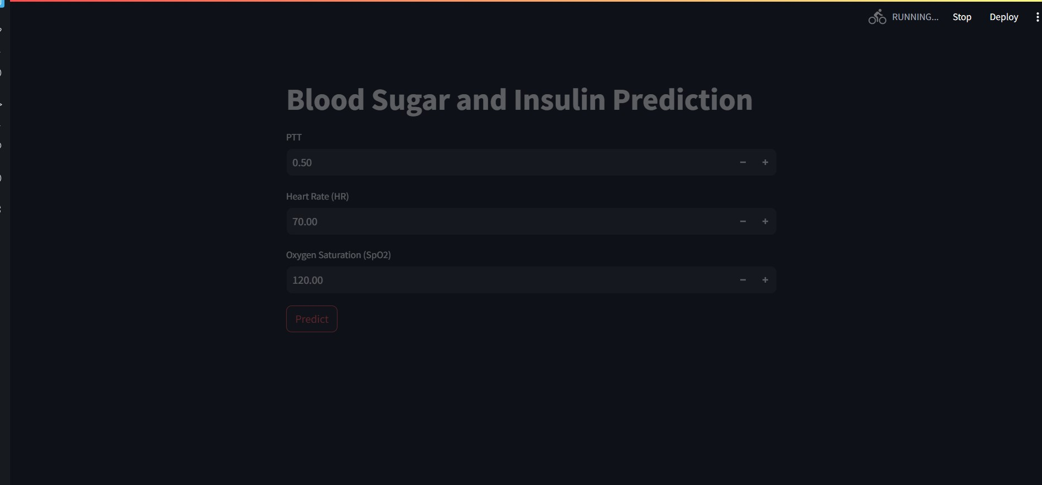

Slide 26
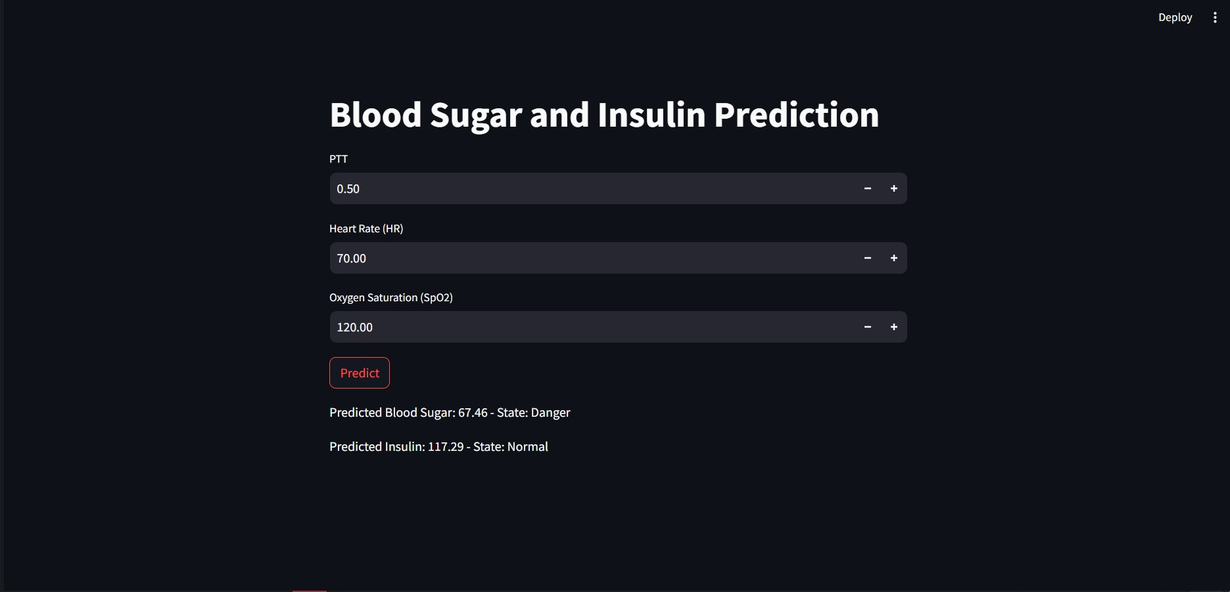

Slide 27
THANKS

