Slide 1
Algorithms: K Nearest Neighbors

Slide 2





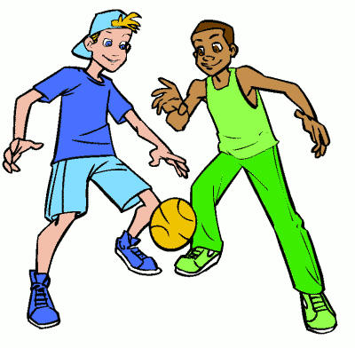
Simple Analogy..
Tell me about your friends(who your neighbors are) and I will tell you who you are.
Notes:
Based on similarity function
“tell me who your neighbors are, and I’ll tell you who you are”
Simplest Algorithms

Slide 3
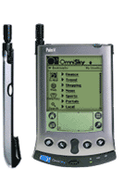
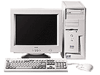

Instance-based Learning
Its very similar to a
Desktop!!

Slide 4
KNN – Different names
K-Nearest Neighbors
Memory-Based Reasoning
Example-Based Reasoning
Instance-Based Learning
Lazy Learning

Slide 5
What is KNN?
A powerful classification algorithm used in pattern recognition.
K nearest neighbors stores all available cases and classifies new cases based on a similarity measure(e.g distance function)
One of the top data mining algorithms used today.
A non-parametric lazy learning algorithm (An Instance-based Learning method).
Notes:
KNN stattistical estimation
Pattern recognition in the beginning of 1970

Slide 6
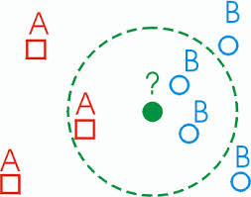
KNN: Classification Approach
An object (a new instance) is classified by a majority votes for its neighbor classes.
The object is assigned to the most common class amongst its K nearest neighbors.(measured by a distant function )
Notes:
Algorithm

Slide 7
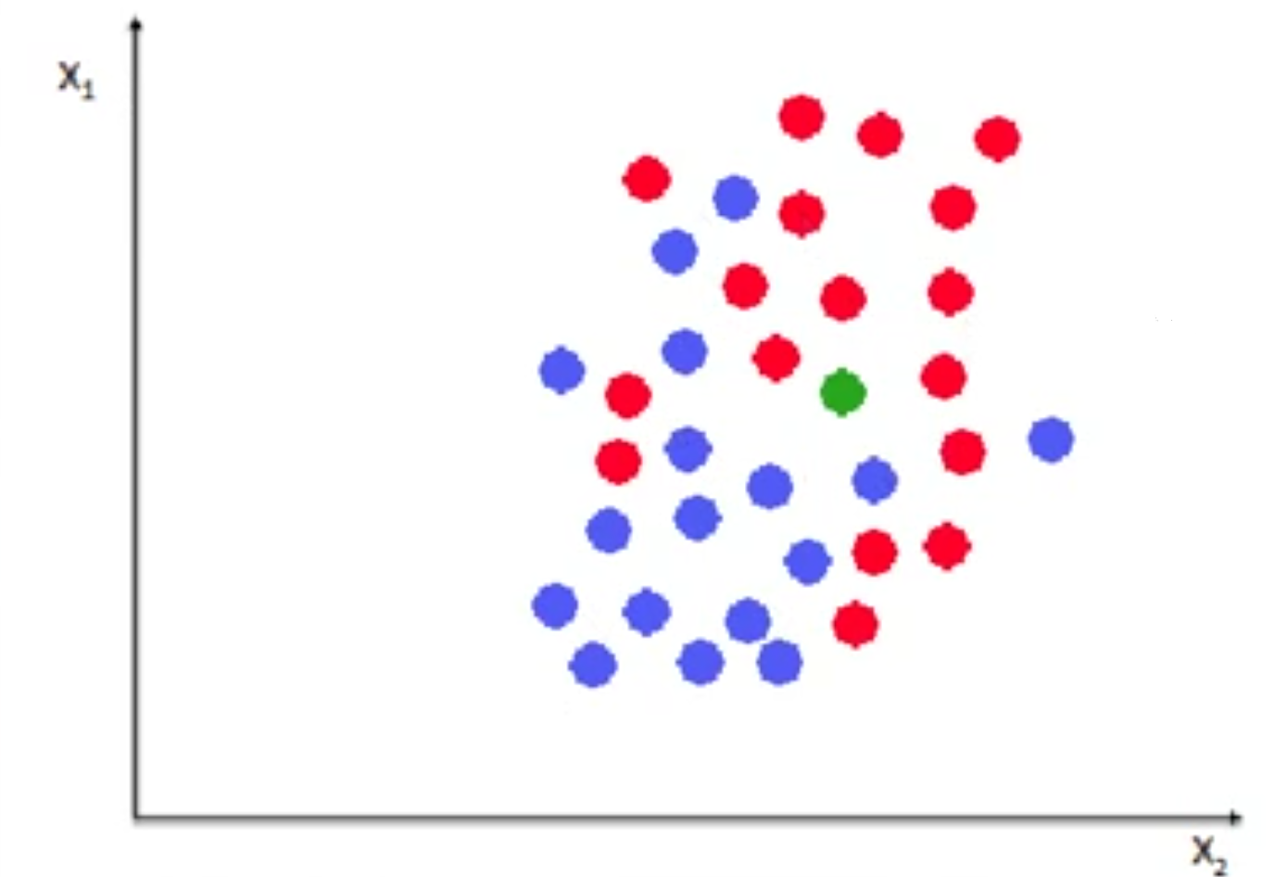
Notes:
Weight and hight of people and we assume
Red : female
Blue: Male
So we have new measurement of hight and weight …
K=1,female ,we assigned class =female
K=5 3 female, 2 males
K=odd
K=6 we have ties

Slide 8
Distance Measure
Compute Distance
Test Record
Training Records
Choose k of the “nearest” records
Notes:
Although there are other possible choices, most instance-based learners use Euclid- ean distance.

Slide 9
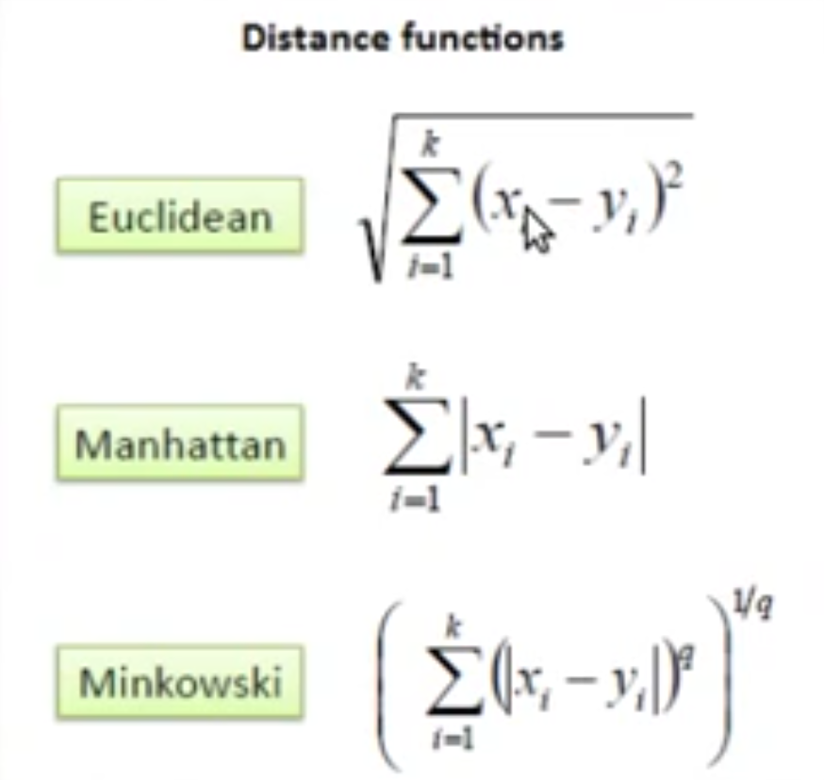
Distance measure for Continuous Variables
Notes:
Although there are other possible choices, most instance-based learners use Euclid- ean distance.
Other distance metrics may be more appropriate in special circumstances.
If we have too many points Sum the squared differences and we get the square roots
In Manhanttan distances : get absoulte values
Min-ko-waski distance=
Different distance measure .. We use the common one

Slide 10
Distance Between Neighbors
Calculate the distance between new example (E) and all examples in the training set.
Euclidean distance between two examples.
  X = [x1,x2,x3,..,xn]
  Y = [y1,y2,y3,...,yn]
  The Euclidean distance between X and Y is defined as:
Notes:
N-feature size

Slide 11
K-Nearest Neighbor Algorithm
All the instances correspond to points in an n-dimensional feature space.
Each instance is represented with a set of numerical attributes.
Each of the training data consists of a set of vectors and a class label associated with each vector.
Classification is done by comparing feature vectors of different K nearest points.
Select the K-nearest examples to E in the training set.
Assign E to the most common class among its K-nearest neighbors.
Notes:
This single number K is given prior to the testing phase and this number decides how many neighbors influence the classification.

Slide 12
3-KNN: Example(1)
Customer | Age | Income | No. credit cards | Class
George | 35 | 35K | 3 | No
Rachel | 22 | 50K | 2 | Yes
Steve | 63 | 200K | 1 | No
Tom | 59 | 170K | 1 | No
Anne | 25 | 40K | 4 | Yes
John | 37 | 50K | 2 | ?
Distance from John
sqrt [(35-37)²+(35-50)² +(3-2)²]=15.16
sqrt [(22-37)²+(50-50)² +(2-2)²]=15
sqrt [(63-37)²+(200-50)² +(1-2)²]=152.23
sqrt [(59-37)²+(170-50)² +(1-2)²]=122
sqrt [(25-37)²+(40-50)² +(4-2)²]=15.74
YES

Slide 13
How to choose K?
If K is too small it is sensitive to noise points.
Larger K works well. But too large K may include majority points from other classes.
Rule of thumb is K < sqrt(n), n is number of examples.
Notes:
If the sample set is finite..
Historically the optomal K for mpst datasets has been between 3-10 . That produces much better results than 1NN

Slide 14
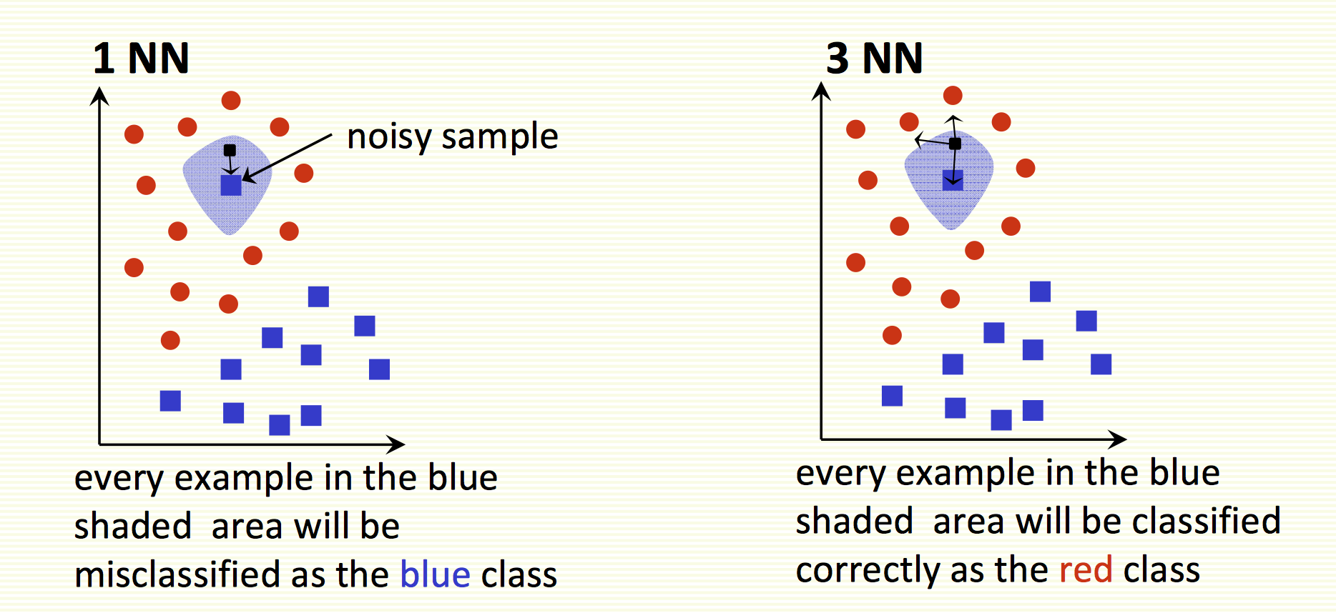

Slide 15
K-nearest neighbors of a record x are data points that have the k smallest distance to x

Slide 16
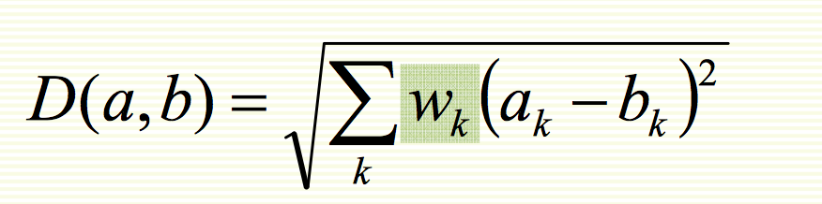
KNN Feature Weighting
Scale each feature by its importance for classification
Can use our prior knowledge about which features are more important
Can learn the weights w_{k} using cross‐validation (to be covered later)

Slide 17
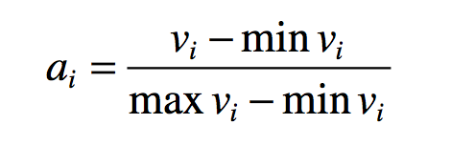
Feature Normalization
Distance between neighbors could be dominated by some attributes with relatively large numbers.
    e.g., income of customers in our previous example.
Arises when two features are in different scales.
Important to normalize those features.
  Mapping values to numbers between 0 – 1.
Notes:
Some configurations over data before applying KNN
Different attributes are often measured on different scales,
Numerical: Here the difference between two values is just the numerical difference between them, and it is this difference that is squared and added to yield the distance functio
Nominal: the difference between two values that are not the same is often taken to be 1, whereas if the values are the same the difference is 0. No scaling is required in this case because only the values 0 and 1 are used.

Slide 18
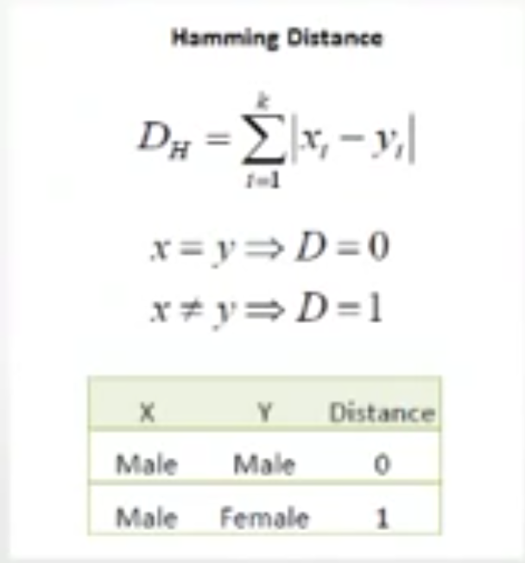
Nominal/Categorical Data
Distance works naturally with numerical attributes.
Binary value categorical data attributes can be regarded as 1 or 0.
Notes:
For attributes with more than two values, binary indicator variables are used as an implicit solution.
Ex: In a customers’ Bank field with 3 values,
Bank1 – 100
Bank2 – 010
Bank3 - 001

Slide 19
KNN Classification
Loan$
Age

Slide 20
KNN Classification – Distance
Age | Loan | Default | Distance
25 | $40,000 | N | 102000
35 | $60,000 | N | 82000
45 | $80,000 | N | 62000
20 | $20,000 | N | 122000
35 | $120,000 | N | 22000
52 | $18,000 | N | 124000
23 | $95,000 | Y | 47000
40 | $62,000 | Y | 80000
60 | $100,000 | Y | 42000
48 | $220,000 | Y | 78000
33 | $150,000 | Y | 8000
48 | $142,000 | ?
Euclidean Distance

Slide 21
KNN Classification – Standardized Distance
Age | Loan | Default | Distance
0.125 | 0.11 | N | 0.7652
0.375 | 0.21 | N | 0.5200
0.625 | 0.31 | N | 0.3160
0 | 0.01 | N | 0.9245
0.375 | 0.50 | N | 0.3428
0.8 | 0.00 | N | 0.6220
0.075 | 0.38 | Y | 0.6669
0.5 | 0.22 | Y | 0.4437
1 | 0.41 | Y | 0.3650
0.7 | 1.00 | Y | 0.3861
0.325 | 0.65 | Y | 0.3771
0.7 | 0.61 | ?
Standardized Variable
Notes:
That’s price to pay

Slide 22
Strengths of KNN
Very simple and intuitive.
Can be applied to the data from any distribution.
Good classification if the number of samples is large enough.
Weaknesses of KNN
Takes more time to classify a new example.
  need to calculate and compare distance from new example to all other examples.
Choosing k may be tricky.
Need large number of samples for accuracy.
Notes:
Robust: strong and healthy; vigorou

