Slide 1


Slide 2

Quality Assessment for Alinma Banking App
مصرف الإنماء
alinma bank
Supervisor: Dr. Sultan S Al-Qahtani
Group Members:
Abdulaziz AlOtaibi
Faisal Aldrees
Abdulrahman AlGhofaily

Slide 3

Introduction
App analysis results:
Clear text traffic.
Content provider.
Clear text secret key
Executing raw SQL query
Using MD5 hash
Logs information
Insecure random number generator
Encryption mode CBC with PKCS5/PKCS7 padding.
Code quality:
Vertical alignment.
Ambiguity.
High degree of connectivity.
Conclusion
Presentation Content

Slide 4
Introduction
in this work shop our main objective is to apply a static analyzation on local banking apps in order to practice what we learn about the software quality in software engineering 2.
We will describe some of the issues that we found during our research, and we will provide a solution to each one of them in order to help the product to get improved by development department in the next stage of the process.
We choose ALINMA banking app to analyze using MOBSF static analyze tool and we found some problems that will be described in the next sides.

Slide 5
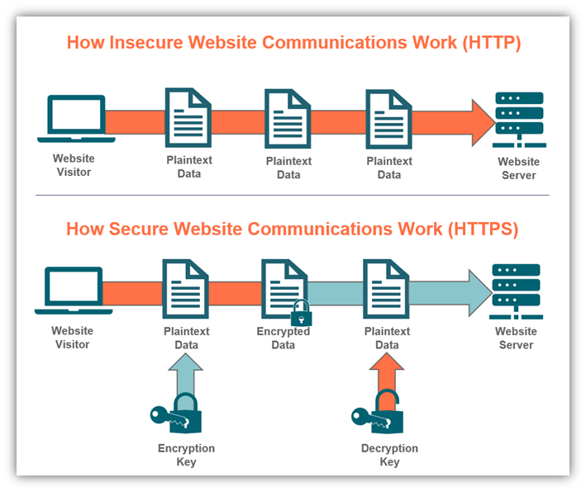
App analysis results: Clear text traffic
what is cleartext traffic?
Cleartext is transmitted or stored text that has not been subjected to encryption and is not meant to be encrypted.
Cleartext does not require decryption in order to be displayed so it's useful but no
secure to deliver sensitive data.

Slide 6
App analysis results: Clear text traffic
Clear text in alinma banking app network traffic:
we found that Alinma bank using the cleartext in their network traffic which make the app is
not secure and there will be some risks in communication because they are using cleartext
HTTP.
As we said this may leak information about your users and open your app up to injection of
unauthorized content.
we need to check first if regress to cleartext traffic by accident or because of developing team.
Example: an inadvertent change in one of the server components could make the server
provide the app with HTTP URLs instead of HTTPs URLs.

Slide 7
App analysis results: Clear text traffic
How to protect the app from these mistakes?
- we have two mechanisms:
1- Block cleartext traffic in production:
To protect the installed base of your app against regressions to cleartext traffic, declare usesCleartextTraffic=”false” attribute on the application element in your app’s. When the attribute is set to "false", platform components will refuse the app's requests to use cleartext traffic. For example, if your app accidentally attempts to sign in the user via a cleartext HTTP request, the request will be blocked, and the user’s identity and password will not leak to the network.

Slide 8
App analysis results: Clear text traffic
How to protect the app from these mistakes?
2- Detect cleartext traffic during development:
The main idea in this mechanisms is To spot cleartext traffic during development. and there are helpful tools. for example, StrictMode , StrictMode is a tool for highlighting potential problems in an application.
This is a useful tool for identifying which bits of the app are using TLS/SSL traffic.
SSL stands for Secure Sockets Layer.
TLS stands for Transport Layer Security.

Slide 9
App analysis results: Content provider
Content provider:
- A content provider manages access to a central repository of data.
In alinma banking app Content Provider is found to be shared with other apps on the device
therefore, leaving it accessible to any other application on the device.

Slide 10
App analysis results: Clear text secret key
Clear text secret key:
After static analyzing and viewing the source code, we have noticed that one of the secret keys
is so simple, and in clear text.
com/
├─ bumptech/
├─ manager/
├─ RequestManagerRetriver.java
In this file, line 40 we have final String FRAGMENT_INDEX_KEY = “key”, this is a major security issue, even though that the secret key cannot extract confidential data, this represents a weakness in the security of the app code and that it is not well implemented.
After researching, we have concluded that using Environment Variables is the best way to overcome this issue, because it is not good practice if you store secret keys hard codded in the source code, since the code will be available for the public, and even if it is closed source, it would be available for the developers in the company that are not concerned with those keys.

Slide 11
App analysis results: Clear text secret key (cont.)
Environment variables:
Environment variables, as the name says, are variables that are stored in the Operating System, not in the memory at compilation time, in order to set an environment variable in Linux by running in your terminal the command:
export KEY=”YOUR_SECRET_KEY”
and in order to view it run:
echo $KEY
but this is not a good way for making environment variables since you would need to manually set the environment variable yourself each time you want to add one.

Slide 12
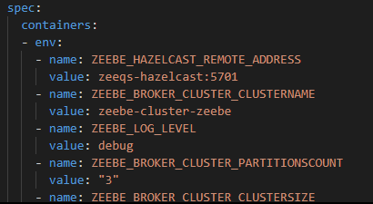
App analysis results: Clear text secret key (cont.)
Kubernetes:
One of the modern technologies released by google called Kubernetes (aka k8s) and one of its features is supporting the implementation of environment variables in production, it will support it by initializing the environment variables in a set of configuration files (a file for each container, each container is a Docker image) called “Helm charts” and those variables will be introduced in the Operating System as soon as the containers deployed to the server. K8s acts as docker-compose but in a production level, but docker-compose is used just in a development level.
You can read more about Kubernetes and docker-compose in:
https://kubernetes.io/
https://docs.docker.com/compose/

Slide 13
App analysis results: Clear text secret key (cont.)
Environment variables:
And at the end, you can fetch the environment variable to your code using the following code:
String value = System.getenv(yourEnvironmentVariableName);
So, for the problem of the hardcoded credentials we suggest using environment variables using k8s or any technology that you find suitable, and for the simple secret key, you can simply just make a more complicated one.

Slide 14
App analysis results: Executing raw SQL query
Executing raw SQL query:
Another security issue that we have found, which is the use of SQLite database and executing the queries as raw text, for example, in
com/
├─ pushwoosh/
├─ f/
├─ c/
├─ b.java
line 292, we have
private static String e(Collection<String> collection) {
return "DELETE FROM " + f.a + " WHERE " + "inbox_id" + " IN ('" + TextUtils.join("', '", collection) + "')";
}
This issue can cause SQL injection.

Slide 15
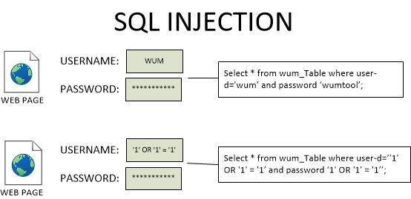
App analysis results: Executing raw SQL query (cont.)
SQL injection:
SQL injection is an attack that might result unauthorized access to sensitive data, such as user’s credentials.
You can read more about SQL injection in https://portswigger.net/web-security/sql-injection

Slide 16
App analysis results: Executing raw SQL query (cont.)
Why this code will be vulnerable for SQL injection?
In this code we have
return "DELETE FROM " + f.a + " WHERE " + "inbox_id" + " IN ('" + TextUtils.join("', '", collection) + "')";
The attacker might for example make the value of f.a as a SQL query, not just as a string, and at the end of the query he can add “-- -” to consider all of the rest as a comment, so simply he can do anything with this database.
The code was obfuscated, so we were not sure what dose it do, but after researching, we have found that pushwoosh is a package for automated push-notifications, so, we suggest using another package.

Slide 17
App analysis results: Using MD5 hash
Using MD5 hash:
We have found another issue, and also with the package called pushwoosh that we have discussed earlier! The issue is the use of MD5 hash in:
com/
├─ pushwoosh/
├─ internal/
├─ platform/
├─ utils/
├─ GeneralUtils.java
line 131, we have a method declared as
private static String md5(String str){
…
}
That takes a string and return the MD5 hash of that string.

Slide 18
App analysis results: Using MD5 hash (cont.)
What is hashing?
Hashing is a process of transforming a given text (key, string of characters) into another fixed-sized value called “enciphered text” or hash value or just hash.
For example, if your password is ‘qwerty’ (bad idea), in the database you’ll have d8578edf8458ce06fbc5bb76a58c5ca
Do not confuse yourself with encryption, as encryption could be decrypted using a private key, but hashing is a “One-Way function” which makes it very hard (almost imposable) to reconstruct the original input from the output hash, a good way that I like to explain what hash is, that the original value is a fruit, if you take the juice of that fruit(The hash value) so you cannot get the juice back to fruit again.

Slide 19
App analysis results: Using MD5 hash (cont.)
Why MD5 is not secure?!
There are a lot of dictionary tables you can find online for MD5, for example, in MD5decrypt, MD5Online, the dictionaries are there because MD5 is kinda old hash, so it is widely used in huge databases over the years, so if your password is common, it is most likely to find your password in that huge dictionary.
Also, Brute force attacks are fast on MD5 hashes, since it is fast to use, so it is easy to try a lot of combinations in a few seconds. And there are a lot of other issues.
(You can read more in Securing SQL server by Denny Cherry, Chapter 4: Database encryption)

Slide 20
App analysis results: Using MD5 hash (cont.)
How to solve this problem?
We have to ways of solving this issue, the first on is basically changing the used hash, and the second one is by using something called “Salt”.
What is MD5 salt?
In cryptography salting is a random string that you add to the one-way function, to generate a different hash that with the original string alone. MD5 does not provide this, it you can easily you can concatenate to strings to get the benefits of salting.
The benefits of salting, that that your hashes in the database will be different than those in the big dictionary, also it will make that hash characters longer so it will be hard to brute force.

Slide 21
App analysis results: Logs information
Logs information:
The app create log files. And creating a log file is a good way to keep track of the app on a different sides during the development phase, such as tracking errors, crashes, and performance.
These logs are stored locally on the user device when the app is offline, and sent back to the endpoint when the app is back online. However, these logs may contain a sensitive data or information, and creating logs for such may expose it to the attackers or malicious applications.
What should we do to prevent or avoid exposing user data?
The ideal solution is to set the logging levels appropriately, and minimize logging files as possible, so it doesn’t violate the user confidentiality.

Slide 22
App analysis results: Insecure random number generator
Insecure random number generator:
We found out in one of the code classes an insecure random number generator was used (which is from java.util.Random library).
This random number generator is easy to break since it is not cryptographically strong. The numbers that are generated by it are not completely random. It uses the clock as the seed / or to generate the seed (seed is a number that used to generate (semi-random) number using an algorithm). So, if the attacker knows when the seed was generated, the attacker will be able to reproduce the seed using the same algorithm.
Another issue is the seed is 48 bits-based, meaning 2^48 attempts are required to guess that random number, and it is not a big deal for today’s CPU’s.

Slide 23
App analysis results: Insecure random number generator (cont.)
How could we generate a safe random number?
The solution is to use more advanced/strong cryptographically random number generators, such as (java.util.SecureRandom) generator. The SecureRandom generates non-deterministic output. It takes random data from the OS and use it as a seed. It is also 128 bits-based seed, which means 2^128 attempts are required to break it.

Slide 24
App analysis results: Encryption mode CBC with PKCS5/PKCS7 padding
Encryption mode CBC with PKCS5/PKCS7 padding:
We found out that the app uses encryption mode CBC with PKCS5/PKCS7 padding. This configuration is vulnerable to padding oracle attack, which may lead to leakage of sensitive data. As we can see in:
com/
├─ pushwoosh/
├─ internal/
├─ a/
├─ a.java
Line 11, an instance of Cipher “AES/CBC/PKCS7Padding” was declared as:
Cipher instance = Cipher.getInstance(“AES/CBC/PKCS7Padding”);
And being used to encrypt given byte array.

Slide 25
App analysis results: Encryption mode CBC with PKCS5/PKCS7 padding (cont.)
What is CBC?
CBC stands for Cipher-Block Chaining, it is a mode of operation for block cipher, it means that we use the ciphertext from the previous block to impact the next one.
Here is how CBC works:
if we have m message blocks of size B that contains a plaintext, using the CBC mode, we will do the next.
For the first block we will use a random “Initialization vector” (IV) of fixed-size input, we will XOR it with the first message block, then the result will be encrypted by AES (Advanced Encryption Standard) encryption function using a given key.
Now the output of this whole previous process is a ciphertext C. We will use this ciphertext of the first message block to encrypt the next message block by XOR the ciphertext with the second message block. And the process will be repeated until the whole message blocks are chained.

Slide 26
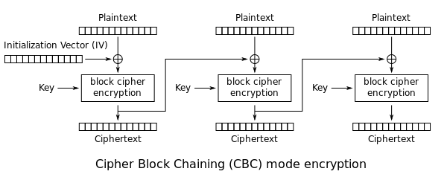
App analysis results: Encryption mode CBC with PKCS5/PKCS7 padding (cont.)
What is CBC? (cont.)
To summarize the whole process into a formula: Ci = EK(Bi ⊕ Ci-1).
Where EK denotes the block encryption algorithm using key K, Ci-1 is the cipher corresponding to
Bi-1.
Note: In the formula above, we are assuming C0 to be the initialization vector

Slide 27
App analysis results: Encryption mode CBC with PKCS5/PKCS7 padding (cont.)
What is PKCS5/PKCS7 Padding?
Let’s say we have a message block of size 8 bytes, and the plaintext that it occupies only 5 bytes of it, we still have 3 bytes that are empty, this is when padding take a place. Padding is used in a block cipher where we fill up the blocks with padding bytes. The padding depend on the number of bytes that do not have any content. There are many padding standards, two of them are PKCS5 and PKCS7, PKCS5 Password-based encryption standard, meanwhile Cryptographic Message Syntax standard.

Slide 28
App analysis results: Encryption mode CBC with PKCS5/PKCS7 padding (cont.)
What is Padding oracle attack?
Through a padding oracle attack, an attacker can decrypt information, without knowing the encryption key. The attacker will need 256 SSL 3.0 requests on average to reveal one byte of the encrypted message. On every request the attacker make, the application will response. There are 3 types of responses:
1- Valid padding & valid data. The response status is 200 OK.
2- Invalid padding. The response Status is 500 Internal Server Error, or 403.
3- Valid padding & invalid data. The response status is 404 Not Found.
By repeating the process, the attacker can reveal the whole message byte by byte.
How to protect against Padding Oracle Attack?
We need to make sure that the application does not return a different error message when padding is wrong. Using an Encrypt-then-MAC construction, where a Message Authentication Code (MAC) is applied to the ciphertext.

Slide 29
Code quality
Vertical alignment:
Vertical alignment is the state or act of lining items up, one above each other. we found in this path (com\alinma\retail\mobile) some classes don’t use Vertical alignment concept and that makes the code harder to read but we can say that the overall quality of this classes is fine and to solve this problem we can use tools to help us for example checkstyle, and Prettier in Visual Studio Code.
Ambiguity:
we found some ambiguity in many classes. in this path for example (com\alinma\tls) at line 49 we found some dollar sign ($) and it doesn’t mean anything related to the code in the class also at the same class in line 54 we can see a print message that says “AAA” also it is ambiguous. Another path also we found in it some Ambiguity is this path (com\cordova\plugin\android\fingerprintauth) in line 297 there is a variable called z the method takes it as a parameter, in the same path line 358 there is a variable e the method also takes it as a parameter.

Slide 30
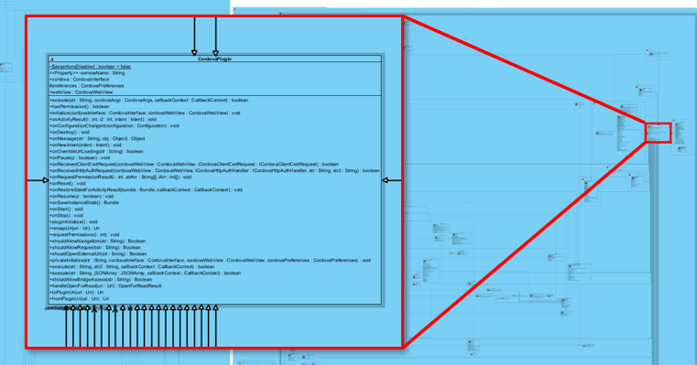
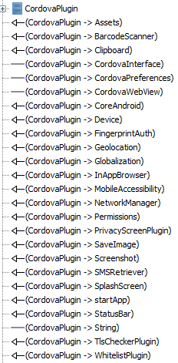
Code quality (cont.)
High degree of connectivity:
By analyzing the relationships between the classes, we found out there is a high degree of connectivity among the objects.
CordovaPlugin class acts as a hub in the system, if this class fails or has a security issue, all classes that in relationship with this class will fail. And to avoid this we should lower the degree of connectivity.

Slide 31
Conclusion
In conclusion, we can say that there are problems in the application, some of them in security, and others are related to the cleanliness of the code, and they must be dealt with by the development department according to the solutions presented in the above report, and they must be implemented according to the seriousness.
The problems of encrypted messages are serious.
Code problems are of course less serious than message encryption problems between the application and the server, but they are important in maintenance and making the code readable.
Finally, we can say that the quality is not related to security problems alone, but also to the problems of the code, its cleanliness, and the way the application operates and maintains it. In all these matters, quality plays an important role and must be dealt with caution and more attention.

