Slide 1
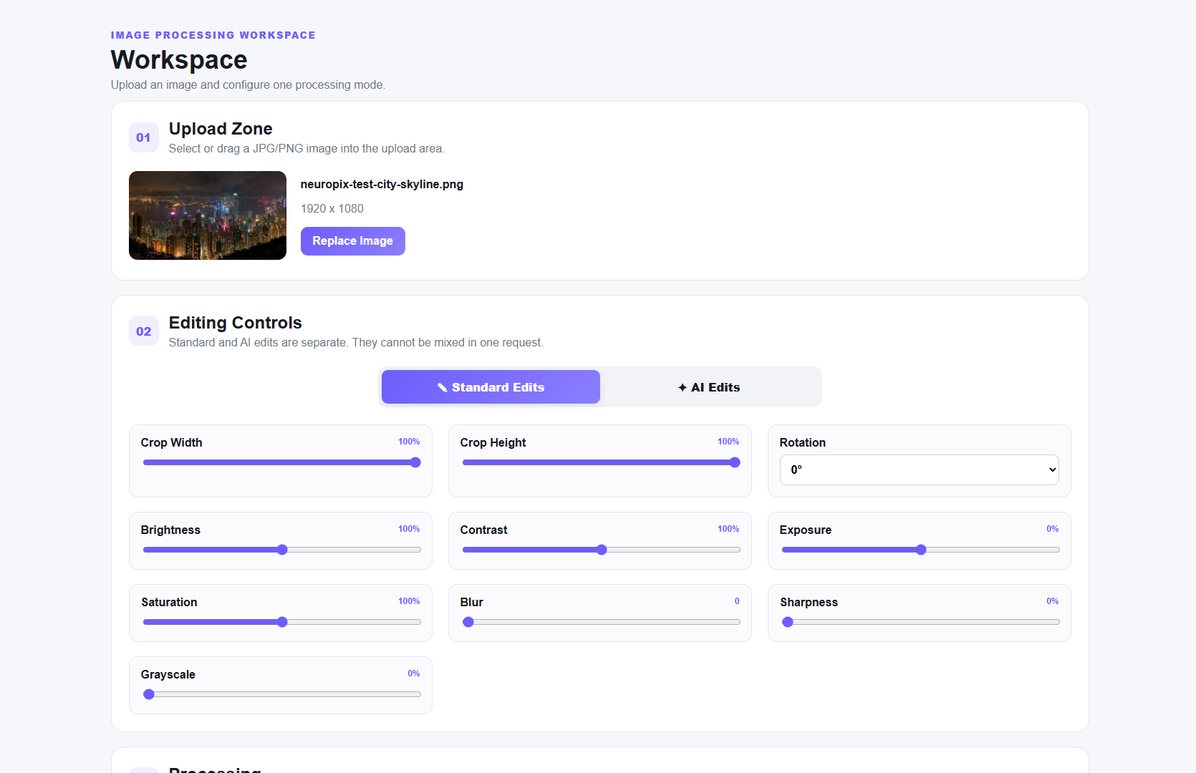
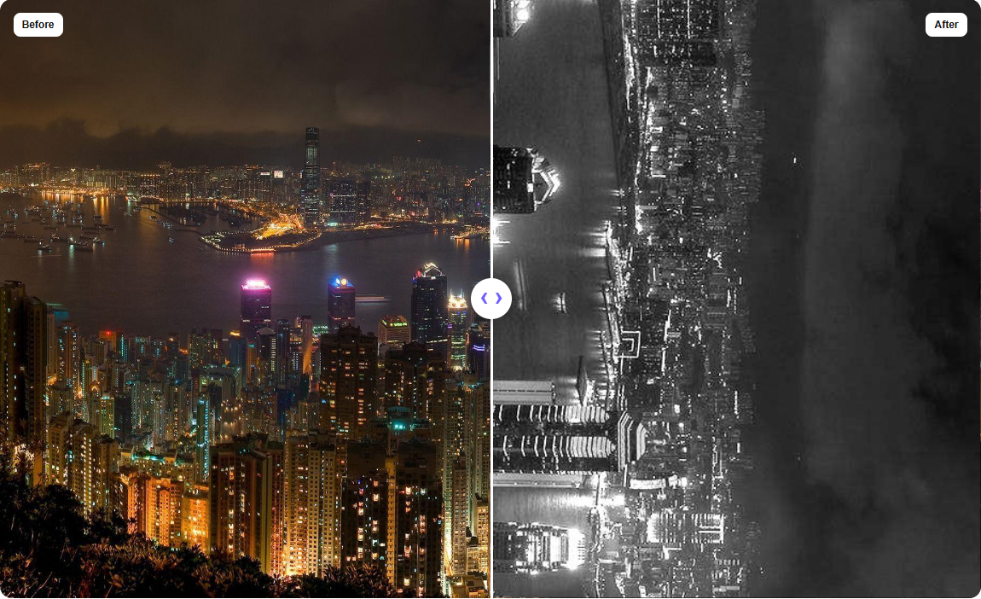
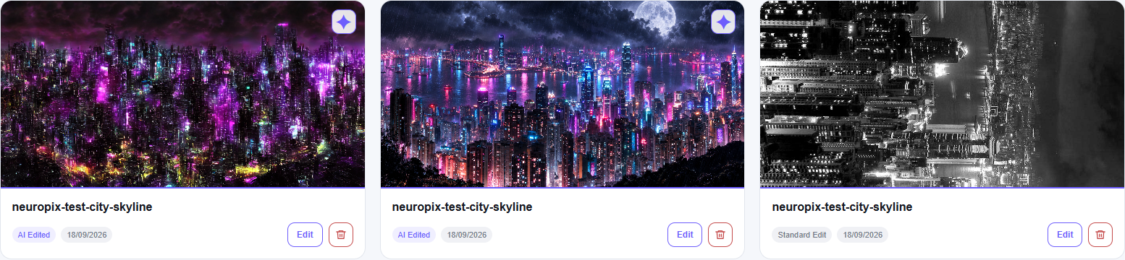
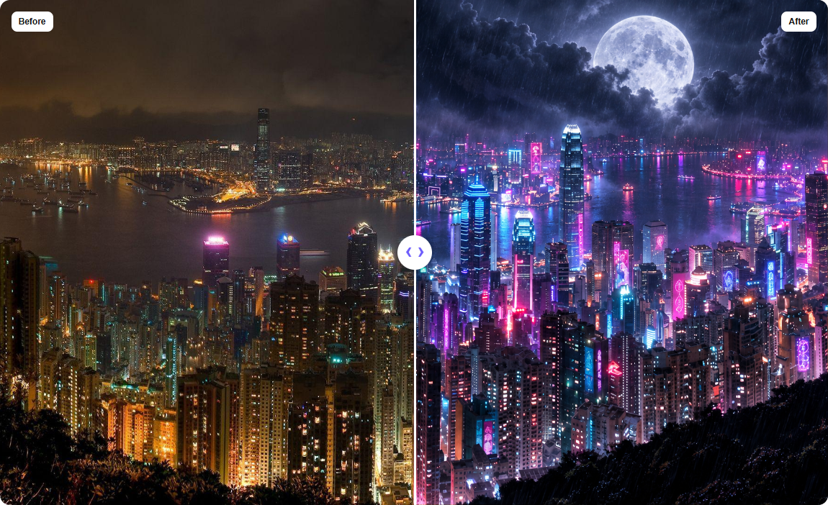
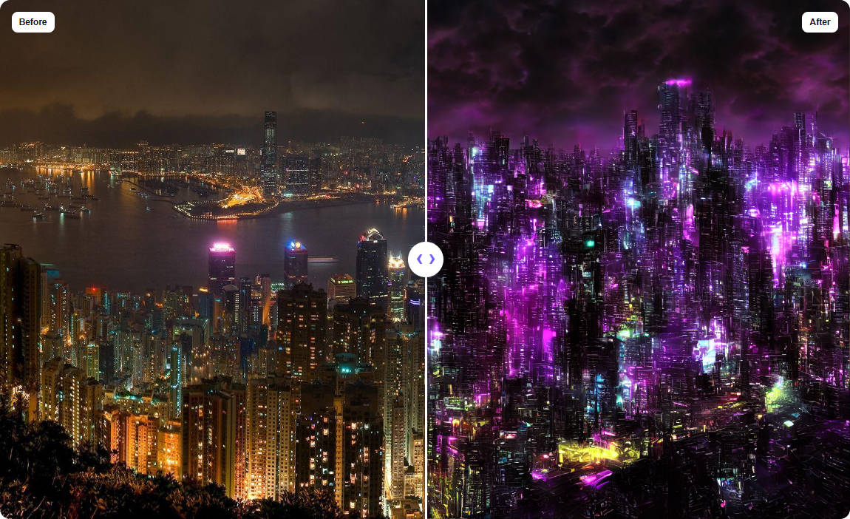
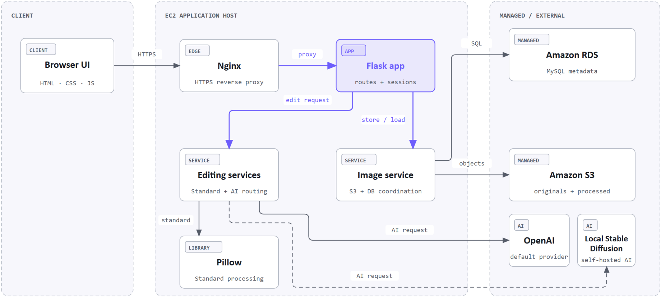
NeuroPix: AI-Enhanced Image Processing and Management Web Application
Abdulrahman Alguydi, Mohammed Dafterdar, Saud Almansour
Department of Software Engineering, College of Engineering, University of Business & Technology
YB0062@st.ubt.edu.sa | VA0056@st.ubt.edu.sa | VA0040@st.ubt.edu.sa
Supervisor: Dr. Faisal Arafsha
ABSTRACT
RESULTS
SUMMARY
Many image-editing tasks require users to move a file between a standard editor, an AI service, and separate storage. NeuroPix brings these steps into an authenticated web application.
Pillow handles standard adjustments, while OpenAI and a locally hosted Stable Diffusion 1.5 model process AI edits. Flask connects the interface to MySQL and Amazon S3, which store account details, image records, and files. Users can work from the same uploaded image, compare each result with the original, and keep completed edits in a personal gallery.
NeuroPix was created for users who want standard image controls and AI editing without moving files between several applications. After signing in, a user can upload an image, apply familiar adjustments or select an AI provider, and compare the result with the original.
Guided fields separate modification, background, and enhancement requests, so the user does not need to write one detailed prompt. Completed images can be downloaded, reopened for further editing, or removed from a private gallery. NeuroPix brings the complete editing process into one connected browser workspace.
INTRODUCTION
CONCLUSIONS
Combining conventional edits with AI changes usually means moving an image between tools: crop in one editor, upload to an AI service, compare the result, then organize saved files by hand. An open-ended AI prompt also forces users to describe both the change and what must stay the same.
NeuroPix keeps the source, editing controls, comparison, and saved results together for users with basic browser skills.
Objectives
Browser-based JPG/PNG editing with no desktop editor
Standard controls plus purpose-specific AI fields
Images in Amazon S3, metadata in MySQL
Comparison, download, and a personal gallery
NeuroPix: a deployed web application for Standard and AI-assisted editing, comparison, download, and personal image management, built within the team's budget and hardware.
Building it taught us where the trade-offs sit. Waiting for an AI result was the part users feel most, and running our own model kept costs down while tying the service to one computer. Designing around one clear path through the site mattered more than adding features.
Future work
Move AI work to a background queue with progress reporting
Improve recovery when a save is incomplete
Adopt feature branches, code review, and staging
Better local output quality within RTX 3080 limits
The Studio: upload an image and set the controls
A Standard edit in the comparison view
METHODS
The gallery of saved results
REFERENCES
Flask/Jinja pages, HTML/CSS/JS interface
Standard mode: ten Pillow controls (crop, rotation, contrast, blur, ...) in a fixed order
Structured pre-prompting: modification, background, and enhancement fields, with scope and preservation context added before calling OpenAI
Local AI: Stable Diffusion 1.5 in Docker on an RTX 3080 via a reverse SSH tunnel
Hosted on AWS EC2 with Nginx, HTTPS, RDS, and S3
NeuroPix project team, "NeuroPix: AI-Enhanced Image Processing and Management Web Application," senior project report, University of Business & Technology, 2026.
NeuroPix project team, "NeuroPix source repository," GitHub, 2026. github.com/AbdulrahmanAlguydi/NeuroPix
NeuroPix project team, "Software Requirements Specification,"
NeuroPix project team, "High-Level Design,"
Pillow contributors, "Pillow documentation." pillow.readthedocs.io
R. Rombach, A. Blattmann, D. Lorenz, P. Esser, and B. Ommer, "High-resolution image synthesis with latent diffusion models," in Proc. IEEE/CVF CVPR, 2022, pp. 10684-10695.
OpenAI, "Introducing ChatGPT Images 2.5," Sep. 8, 2026.
Amazon Web Services, "Amazon RDS for MySQL." docs.aws.amazon.com
AI edit made with OpenAI
AI edit made with local model
Both AI paths were given the same photo and the same prompt. OpenAI returned a neon night city with rain and a large moon while keeping the skyline composition, and the self-hosted model returned a stronger purple, futuristic version of the same scene.
System architecture

