Slide 1

MΛTTER OF PLΛCE
FOR PARTNERS
An introduction for the first agents and brokerages invited into Matter of Place.
Agenda
01 / 14
Notes:
Welcome. This deck introduces Matter of Place to the first agents and brokerages we are inviting in. Matter of Place is a selective real-estate media platform for existing residential property in California, New York and Florida. Use the Agenda link on any slide to move between sections.

Slide 2

Agenda
AGENDA
In this deck.
01
Who we are
07
Five Features
02
The editorial standard
08
The four products compared
03
How selection works
09
Precision distribution
04
The Feature
10
What we do not do
05
The Reach
11
Questions
06
The Campaign
12
How to submit
MATTER OF PLACE · FOR PARTNERS
02 / 14
Notes:
Each line is a link to its section. Every slide carries a small Agenda link in the top right corner that returns here.

Slide 3

Agenda
WHO WE ARE
A selective real-estate media platform.
We select, present and distribute exceptional existing residential property, through a disciplined editorial lens.
California · New York · Florida
Existing residential property only
Not a brokerage
Not a listing marketplace
Not a lead-generation service
MATTER OF PLACE · FOR PARTNERS
03 / 14
Notes:
Matter of Place is editorial first. We decide what deserves attention, present it properly, and then distribute it through owned media, social, email and precision programmatic media. We work in three markets only: California, New York and Florida, and only with existing residential property.

Slide 4
Agenda
THE EDITORIAL STANDARD
What we look for.
Architecture
Setting
Design
History
Originality
Craft
Materiality
Sense of place
Price is not on the list.
MATTER OF PLACE · FOR PARTNERS
04 / 14
Notes:
The eight qualities: Architecture, Design, Originality, Materiality, Setting, History, Craft, Sense of place. A property's price does not decide whether it belongs in Matter of Place. A thoughtful, architecturally significant residence can deserve more attention than a larger, generic one.

Slide 5

Agenda
HOW SELECTION WORKS
Six steps, in this order.
01
Submission
You send the property and its story.
02
Editorial review
We read it against our editorial standard.
03
Acceptance
Selected properties are confirmed. Others are not charged.
04
Exposure
You choose the product that suits the property.
05
Publication
The property receives its permanent place.
06
Distribution
The story travels through owned and paid channels.
Payment never overrides editorial review. Declined properties are not charged.
MATTER OF PLACE · FOR PARTNERS
05 / 14
Notes:
Every property is reviewed against the editorial standard before any product is chosen or paid for. Payment never overrides editorial review, and a declined property is not charged. Five Features credits are not used by declined properties.

Slide 6

Agenda
PROPERTY EXPOSURE
The Feature
$295
Editorial presence.
Dedicated Matter of Place property page
Professionally edited editorial narrative
Architecture, design and location context
Curated image sequencing
Matter of Place social carousel
Collaborator invitation where applicable
Agent or brokerage attribution
Direct inquiry routing
Search-indexable permanent URL
Placement in the California, New York or Florida collection
Submit a Property
MATTER OF PLACE · FOR PARTNERS
06 / 14
Notes:
The Feature, $295. The Feature is editorial presence: a permanent, search-indexable Matter of Place page with an edited narrative, curated images, a social carousel, attribution and direct inquiry routing. Call to action on the site: Submit a Property.

Slide 7
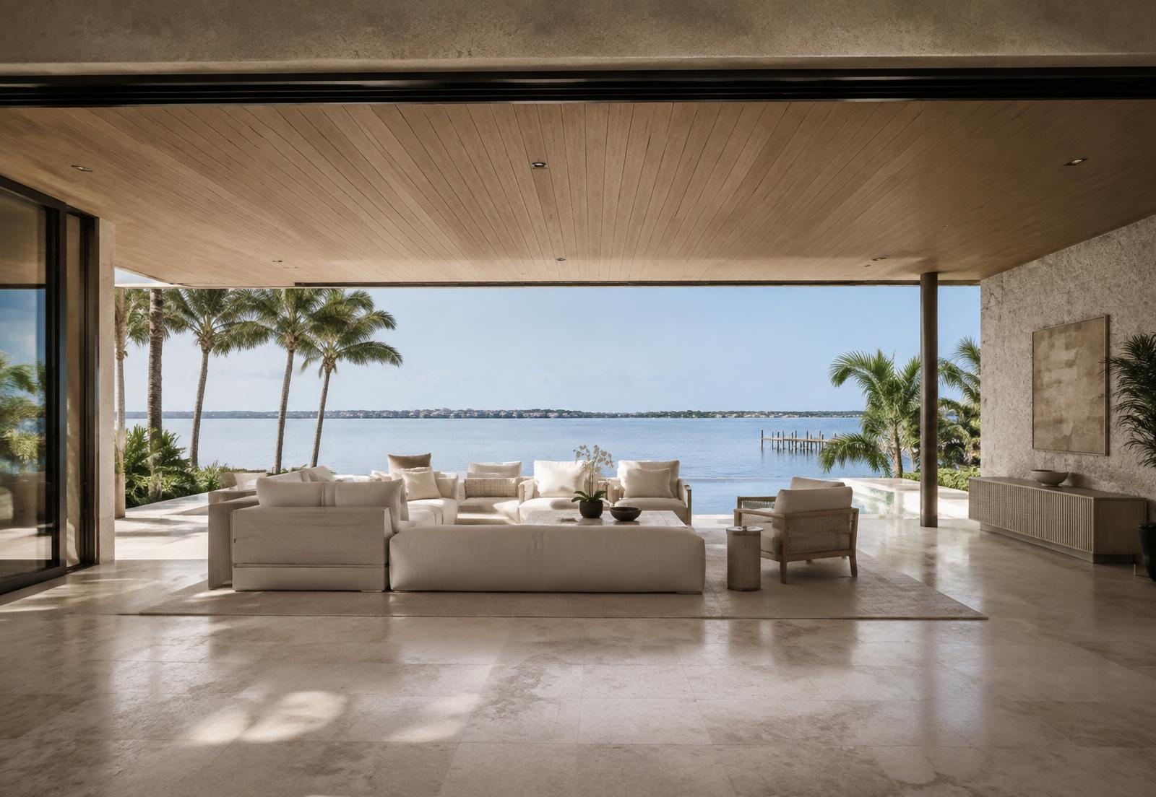
Agenda
RECOMMENDED
PROPERTY EXPOSURE
The Reach
$695
Editorial presence, expanded through precision distribution.
Everything in The Feature
Matter of Place Stories
Newsletter inclusion
Priority editorial scheduling
Homepage or market-page rotation
Additional social distribution
Programmatic campaign planning
Audience-targeting setup
Campaign reporting framework
Option to add programmatic media spend
Programmatic media spend is billed separately.
Expand the Reach
MATTER OF PLACE · FOR PARTNERS
07 / 14
Notes:
The Reach, $695. The Reach is our recommended product. It adds Stories, newsletter inclusion, priority scheduling, homepage or market-page rotation and programmatic campaign planning. Programmatic media spend is not included in the $695; it is billed separately. Call to action on the site: Expand the Reach.

Slide 8

Agenda
PROPERTY EXPOSURE
The Campaign
$1,495
A deeper, multi-channel property campaign.
Recommended media investment: $500 to $2,500+
Everything in The Reach
Deeper editorial research and an expanded property story
Multi-post editorial treatment
Short-form video or reel from supplied assets
Standalone property email
Priority homepage positioning
A 10 to 14 day campaign window
Multiple creative variants where appropriate
Programmatic media and retargeting strategy
Campaign optimization and post-campaign reporting
Build a Campaign
MATTER OF PLACE · FOR PARTNERS
08 / 14
Notes:
The Campaign, $1,495 (Recommended media investment: $500 to $2,500+). The Campaign is a deeper, multi-channel treatment over a 10 to 14 day window, including a short-form video from supplied assets and a standalone email. We suggest a media investment of $500 to $2,500 or more, billed separately. Media spend is never required. Call to action on the site: Build a Campaign.

Slide 9

Agenda
PROPERTY EXPOSURE
Five Features
$1,250
For agents, teams and brokerages with several qualifying properties.
$250 per property
Five Feature credits
No expiration during the initial launch period
Submit properties individually
Every property remains subject to editorial approval
Declined properties do not use a credit
Distribution upgrades available per property
Secure Five Features
MATTER OF PLACE · FOR PARTNERS
09 / 14
Notes:
Five Features, $1,250 ($250 per property). Five Features is a package of five Feature credits for agents, teams and brokerages with several qualifying properties: $250 per property. It is not a subscription or membership. Every property is still reviewed, and a declined property does not use a credit. Call to action on the site: Secure Five Features.

Slide 10
Agenda
PROPERTY EXPOSURE
The four products, side by side.
 | The Feature | The Reach Recommended | The Campaign | Five Features
PRICE | $295 | $695 | $1,495 | $1,250
PURPOSE | Editorial presence. | Editorial presence, expanded through precision distribution. | A deeper, multi-channel property campaign. | For agents, teams and brokerages with several qualifying properties.
BUILDS ON | A permanent editorial page | Everything in The Feature | Everything in The Reach | Five Feature credits
ADDS | Narrative, image sequencing, social carousel, attribution, inquiry routing | Stories, newsletter, priority scheduling, campaign planning | Expanded story, short-form video, standalone email, 10 to 14 day window | Submit properties individually; distribution upgrades per property
PAID MEDIA | Not part of The Feature | Optional, billed separately | Recommended media investment: $500 to $2,500+, billed separately | Per property, billed separately
PER PROPERTY | $295 | $695 | $1,495 | $250 per property
MATTER OF PLACE · FOR PARTNERS
10 / 14
Notes:
Every product begins with editorial review. The Reach is recommended for most properties. Programmatic media is always separate from product fees and is never required.

Slide 11

Agenda
PRECISION DISTRIBUTION
Beyond the post.
Selected campaigns can extend beyond our owned audience through targeted programmatic media across premium inventory.
MEDIA FROM
$250
MANAGEMENT
15% of media spend
MINIMUM MANAGEMENT FEE
$100
FORMATS
Premium display · Native · Online video · Retargeting · CTV · Select DOOH
Channel selection varies by campaign. Media budgets are separate from editorial product fees.
MATTER OF PLACE · FOR PARTNERS
11 / 14
Notes:
Not every campaign uses every channel. Distribution is chosen by property, location, audience, campaign objective, budget and available creative. Programmatic media begins from $250, with a management fee of 15% of media spend and a $100 minimum management fee. We never promise views, leads or sales.

Slide 12

Agenda
WHAT WE DO NOT DO
Clear from the start.
No guaranteed buyers, leads or sales.
No new developments.
No markets outside California, New York and Florida.
No acceptance for payment alone.
We provide editorial exposure and media distribution, not transaction guarantees.
MATTER OF PLACE · FOR PARTNERS
12 / 14
Notes:
Be direct about this with every partner. Matter of Place is not a brokerage, does not sell leads and does not guarantee a transaction. It covers existing residential property in three states only.

Slide 13
Agenda
QUESTIONS
What partners ask first.
Does paying guarantee acceptance?
Is paid media included?
No. Every property is subject to the Matter of Place editorial standard.
No. Programmatic media budgets are separate from editorial product fees.
Do you guarantee buyers or leads?
Can agents purchase multiple Features?
No. Matter of Place provides editorial exposure and media distribution, not transaction guarantees.
Yes. Five Feature credits are available for $1,250.
Can I submit properties outside California, New York or Florida?
Can a property remain discreet?
Yes. Sensitive property details can be handled discreetly where appropriate.
Not currently.
Do you work with new developments?
Not currently. Matter of Place is focused on existing residential property.
MATTER OF PLACE · FOR PARTNERS
13 / 14
Notes:
Does paying guarantee acceptance? No. Every property is subject to the Matter of Place editorial standard. Do you guarantee buyers or leads? No. Matter of Place provides editorial exposure and media distribution, not transaction guarantees. Can I submit properties outside California, New York or Florida? Not currently. Do you work with new developments? Not currently. Matter of Place is focused on existing residential property. Is paid media included? No. Programmatic media budgets are separate from editorial product fees. Can agents purchase multiple Features? Yes. Five Feature credits are available for $1,250. Can a property remain discreet? Yes. Sensitive property details can be handled discreetly where appropriate.

Slide 14

Agenda
HOW TO SUBMIT
Send us the property and its story.
matterofplace.com/submit
We review every submission and reply.
California, New York and Florida. Existing residential property.
MΛTTER OF PLΛCE
A PRODUCT OF OMNIKOM
MATTER OF PLACE · FOR PARTNERS
14 / 14
Notes:
Close by pointing partners to matterofplace.com/submit. We review every submission and reply. Matter of Place is a product of Omnikom.

