Slide 1
Assigment#2
Abdulrahman Atyani 1221808
Tareq Nazzal 1221899

Slide 2
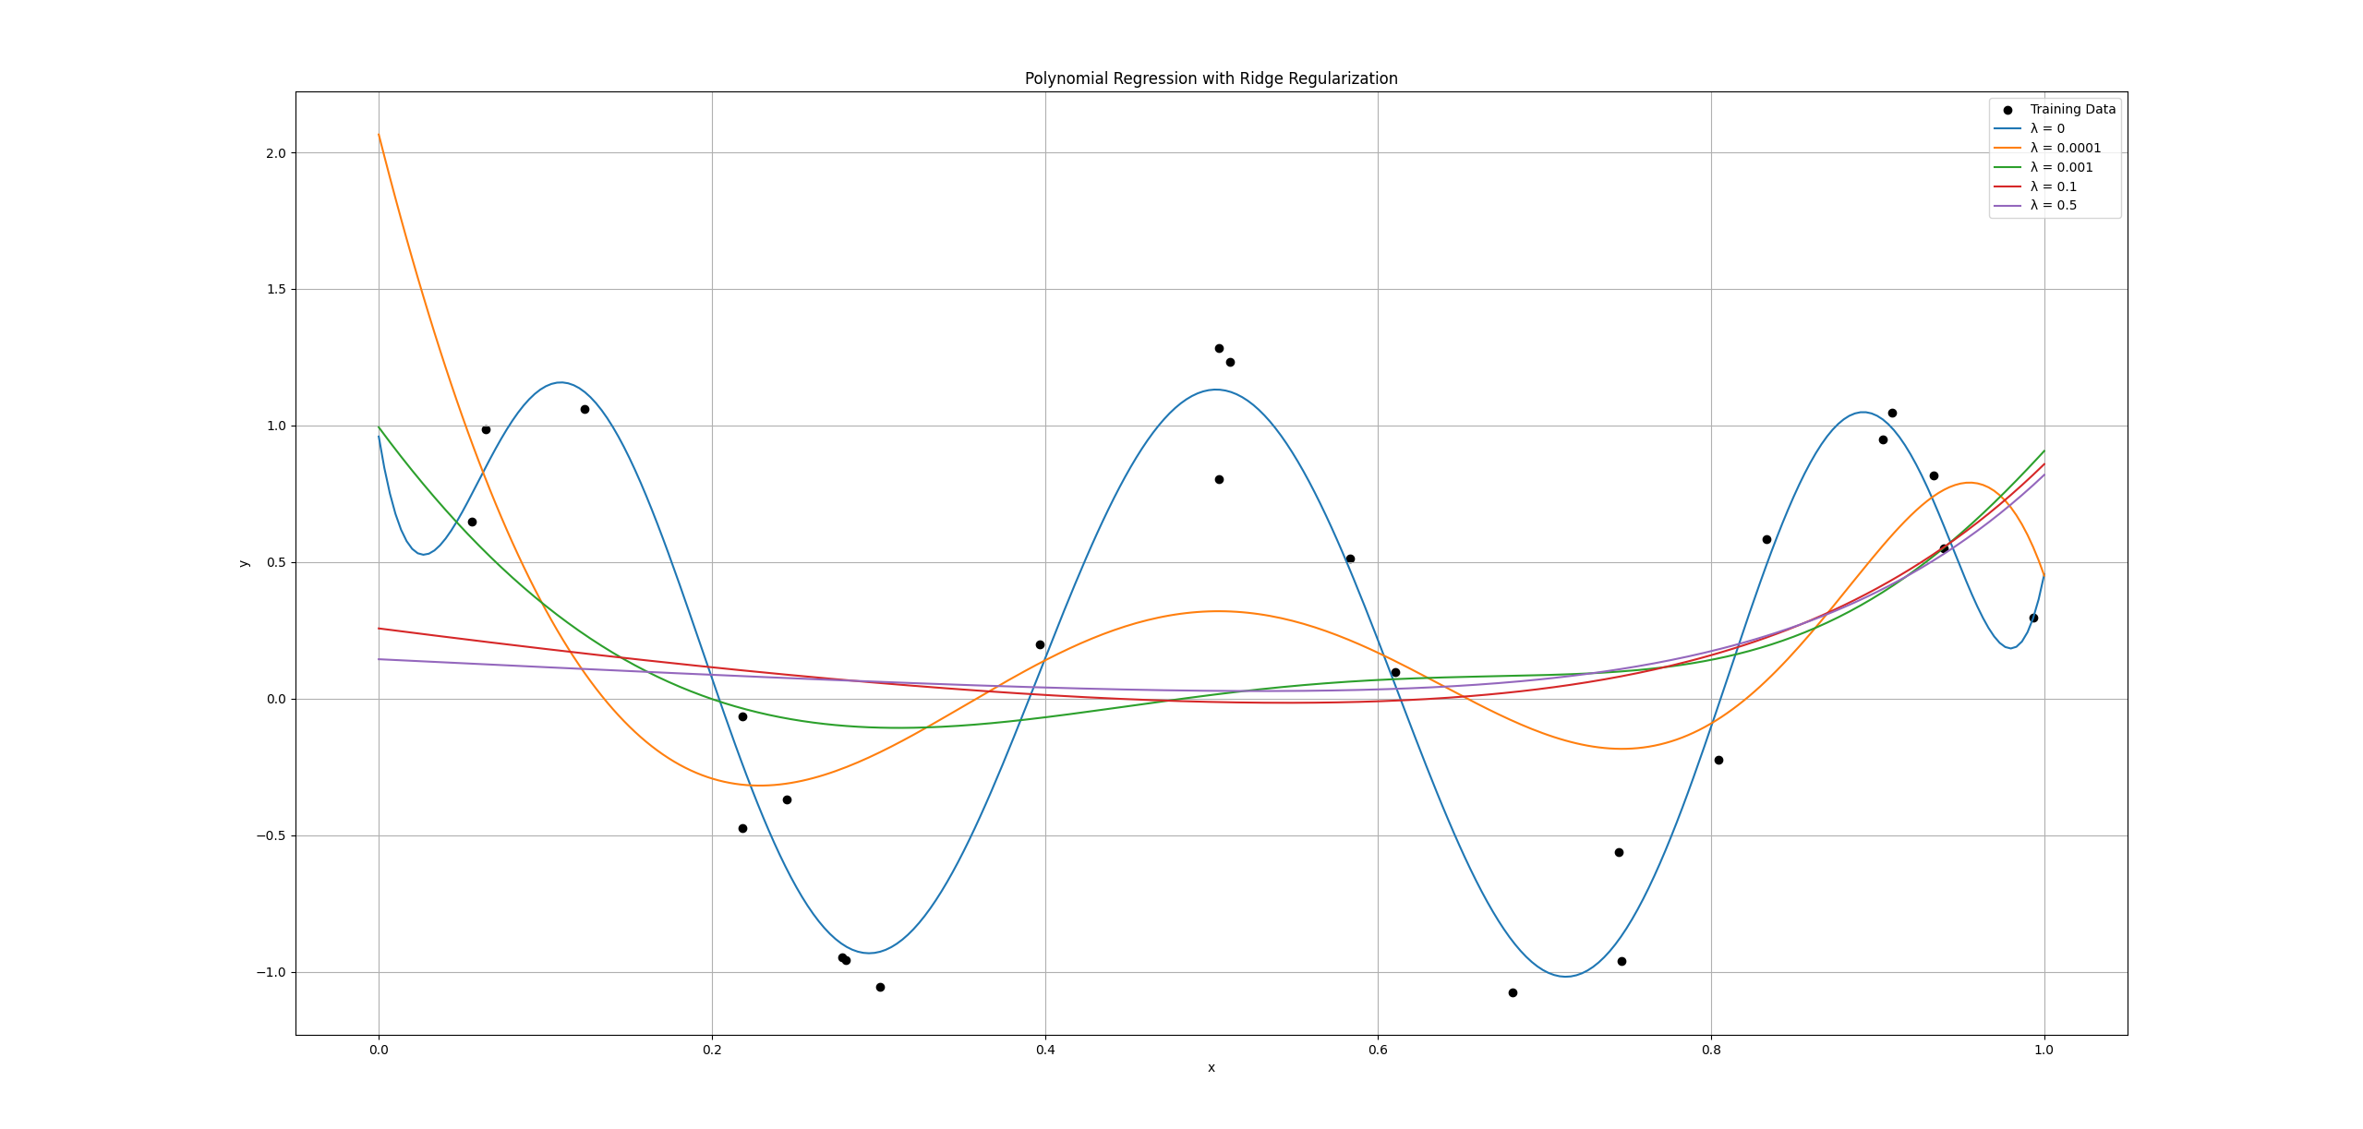
Part#1-(A):Non-Linaer regression
When λ = 0, the model overfits because the polynomial becomes too flexible and follows the noise. As λ increases, the curve becomes smoother but may underfit. A small λ gives the best balance.

Slide 3
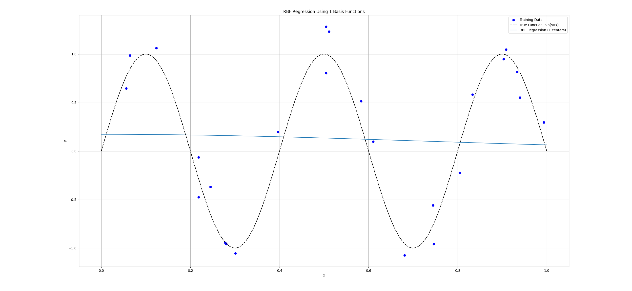
B) non-linear regression (without regularization)
1 RBF function
With only 1 RBF, the model cannot follow the sine function and clearly underfits.

Slide 4
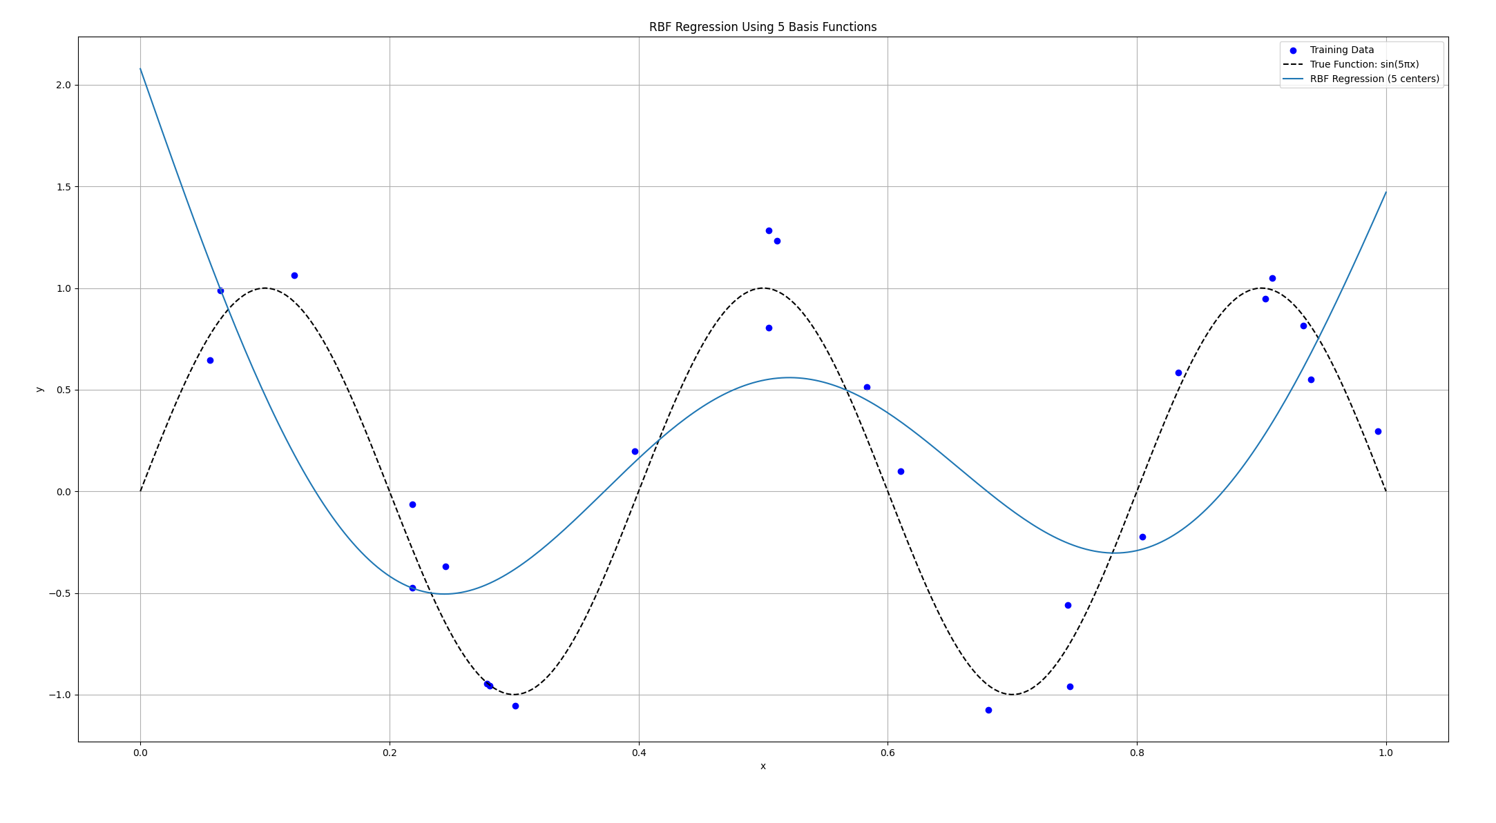
5 RBF functions
With 5 RBFs, the model improves and follows the general shape but still shows slight underfitting.

Slide 5
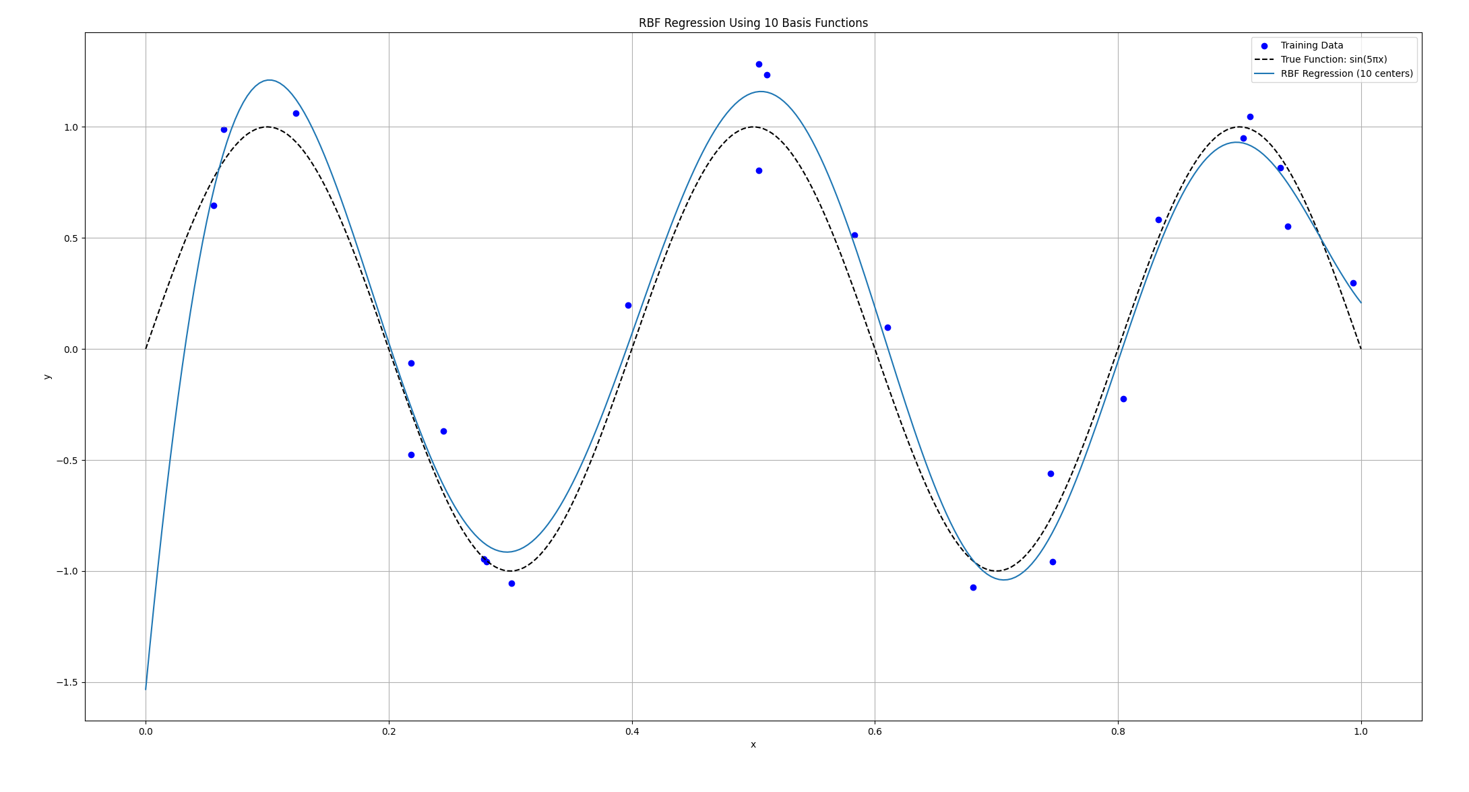
10 RBF functions
With 10 RBFs, the model fits the data smoothly and gives the best generalization.

Slide 6
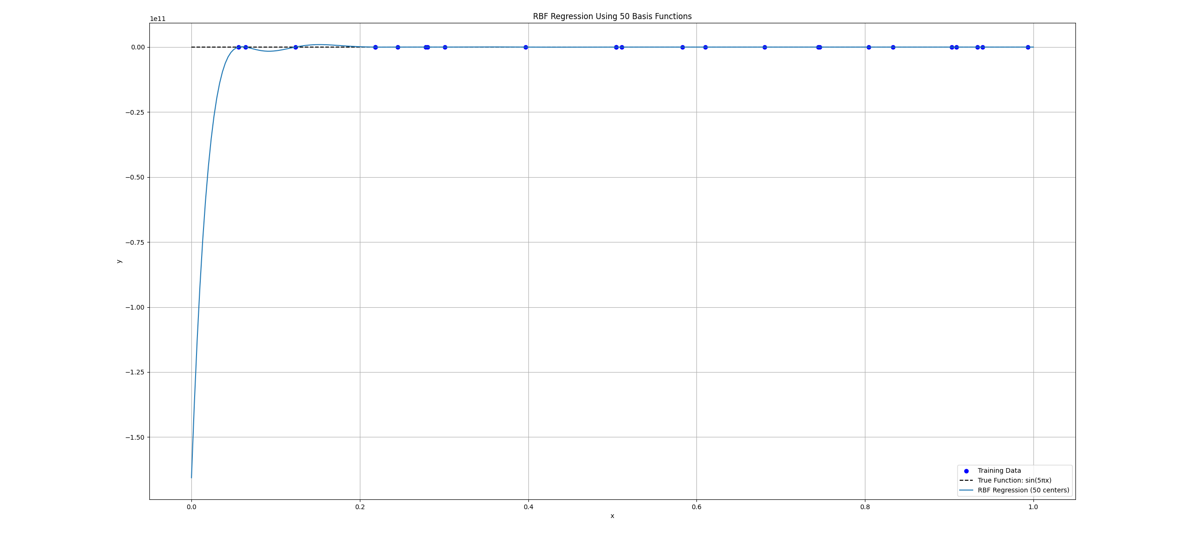
50 RBF functions
With 50 RBFs, the model becomes too flexible and starts fitting noise, causing overfitting.

Slide 7
Part 2 – Logistic Regression

Slide 8
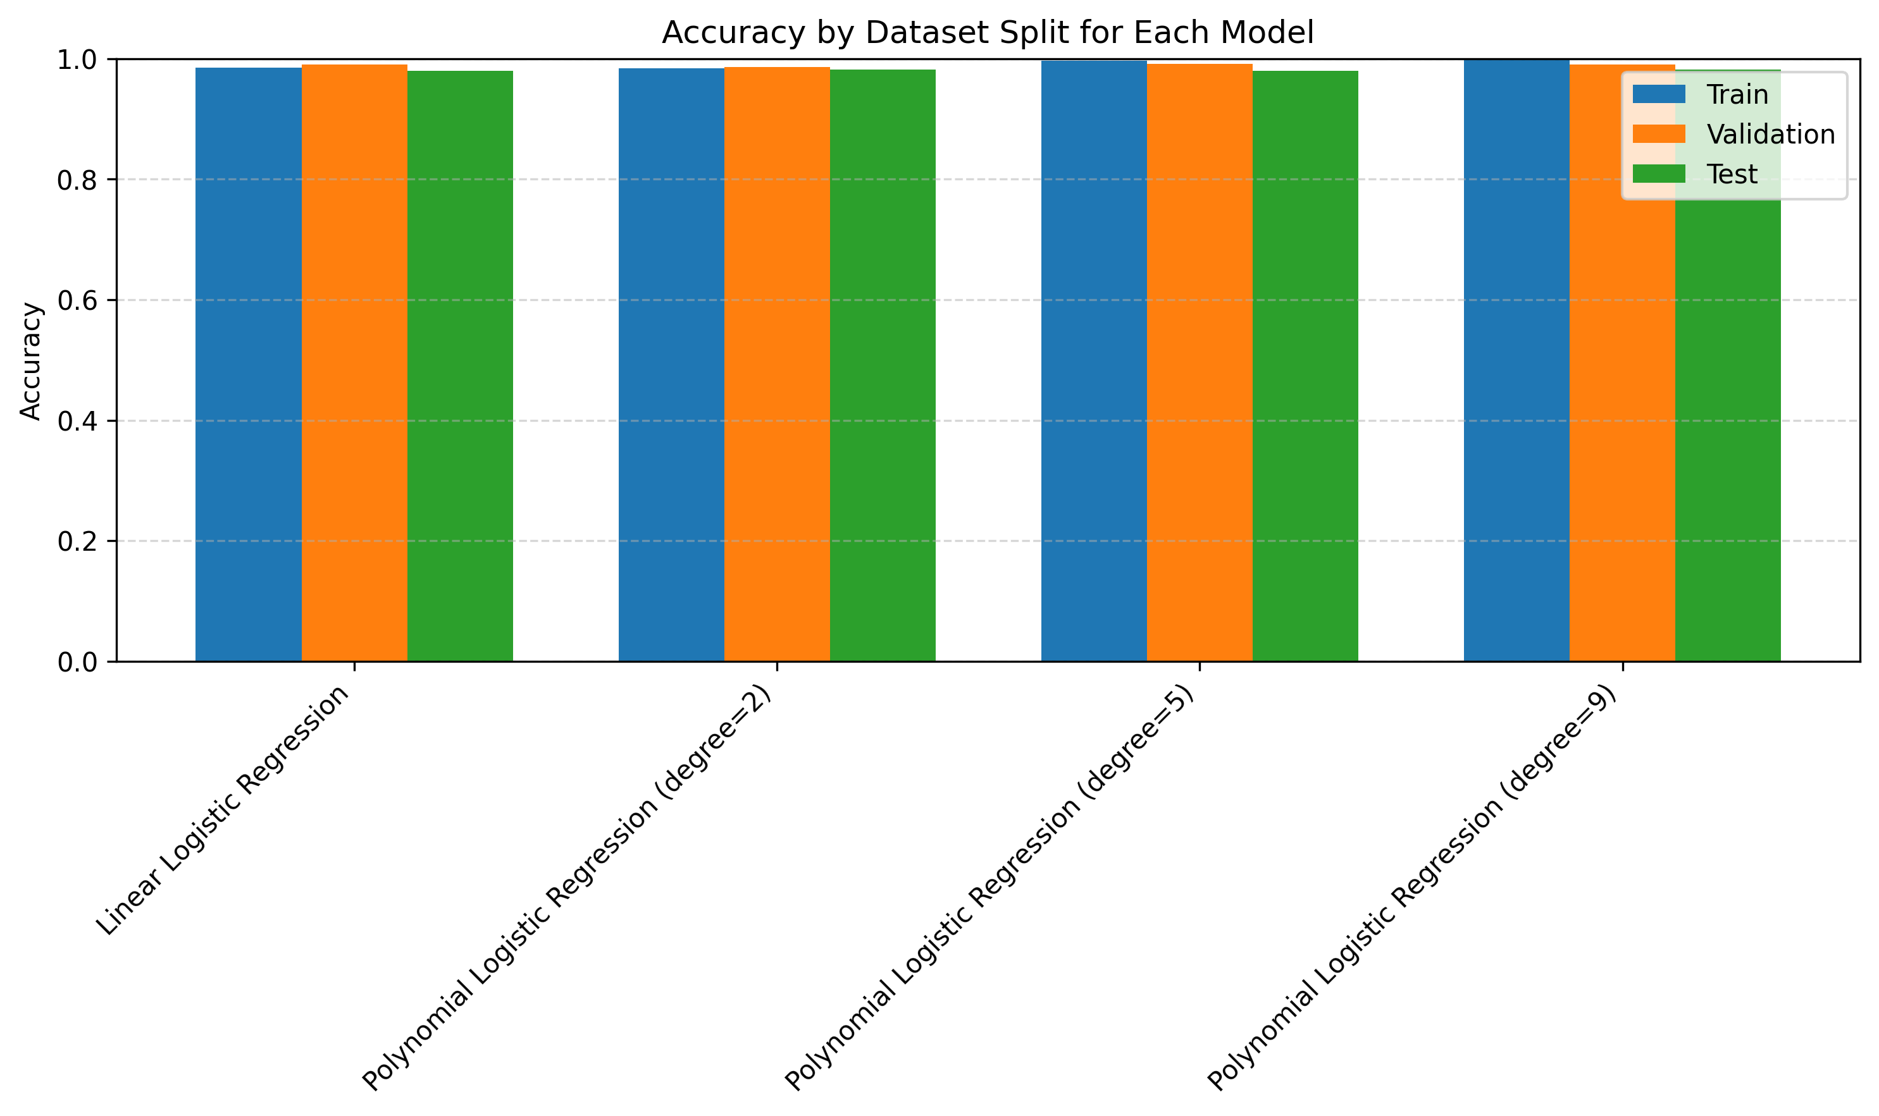
The plot shows that all models achieve very similar accuracy across the training, validation, and test sets, which indicates that there is no strong overfitting. It also suggests that the models generalize well, even as polynomial complexity increases.

Slide 9
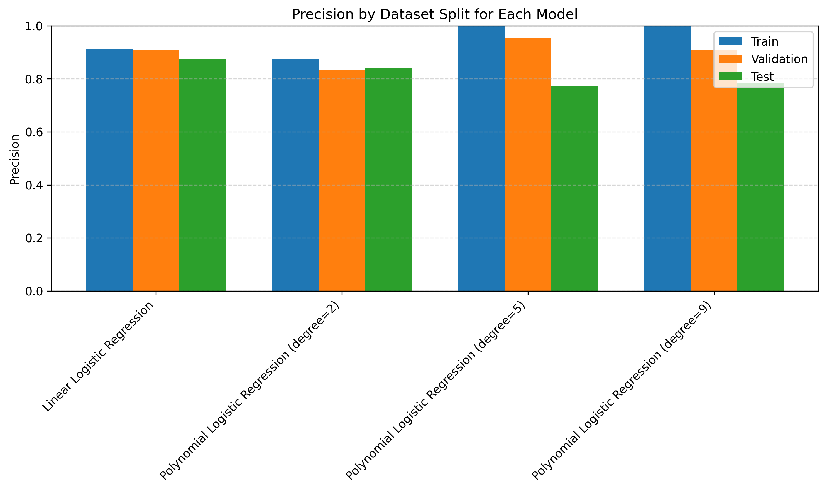
The plot shows that precision increases sharply for higher-degree models on the training set, but drops noticeably on the validation and test sets. This gap indicates growing overfitting as model complexity increases.

Slide 10
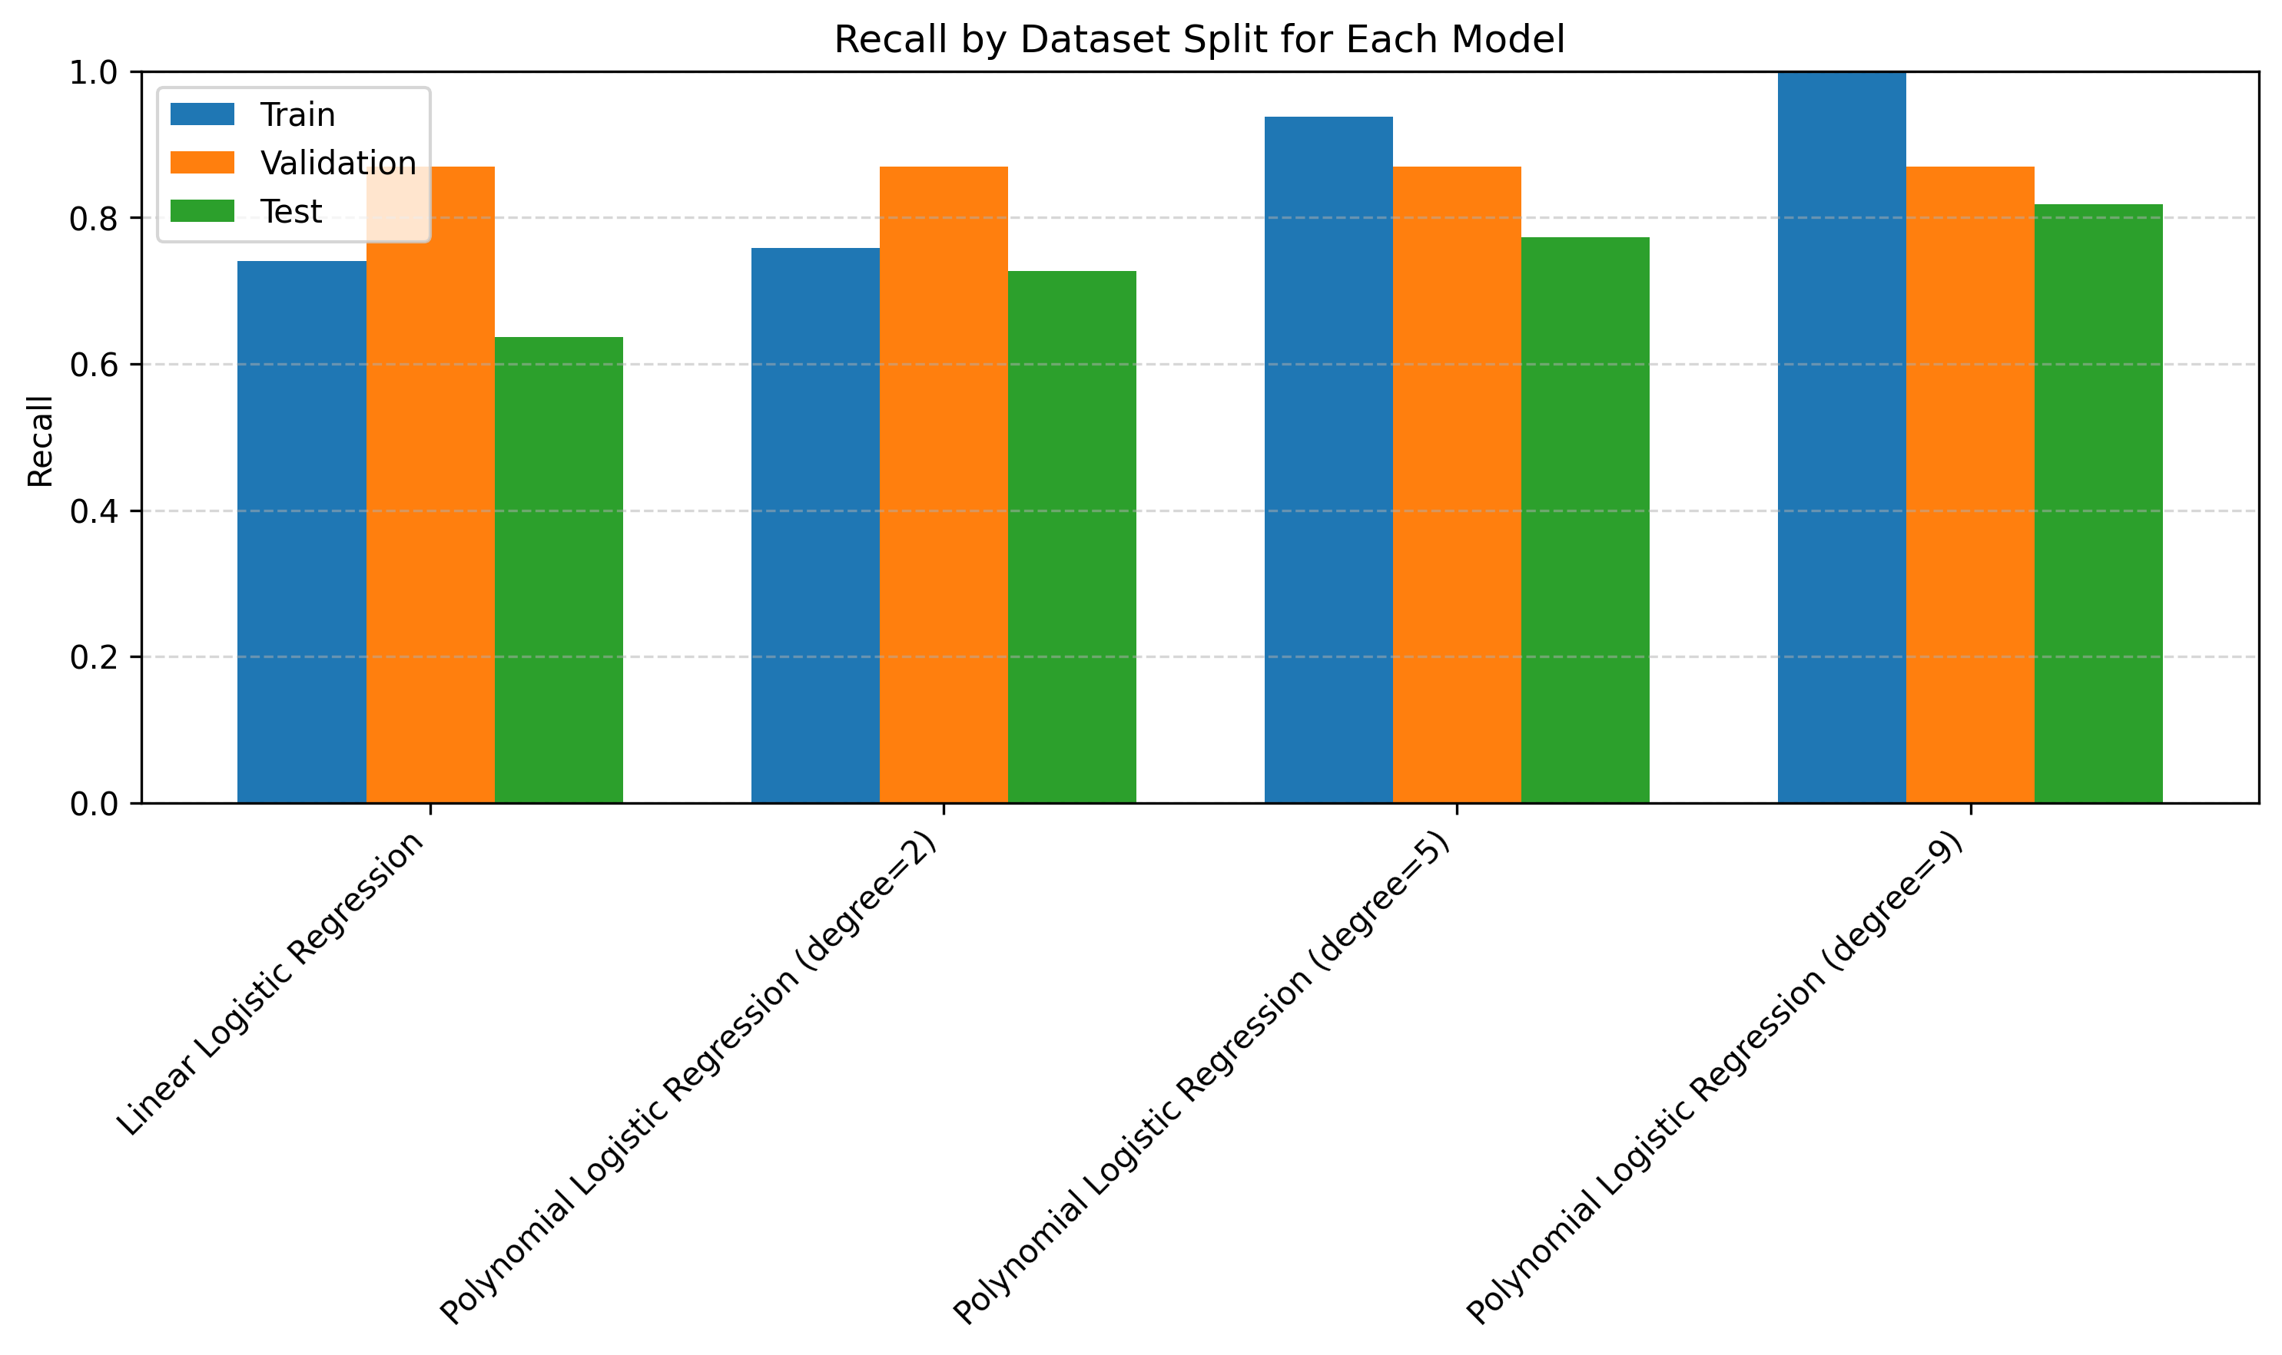
The plot shows that recall rises sharply on the training set as model complexity increases, but the validation and test recall improve only slightly. This widening gap indicates that higher-degree models start overfitting by memorizing patterns in the training data rather than generalizing well.

Slide 11
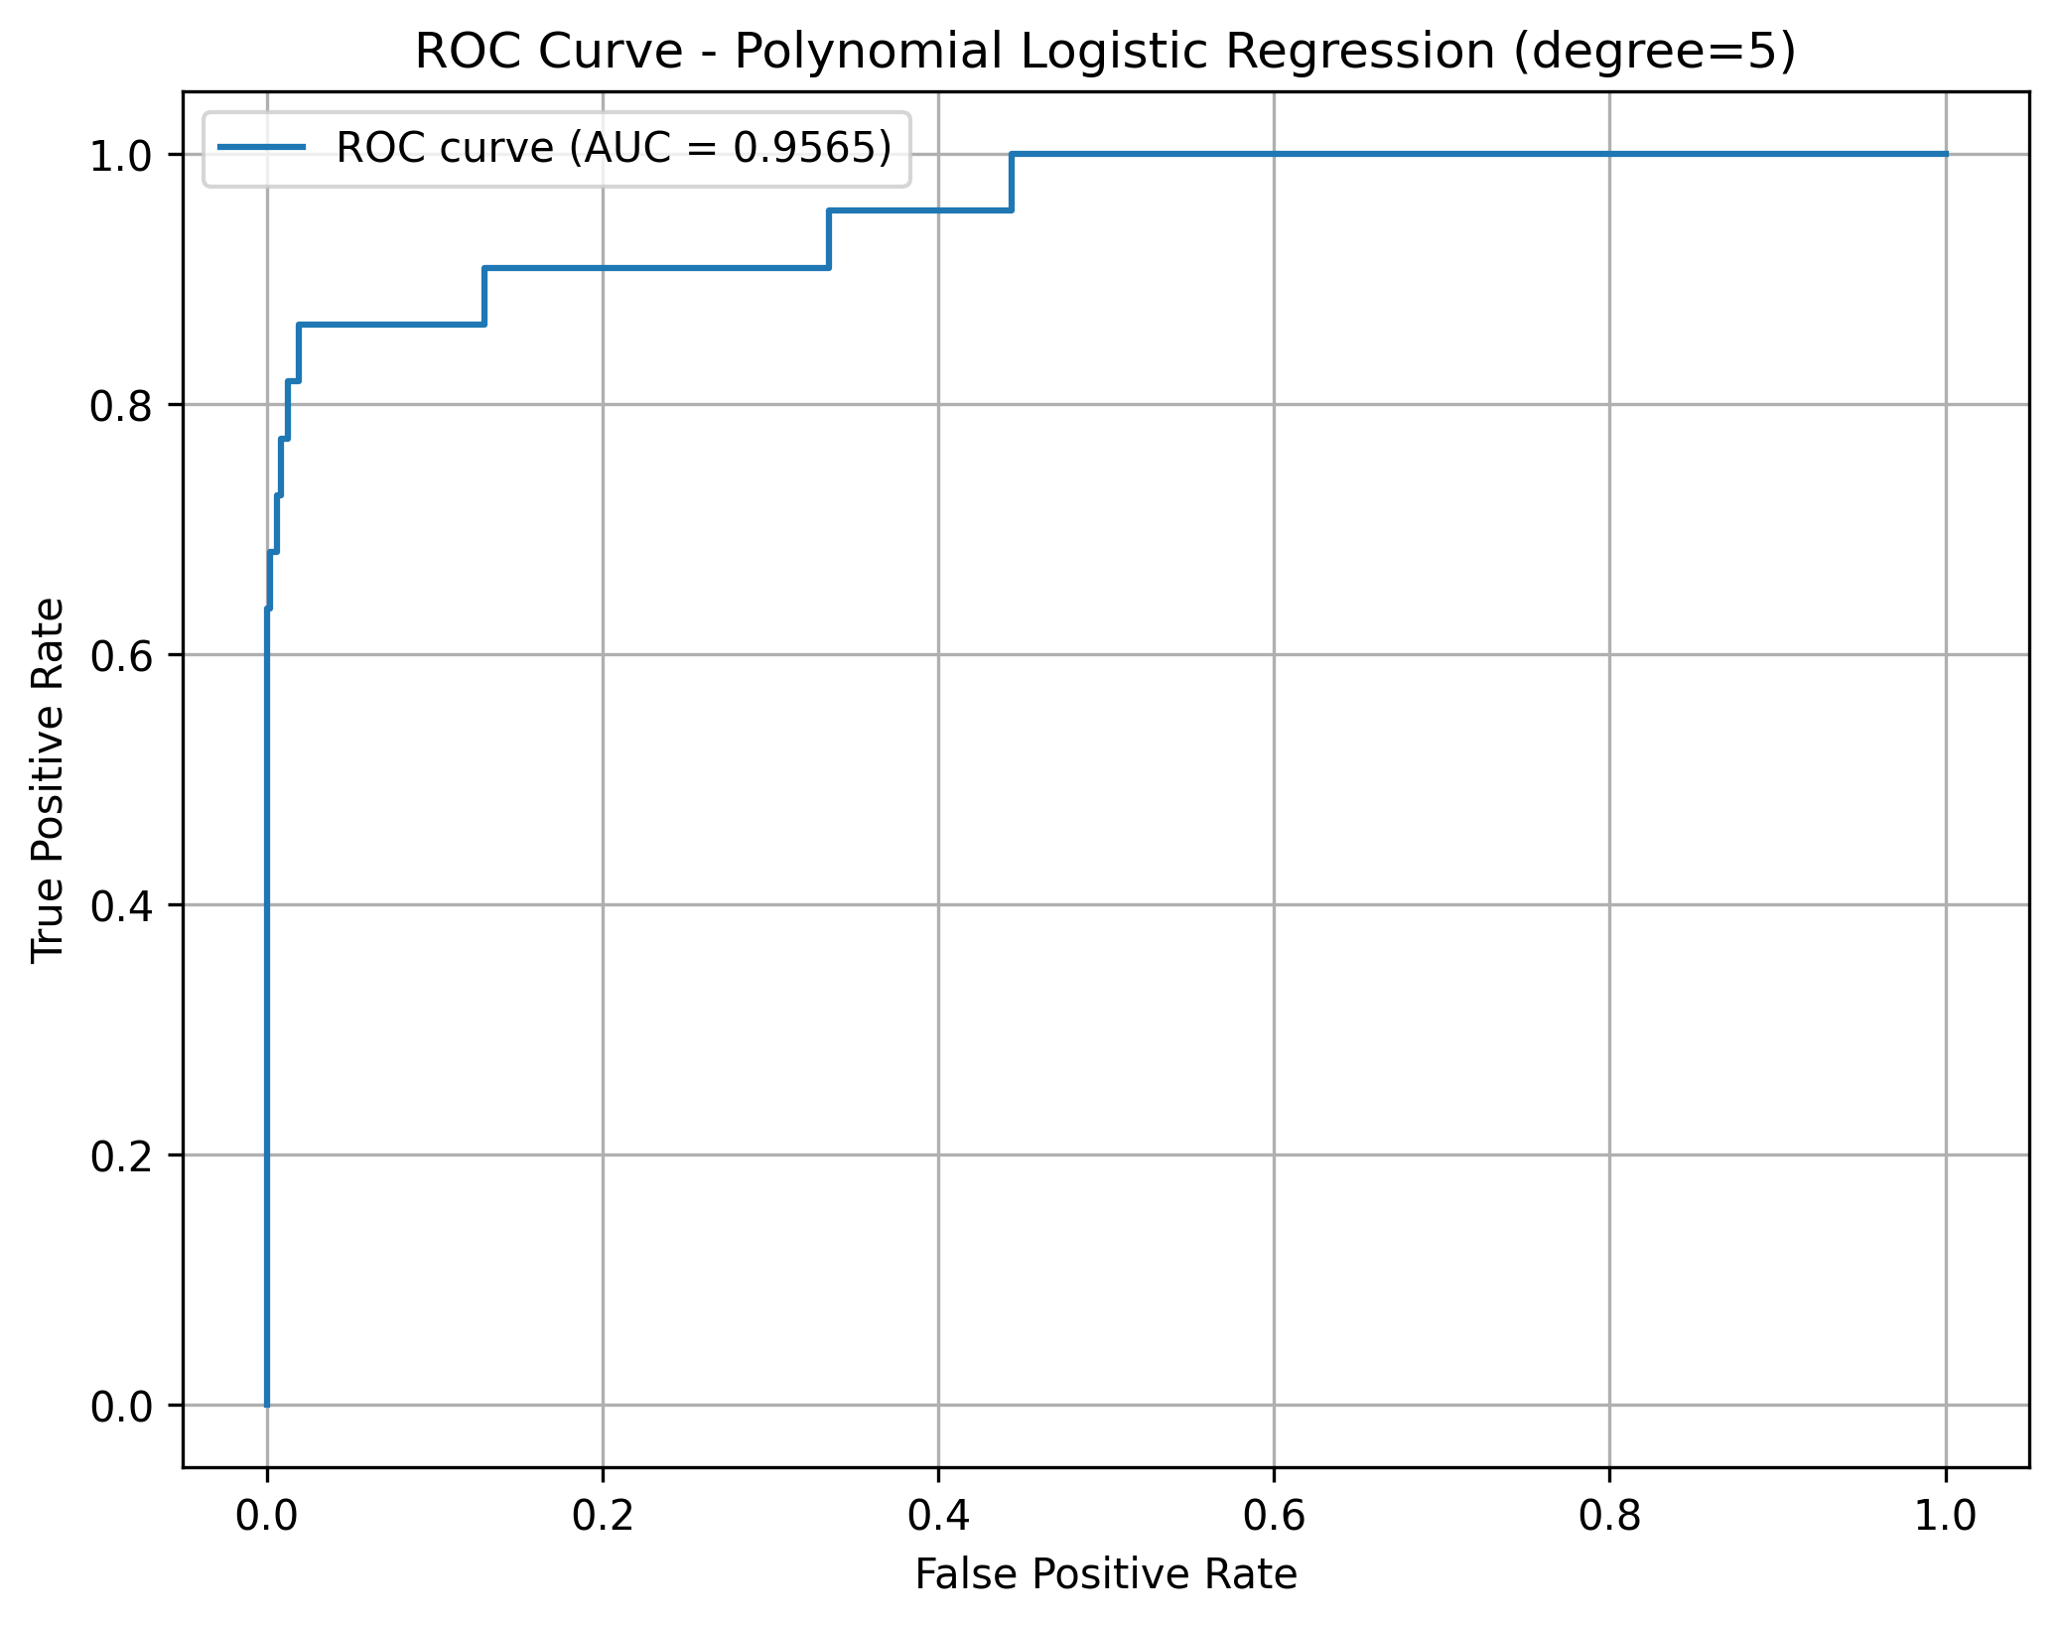
The ROC curve shows that the degree-5 polynomial model achieves a very strong AUC of about 0.96, indicating excellent ability to distinguish between churn and non-churn customers. The curve stays close to the top-left corner, which reflects a high true-positive rate while keeping false positives low.

