Slide 1
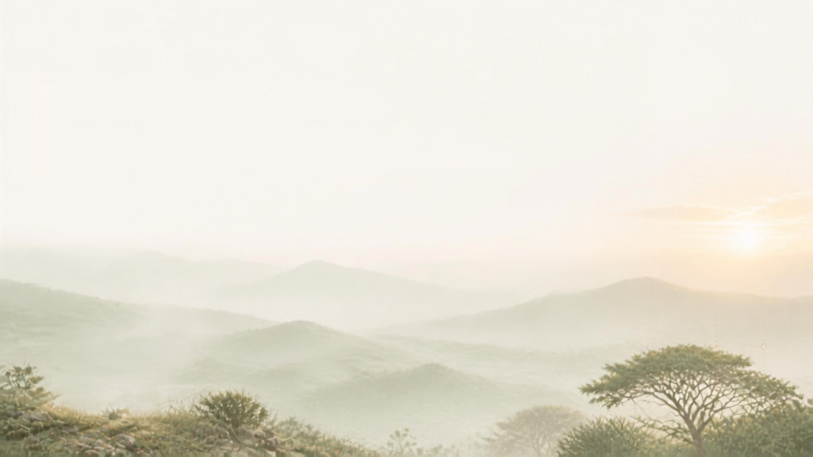

Wildlife reserve
Control and Detection System
Final Presentation · Group 10 · Species identification on iWildCam 2020 (WILDS)
Notes:
Group 10 final presentation: automatic species identification for camera-trap images, evaluated on cameras the model has never seen.

Slide 2
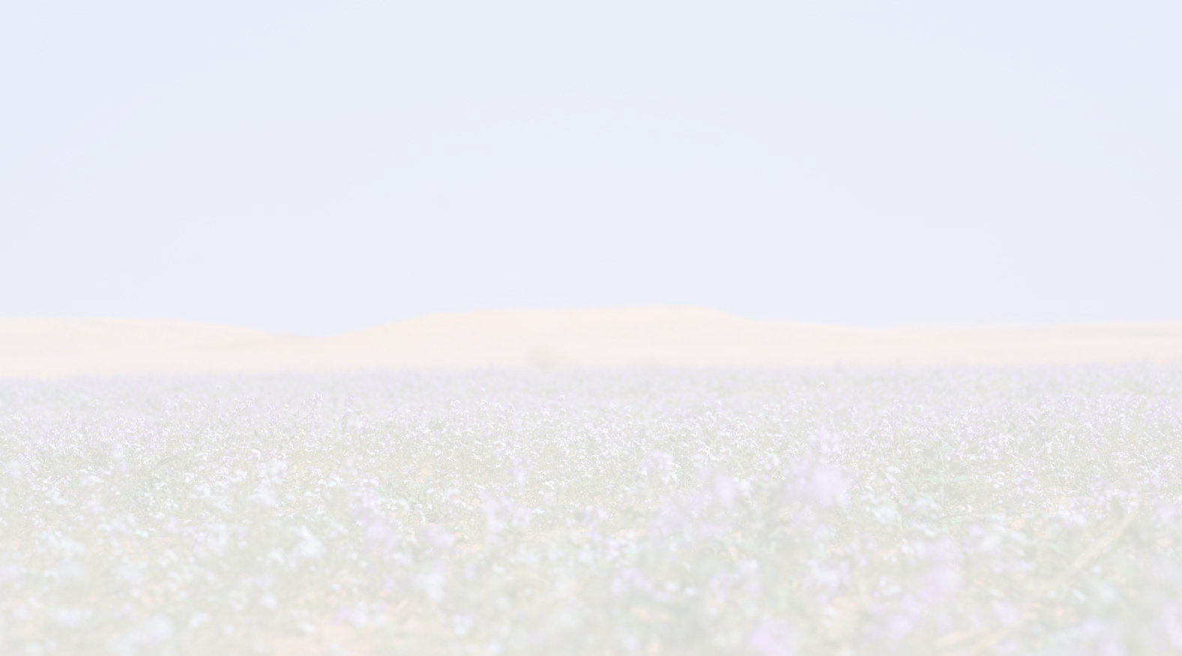
Team Introduction
Mansour Almutairi
Abdulrahman Bin shannar
Programmer With a Background in IT Technical Support, with extensive experience using various enterprise customer service software and platforms
Core Skills: Proficiency in corporate software, Troubleshooting, System Maintenance, SQL, C# (ASP.NET), and UX/UI Design.
Objective: Streamlining technical workflows, adapting quickly to company systems, and driving team success.
Senior Information Systems student specializing in AI Engineering, Machine Learning, and Data Analysis. Oracle Student Ambassador & Mostaqbali Team Leader, former IEEE Student Branch President, and Head of Operations & Quality at Tuwaiq Club. Former IT Intern at REANDA International, with experience in Business Analysis, AI integration, and project management. IBM Certified in Data Analysis.
Muhannad Qahl
a Data Analytics professional with a strong interest in Data Analytics and Business Intelligence. I completed the Data Analytics Professional Program in power bi at King Saud University , where I strengthened my skills in analyzing data and transforming it into meaningful business insights.

Slide 3
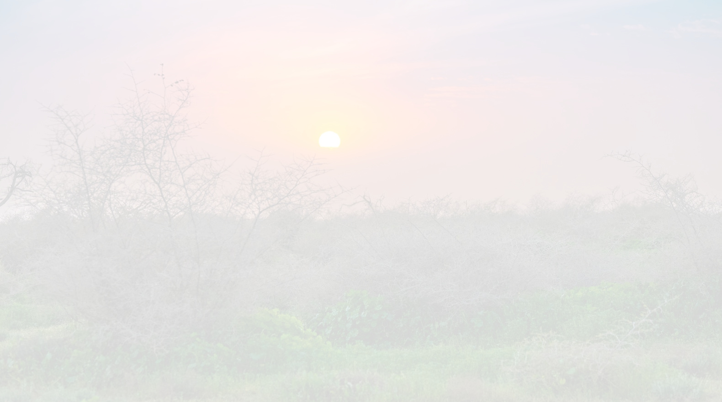
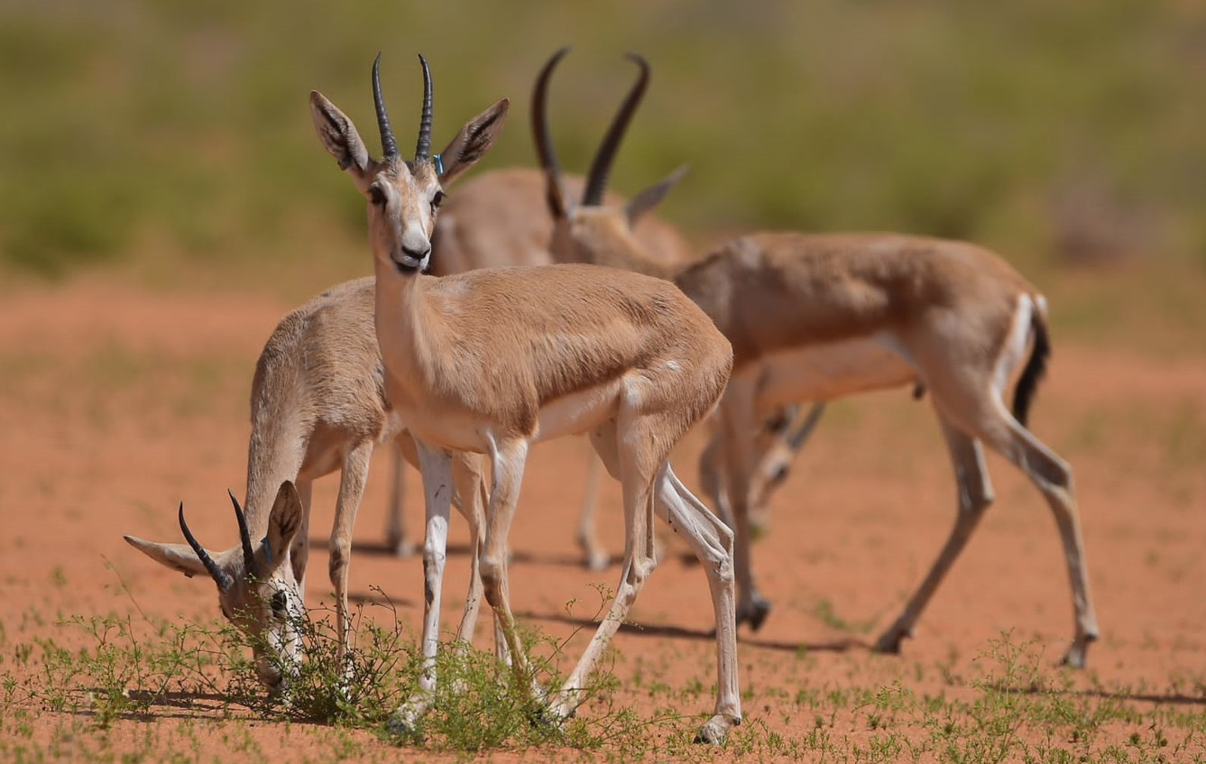
Problem
A live monitoring program — and a photo backlog
The King Abdulaziz Royal Reserve (KARR) runs an active camera-trap program across Riyadh and Eastern-region habitats. Every trigger produces a burst of photos, most of them empty, and every photo still needs a person to look at it before a sighting counts.
103
field cameras deployed across the reserve
28,000 km²
reserve area in Riyadh & the Eastern Province
34%
of all 203,029 dataset frames show no animal at all
THE QUESTION WE SET OUT TO ANSWER
Can a model name the species in a camera-trap photo taken by a camera it has never seen before?
Reserves keep installing new cameras, so a model that only works on backgrounds it has memorised is of no use in the field.
Notes:
Context from our proposal: KARR's camera network and the manual-review bottleneck. The key word in our question is 'never seen' - that shapes every evaluation choice later.

Slide 4
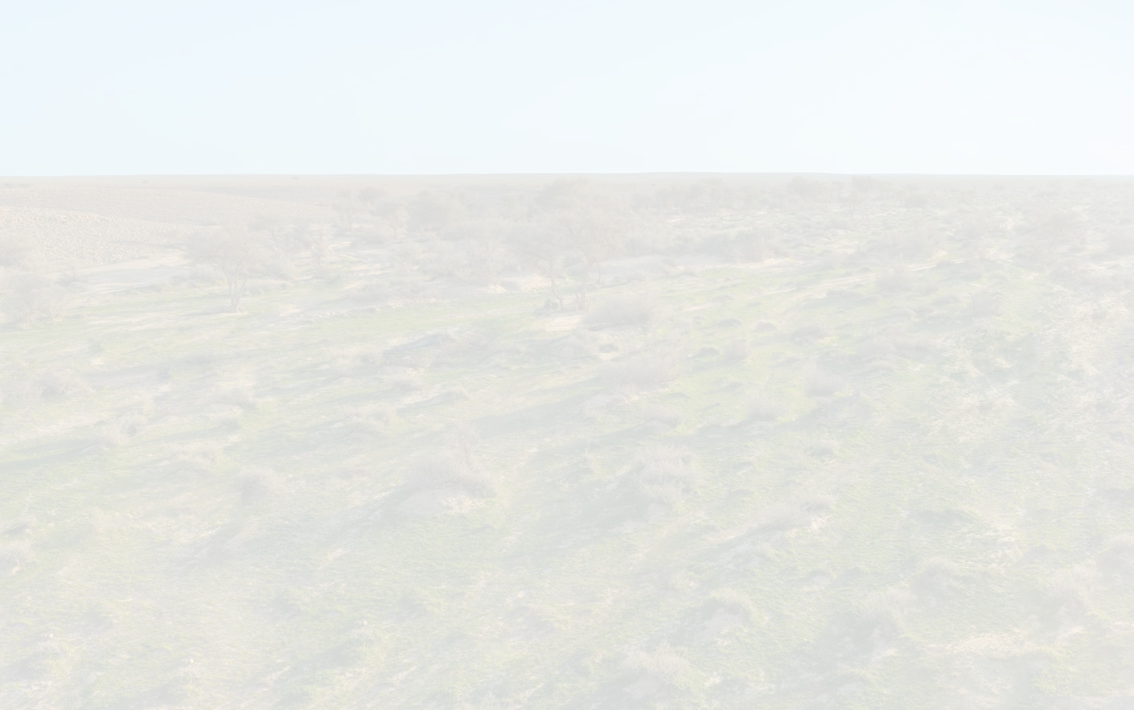



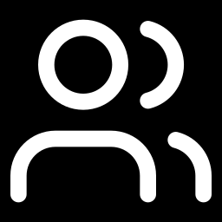

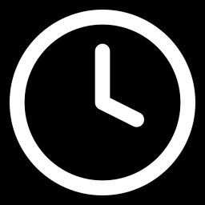
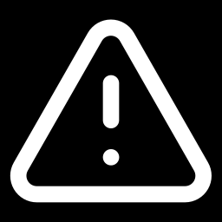
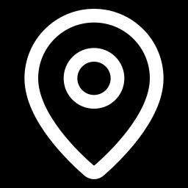
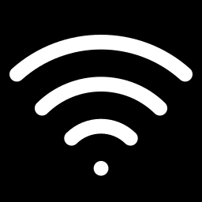
Problem
Today, every photo waits in a human review queue
Our EDA projects about 1 million images a year for KARR's 103 cameras; most are empty frames or near-duplicate bursts of the same animal.
Camera triggers
Image uploaded
Manual review queue
Species logged (delayed)
▲ the bottleneck
Reviewer hours
Thousands of blank or duplicate frames need the same manual attention as a real detection.
Delayed conservation action
A rare-species sighting only surfaces when someone happens to reach that image in the queue.
Hardware misallocation
Cameras at low-yield stations are never flagged for relocation — there is no data-driven signal.
Bandwidth & data costs
Remote cameras send every frame, blank or not, over limited cellular links.
WHAT WE NEED An automatic first pass that filters empty frames and names the species, so people review only what matters — and that keeps working when a new camera is installed.
Notes:
Four operational costs from our proposal. The fix has to generalise to new camera locations.

Slide 5
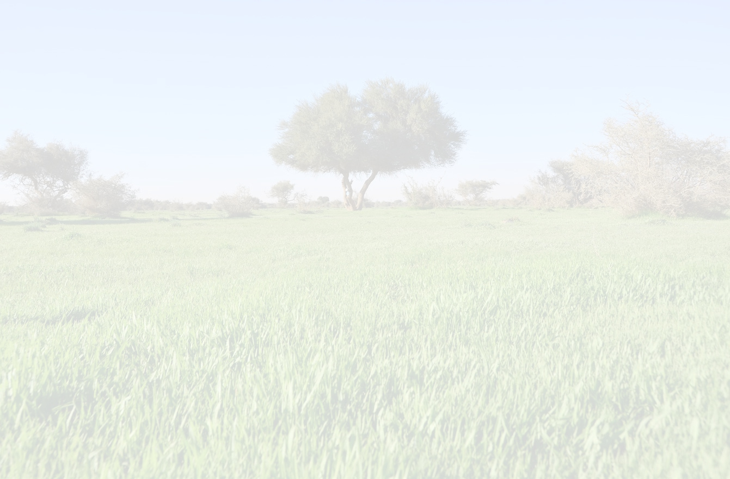
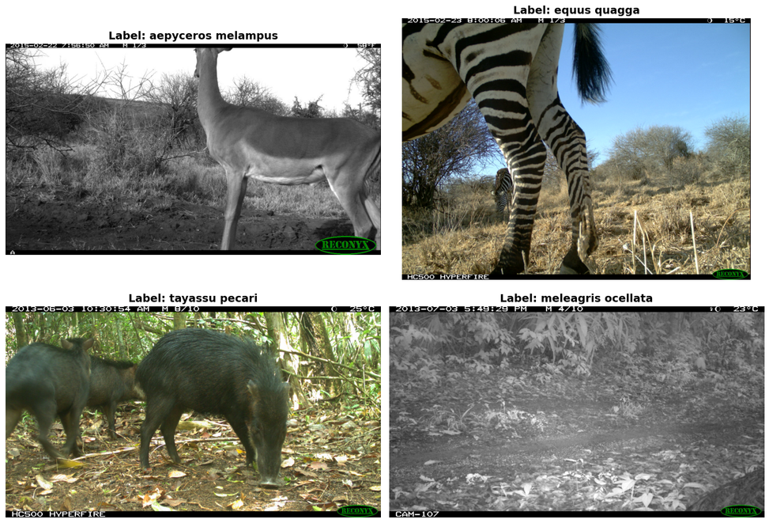
Data
iWildCam 2020 — the WILDS v2.0 camera-trap benchmark
Public stand-in for KARR's own Wildlife Insights data: 203,029 images from 323 camera locations, 182 species. We use the 10 most frequent classes.
10
classes: empty + the 9 most
frequent species
39,898
images sampled across
four official splits
29
test cameras never
seen in training
SPLIT | WHAT IT TESTS | IMAGES | BURSTS | CAMERAS
train | Fitting + model selection | 29,740 | 8,773 | 208
id_val | Seen cameras, later dates | 2,377 | 872 | 107
id_test | Seen cameras, later dates | 3,420 | 982 | 137
ood_val | Never-seen cameras (the real test) | 4,361 | 1,444 | 29
SAMPLING Up to 3,000 images per class for training and 600 per class for evaluation, taken round-robin across bursts so no single burst dominates a class. Same classes, splits and seed in every notebook, so all results are directly comparable.
Example iWildCam frames: day, infrared night and partial views
Notes:
iWildCam is our declared stand-in for KARR data. The ood_val split is the one that matters: 29 cameras whose backgrounds the model never saw.

Slide 6
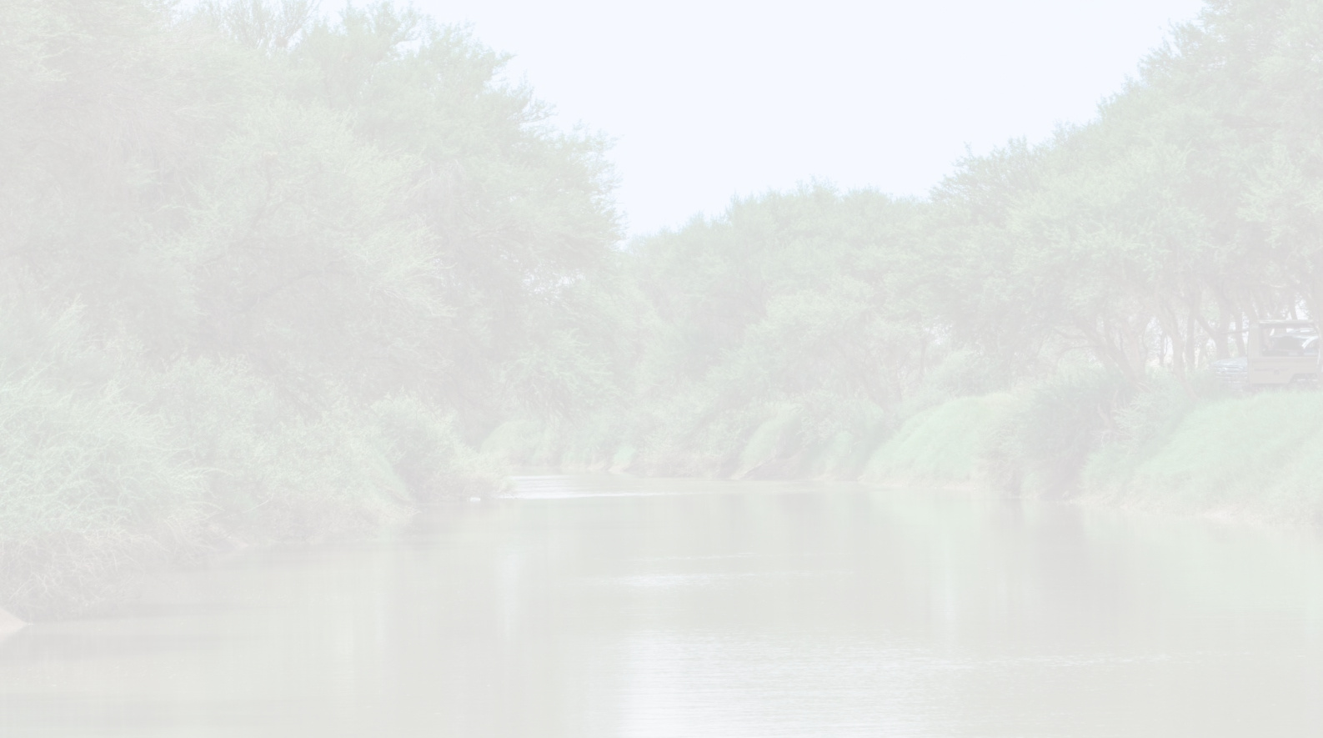
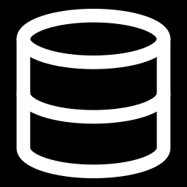
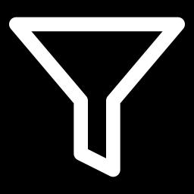
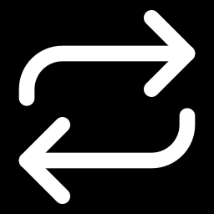
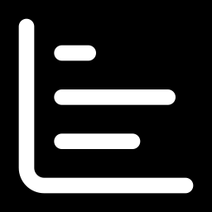
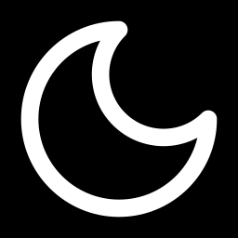
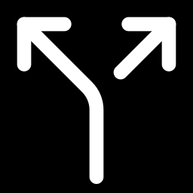
Analysis
EDA: the full release at a glance
All 203,029 images of iWildCam 2020 (WILDS), before any sampling: what the data looks like and what it means for the model.
203,029
34.2%
5.56
images · 323 cameras · 182 classes, 2013–2015
of frames are blank (69,487 images)
frames per burst, across 36,484 bursts
→ Clean: 0 missing cells, 0 duplicate IDs
→ Filtering empty frames is the first job
→ Decide once per burst, not per frame
181
46%
102 / 182
species, and 54 of them have 10 photos or fewer
of frames are infrared (greyscale)
classes appear in the official OOD test split (48 unseen cameras)
→ Score with macro F1, not accuracy
→ Night and day are two visual domains
→ 80 classes are trained but never tested
Notes:
Headline numbers from our EDA notebook on the full release. Each tile ends with the design decision it forced - the rest of the deck follows from these.

Slide 7
Analysis
The real workload is bursts, not frames
EDA projection for KARR's 103 cameras: ≈1.01 million images a year (26.9 per camera-day). A planning figure, extrapolated from forest and savanna cameras to desert.
82%
of frames are repeats within a burst. One decision per burst cuts review from 844 to 152 hours, with no machine learning at all.
43%
of bursts are blank end to end. A blank filter at 95% recall takes review to 88 hours: 90% less than today.
88%
less data to send. Blanks are 34% of images but only 33% of bytes, so the big saving is sending one frame per burst.
Notes:
Seconds per decision and the filter's operating point are assumptions; the EDA shows the conclusion holds from 2 to 8 seconds. KARR numbers are planning figures, not forecasts.

Slide 8
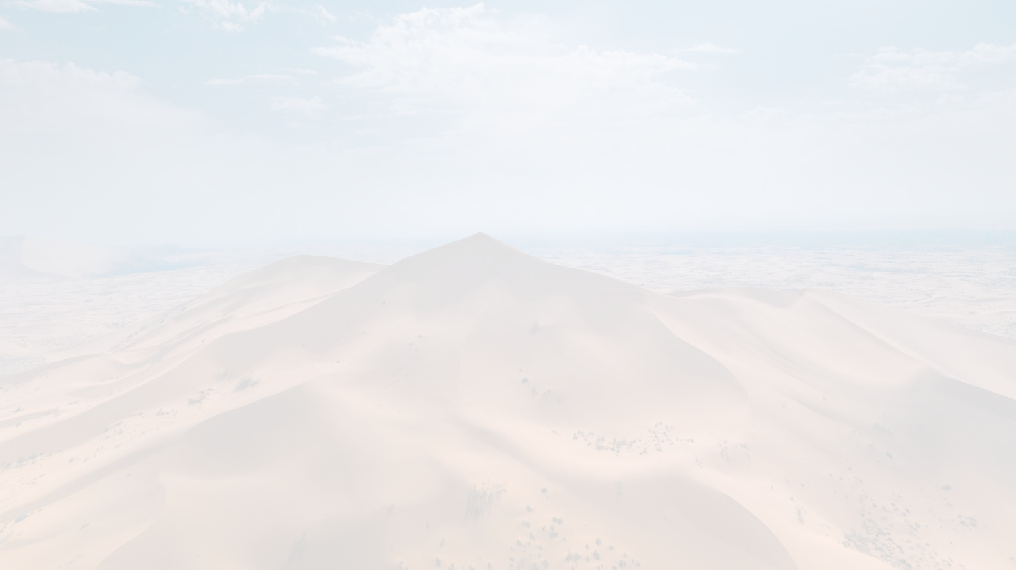
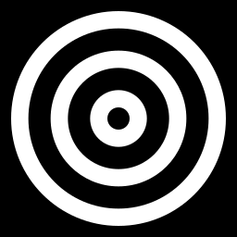
Analysis
A brutal long tail, so we scoped to the top 10
One species holds 8% of all images
Ocellated turkey has 16,282 photos, an imbalance of 16,282 : 1. The top 10 classes hold 56% of animal photos; the rarer half of species holds 0.8%.
Only 102 of 182 classes reach the official OOD test
80 classes are trained but never tested, and 31 test classes have ten images or fewer, so their F1 rides on a handful of frames.
Our scope: empty + the 9 most frequent species
Every one has at least 130 images on the unseen cameras. Empty still outnumbers gray fox 17.5× in training, so we cap each class at 3,000 images.
Notes:
The EDA proposed a 65-species list covering 94% of animal photos. For modelling we narrowed to the top 10 so every class has enough unseen-camera test images to score reliably.

Slide 9
Analysis
When animals are active, and how the camera sees them
A three-way clock beats night/day
81 diurnal, 38 crepuscular and 62 nocturnal species. Curassow and agouti peak at dawn and dusk. Hour of day is a free feature, and our LR / XGBoost models use it.
Almost half the frames are infrared
46% of images are greyscale IR, including 30% of daytime frames under dense canopy. The official OOD test cameras run more IR than training (53% vs 43%).
The calendar is a shortcut
92% of images come from 2013, in one campaign wave. Month and year only encode which cameras were running, so they stay out of the model.
Notes:
Clocks are local camera time with no timezone correction, so the bands are approximate; the infrared flag is a more reliable darkness signal than the clock.

Slide 10
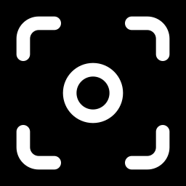
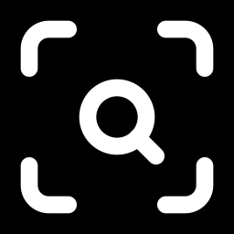
Analysis
Why unseen cameras are hard
Training cameras vs the 48 official OOD test cameras, compared on five axes.
The split is by camera
The train, val and test splits share 0 camera locations, while id_val / id_test reuse training cameras. The gap between them is the domain-shift penalty, so we used the shipped splits only.
The animal is tiny
With no boxes, background subtraction puts the median animal at 1.6% of the frame (≈28×28 px at 224 px) and 42% of bursts under 1%. This is why we detect first, then classify the crop.
The pixels name the camera
45% of frames carry a burned-in bottom bar (camera model, sometimes an ID) and 34% a top bar. The split can't close this leak. Recommended fix: crop the top and bottom 5%.
Notes:
The biggest shift is which species live in front of the camera, not how the photos look. That prior shift is why class-balanced training matters more than appearance tricks.

Slide 11
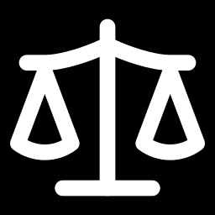
Analysis
The background can give the answer away
Camera traps never move, so a model can learn which camera it is looking at instead of which animal is in front of it.
Two classes are identifiable by site alone
Black-fronted duiker and empty appear at cameras no other class visits. We therefore report honest macro F1 over the other 8 classes.
Easy sites flatter the average
Camera-weighted accuracy is 0.807 vs 0.637 image-weighted. The 6 contested cameras hold 72% of test images — that is where the real work is.
Every feature audited for site leakage
We measured how much of each feature's variance is explained by camera ID. Burst length was a site fingerprint and was dropped; box size, position and detector confidence passed (5–19%).
Notes:
This is why accuracy alone misleads here. Contested cameras = sites where two or more of our classes appear; only there does the model have to actually look at the animal.

Slide 12

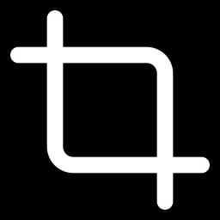




Approach
Detect → crop → classify → vote
Instead of asking a model to read the whole scene, we point it at the animal and decide once per trigger event.
STEP 1
Camera trigger
A burst of ~3 frames per event, daylight or infrared night.
STEP 2
MegaDetector v6
Finds the animal: one box and a confidence per image.
STEP 3
Crop the animal
Padded box, about 2× zoom. Whole frame if confidence < 0.15.
STEP 4
Pretrained features
BioCLIP (biology CLIP) or SpeciesNet (camera-trap model).
STEP 5
Classifier head
Logistic regression, XGBoost or a small MLP on our 10 classes.
STEP 6
Vote per burst
One answer per event: the most confident frame decides.
WHAT WE PROPOSED
Train a CNN from scratch with no pretrained weights, and use classical ML on metadata as the baseline to beat.
WHAT THE DATA TOLD US
The scratch CNN plateaued at 0.32 honest F1 and regularisation did not help on new cameras — so we moved to pretrained, camera-trap-specific features and kept LR / XGBoost as the heads.
Notes:
The pipeline every final model shares. Be upfront that we changed plan from the proposal and why.

Slide 13



Approach
Evaluation built for new cameras, not memorised ones
SPLIT BY CAMERA
Official WILDS splits
Test cameras never appear in training
ood_val: 29 unseen cameras, 4,361 images
id_test kept to measure the seen-vs-unseen gap
SELECT WITHOUT PEEKING
Held-out selection cameras
36 training cameras (4,529 images) held out to choose models
Test split read once, after the choice
One-standard-error rule, bootstrapped over cameras
HONEST METRIC
Honest macro F1
Macro F1 over the 8 classes that need the animal to be seen
Excludes duiker and empty (separable by site)
Reported per image and per burst
WHY IT MATTERS Choosing on held-out cameras instead of the test set cost only 0.014 F1 in the final notebook, and 84% of model rankings on the selection cameras matched the test ranking — the selection signal was real.
Notes:
This keeps the promise in our proposal: split by camera station and report F1 per species, not one overall accuracy number.

Slide 14
Models
Five model families, each fixing the last one's weakness
01
CNN from scratch
DEEP LEARNING · OUR OWN NETWORK
A small CNN trained only on our photos (64–128 px), as proposed.
02
ResNet-18 fine-tuned
DEEP LEARNING · TRANSFER
ImageNet-pretrained, 192 px, layer-wise learning rates, mixup and label smoothing.
03
EfficientNetV2-S + XGBoost
EMBEDDINGS + BOOSTING
Frozen pretrained image features fed to a gradient-boosted tree classifier.
04
BioCLIP + LR / XGBoost
CROPS + CLASSICAL ML
Biology-specific CLIP features of the MegaDetector crop, plus time-of-day and box features.
05
SpeciesNet + MLP
CAMERA-TRAP FOUNDATION MODEL
Google's EfficientNetV2-M trained on 65M camera-trap images; a small MLP maps its label scores to our 10 classes.
LESSON
Less overfitting helped seen cameras (0.489 → 0.545) but unseen cameras stayed flat.
LESSON
Pretraining gave +0.10; all the tuning after that only +0.025.
LESSON
Frozen features + boosting matched full fine-tuning at a fraction of the cost.
LESSON
Cropping beat the full frame by +0.11; LR and XGBoost tied.
LESSON
Best on every metric; zero-shot alone already reached 0.825 per burst.
0.320
honest F1, unseen cameras
0.446
honest F1, unseen cameras
0.437
honest F1, unseen cameras
0.598
honest F1, unseen cameras
0.734
honest F1, unseen cameras
Honest F1 = macro F1 over 8 classes on the 29 unseen cameras, per image. Also tried along the way: background-subtraction crops (0.510) and SpeciesNet zero-shot with no training at all (0.825 per burst).
Notes:
Order is chronological. Each step was chosen because of what the previous one got wrong.

Slide 15
Comparison
Better inputs beat more tuning
+0.10
Pretraining
Scratch CNN → ImageNet ResNet-18 (0.320 → 0.421)
+0.025
All the tuning in v3
Resolution, layer-wise LR, mixup (0.421 → 0.446)
+0.11
Cropping the animal
BioCLIP full frame → MegaDetector crop (0.490 → 0.598)
+0.14
Camera-trap foundation model
BioCLIP pipeline → SpeciesNet (0.598 → 0.734)
Notes:
Read the deltas on the right: tuning a model that looks at the whole scene bought very little; changing what the model sees bought a lot.

Slide 16
Comparison
Full scoreboard on the 29 unseen cameras
MODEL | ACCURACY | MACRO F1 | HONEST F1 | HONEST F1 / BURST
SmallCNN from scratch (64 px) | – | 0.434 | 0.320 | –
ResNet-18, single LR (128 px) | – | 0.505 | 0.421 | –
ResNet-18 v3 (192 px, layer-wise LR, mixup) | 0.637 | 0.543 | 0.446 | –
EfficientNetV2-S + XGBoost | 0.581 | 0.512 | 0.437 | –
BioCLIP, full frame | 0.653 | 0.581 | 0.490 | –
BioCLIP + background-subtraction crop | 0.672 | 0.600 | 0.510 | 0.552
BioCLIP + MegaDetector crop (LR + XGBoost vote) | 0.725 | 0.662 | 0.598 | 0.716
SpeciesNet + MLP probe (final) | 0.752 | 0.734 | 0.734 | 0.908
LOGISTIC REGRESSION VS XGBOOST
Same BioCLIP features, honest F1 on unseen cameras
INPUT | LOG. REG. | XGBOOST
Full frame + meta | 0.506 | 0.493
Crop + meta | 0.580 | 0.582
Crop + frame + meta | 0.571 | 0.570
Soft vote of both on crops: 0.598
Near-identical scores: which classifier we used mattered far less than what we fed it.
Honest F1 = macro F1 over the 8 classes that need the animal (excludes duiker and empty). Per burst = one vote per trigger event. '–' = not reported in that notebook.
Notes:
Full numbers for reference. The side panel answers the 'which ML model is better' question directly.

Slide 17
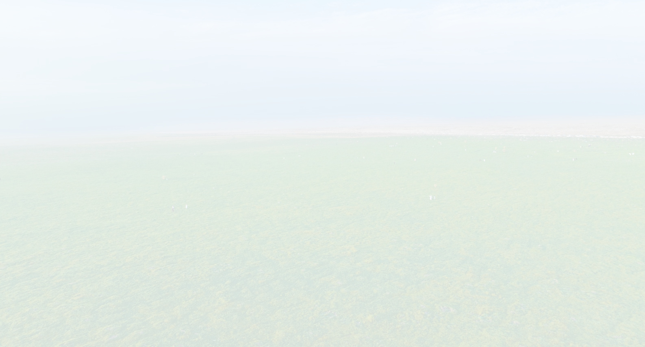
Final Model
SpeciesNet + MLP probe, voted per burst
MegaDetector v6 crop
the animal's box from each frame
0.908
honest macro F1
per burst
90.3%
accuracy
per burst
0.734
honest macro F1
per image
1
SpeciesNet classifier
EfficientNetV2-M · 65M camera-trap images · Google
2
WHY WE CHOSE IT
Won selection on the 36 held-out cameras (0.954 burst honest F1) — chosen before the test set was read
+0.19 over our best pipeline trained on our data alone (0.908 vs 0.716 per burst)
Biggest gains on the hard classes: red brocket deer 0.70, puma 0.61, gray fox 0.63
Small and deployable: a 484 KB head on top of the public SpeciesNet model
471 features
461 SpeciesNet label scores + 10 mapped class scores
3
MLP head
256 hidden units · ReLU · dropout 0.2 · class-balanced loss
4
Burst vote (max rule)
the most confident frame decides the burst
CAVEAT SpeciesNet was trained on public camera-trap repositories and iWildCam is public, so it may have seen these images. Our clean, learned-from-our-data result is the BioCLIP pipeline: 0.598 per image / 0.716 per burst.
5
Notes:
Selected on held-out cameras, not on the test split. The 'everything' ensemble later scored 0.922 on test, but picking it would have meant peeking; the honest choice cost 0.014.

Slide 18
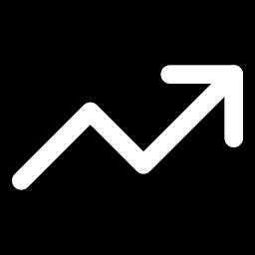
Results & Insights
Where the final model is strong — and where it still struggles
Strong on large, distinctive animals
Great curassow 0.93, black-fronted duiker 0.90, ocellated turkey 0.84, white-lipped peccary 0.83.
Weakest on the rarest mammals
Agouti 0.55, puma 0.61, gray fox 0.63 — the smallest training classes. Earlier models mostly confused gray fox with ocelot, puma and red brocket deer.
Empty became a dumping ground
Recall 0.98 but precision 0.41: 28% of animal crops get SpeciesNet's top label 'blank' — likely the ~18% of frames where MegaDetector found no confident box and the whole frame was used.
Notes:
The final model wins on 8 of 10 classes. The price is the empty class: it over-predicts 'blank', which is a crop problem more than a model problem.

Slide 19
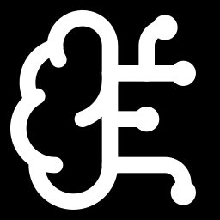
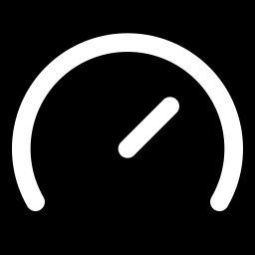
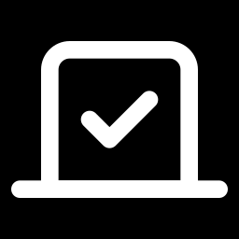
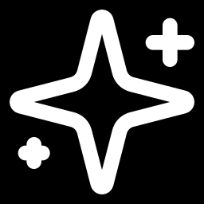
Results & Insights
What we learned
Pretrained features are the biggest lever
Tuning can't fix a shortcut
Look at the animal, not the scene
0.320 → 0.734
+0.025
+0.108
Scratch CNN → ImageNet ResNet (0.421) → camera-trap SpeciesNet, honest F1 on unseen cameras.
Layer-wise learning rates and mixup cut the train/val gap (0.215 → 0.144) but barely moved unseen-camera F1.
MegaDetector crops lifted BioCLIP from 0.490 to 0.598. Our background-subtraction boxes were almost the whole frame (median side 0.93).
One trigger, one vote
The classifier matters less than its inputs
Domain models work out of the box
+0.174
0.580 ≈ 0.582
0.825
Deciding once per burst: 0.734 → 0.908 for SpeciesNet, and +0.118 (0.598 → 0.716) for BioCLIP.
Logistic regression vs XGBoost on the same crops; a soft vote of both reached 0.598.
SpeciesNet zero-shot per burst, with zero training images — above everything we trained on BioCLIP.
Notes:
Six lessons, each backed by a number from our notebooks.

Slide 20
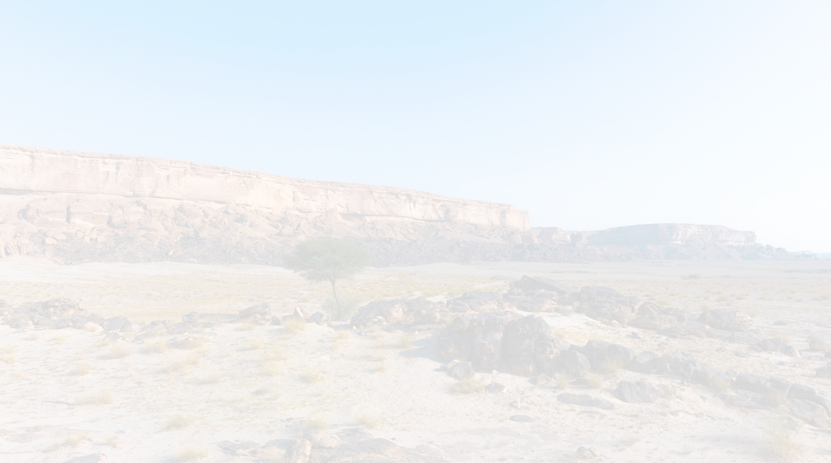
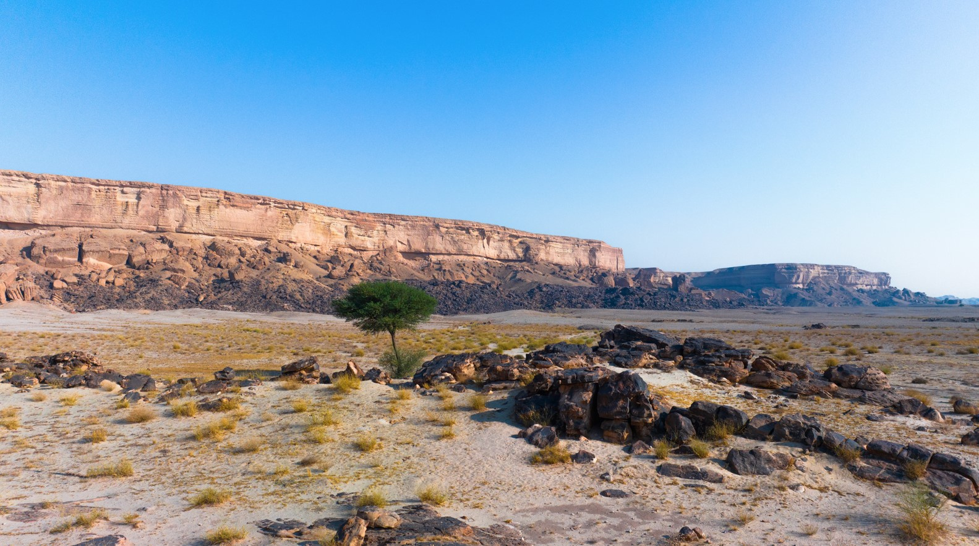

Conclusion
Main takeaways
It works on cameras it has never seen
0.908 honest macro F1 and 90.3% accuracy per burst across 29 unseen camera locations.
Start from camera-trap foundation models
SpeciesNet features beat every generic backbone we tried; zero-shot alone reached 0.825 per burst.
Honest evaluation makes the number trustworthy
Split by camera, select on held-out cameras, and exclude classes the background gives away.
The remaining gap is known
Empty-vs-animal confusion and the rarest mammals (agouti, puma, gray fox) hold most of the errors.
NEXT STEPS Whole-image SpeciesNet for frames with no confident detection · fine-tune on KARR's own labelled Arabian species · serve the exported model behind a confidence-ranked review queue and dashboard
Notes:
Close on the answer to our question from slide 3: yes, on never-seen cameras, with an honest 0.908 per burst - and we know exactly where the remaining errors are.

Slide 21
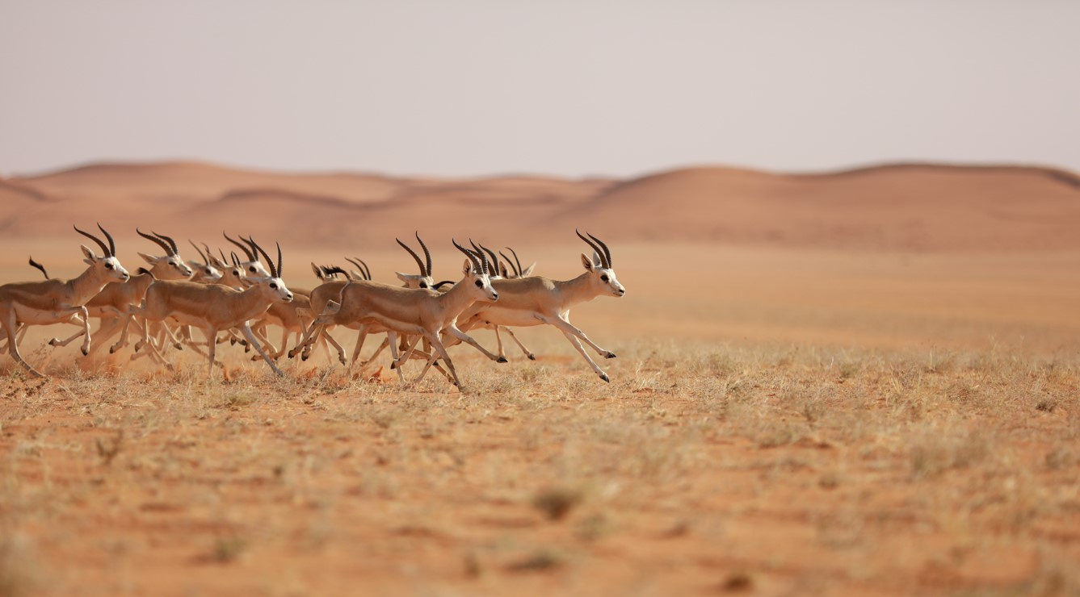
Thank You

