Slide 1
Understanding the Baum-Welch Algorithm
Training Hidden Markov Models

Slide 2
What are Hidden Markov Models?
Hidden Markov Models (HMMs) are probabilistic models used to describe systems that evolve over time and are not directly observable. The model assumes that there is an underlying "hidden" state sequence, and each state generates observable outcomes with associated probabilities. This concept is widely applicable in various fields such as speech recognition, bioinformatics, finance, and natural language processing.

Slide 3
The Power of HMMs: Applications Across Diverse Fields
Speech Recognition: HMMs help identify individual phonemes in spoken language, allowing us to understand what someone is saying.
Gene Sequencing: By analyzing DNA sequences, HMMs predict protein structures, unlocking insights into biological processes.
Financial Modeling: HMMs analyze stock market trends, enabling better predictions and financial strategies.
Anomaly Detection: HMMs identify unusual patterns in data streams, like sensor readings or network traffic, flagging potential anomalies.
Natural Language Processing: HMMs can tag parts of speech and segment text, aiding in language understanding and machine translation.

Slide 4
Challenges in HMM Training
Estimating Model Parameters: How do we learn the transition and emission probabilities that drive the HMM from only the observed data?
Hidden States in the Dark: Without direct access to the hidden states, we need an efficient way to infer them from the data.
Optimizing for Accuracy: We need an algorithm that can effectively estimate the HMM parameters to accurately model the observed sequences.

Slide 5
Introducing the Baum-Welch Algorithm
The Key to Learning HMMs: The Baum-Welch algorithm is an Expectation-Maximization (EM) algorithm designed to train HMMs by iteratively refining their parameters.
Two Crucial Steps: The algorithm operates in two key steps:
E-step: Calculates expected state probabilities and transition/emission counts based on the current model parameters.
M-step: Updates the model parameters (transition and emission probabilities) based on the expectations from the E-step.

Slide 6
The Baum-Welch Algorithm - Overview
Initialization
Convergence Check
Forward Procedure
Backward Procedure
E-step
M-step
Iteration

Slide 7
Initialization (Step 1)
Initialize transition probabilities (A), emission probabilities (B), and initial state probabilities (π)
Discuss the importance of appropriate initialization for convergence

Slide 8
Forward and Backward Procedures (Steps 2-3)
Explain the calculation of forward and backward probabilities
Forward Probabilities: Like a detective gathering evidence, the E-step calculates the likelihood of reaching a state at any time step given the observed sequence.
Backward Probabilities: Imagine rewinding the sequence - the E-step also calculates the likelihood of the remaining

Slide 9
Forward Procedures (Steps 2)
In the forward pass, the algorithm calculates the probability of observing a partial sequence up to a given point in time. This is achieved through a recursive process that considers both the emission probabilities from each state and the transitions between states. The forward probabilities provide a crucial component for the subsequent E-step.

Slide 10

Forward Procedures (Steps 2)
The alpha function calculates the combined probability of observed data and the state at a given time. It is recursive, with the previous alpha influencing the next calculation, hence termed the "forward phase." The equation includes terms for state transition probability (from A) and emission probability (from B). The right-hand side involves a summation over all potential states at the preceding time, contributing to a comprehensive assessment.

Slide 11
backward Procedures (Steps 3)
The backward pass complements the forward pass by computing the probability of observing the remaining part of the sequence from a given point. Like the forward pass, this is computed recursively and is essential for estimating the expected counts in the E-step. Together, the forward and backward probabilities ensure a comprehensive understanding of the likelihood of the observed sequence.

Slide 12

backward Procedures (Steps 3)
The beta function calculates the conditional probability of observed data from time k+1 given the state at time k. It operates recursively, with the next beta influencing the current calculation, hence referred to as the "backward phase." The equation includes terms for state transition probability (from A) and emission probability (from B). The right-hand side involves a summation over all potential states at the subsequent time, contributing to a comprehensive assessment.

Slide 13
Expectation Step (E-step - Step 4)
Expected State Probabilities: By combining the forward and backward probabilities, the E-step reveals the most likely state to be in at each time step, considering both past and future observations.
Transition and Emission Counts: This step also estimates the frequency of transitions between states and the emission of observed data from each state based on the expected probabilities.

Slide 14

Expectation Step (Step 4)
In the E-step, we calculate two quantities: ξt​(i,j) and γt​(i). These quantities are crucial for estimating the expected number of transitions and emissions.
Formula:

Slide 15


Maximization Step (Step 5)
Updating Transitions: Based on the expected transition counts from the E-step, the M-step refines the probabilities of moving between hidden states.
Fine-tuning Emissions: Using the expected state probabilities and observed data, the M-step re-estimates the probabilities of emitting specific observations from each state.
And we use these formula to update:

Slide 16
Convergence Check (Step 6)
Reaching Stability: Through repeated E-step and M-step iterations, the Baum-Welch algorithm eventually converges, meaning the model parameters stabilize and no longer significantly change.
Optimal HMM Representation: At this point, the HMM accurately reflects the hidden patterns and dynamics underlying the observed sequence, allowing for reliable predictions and insights.

Slide 17
Iteration (Step 7)
Emphasize the iterative nature of the algorithm
Explain when to stop iterating: convergence or a specified number of iterations

Slide 18
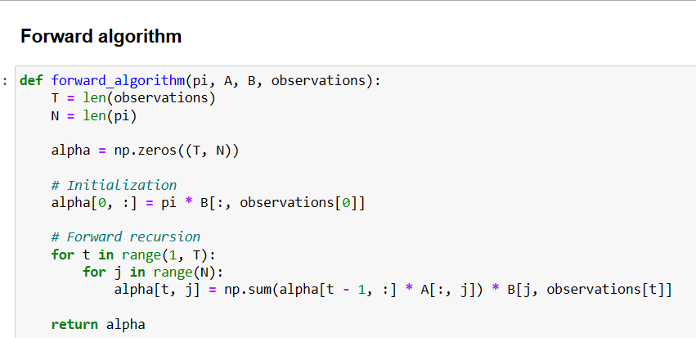
Code for the Baum-Welch Algorithm
This function calculates the forward probabilities for each state at each time step given the model parameters and a sequence of observations.

Slide 19
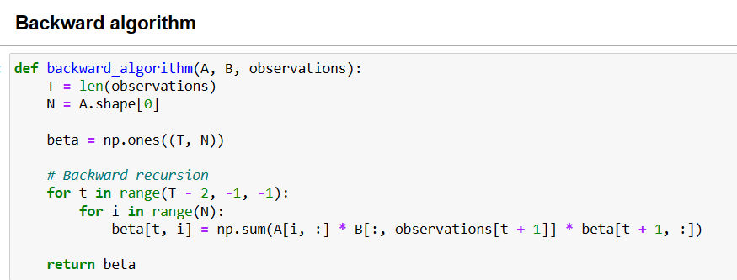
Code for the Baum-Welch Algorithm
This function calculates the backward probabilities for each state at each time step given the model parameters and a sequence of observations.

Slide 20
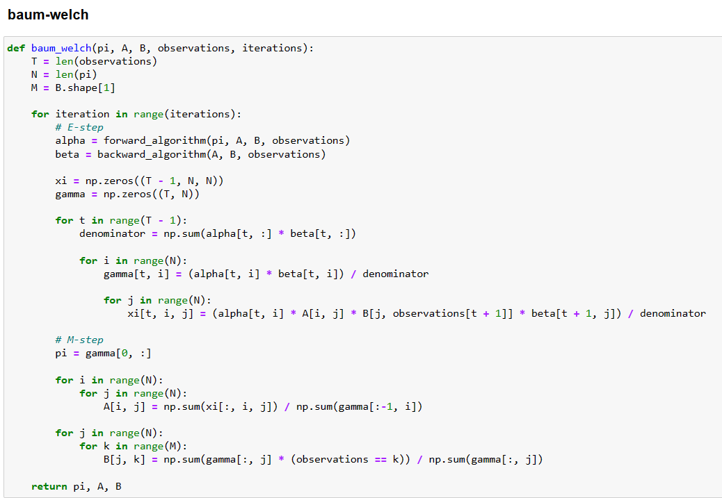
Code for the Baum-Welch Algorithm
The function iteratively performs the E-step (using forward and backward algorithms to compute the expected values of hidden variables) and the M-step (updating the model parameters based on the expected values). This process is repeated for the specified number of iterations to refine the HMM parameters based on the given observations.

Slide 21
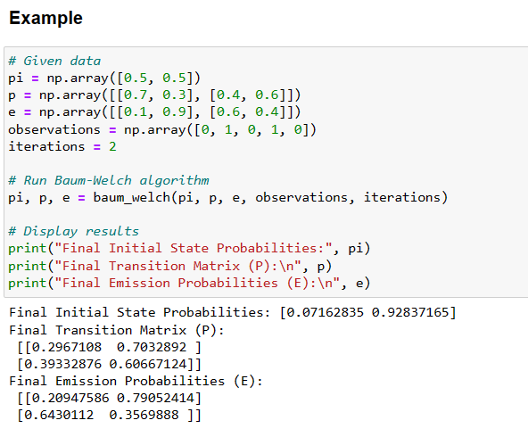
Code for the Baum-Welch Algorithm
Output:

Slide 22
Conclusion :
The Baum-Welch algorithm is a specific instance of the Expectation-Maximization (EM) algorithm. In the E-step, the forward and backward formulas provide insights into the expected hidden states based on the observed data and the initial set of parameter matrices. The M-step update formulas subsequently refine the parameter matrices to optimize the fit with both the observed data and the expected hidden states. This iterative process continues until the parameters converge or the model meets specified accuracy criteria.

Slide 23
Thank You

