Slide 1
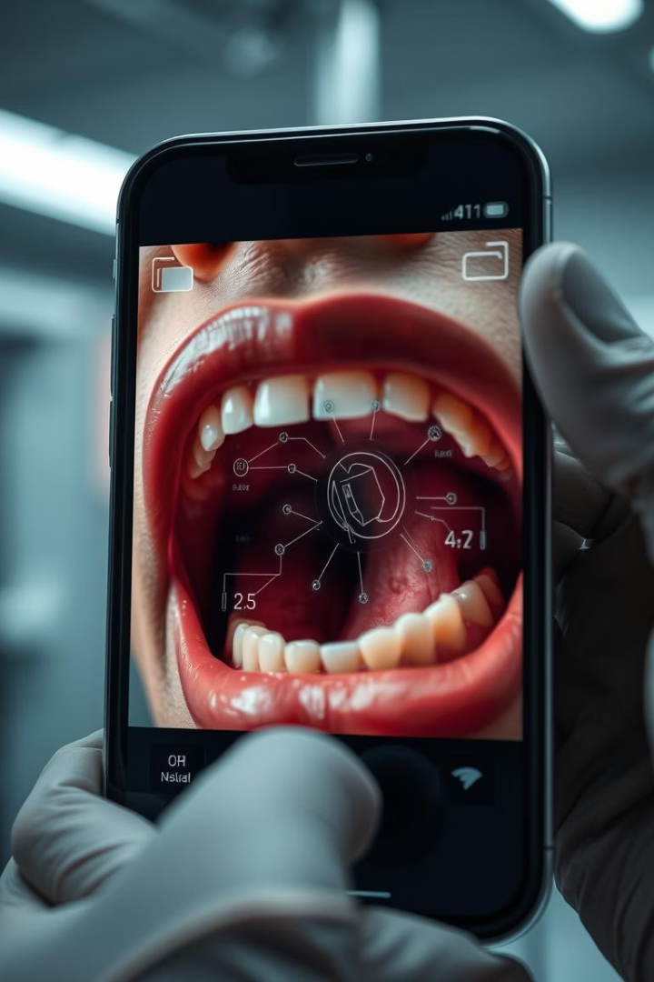
Deep Learning for Early Oral Cancer Detection via Mobile Imagery
A critical review and implementation of an IEEE 2020 paper.
Oral and lip cancers cause high mortality, making early detection of oral potentially malignant disorders (OPMDs) crucial. Low-resource settings face specialist shortages, so this project proposes using smartphone images and AI for screening.
Our objectives are to build deep learning models for classification (lesion vs. normal) and detection (localize lesions for referral) on mobile-captured oral images. We also aim to create a clinician-annotated dataset for training these models.
Presented by team 4
Abdulrahman Ahmed Saeed
2100811
Abdelrahman Ezz eldin
2101000
Omar Ashraf Abdelsattar
2100354

Slide 2
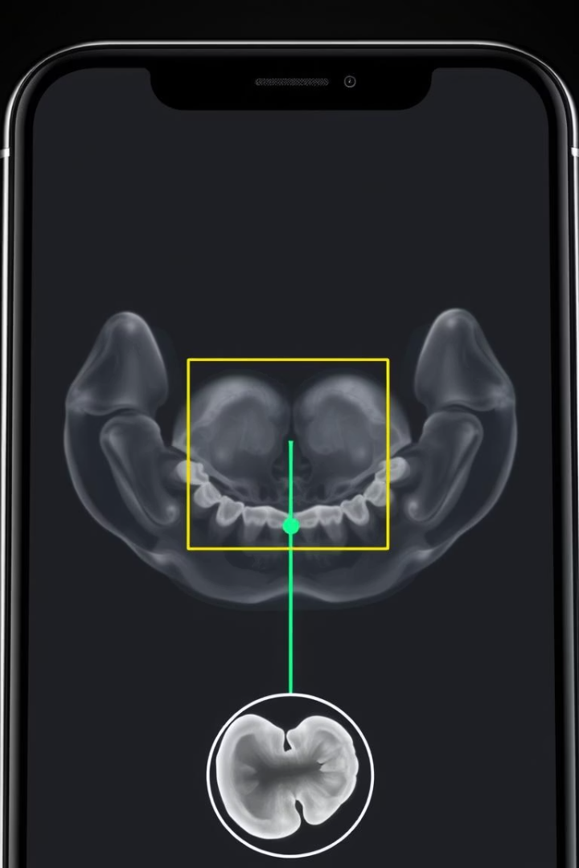



Goals Achieved?
Strong Classification
Weaker Detection
ResNet-101 achieved an F1 score of 87.07% for lesion detection and 78.30% for referral, confirming AI screening feasibility.
Faster R-CNN's detection performance was lower (F1≈41%), indicating missed or poorly localized lesions.
Proof-of-Concept
The study demonstrates AI's ability to identify lesions in smartphone photos, but requires larger data and refinement for deployment.

Slide 3
Paper Deep Learning Methods
ResNet-101 (Classification)
Faster R-CNN (Detection)
A 101-layer CNN, pretrained on ImageNet, was fine-tuned to classify images as “suspicious” or “non-suspicious.” Transfer learning leveraged pretrained features for robust classification.
This two-stage detector uses a Region Proposal Network (RPN) to suggest candidate lesion regions. A classification head (ResNet-101 + FPN backbone) then refines bounding boxes and predicts risk. Both networks utilize deep convolutional features for extraction and object detection.

Slide 4
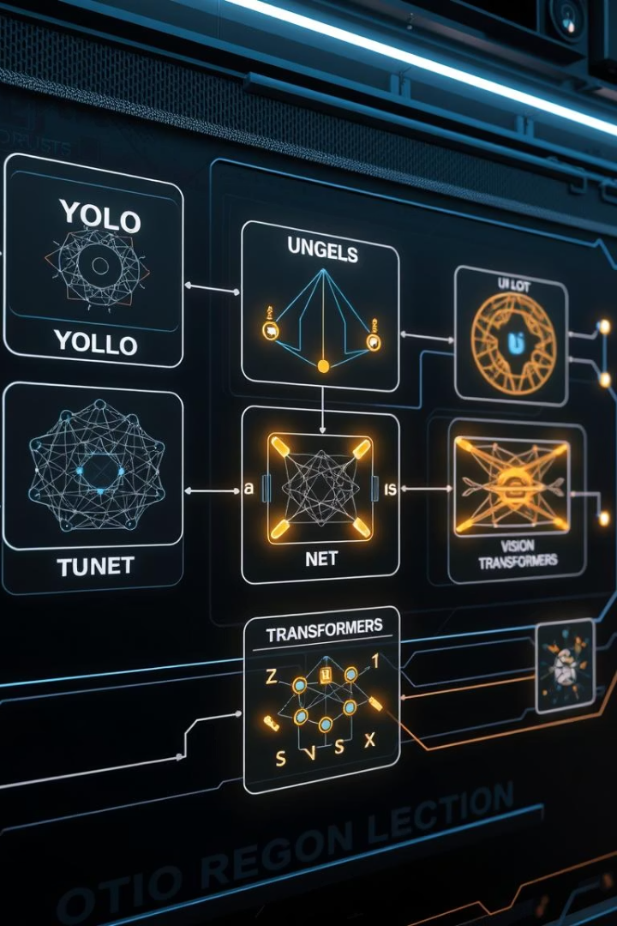
Other SOTA Methods
One-Stage Detectors
Models like YOLOv5, SSD, and RetinaNet offer real-time detection with faster inference and lower latency, suitable for oral lesion detection with promising speed-performance trade-offs.
Segmentation Models
Architectures such as Mask R-CNN or U-Net can segment lesions at a pixel level, providing more precise localization than traditional bounding boxes.
Advanced Backbones
EfficientNet, DenseNet, Vision Transformers (ViT/Swin), and attention-based CNNs can significantly improve model accuracy and efficiency.

Slide 5
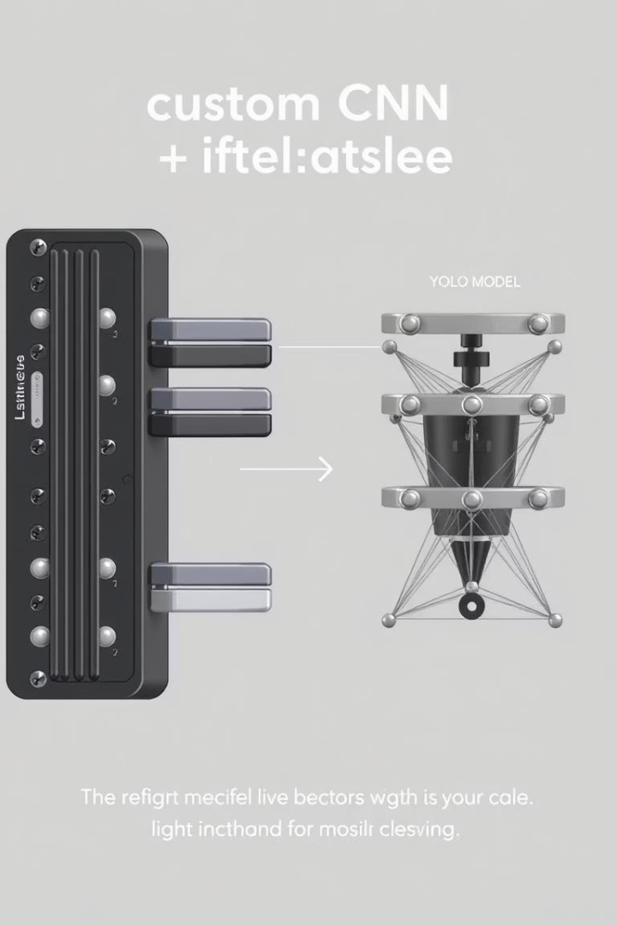



Our Implementation
Custom CNN
A lightweight CNN with 3-5 convolutional layers was built from scratch for lesion classification, enabling faster training and less memory usage on limited hardware.
Faster R-CNN
Just like the paper we implemented Faster R-CNN however, we trained it using The kaggle dataset which we annotated manually using VGG.
Resource Constraints
These choices were driven by limited compute resources, as either RESNET-101 or RESNET-50 models are so computationally heavy so we allowed implementation within our resource limits.

Slide 6
Dataset Comparison
Original (JBHI) Dataset
Kaggle Dataset (Implementation)
Comprised of ~2,155 images from 396 individuals in Tamil Nadu, India, with high-quality annotations by multiple clinicians using a composite label approach. It focuses specifically on OPMDs and cancerous lesions.
A public dataset of 1,238 oral images (1,198 after cleaning), labeled as “cancer” vs. “non-cancer,” sourced from various origins. This dataset is more heterogeneous and smaller than the JBHI dataset.
The original data had expert consensus and specific demographic context, while the Kaggle data is more diverse and smaller. Both datasets are still limited in size (<3K images) and may lack global diversity, potentially impacting model generalizability across new populations.

Slide 7
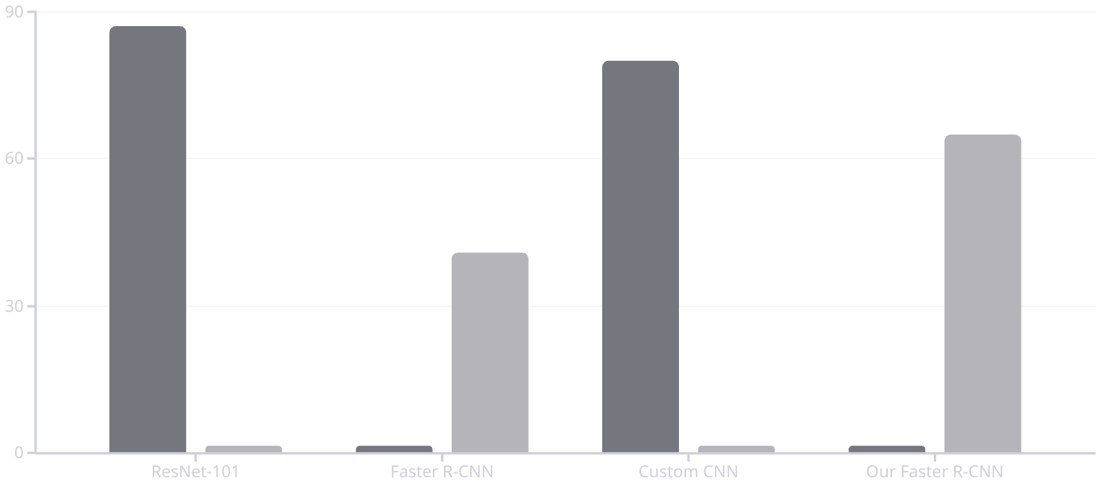
Results Comparison
Classification F1
Detection F1
The paper's ResNet-101 achieved a high classification F1 of 87.07%, while Faster R-CNN's detection F1 was low at 41%. Our Custom CNN on Kaggle data yielded a classification F1 of approximately 82%, slightly lower due to less data. Our Faster R-CNN model achieved a detection IoU of ~0.77 and an F1 of ~71.79%, offering faster performance.

Slide 8
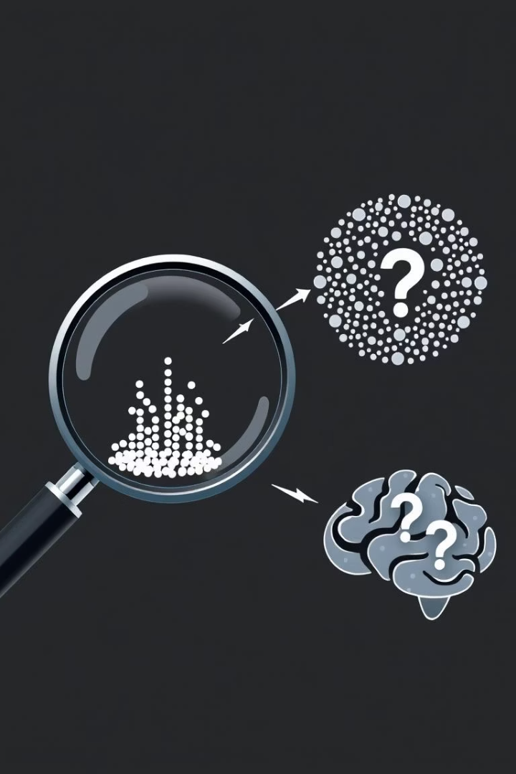




Criticism & Improvement Suggestions
Limited Data
The small dataset (~2–3K images) leads to overfitting and poor generalization. Increasing data through multi-center collaboration or augmentation is crucial for robust models.
Detection Shortcomings
Faster R-CNN's underperformance (F1≈41%) suggests evaluating alternative detectors like EfficientDet, RetinaNet, or Transformer-based DETR for better localization and IoU.
Explainability Missing
Lack of model explainability (e.g., heatmaps) hinders clinical trust. Incorporating tools like Grad-CAM or LIME can highlight lesion features informing predictions.
Lack of Ablation
The paper omitted ablation studies on different choices (backbones, preprocessing). Future work should include these and external dataset validation for robustness.

Slide 9





Implementation Summary
Model Design
Custom CNN: 4 conv layers, pooling, ReLU, dropout, sigmoid output. Faster R-CNN:outperformed the paper due to lighter dataset.
Hyperparameters
Adam optimizer (lr=1e-4) for classification with binary cross-entropy loss. Batch size=180, trained for 100 epochs. Faster R-CNN used default loss and data augmentation.
Dataset
1,198 images total, split 80% training, 10% testing and 10% validation. Training data augmented (rotations, flips) to reduce overfitting.
Annotation
Lesion bounding boxes manually annotated on approximately 600 images using VIA (VGG Image Annotator), crucial for R-CNN training quality.
Compute
Training on a single GPU (~6GB VRAM) influenced batch size and model complexity. Inference speed on CPU/GPU was measured for mobile deployment feasibility.

Slide 10
Conclusion
Deep learning accurately classifies oral lesion images, confirming the original paper’s findings. While we could not use high-capacity models like ResNet-101 due to hardware limitations, our custom CNN and Faster R-CNN implementation still yielded competitive—and in the case of object detection, superior—results. This suggests that:
However, models are limited by data size and their black-box nature. More data and explainability are crucial before clinical use. Model performance also depends on image quality and acquisition consistency. AI screening for oral cancer is promising; with improved data, annotation, and interpretability, such systems could aid early diagnosis in low-resource settings, offering a feasible trade-off between speed and accuracy for point-of-care use.
Github Link for the implementation
Abdulrahmana-4/Oral-Cancer-Detection

