Slide 1
Demographic and financial Analysis using power bi
Internship Program: Soulvibe.Tech
Batch Name: SVT/DAINT/2025/06/B09

Slide 2
Introduction
This Power BI project Demographic and Financial Dashboard created to analyze individual-level data, combining variables such as age, gender, education, occupation, dependents, income, work experience, and location. The aim is to discover trends and generate actionable insights that can inform decision-making in areas such as education, employment, and financial planning
Tools Used Power BI Desktop: Data import, cleaning, modeling, and visual design

Slide 3
Project Objectives
Visualize key demographic distributions
Understand income variation by education and location
Identify high-earning individuals and related factors
Discover trends in work experience and financial growth
Build a user-friendly, interactive dashboard for stakeholders

Slide 4
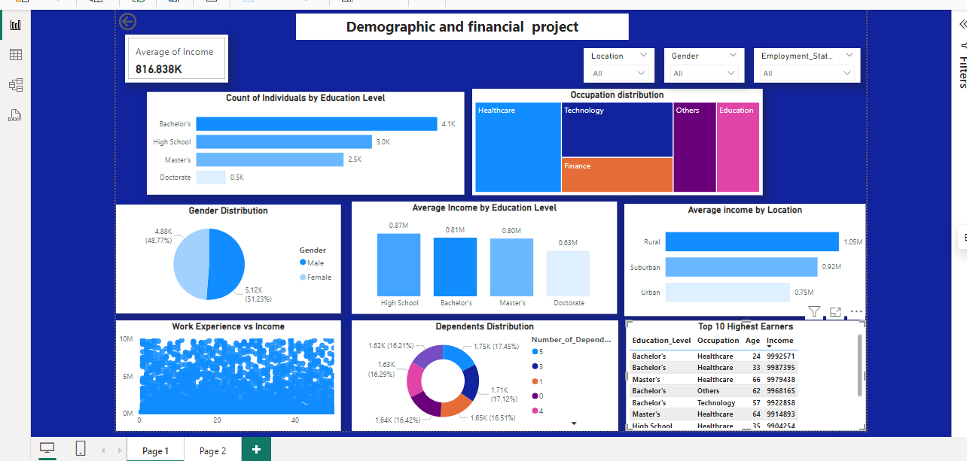
Dashboard Screenshot

Slide 5
Key Insights
Education & Income: Individuals with High School education surprisingly show slightly higher average income than Bachelor's and Master's holders in this dataset. Doctorate holders earn the lowest on average,
Average Income by Location: People in rural areas have the highest average income (1.05M), followed by suburban (0.92M) and urban (0.75M)
Occupation Distribution: Healthcare and Technology dominate among top earners.
Work Experience: the more experienced the individual, the higher their income tends to be.
Number of Dependents: Individuals with more dependents tend to cluster in the lower income, indicating a financial burden
Top Earners: Top 10 earners are largely from Healthcare and Technology sectors most of them have Bachelor’s or Master’s degrees, and are aged between 33–66.

Slide 6
Recommendations
Conduct further research into why high school grads outperform degree holders in income
Encourage career development in Healthcare and Technology, where income potential is highest.
Provide financial planning programs, child benefits, or tax relief to individuals with multiple dependents
early-career mentorship, internships, and training programs as experience growth clearly leads to higher income

Slide 7
Conclusion
This dashboard project successfully demonstrates how demographic variables and financial indicators interact, revealing critical patterns in income distribution. The visualizations enable informed decision-making and provide a foundation for deeper analysis in employment, education, and social planning.

Slide 8
Thank you

