Slide 1
HyMedia: Cloud-Native Multimedia Sharing Platform A scalable multimedia platform supporting images, videos, audio and GIF media with advanced search, privacy controls and creator monetization.
Name: Abdulrehman Mohamedrafiq Vohra Student ID: B00968573 Course: COM682_Cloud_Native_Development
System Overview
HyMedia is a cloud-native multimedia sharing platform designed to run on Microsoft Azure. The system enables users to upload, manage, and interact with media such as images, videos, and audio while supporting features like tagging, privacy controls, sensitive content filtering, and premium creator subscriptions.
The platform uses a serverless architecture with REST APIs, scalable cloud storage, and asynchronous processing to ensure efficient media handling and the ability to scale as user activity and content volume increase.

Slide 2
Problem definition
A multimedia social platform has two very different workload types:
Large binary objects (media files) Images/videos/audio are heavy and require scalable object storage, high throughput, and global delivery.
Hot metadata (likes, comments, tags, feed ranking) Metadata changes constantly and must support fast reads for infinite scrolling feeds and search filtering.
Traditional solutions (single VM/monolith) break under:
Burst traffic (viral content spikes)
CPU-heavy processing (thumbnails, transcoding, waveforms, AI tagging)
Global latency (users far from origin)
Complex privacy (private-to-selected users, premium-only, unlisted links)
Safety & compliance (sensitive content filters + 18+ gating)
This creates a requirement for a cloud-native architecture that supports horizontal scaling, asynchronous processing, and managed storage/services.

Slide 3

Cloud-native approach & design principles
Architecture style: Serverless + event-driven “Web–Queue–Worker” pattern
Reason: keep the user-facing path fast and offload slow tasks to a scalable worker.
Key design principles (REST + cloud):
Stateless API layer (scales easily; no server-side session state)
Resource-oriented REST design using HTTP verbs (GET/POST/PATCH/DELETE)
Direct-to-Blob uploads using time-limited SAS (avoid routing huge files through API)
Async processing pipeline using queue + Functions
Polyglot persistence:
SQL for identity, ACLs, entitlements, payments/audit
NoSQL for flexible feed metadata and evolving content signals
Defense-in-depth: auth, access checks, private URL signing, encryption
Service evolution: API versioning

Slide 4

System scope (what HyMedia supports)
Supported media types
Images: JPG/JPEG, PNG, GIF, WEBP, HEIC/HEIF, BMP/TIFF (stored as blobs)
Video: MP4, MOV, WEBM, MKV (stored as blobs; transcoding planned)
Audio: MP3, WAV, AAC/M4A, OGG (stored as blobs; waveform/transcription planned)
Core user features
Signup/Login + session cookies
Upload with caption, hashtags, tag users, tag location
Likes + comments
Infinite scroll home feed + explore page
Advanced search (filters + tags + location)
Sensitive content preferences + 18+ gating
Privacy per post: public/private-to-selected/unlisted/premium-only
Creator subscriptions & monetization (planned)

Slide 5
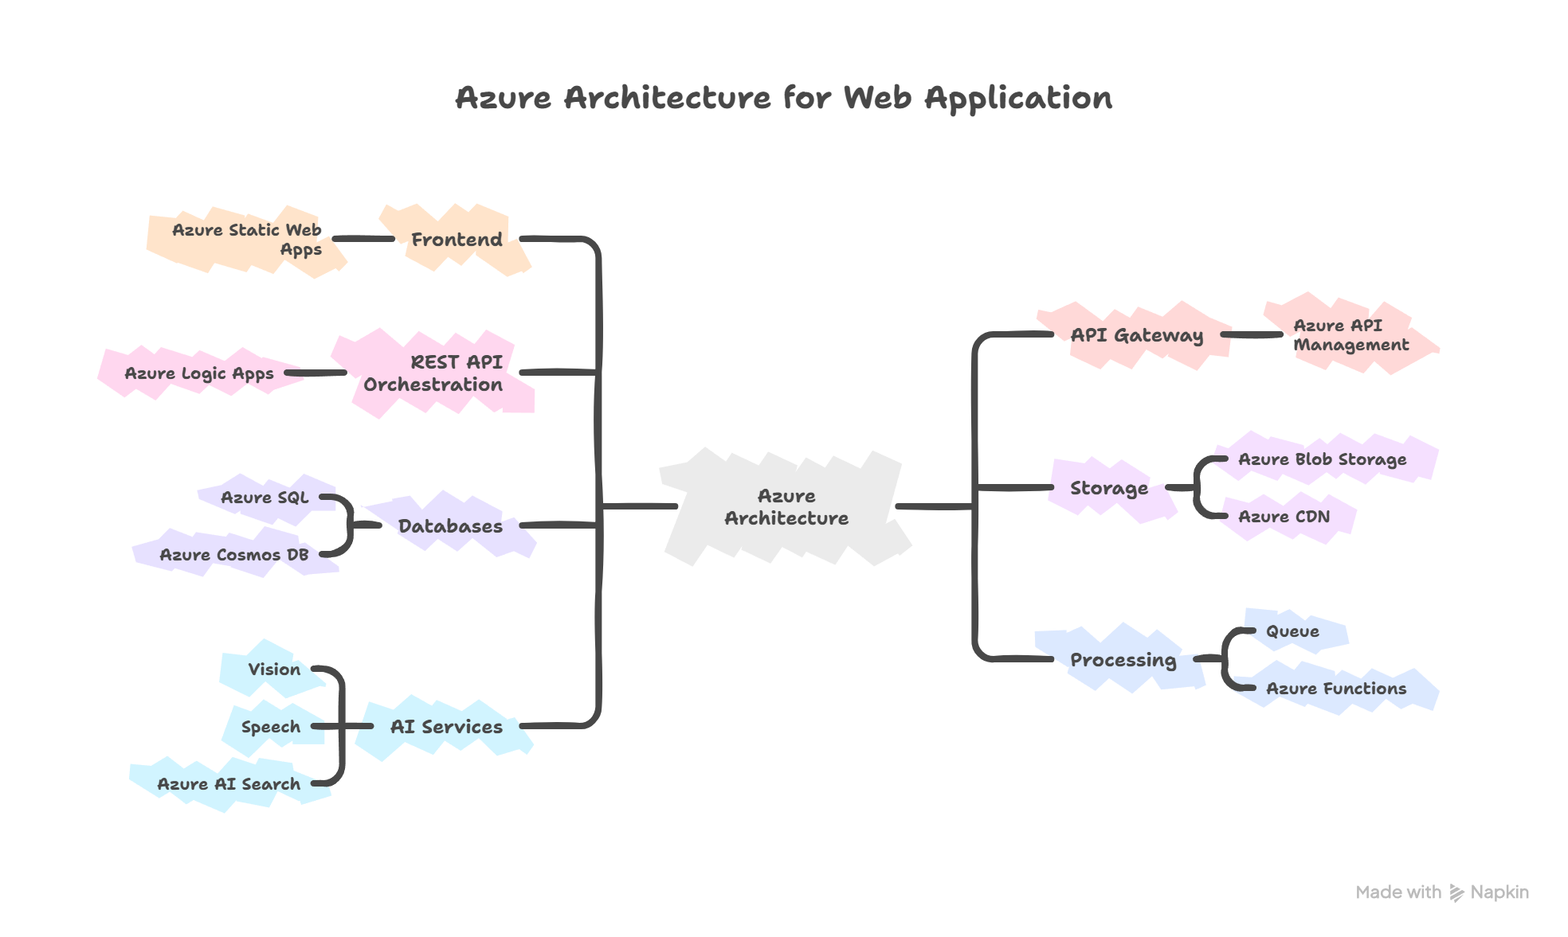
Azure high-level architecture
Frontend
Azure Static Web Apps (SPA UI + theme system)
API gateway
Azure API Management (auth enforcement, throttling, version routing)
REST API orchestration (CW requirement)
Azure Logic Apps (HTTP-trigger) as CRUD endpoints and integration hub
Storage
Azure Blob Storage for media binaries (unstructured data)
Azure CDN for fast global delivery (public assets; private via signed URLs)
Databases
Azure SQL: users, sessions, privacy ACL, creator subscriptions, payouts ledger
Azure Cosmos DB: denormalized feed docs, tags, engagement counts, AI labels
Processing
Queue (Service Bus or Storage Queue) for async tasks
Azure Functions for processing (thumbnails/transcode/waveform/AI enrichment)
AI services (planned/advanced)
Vision for auto-tagging + image embeddings
Speech for transcription (audio/video)
Azure AI Search for text + vector search

Slide 6

Detailed workflow: Upload → process → publish
Fast path (synchronous)
Browser sends POST /api/v1/assets with metadata (privacy, tags, sensitive flags).
Logic App validates identity, creates DB records (SQL/Cosmos), returns:
assetId
time-limited SAS upload URL for Blob
Browser uploads file directly to Blob using SAS (no API bottleneck).
Slow path (asynchronous) 4. Blob upload event (or API) enqueues a message: {assetId, blobPath, mediaType}. 5. Functions worker consumes queue:
Validate MIME + file signature
Generate thumbnail / preview
Video transcode variants (planned)
Audio waveform extraction (planned)
AI tagging + moderation labels (planned)
Update Cosmos metadata: processingStatus=READY, store derived assets.
Feed/search can now surface the content based on privacy + preferences.
This approach scales because upload requests stay lightweight while processing scales independently.

Slide 7

Authentication + session cookies
Auth flow
POST /api/v1/auth/signup
POST /api/v1/auth/login
On login success:
API issues a secure session cookie:
HttpOnly (not accessible via JS)
Secure (HTTPS only)
SameSite=Lax/Strict (CSRF mitigation)
Session data stored in SQL:
Sessions(sessionId, userId, createdAt, expiresAt, revokedAt, userAgentHash, ipHash)
Requests include cookie automatically. API gateway + Logic Apps validate session on each request (stateless API servers).
Logout
POST /api/v1/auth/logout revokes session record.

Slide 8

Privacy model + enforcement (core differentiator)
Each asset has visibility:
PUBLIC
PRIVATE_SELECTED
UNLISTED_LINK
CREATOR_PREMIUM
Private-to-selected implementation
SQL table AssetACL(assetId, viewerUserId, permission).
Request to view private content:
API checks ACL:
owner always allowed
viewer must exist in ACL
Unlisted
Not searchable/feed
Accessible via signed share token:
POST /api/v1/assets/{id}/share-links creates token with expiry
Creator premium
Viewer must have active subscription entitlement.
This privacy enforcement is applied both:
when listing feeds/search results
when returning actual media URLs

Slide 9
Sensitive content | 18+ gating
Each asset stores:
isSensitive (blur/hide controls)
isAdult18Plus
Each user stores preferences:
sensitiveMode: HIDE | BLUR | SHOW
adultContentEnabled: boolean (only if verified)
Age verification approach
MVP: DOB + self-declaration + explicit consent
Planned: third-party verification / manual review workflow
API rules:
If asset is 18+ and user not verified → block or show warning screen.
If asset is sensitive → apply user preference (hide/blur/show).

Slide 10
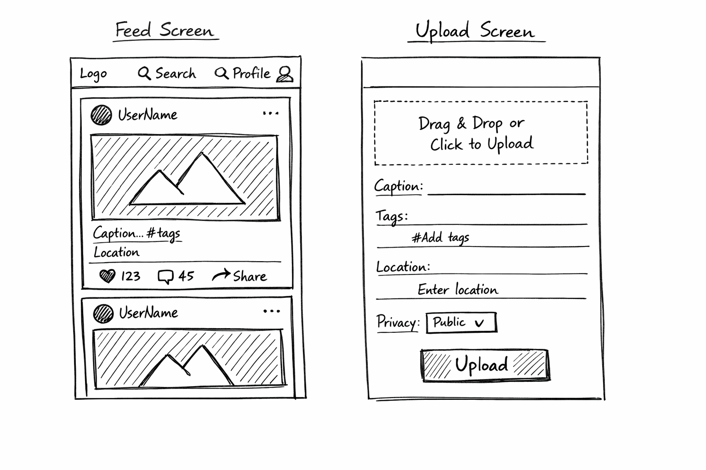
Wireframe content
Main feed
Infinite scroll cards:
media preview
caption + tags
like/comment/share
badges: sensitive / 18+ / premium
Upload page fields:
file upload + validation message
caption
hashtags
tag users (@mentions)
tag location (autocomplete)
privacy selector:
public / private-to-selected / unlisted / creator-premium
sensitive toggle
18+ toggle
allow comments on/off
upload button
Two-step upload note:
“Create record → SAS URL → direct blob upload → async processing”

Slide 11
Data model (SQL + Cosmos)
CosmosDB NoSQL Model
{ "assetId": "a_123", "ownerId": "u_001", "createdAt": "2026-03-06T10:20:00Z", "mediaType": "video", "mimeType": "video/mp4", "blobPath": "assets/u_001/a_123/original.mp4", "derived": { "thumbnailPath": "assets/u_001/a_123/thumb.jpg", "previewPath": "assets/u_001/a_123/preview.mp4" }, "caption": "Weekend vlog", "hashtags": ["#london", "#food"], "taggedUsers": ["u_021", "u_099"], "location": { "name": "Harrow", "lat": 51.58, "lon": -0.33 }, "visibility": "PRIVATE_SELECTED", "isSensitive": false, "isAdult18Plus": false, "engagement": { "likeCount": 125, "commentCount": 18 }, "ai": { "tags": ["street", "restaurant"], "moderationLabels": ["safe"], "embeddingRef": "vec_a_123" }, "processingStatus": "READY" }
SQL tables (ERD)
Users(UserId, Email, PasswordHash/ExternalId, DOB, Is18Verified, CreatedAt)
Sessions(SessionId, UserId, ExpiresAt, RevokedAt)
AssetsCore(AssetId, OwnerId, Visibility, IsSensitive, IsAdult18Plus, CreatedAt)
AssetACL(AssetId, ViewerUserId, Permission)
Subscriptions(SubscriptionId, SubscriberId, CreatorId, Status, StartAt, RenewAt)
Payments(PaymentId, UserId, Amount, Reason, Timestamp)
PayoutLedger(PayoutId, CreatorId, Amount, RuleId, Timestamp, Status)
Cosmos documents
AssetFeedDoc:
assetId, ownerId, createdAt
mediaType, mimeType, blobPublicUrl OR signedUrlRef
caption, hashtags, taggedUsers, location
likeCount, commentCount
aiTags, moderationLabels, embeddingRef
processingStatus
Why this split:
SQL = correctness/permissions/entitlements
Cosmos = fast feed reads + flexible metadata + denormalized counts

Slide 12
REST API design
Privacy & access
POST /api/v1/assets/{assetId}/acl Add selected viewers (private-to-selected)
DELETE /api/v1/assets/{assetId}/acl/{viewerUserId}
POST /api/v1/assets/{assetId}/share-links Create unlisted link token
DELETE /api/v1/assets/{assetId}/share-links/{tokenId}
Likes & comments
POST /api/v1/assets/{assetId}/likes
DELETE /api/v1/assets/{assetId}/likes
POST /api/v1/assets/{assetId}/comments
GET /api/v1/assets/{assetId}/comments?cursor=&limit=
DELETE /api/v1/assets/{assetId}/comments/{commentId} (optional)
Tagging
POST /api/v1/assets/{assetId}/tags/users (batch tagging)
POST /api/v1/assets/{assetId}/tags/location
Search
GET /api/v1/search Query: q, tags, mediaType, location, from, to, cursor
POST /api/v1/search/image (planned advanced) Upload query image → returns similar assets
POST /api/v1/search/audio (future) Upload clip → returns best match
Auth
POST /api/v1/auth/signup
POST /api/v1/auth/login
POST /api/v1/auth/logout
GET /api/v1/auth/me
Users
GET /api/v1/users/{userId}
PATCH /api/v1/users/me/preferences Body: theme, sensitiveMode, adultContentEnabled
POST /api/v1/users/me/verify-age (MVP)
Assets (media posts)
POST /api/v1/assets Creates record + returns SAS URL
PUT /api/v1/assets/{assetId}/blob (optional: confirm upload complete; triggers enqueue)
GET /api/v1/assets Feed list with cursor pagination Query: cursor, limit, mediaType, tags, location, creatorId
GET /api/v1/assets/{assetId}
PATCH /api/v1/assets/{assetId} caption, hashtags, taggedUsers, location, flags, visibility
DELETE /api/v1/assets/{assetId}

Slide 13
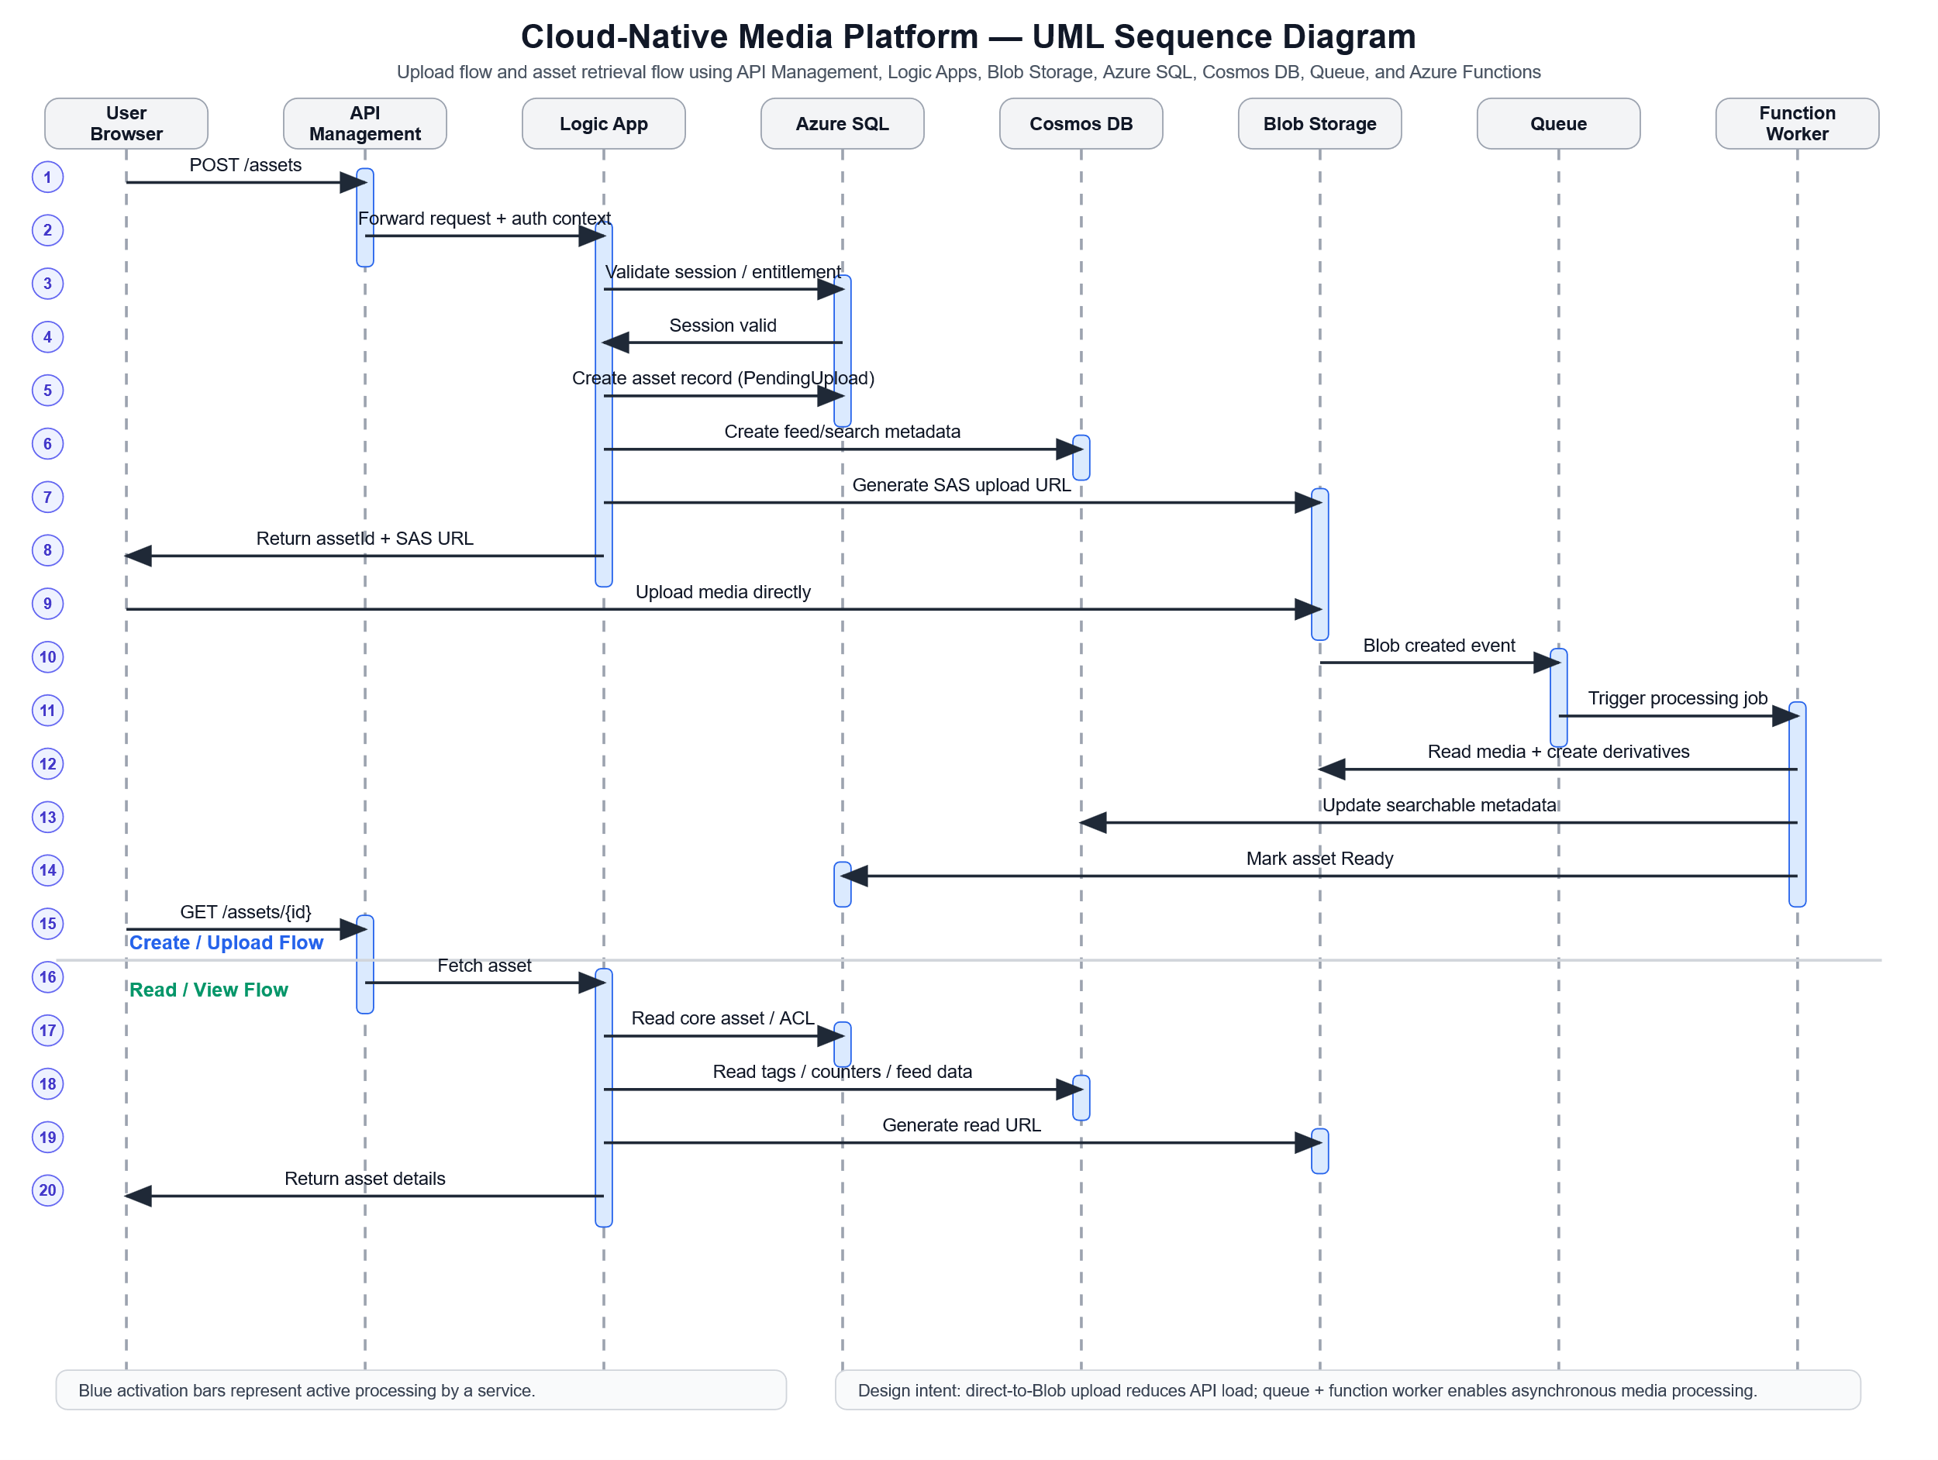
UML sequence diagrams
Your module says CREATE + GET is enough to prove CRUD understanding.
UML: CREATE asset (upload)
User selects file + metadata in browser
Browser → APIM: POST /api/v1/assets
APIM → LogicApp(CreateAsset): forward request
LogicApp validates session cookie, writes:
SQL: AssetsCore (+ ACL if private-to-selected)
Cosmos: placeholder feed doc
LogicApp generates SAS URL for blob upload
Response returns assetId + sasUploadUrl
Browser uploads directly to Blob using SAS
Blob triggers queue message for processing
Function processes media, writes results to Cosmos doc
Asset becomes visible per privacy rules
UML: GET feed (privacy enforced)
Browser → APIM: GET /api/v1/assets?cursor&filters
LogicApp validates session + user preferences
Query Cosmos for candidate feed docs
For private/premium assets, LogicApp checks SQL ACL/entitlements
LogicApp filters list; returns only allowed items + URLs
Browser loads media via CDN or signed URL

Slide 14

Advanced features | limitations | scalability | conclusion
Advanced features (planned)
Image similarity search: embeddings + vector search
Audio recognition (Shazam-like): fingerprinting pipeline + index (future research)
AI moderation/content safety: classify sensitive/18+
Recommendations/personalization: feed ranking improvements
Monetization
Creator monthly subscriptions (premium-only posts)
Creator payouts after thresholds (followers/engagement)
Fraud controls: rate limits, anomaly detection, bot prevention
Limitations
Audio recognition is complex: requires dataset + fingerprinting accuracy concerns
AI moderation can be wrong: false positives/negatives
Cost risks: CDN egress, storage growth, AI calls
Vendor lock-in risks: mitigated via modular interfaces and export paths
Scalability assessment
Serverless auto-scaling handles traffic spikes
Blob storage scales for massive media volumes
Queue decouples processing to prevent overload
Cosmos DB supports high read throughput for feed/search
CDN reduces latency and origin load
Conclusion HyMedia is designed as a cloud-native serverless multimedia platform that supports rich media, strong privacy controls, safety preferences
, interactive social features, and a clear roadmap for AI-powered discovery and monetization.

Slide 15
References
Amazon Web Services (2023) What is cloud computing? Available at: https://aws.amazon.com/what-is-cloud-computing/ (Accessed: 5 March 2026).
Fielding, R.T. (2000) Architectural styles and the design of network-based software architectures. Doctoral dissertation. University of California, Irvine.
Microsoft (2024) Azure Blob Storage documentation. Available at: https://learn.microsoft.com/en-us/azure/storage/blobs/ (Accessed: 5 March 2026).
Microsoft (2024) Azure Cosmos DB documentation. Available at: https://learn.microsoft.com/en-us/azure/cosmos-db/ (Accessed: 5 March 2026).
Microsoft (2024) Azure Functions documentation. Available at: https://learn.microsoft.com/en-us/azure/azure-functions/ (Accessed: 5 March 2026).
Microsoft (2024) Azure Logic Apps documentation. Available at: https://learn.microsoft.com/en-us/azure/logic-apps/ (Accessed: 5 March 2026).
Microsoft (2024) Azure Content Delivery Network (CDN) documentation. Available at: https://learn.microsoft.com/en-us/azure/cdn/ (Accessed: 5 March 2026).
Microsoft (2024) Designing RESTful web APIs. Available at: https://learn.microsoft.com/en-us/azure/architecture/best-practices/api-design (Accessed: 5 March 2026).
Newman, S. (2021) Building microservices: Designing fine-grained systems. 2nd edn. Sebastopol: O’Reilly Media.
Pahl, C. (2015) ‘Containerization and the PaaS cloud’, IEEE Cloud Computing, 2(3), pp. 24–31.
Tariq, Z. and Kamal, R. (2025) COM682 Cloud Native Development: Module introduction. Ulster University.
Ulster University (2025) COM682 coursework assessment overview. Ulster University.
Ulster University (2025) Cloud computing concepts lecture slides. Ulster University.
Zhang, Q., Chen, M. and Li, L. (2010) ‘Cloud computing: state-of-the-art and research challenges’, Journal of Internet Services and Applications, 1(1), pp. 7–18.
OpenAI, 2026. ChatGPT. [Online] Available at: https://chat.openai.com/ [Accessed 5 March 2026].

Slide 16
Appendix: Coursework Submission Checklist
General • Did you include a title slide with project name, one-line description, your name, and student number? • Is your submission in PowerPoint format and within 15 slides (excluding references)? Problem & Context • Did you discuss the problem you are solving? • Did you identify issues related to scalability of resources in your project?
Solution Design • Did you include a solution architecture diagram using only Azure resources? • Did you design and present a multimedia hosting webpage layout (wireframe or design diagram)? • Did you include a network/architecture diagram showing compute, storage, networking, etc.? • Did you design a database schema (list of resources and/or ERD diagram) for storing user entries? • Did you design the REST API for CRUD operations and present it in a UML diagram? • Did you integrate (or at least propose integration of): o Static HTML hosting of a webpage frontend? o REST endpoints for service logic and storage connections. o Use of both SQL and NoSQL database structures?
Critical Evaluation • Did you provide an overview of advanced features you intend to develop in the final solution? • Did you include an assessment of limitations of your designed solution? • Did you include an assessment of scalability (horizontal/vertical scaling, autoscaling, etc.)? • Did you justify why you selected specific Azure services over alternatives?
Conclusion & References • Did you include concluding comments summarising your design? • Did you provide references to sources, frameworks, or Azure documentation you used?
✅ If you can tick all these boxes, your submission is likely to meet the expectations.

