Slide 1


Slide 2
Sudden Cardiac Death
Incidence and etiology of sudden death in general population
Sudden cardiac arrest in athletes
Screening and recognition of cardiac warning signs
Preparation for cardiac emergencies
Management of sudden cardiac arrest

Slide 3
Sudden Death in General Population
Sudden cardiac arrest (SCA) is the sudden and unexpected cessation of the heart’s pumping activity.
The resultant lack of blood flow to the brain leads to unconsciousness in about 20 to 30 seconds.
If flow is not resumed, permanent brain damage will begin to occur in 4 to 6 minutes, and the condition is generally fatal if not treated in 10 minutes.
When the heart is not pumping blood, there is no delivery of oxygen or glucose to any of the body’s tissue—including the heart itself because the heart tissue is perfused by blood flowing from the aorta into the coronary arteries.
When sudden cardiac arrest results in death, it is termed sudden cardiac death.
overall survival rate is about 5% to 7%.

Slide 4
Sudden Death in General Population
In the general population, SCA most often occurs in people age 50 to 75 years, which is consistent with the development of ischemic heart disease and congestive heart failure.
About two thirds of people who experience SCA have coronary artery disease; SCA is often the first manifestation of underlying heart disease.

Slide 5
Sudden Cardiac Arrest in Athletes
Exercise-related SCA has been defined as sudden cardiac arrest occurring within 1 hour of participation in sport or exercise.
Consistent with the low prevalence of cardiovascular disease in people younger than 35 years of age, the frequency of sudden death in athletes is considered to be very low but not precisely known.
The vast majority (85%) of sudden deaths in athletes are a result of underlying cardiovascular conditions.
“Commotio cordis”: provocation of ventricular fibrillation or ventricular tachycardia by a blow to the anterior chest over or near the heart. The impact must occur at a specific point in the cardiac electrical cycle, called the vulnerable period of repolarization (during the second half of the T wave). This is usually caused by a solid object such as a baseball and may occur with only mild or moderate force.

Slide 6
Sudden Cardiac Arrest(SCA) Rhythms
Ventricular fibrillation (VF)
Pulseless electrical activity
Asystole
SCA should be differentiated from a “heart attack.” The medical term for a heart attack is myocardial infarction. This condition results in the death of some heart muscle resulting from total (or near total) occlusion of a coronary artery.

Slide 7
Ventricular fibrillation (VF)
Ventricular fibrillation is the most common initial rhythm,occurring in about 60% of cases when assessed by an on-site automated external defibrillator
It is the rhythm most amenable to treatment, which is a high energy shock delivered to the heart called defibrillation.
Studies have found survival rates as high as 74% when defibrillation occurs within 3 minutes from the time of collapse and report that AEDs added to an on-site response plan can double survival rates.

Slide 8
Pulseless Electrical Activity
Pulseless electrical activity (PEA) is the term used for any other electrocardiographic (ECG) rhythm, including normal sinus rhythm, when there is no associated cardiac contraction.
This may be amenable to treatment when a reversible condition is the cause, such as hypovolemia or hyperkalemia, but the mortality from this condition is higher than for VF

Slide 9
Asystole
Asystole, or“flatline,” means the absence of any cardiac electrical activity and therefore the absence of any mechanical cardiac function.
Patients found in this rhythm have a grim prognosis,with most studies reporting survival of only 0% to 2%

Slide 10
Preventive Measures
Screening :Every person who intends to participate in vigorous physical activity, especially competitive sports, should receive thorough screening for cardiovascular and other disorders that might predispose to illness or even death.
Recognition of Cardiac Warning Signs: Symptoms include syncope, palpitations, episodic or exertional dyspnea,exertional chest pain, and early fatigue etc.

Slide 11
Recognition of Cardiac Warning Signs
Lightheadedness
Dizziness
Syncope or near-syncope
Chest pain or pressure
Palpitations (fluttering in chest)
Nausea/vomiting (unrelated to other illness)
Fatigue/weakness (disproportionate to baseline or to others)
Shortness of breath
Note: These symptoms are particularly worrisome if they occur during or immediately after exertion.

Slide 12
Preparation for Cardiac Emergencies
SCA awareness
CPR training
AED deployment throughout the campus

Slide 13
Equipment and Supplies
Defibrillators
Ventilation aids
Telephone or other communications equipment to call emergency centers or hospitals

Slide 14
Defibrillators
Defibrillators are of two main types: manual and automated
Manual defibrillators must be used by medical personnel with specific training in cardiac rhythm recognition and management and in operation of the defibrillator.
This type of defibrillator requires the user to interpret the ECG rhythm and determine if an electric counter shock should be delivered; if so, the user must be able to set the energy level, activate the charging process, and then push a button to deliver the shock.

Slide 15
AED
The other type is typically referred to as automated external defibrillator or AED .
These devices can be used by virtually anyone, even without prior training, although training is highly advised
These portable, battery powered devices provide verbal and visual prompts to the user once the device is turned on.
The most important user action is to place the two ECG sensing defibrillation pads onto the proper locations on the patient’s chest .
Some models require the user to push an “analyze” button and/or a “shock” button to deliver the electric shock (semiautomatic) and some perform analysis, charging, and shock delivery without further user action (fully automatic).

Slide 16
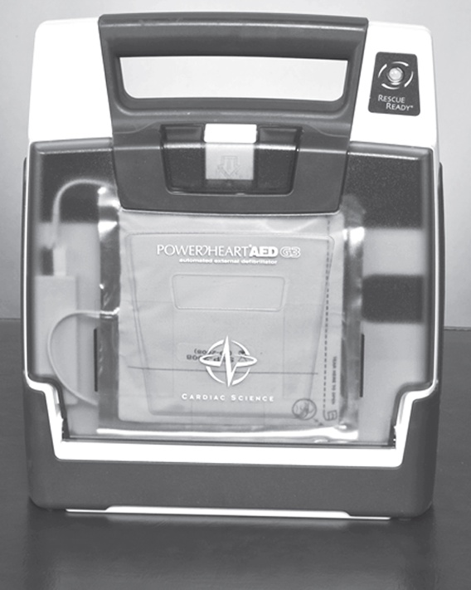
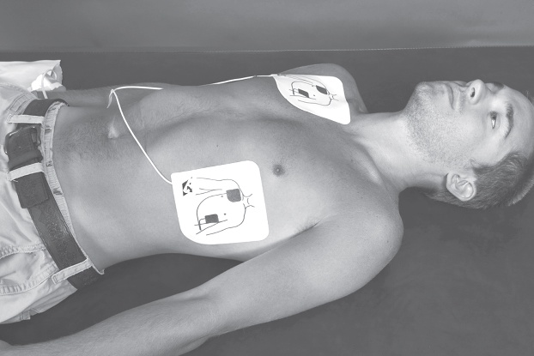
AED
Automated External Defibrillator.
Standard location of defibrillation
pads on an adult.

Slide 17
Ventilation Aids
Protection from blood and body fluid during mouth to mouth resuscitation
Facilitate better ventilation
The simplest adjuncts are a variety of face shields and masks that cover the victim’s mouth and nose and provide a port for the rescuer’s mouth
Many of these have a one-way valve either incorporated or as an attachment to prevent air and fluid exchange from the victim to the rescuer.

Slide 18
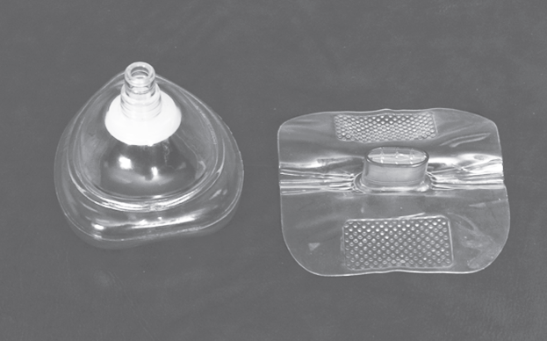
Ventilation Aids
Example of a pocket mask (left)
and a face shield (right).

Slide 19
Management of Sudden Cardiac Arrest
Successful resuscitation of the victim of SCA requires the proper interventions to be provided in a very short time. The actions that must occur have been called the “Chain of Survival.”
Early recognition of SCA and call to emergency services
Early CPR
Early defibrillation
Early Advanced Life Support

Slide 20
Recognition of SCA and Activation of Local EMS
Ask the person if he/she is ok,no response
Gently shake if there is any response
Make sure no injury is suspected
Activate Emergency Medical Service (EMS)
Open the air way (Head tilt, chin lift maneuver)
In case of C/Spine injury jaw thrust maneuver should be used to open the air way
Begin CPR

Slide 21
Cardiopulmonary resuscitation(CPR)
It is an emergency procedure which is attempted in an effort to return life to a person in cardiac arrest.
It is indicated in those who are unresponsive with no breathing or only gasps.
Checking for breathing is best done by leaning over and placing your face close to the victim’s face while looking to see the chest rise and fall, listening for air movement, and feeling for air movement against your cheek (look, listen, and feel).
Rescue breathing should be started.
This can be done mouth to mouth initially, but a barrier device or bag valve mask device should be used if trained.
Two breaths for 1 second each should be provided, with each breath just large enough to make the victim’s chest rise.

Slide 22
Cardiopulmonary resuscitation (CPR)
CPR involves chest compressions at a rate of at least 100 per minute in an effort to create artificial circulation by manually pumping blood through the heart.
A universal compression to ventilation ratio of 30:2 is recommended for adult ,children and infant if only a single rescuer is present.
If at least 2 rescuers are present a ratio of 15:2 is preferred in adults, children and infants.
In newborns a rate of 30:1 is recommended.

Slide 23
AED
AED use
Transfer of Care
Documentation and Reporting

Slide 24
Thank you

