Slide 1


Slide 2
Definition of Pulmonary Rehabilitation
“A multidisciplinary continuum of services directed to persons with pulmonary diseases and their families, usually by an interdisciplinary team of specialists, with the goal of achieving and maintaining the individual’s maximum level of independence and functioning in the community”.
Notes:
This is the shortest and most comprehensive definition I have found. Dr. John Hodgkin’s is two column's long! This one covers everything very concisely.

Slide 3
Consequences of Respiratory Disease
Peripheral Muscle dysfunction
Respiratory muscle dysfunction
Nutritional abnormalities
Cardiac impairment
Skeletal disease
Sensory defects
Psychosocial dysfunction
Notes:
To understand how and why Pulmonary Rehabilitation is an optimal treatment for Chronic Lung disease you must understand the consequences of respiratory disease on the body as a whole.

Slide 4
Mechanisms for these morbidities
Deconditioning
Malnutrition
Effects of hypoxemia
Steroid myopathy or ICU neuropathy
Hyperinflation
Diaphragmatic fatigue
Psychosocial dysfunction from anxiety, guilt, dependency and sleep disturbances.
Notes:
Pulmonary Rehabilitation tries to address these morbidities and their consequences through education and exercise. Patients are encouraged to become more actively involved in their own health care, more independent in ADLs and less dependent on health professionals and expensive medical resources. Rather than focusing solely on reversing disease processes, PR attempts to reduce symptoms and reduce
the disability from the disease.

Slide 5
GOALS of Pulmonary Rehabilitation
Aims to reduce symptoms, decrease disability, increase participation in physical and social activities and improve overall quality of life.
These goals are achieved through patient and family education, exercise training, psychosocial intervention and assessment of outcomes.
The interventions are geared towards the individual problems of each patient and administered by the multidisciplinary team.

Slide 6
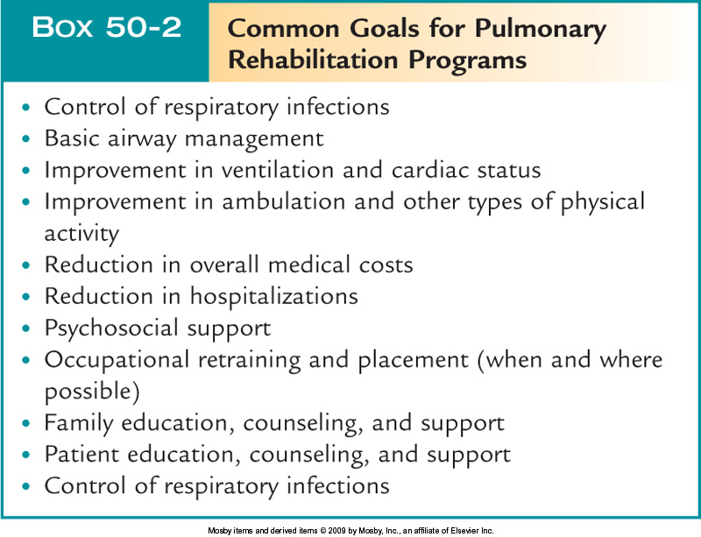
Structure of a Pulmonary Rehab Program
Program goals and objectives

Slide 7
Exclusion criteria
Patients with severe orthopedic or neurological disorders limiting their mobility.
Severe pulmonary arterial hypertension.
Exercise induced syncope.
Unstable angina or recent MI.
Refractory fatigue.
Inability to learn, psychiatric instability and disruptive behavior.

Slide 8
Benefits of Pulmonary Rehabilitation
Improved Exercise Capacity
Reduced perceived intensity of dyspnea
Improve health-related QOL
Reduced hospitalization and LOS
Reduced anxiety and depression from COPD
Improved upper limb function
Benefits extend well beyond immediate period of training

Slide 9
Patient Selection
Obstructive Diseases
Restrictive Diseases
Interstitial
Chest Wall
Neuromuscular
COPD patients at all stages of disease appear to benefit from exercise training programs improving with respect to both exercise tolerance and symptoms of dyspnea and fatigue.

Slide 10
Structure of a Pulmonary Rehab Program (cont.)
Patient evaluation
Patient evaluation begins with a complete patient history.
Next, a complete physical examination is done.
A chest radiograph, CBC, and ECG may be needed.
Pulmonary function testing and exercise evaluation are often needed.

Slide 11
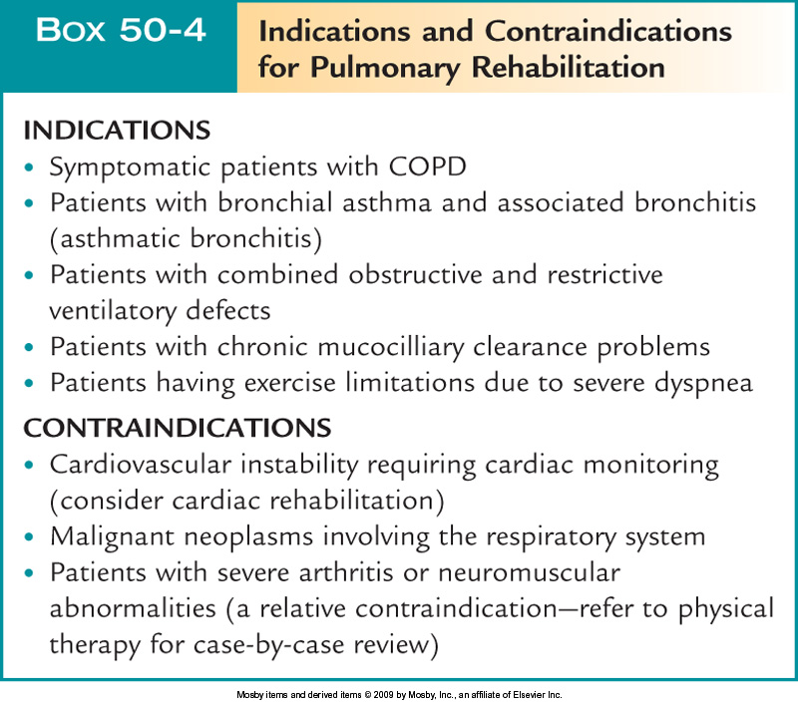
Structure of a Pulmonary Rehab Program (cont.)
Patient selection

Slide 12
Structure of a Pulmonary Rehab Program (cont.)
Program design
Open-ended designs allow the patient to enter the program and progress through it until he or she achieves certain goals.
Closed designs use a set time period to cover the program content.
Classes meet 1 to 3 times per week for 6 to 16 weeks.

Slide 13
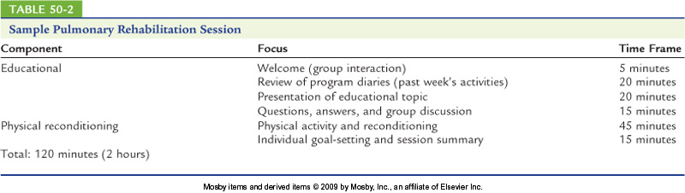
Structure of a Pulmonary Rehab Program (cont.)
Content – not just physical rehab, education too!

Slide 14
Structure of a Pulmonary Rehab Program (cont.)
Physical reconditioning
Consists of an exercise prescription with target heart rate based on the initial evaluation.
For most patients, an initial target heart rate is 20 beats/min above resting rate.

Slide 15
Structure of a Pulmonary Rehab Program (cont.)
Physical reconditioning (cont.)
The exercise prescription includes the following:
Lower extremity aerobic exercises
Timed walking (6- or 12-minute walk)
Upper extremity aerobic exercises
Ventilatory muscle training using progressive resistance

Slide 16

Structure of a Pulmonary Rehab Program (cont.)
Educational component
Respiratory structure, function, and pathology
Breathing control methods
Methods of relaxation and stress management
Exercise techniques and personal routines

Slide 17
Structure of a Pulmonary Rehab Program (cont.)
Educational component (cont.)
Bronchial hygiene techniques
Home O₂ and aerosol therapy
Medications
Dietary guidelines
Recreation and vocational counseling
Encourages active participation in health care
Better understanding of disease
Improved compliance

Slide 18
Psycho-social Intervention
Anxiety, depression, difficulties coping with chronic disease.
Aided by regular patient education session or support groups.
Instruction in progressive muscle relaxation, stress reduction, panic control.
Notes:
Morbid depression in COPD patients ranges from 20-69
Morbid depression in Copd ranges from 20-60%

Slide 19
Chest Physical Therapy
Pursed Lip Breathing – shifts breathing pattern and inhibits dynamic airway collapse.
Posture techniques – forward leaning reduces respiratory effort, elevating depressed diaphragm by shifting abdominal contents.
Diaphragmatic Breathing – Some patients with extreme air trapping and hyperinflation have increased WOB with this technique.
Postural Draining – valuable in patients who produce more than 30cc/24 hours/ Coughing techniques.
Notes:
See benefits of PLB.

Slide 20
Nutritional Assessment
Diet history, BMI
Over or Under weight.
Classes in weight management and/or nutritional counseling to improve weight management

Slide 21
Facts About COPD & Diet
Diet and Nutrition should be an important part of treatment.
Breathing requires more energy with COPD.
Muscles involved may require 10x more calories than those without COPD.
Good nutrition will help reduce hospitalisation from chest infection.

Slide 22
Dietary Advice if you are underweight

Slide 23
Underweight
Weight loss
Loss of respiratory muscle strength
More energy required
to breathe
Increased difficulty breathing and increased risk of infection

Slide 24
Dietary Advice if you are Overweight

Slide 25
Overweight
Consequence of :
high energy intake from food
reduced exercise tolerance
steroid use
Extra weight increases workload of heart and lungs to supply oxygen around body.
Excess fat in abdominal area makes it difficult for the lungs to expand fully.

Slide 26
Hints for weight control
Think of the benefits of weight loss
Make healthier changes to your diet
Fill up on fruit and vegetables
Have regular meals
Set realistic, achievable target lose (1-2lbs/week).
Do not crash diet. Consider keeping a food diary

Slide 27
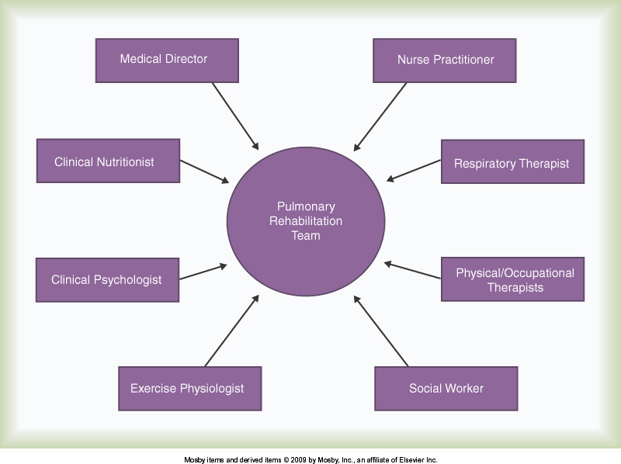
Structure of a Pulmonary Rehab Program (cont.)

Slide 28
Structure of a Pulmonary Rehab Program (cont.)
Facilities
The facility must be easy to reach, be accessible to public transportation, and have available parking.
Rooms should be spacious and comfortable with adequate lighting and ventilation.
A room for counseling is helpful.

Slide 29
Structure of a Pulmonary Rehab Program (cont.)
Scheduling
Class times need to be scheduled at a time most convenient for the patients.
Traffic patterns, bus schedules, and availability of rides are important factors to consider.
Class size
The ideal class size is 3 to 15 patients.

Slide 30
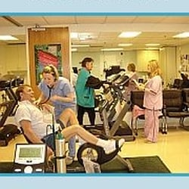
Structure of a Pulmonary Rehab Program (cont.)
Equipment (cont.)
Stationary bicycles, treadmills, rowing machines
Pulse oximeter
Inspiratory & Expiratory resistance devices,Emergency O₂ should be in the room.

Slide 31
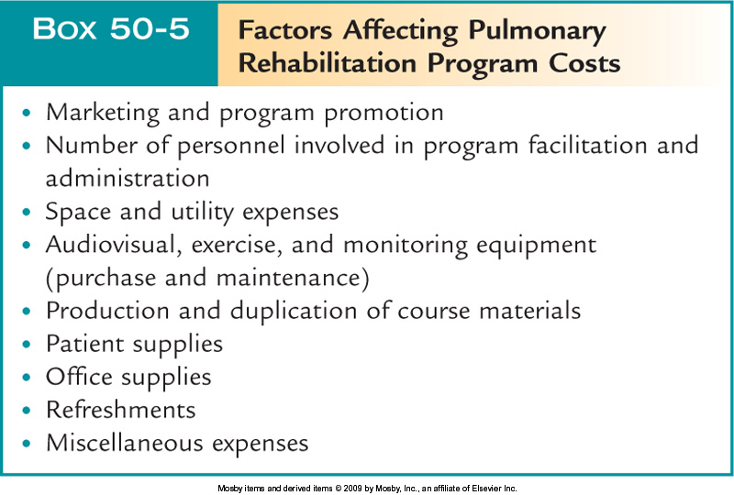
Structure of a Pulmonary Rehab Program (cont.)

Slide 32
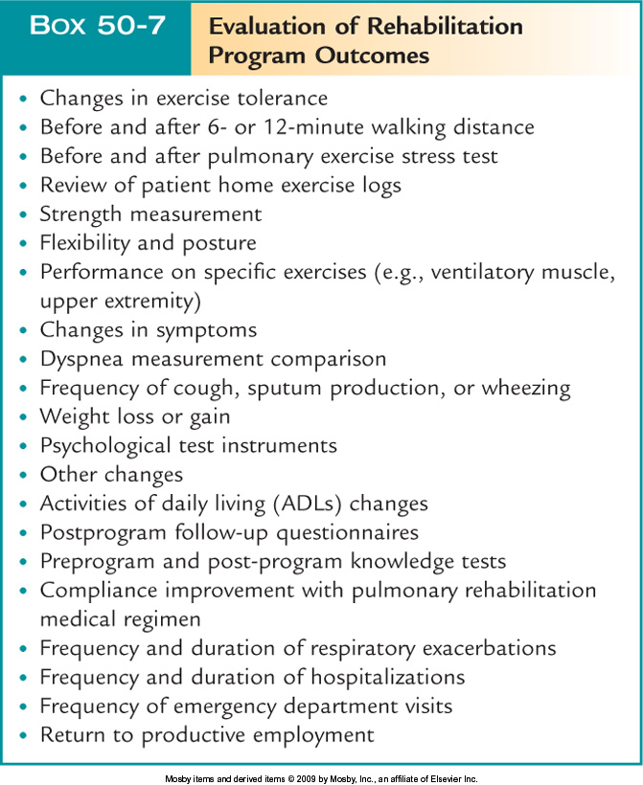
Structure of a Pulmonary Rehab Program (cont.)
Program
Results

Slide 33
Structure of a Pulmonary Rehab Program (cont.)
Potential hazards
Cardiovascular abnormalities
Muscular abnormalities
Miscellaneous
Exercise-induced asthma
Hypoglycemia
Dehydration

Slide 34
Postural Drainage
Postural drainage (bronchial drainage), an intervention for airway clearance, is a means of mobilizing secretions in one or more lung segments to the central airways by placing the patient in various positions so gravity assists in the drainage process.
When secretions are moved from the smaller to the larger airways, they are then cleared by coughing or endotracheal suctioning.
Postural drainage therapy also includes the use of manual techniques, such as percussion, shaking, and vibration, coupled with voluntary coughing.

Slide 35
GOALS
Prevent Accumulation of Secretions in Patients at Risk for Pulmonary Complications
• Patients with pulmonary diseases that are associated with increased production or viscosity of mucus, such as chronic bronchitis and cystic fibrosis.
• Patients who are on prolonged bed rest.
• Patients who have received general anesthesia and who may have painful incisions that restrict deep breathing and coughing postoperatively.
• Any patient who is on a ventilator if he or she is stable enough to tolerate the treatment.
Remove Accumulated Secretions from the Lungs
• Patients with acute or chronic lung disease, such as pneumonia, atelectasis, acute lung infections, COPD.
• Patients who are generally very weak or are elderly.
• Patients with artificial airways.

Slide 36
Postural Drainage: Indications
Difficulty with secretion clearance
Adult having difficulty expectorating sputum volume greater than approximately 25 ml/day
Atelectasis caused by mucus plugging
Presence of a foreign body in the airway

Slide 37
Relative Contraindications to PD
• Severe hemoptysis
• Untreated acute conditions
Severe pulmonary edema
Congestive heart failure
Large pleural effusion
Pulmonary embolism
Pneumothorax
• Cardiovascular instability
Cardiac arrhythmia
Severe hypertension or hypotension
Recent myocardial infarction
Unstable angina
• Recent neurosurgery
Head-down positioning may cause increased intracranial pressure; if PD is required, modified positions can be used

Slide 38
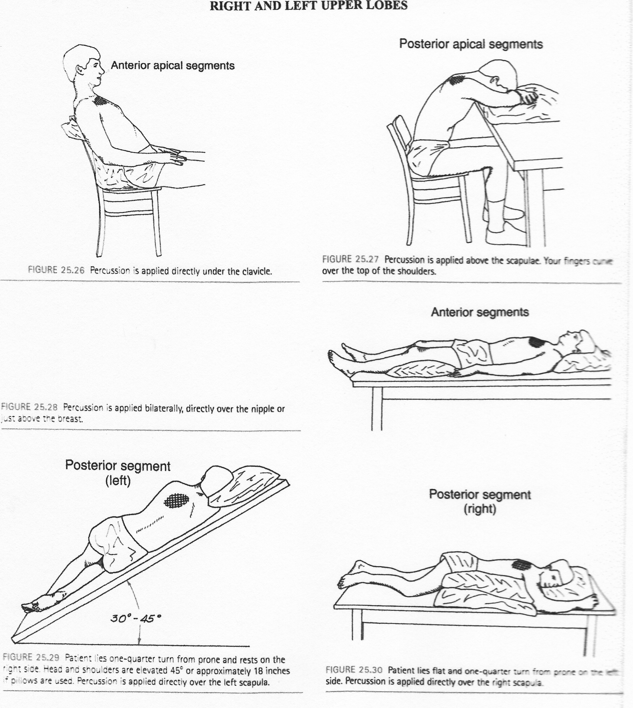

Slide 39
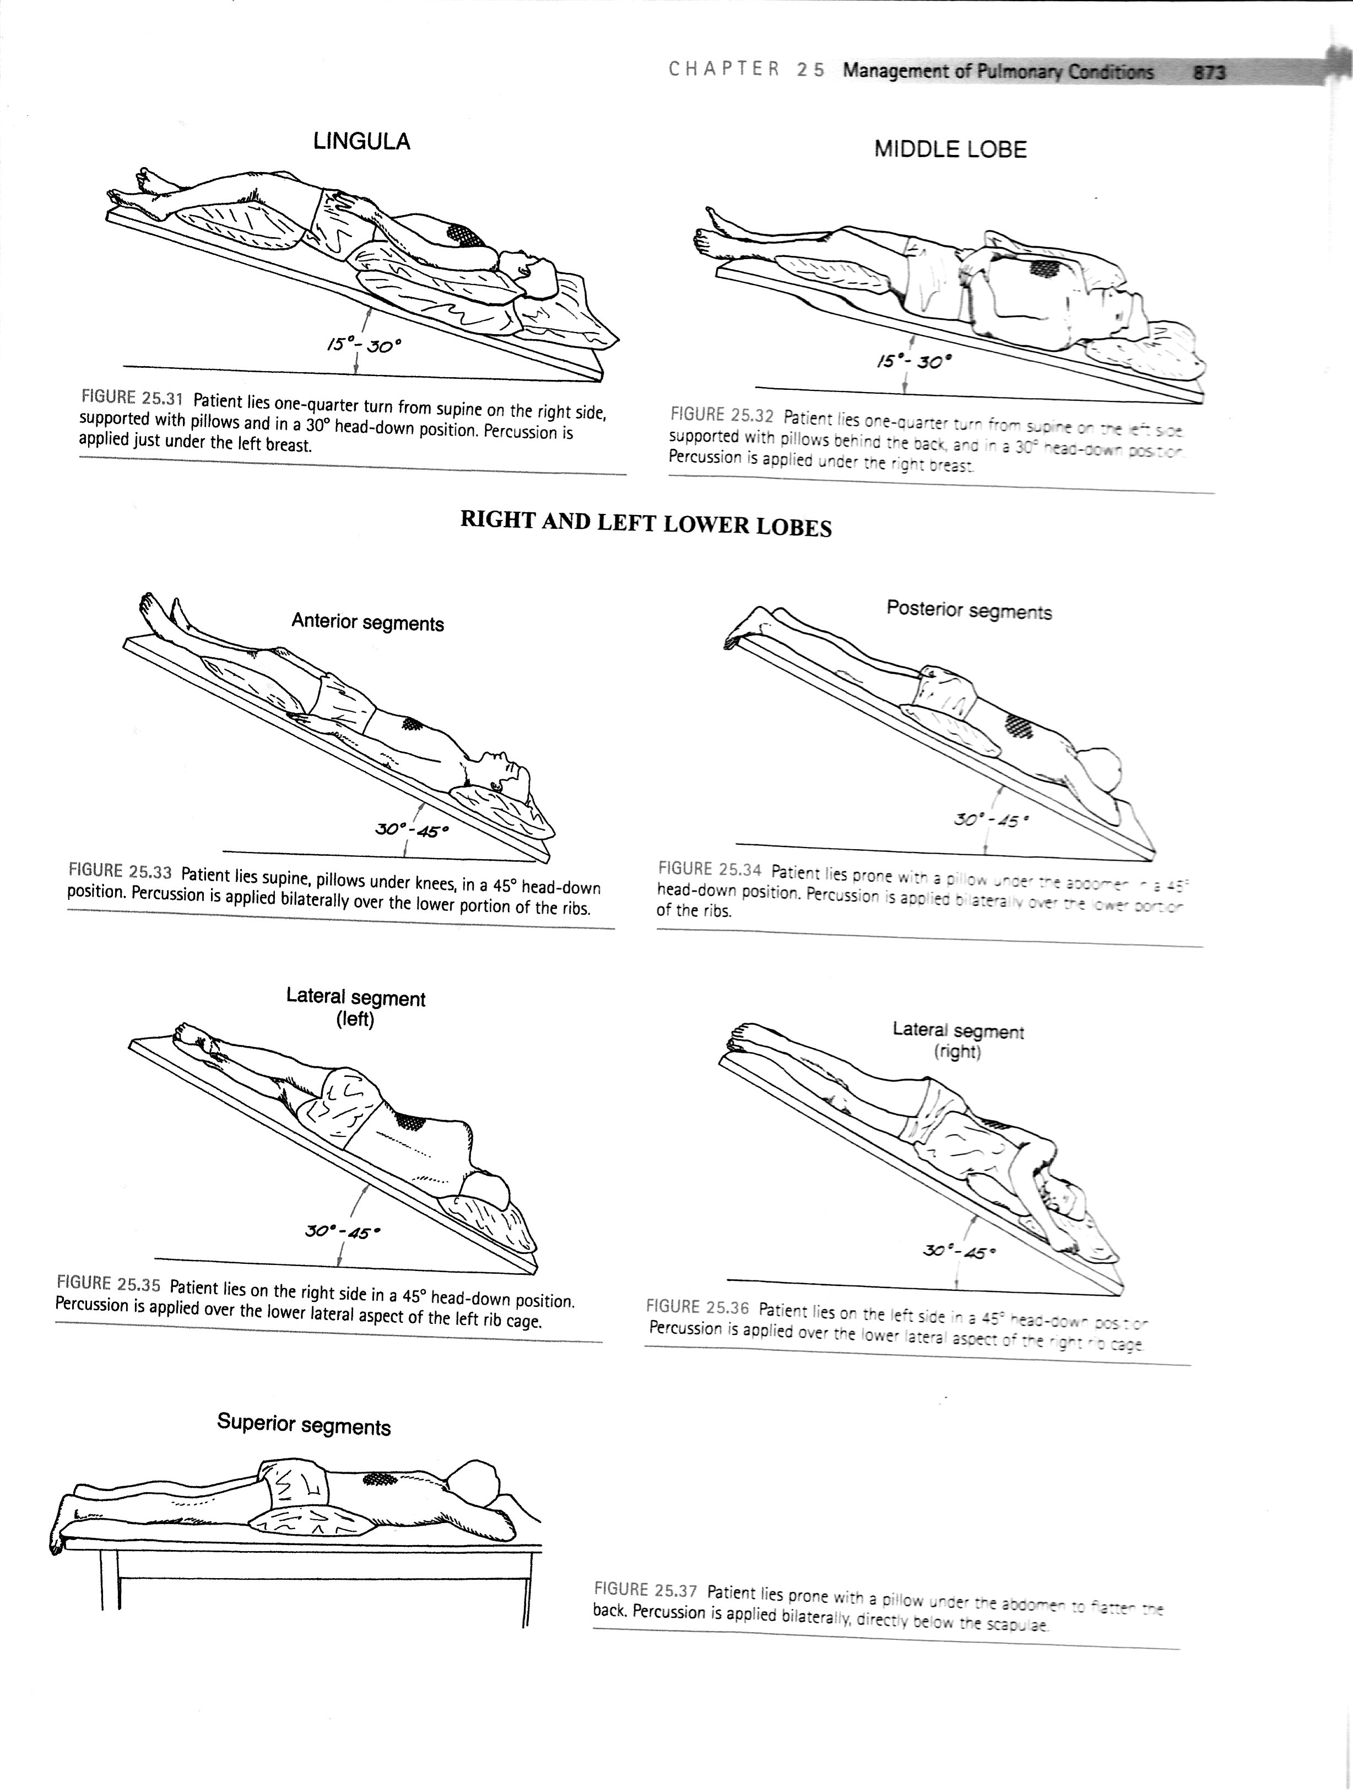

Slide 40
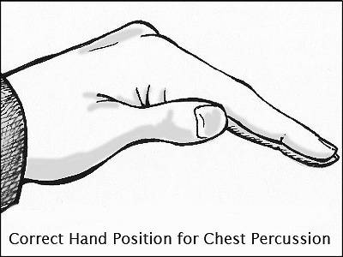
Percussion
Percussion is used to augment mobilization of secretions by mechanically dislodging viscous or adherent mucus from the airways. Percussion is performed with cupped hands over the lung segment being drained.
The therapist’s cupped hands strike the patient’s chest wall in an alternating, rhythmic manner
The therapist should try to keep shoulders, elbows, and wrists loose and mobile during the maneuver.
Mechanical percussion is an alternative to manual percussion techniques.
Percussion is continued for several minutes or until the patient needs to alter position to cough. This procedure should not be painful or uncomfortable.
Perform 2-5 minutes per lung segment

Slide 41
Relative Contraindications to Percussion
Osteoporotic bone
Over tumor area
If a patient has a pulmonary embolus
If the patient has a condition in which hemorrhage could easily occur, such as in the presence of a low platelet count, or if the patient is receiving anticoagulation therapy
If the patient has unstable angina
If the patient has chest wall pain, for example after thoracic surgery or trauma

Slide 42
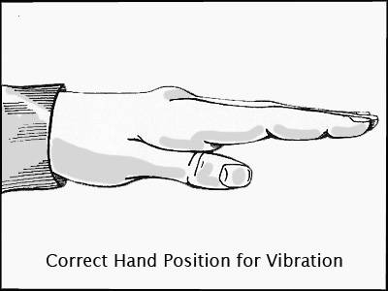
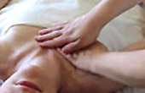
Vibration
Vibration, another manual technique, often is used in conjunction with percussion to help move secretions to larger airways.
It is applied only during the expiratory phase as the patient is deep-breathing.
Vibration is applied by placing both hands directly on the skin and over the chest wall (or one hand on top of the other) and gently compressing and rapidly vibrating the chest wall as the patient breathes out. Pressure is applied in the same direction as the chest is moving.
The vibrating action is achieved by the therapist isometrically contracting (tensing) the muscles of the upper extremities from shoulders to hands.

Slide 43
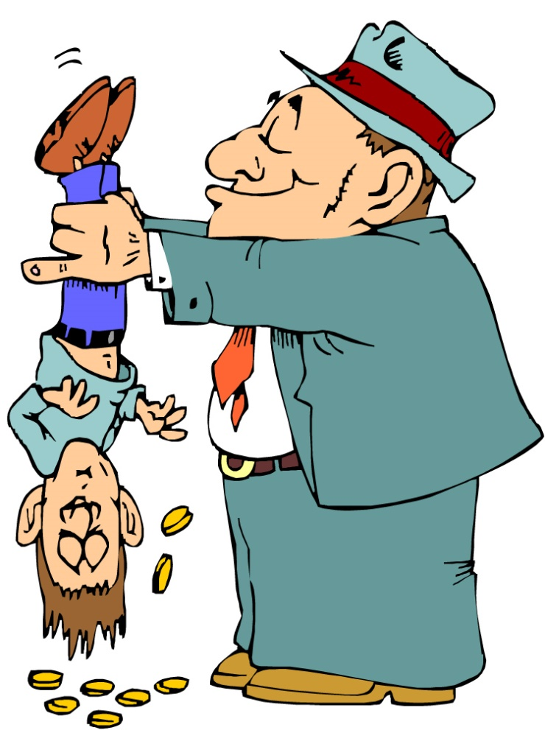
Shaking
Shaking is a more vigorous form of vibration applied during exhalation using an intermittent bouncing maneuver coupled with wide movements of the therapist’s hands.
The therapist’s thumbs are locked together, the open hands are placed directly on the patient’s skin, and fingers are wrapped around the chest wall.
The therapist simultaneously compresses and shakes the chest wall.

Slide 44
Modified Postural Drainage
The positions in which postural drainage is undertaken are modified consistent with the patient’s medical or surgical problems.
Some patients who require postural drainage cannot assume or cannot tolerate the positions optimal for postural drainage.
For example, a patient with congestive heart failure may exhibit indications of orthopnea (shortness of breath while lying flat).
After neurosurgery a patient may not be allowed to assume a head-down position because this position causes increased intracranial pressure.
After thoracic surgery a patient may have chest tubes and monitoring wires that limit positioning. Under these circumstances and others, positioning during postural drainage must be modified.

Slide 45
