Slide 1
Organization and Administration of Emergency Care
DR MUHAMMAD SAAD HASSAN
DPT,MS-OMPT,COCT

Slide 2
Emergency
“An unforeseen combination of circumstances or the resulting state that requires an immediate action.”
(www.merriamwebster.com)
An emergency is any sudden or serious condition that requires medical attention within a minute to several hours.

Slide 3
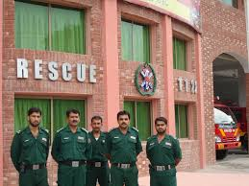
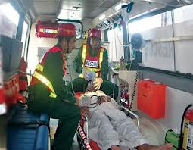
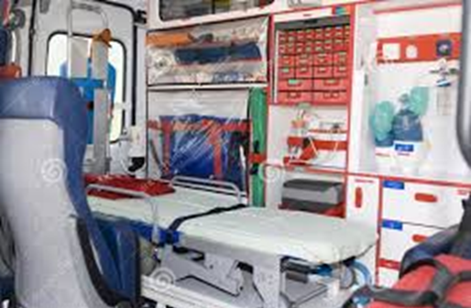

Slide 4
Emergency care | Urgent care
If a medical condition is life- or limb-threatening, or involves severe wounds or amputations, | injuries or illnesses requiring immediate care, but not serious enough to require an ER visit.
If you’re dealing with severe bleeding, trauma, or signs of stroke, proceed to an emergency room as soon as possible. | An urgent care center is also good for general medical examinations, little stitches, and x-rays & other minor conditions that need medical attention within 24 hours.
A sudden loss of breath Allergic reactions to food, animal or bug bites Broken bones Chest pain Constant vomiting Continuous bleeding Deep wounds Weakness or pain in a leg or arm Head injuries Unconsciousness | Flu and cold. Coughs and sore throat. High fevers. Vomiting, diarrhea, stomach pain. Cuts and severe scrapes. Minor injuries and burns. Severe ear infection Severe sore throat Insect bite or sudden rash

Slide 5
Organization and Administration of Emergency Care
Develop and implement emergency action plan
Emergency team
Initial patient assessment and care
Emergency communication
Emergency equipment and supplies
Venue location
Emergency transportation
Emergency care facilities
Legal need and documentation

Slide 6
Emergency Action Plan
An Emergency Action Plan is simply what employees should do in the event of an emergency.
EAP should be developed by organizational or institutional personnel in consultation with local emergency medical services.
Components of Emergency Care Preparation
Development of an EAP
Proper coverage of events
Maintenance and upkeep of emergency equipment and supplies
Selection of appropriate employees as part of the team.
Continuing education of the rehab team in emergency medical care

Slide 7
Emergency
team
EMPLOY/
TEAM
Documentation
Communication
Emergency
action
plan
Emergency
care
facilities
Equipment
and
supplies
Transportation
Venue
location

Slide 8
Medical Emergency Team
House Medical Doctor
Nursing Supervisor
Registered Nurse responsible for patient
Physical Therapist
Michael Brickens, PT is one of the physical therapists who work in EMTC and he is involved in both evaluating patients as well as treating them.
“My responsibilities include providing PT Consultations to individuals that have come to the Emergency Medicine Trauma Center (EMTC) with complaints of musculoskeletal injuries ranging from acute to chronic sprains/strains, segmental dysfunctions to acute fracture/dislocations.”

Slide 9
Medical Emergency Team
Any member of the emergency team can act as a first responder.
A first responder is defined as a person who has been trained to provide emergency care before EMS arrives on the scene.
ARE U CERTIFIED ????? in first aid, cardiopulmonary resuscitation (CPR), automatic external defibrillation (AED), and prevention of disease transmission (Blood borne Pathogens).

Slide 10
cont…..
For this reason, all members of the emergency team should be trained and certified

Slide 11
Initial patient assessment and care
1-CHECK
The scene to make sure it is safe to aid the person
The scene to find evidence on what happened to the person
The victim for airway, breathing, circulation, fractures, and bleeding
2-CALL
The local emergency management service
Give proper directions to the injury site
Meet ambulance at scene and direct to injured person
3-CARE
Calm and reassure the injured person
Reassess and monitor all vital signs
Control any bleeding
Immobilize any injured body part
Provide CPR/AED and appropriate first aid

Slide 12
Emergency communication
An emergency communication system (ECS) is any system typically, computer-based) that is organized for the primary purpose of supporting one-way and two-way communication of emergency messages between both individuals and groups of individuals.
Communication is the key to quick and effective delivery of emergency care in any trauma situation.
Communication prior to an event is a good way to establish a positive working relationship between all groups of professionals.

Slide 13
If emergency medical transportation is not available on site during a particular event, then direct communication with the emergency medical system at the time of injury or illness is necessary.
A backup communications plan should be ready if there is failure of the primary communication system.
Currently the most common method of communication is a cellular telephone.

Slide 14
Emergency equipment and supplies ????
All appropriate emergency equipment and supplies must be on hand at all practices and events.
All assigned emergency team members should be aware of the location and function of all emergency equipment and supplies.

Slide 15
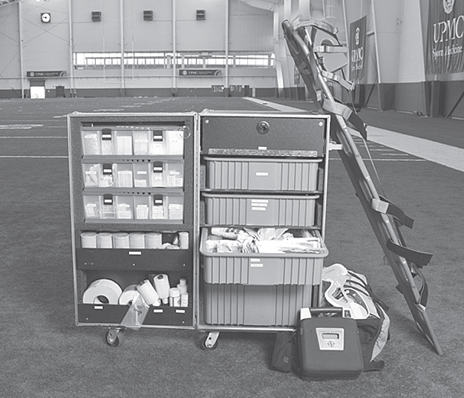
Emergency equipment and supplies
Equipment
AED unit
Immobilization splints
Stretcher/spine board
Airway bag—valve
mask
Supplies
First aid kit
Sterile bandages
Tape and elastic wraps
Blood borne pathogen kits

Slide 16
Venue Locations
The EAP should be specific to venue locations and any unique features that might be found as part of that facility
The EAP for each venue should include information concerning the accessibility to emergency personnel, communications systems, emergency equipment, and emergency vehicle transportation.
Emergency Procedures; Includes all venue drawings, maps, and directions

Slide 17
Emergency Transportation
The EAP should include a policy for transportation of the sick and injured for all athletic events. By definition, an emergency dictates that transport should be via EMS vehicles (ambulance).
The policy on transportation should explain in detail when and where an ambulance will be during the events.

Slide 18
Emergency Care Facilities
The EAP should include information regarding the transportation directions to an emergency medical facility from all venues.
When selecting an appropriate emergency care facility, consider the proximity of the emergency facility to the venues and the level of care available at the facility.
There should be prior notification to the local emergency services that are used by the organization in advance.
It is also recommended that the EAP be reviewed and practiced with both the emergency care facility administrators and medical staff in regard to important information concerning the care.

Slide 19
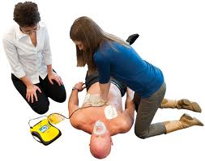
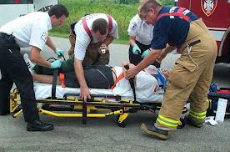
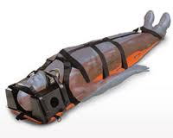
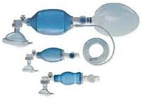
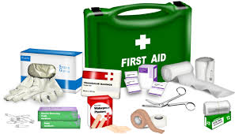
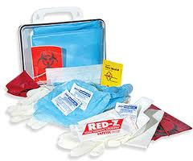

Slide 20

Legal Need and DOCUMENTATION ??
Remember:
If it was not documented, it never happened!

Slide 21
Individual Injury Evaluation Form, used for the documentation of the person’s injuries or problems.
Description of the person or group responsible for documenting the events of the emergency situation.
Follow-up documentation on the evaluation of response to emergency situation.
Documentation on personnel training and regular rehearsal of the emergency action plan.
Documentation of purchase, inventory, and maintenance of all emergency equipment and supplies.

Slide 22
Guidelines for Documentation
Document accurately: Record the facts, not opinions. Never falsify records to cover up a negligent act.
Document completely: You will find it difficult to prove that you provided a service, if you do not documented it.
Note the Time: Be specific about the time something happens. This is especially important when you are writing an incident report or documenting in a communication book. Also, document information as soon as possible; you are more likely to remember important details this way!
Document objectively: Record exactly what you see, hear, and do. Remember to document data you witness yourself, or data from a reliable source. When you include information reported by someone else, cite your source.
Forms & Ink: Be sure to use the correct form for the situation at hand. Be sure to use blue or black ink.
Signature: Be sure to sign all reports and forms.
Mistakes: Do not use white-out; if you make a mistake, cross out the word and initial it.

Slide 23
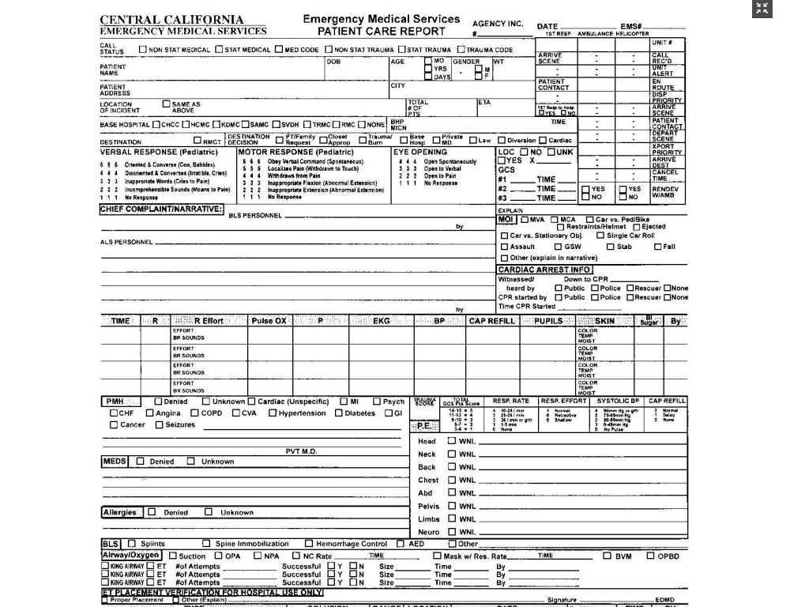

Slide 24


