Slide 1
🛡️
Credit Card Fraud Detection
Using Machine Learning
Data Science Semester Project — 4th Semester
Python • Scikit-learn • XGBoost • SMOTE • Streamlit

Slide 2
📋 Table of Contents
1. Introduction & Problem Statement
2. Dataset Overview
3. Project Architecture & Tech Stack
4. Data Preprocessing Pipeline
5. Exploratory Data Analysis (EDA)
6. Machine Learning Models
7. Model Evaluation & Comparison
8. Results & Best Model Selection
9. Streamlit Web Dashboard
10. Conclusion & Future Work

Slide 3
1. Introduction & Problem Statement
⚠️ The Problem
✅ Our Solution
• Credit card fraud costs $28+ billion annually worldwide
• Traditional rule-based systems can't adapt to new fraud patterns
• Manual review is slow and expensive
• Fraudulent transactions are extremely rare (< 0.2%)
• Both false positives and false negatives are costly
• Machine Learning for automated fraud detection
• SMOTE to handle extreme class imbalance
• Compare 4 ML algorithms to find the best
• Evaluate using F1 Score (not accuracy!)
• Deploy via interactive Streamlit dashboard
• Real-time prediction with confidence scores

Slide 4
2. Dataset Overview
Kaggle Credit Card Fraud Detection Dataset — European cardholders, September 2013
284,807
492
0.172%
31
2 Days
Total Transactions
Fraudulent Transactions
Fraud Rate
Total Features
Time Period
📊 Feature Description
• V1 – V28: PCA-transformed anonymized features
• Time: Seconds since first transaction
• Amount: Transaction amount (in Euros)
• Class: Target → 0 (Legitimate) / 1 (Fraud)
• Original features hidden for confidentiality (PCA applied)
• Only Time & Amount retain original meaning
• V1–V28 are already scaled (no extra scaling needed)
• Extreme imbalance: 99.83% legitimate vs 0.17% fraud

Slide 5
3. Project Architecture & Tech Stack
📥
🧹
📊
🤖
📈
🏆
Raw Data (CSV)
→
Preprocessing & Cleaning
→
EDA (5 Plots)
→
Train 4 Models
→
Evaluate & Compare
→
Best Model (Pickle)
🐍 Language
📊 Data
🤖 ML
Python 3.9+
Pandas, NumPy
Scikit-learn, XGBoost
⚖️ Balancing
📈 Visualization
🌐 Dashboard
Imbalanced-learn (SMOTE)
Matplotlib, Seaborn Plotly
Streamlit

Slide 6
4. Data Preprocessing Pipeline
📥 Step 1: Load Dataset
🔍 Step 2: Inspect Data
Read creditcard.csv using Pandas with error handling
Check shape, dtypes, null counts, duplicates, class distribution
🧹 Step 3: Clean Data
📏 Step 4: Scale Features
Remove ~1,081 duplicate rows; handle missing values with median
StandardScaler on Time & Amount (V1–V28 already PCA-scaled)
✂️ Step 5: Train/Test Split
⚖️ Step 6: Apply SMOTE
80/20 stratified split — maintains class proportions
Oversample minority class on TRAINING data only (prevents leakage!)
⚠️ CRITICAL: SMOTE is applied to training data ONLY — applying it before splitting causes data leakage!

Slide 7
4b. SMOTE — Handling Class Imbalance
What is SMOTE?
❌ Before SMOTE
• Synthetic Minority Over-sampling Technique
• Creates SYNTHETIC fraud examples
• Interpolates between existing minority samples
• Balances the dataset to ~50/50 split
Why not just duplicate fraud cases?
• Duplication causes overfitting
• SMOTE creates NEW realistic data points
• Better generalization on unseen data
Legitimate: ~227,451 samples
Fraudulent: ~394 samples
Ratio: 99.83% vs 0.17%
✅ After SMOTE
Legitimate: ~227,451 samples
Fraudulent: ~227,451 samples (synthetic!)
Ratio: 50% vs 50% ✓
Applied to training data only!

Slide 8
5. Exploratory Data Analysis (EDA)
📊 Class Distribution
Bar chart + pie chart showing 99.83% vs 0.17% imbalance
💰 Amount Distribution
Fraud amounts tend to be smaller (mean ~$122 vs ~$88)
⏰ Time Distribution
Transaction frequency over the 48-hour recording period
🔗 Correlation Heatmap
Feature correlations — V14, V12, V10 most correlated with fraud
📈 Top Features
💡 Key Insight: Most fraud transactions are under $100, making them hard to detect by amount alone!
Box plots of top 8 features showing class separation

Slide 9
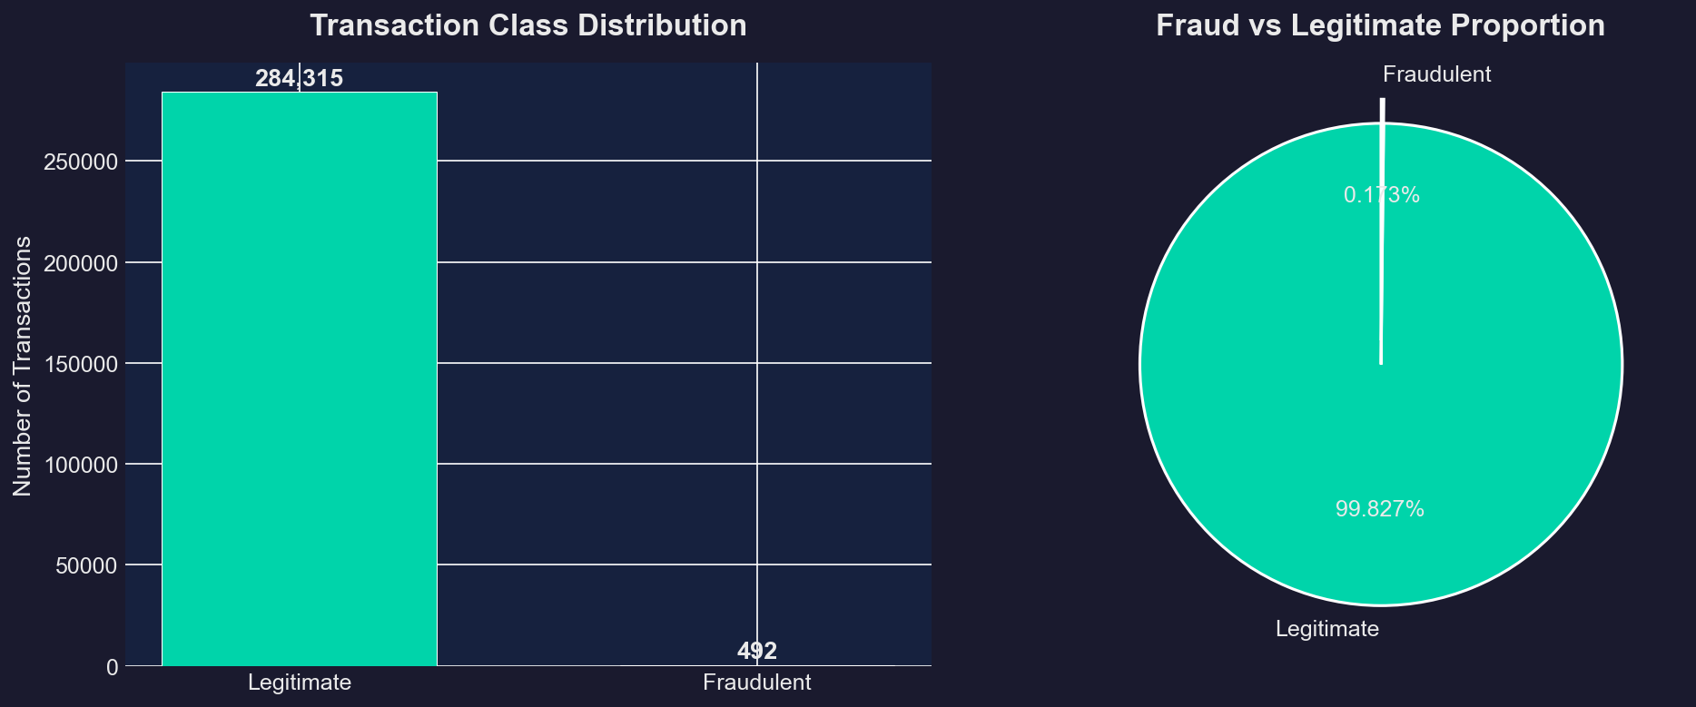
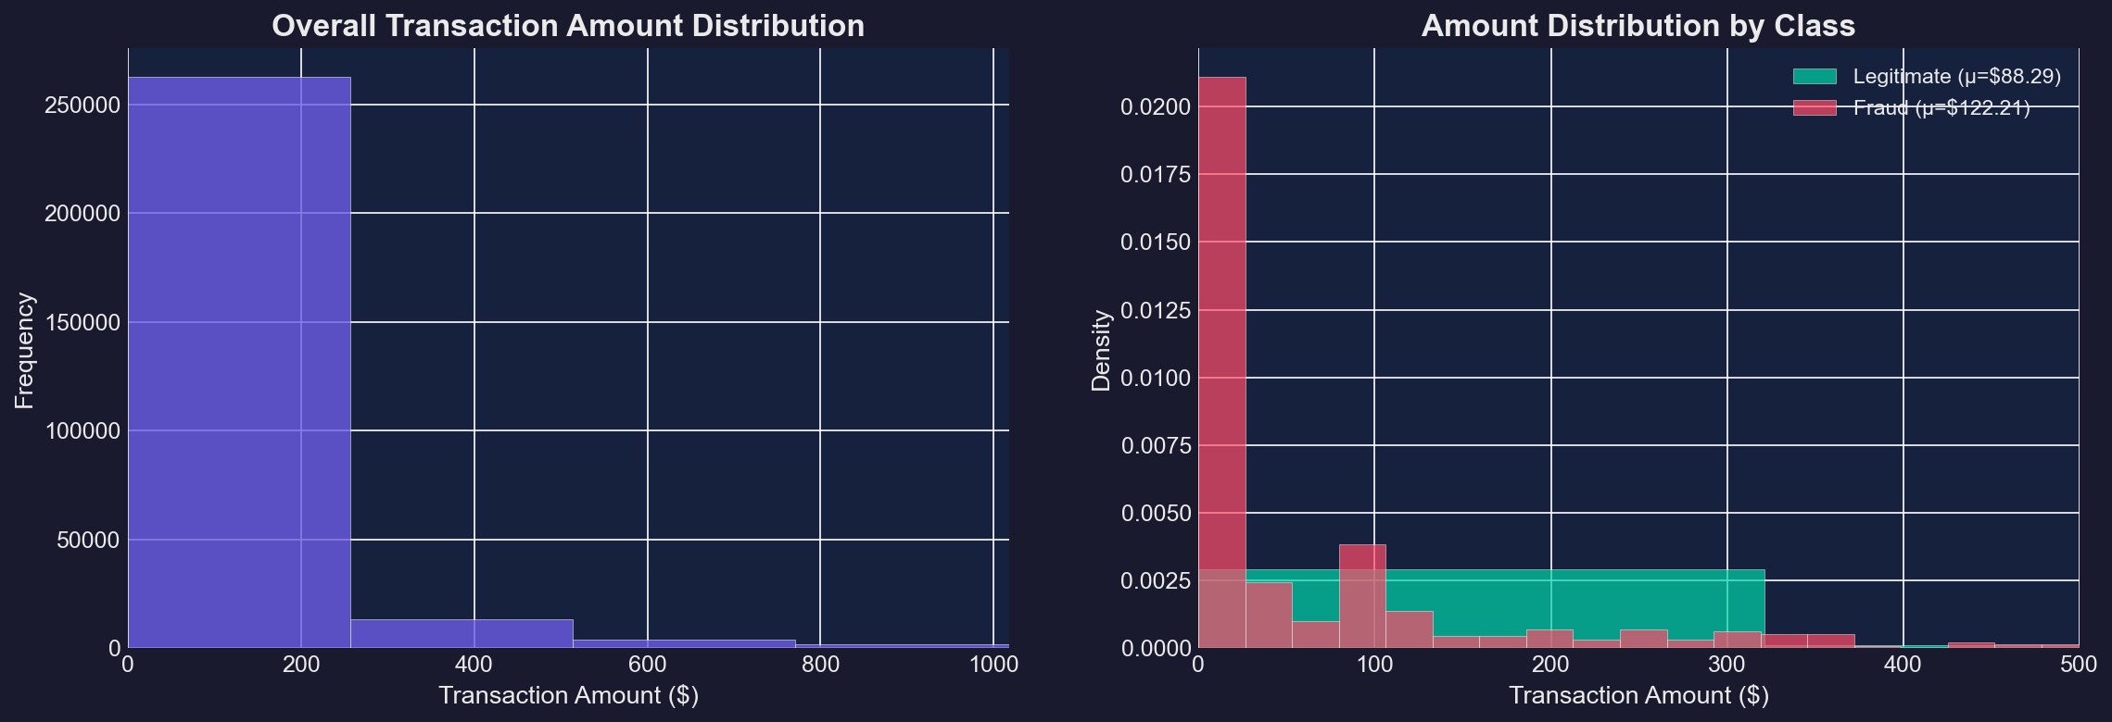
5b. EDA Visualizations
Class Distribution
Amount Distribution

Slide 10
6. Machine Learning Models
1️⃣ Logistic Regression
2️⃣ Decision Tree
Linear classifier — fast baseline
Tree-based — rule learning
• Simple, interpretable • Good for linearly separable data • Outputs probabilities • max_iter=1000, solver='lbfgs'
• Easy to interpret (if-else rules) • Handles non-linear patterns • Prone to overfitting • max_depth=10
3️⃣ Random Forest
4️⃣ XGBoost
Ensemble of 100 decision trees
Gradient boosted trees
• Combines many trees (bagging) • Reduces overfitting • Robust and accurate • n_estimators=100, max_depth=15
• Trees learn from previous errors • State-of-the-art performance • Handles imbalance well • n_estimators=100, lr=0.1

Slide 11
7. Evaluation Metrics Explained
⚠️ Why NOT Accuracy?
A model predicting ALL transactions as legitimate achieves 99.83% accuracy — but catches ZERO fraud!
Accuracy
Precision
Recall
Overall correct predictions TP + TN / Total
Of predicted frauds, how many are actual frauds?
Of actual frauds, how many were detected?
→ Good for balanced datasets only
→ Minimizes false alarms
→ Catches the most frauds
F1 Score ⭐
ROC-AUC
Confusion Matrix
Harmonic mean of Precision and Recall
Model's ability to distinguish between classes
Table of TP, TN, FP, FN counts
→ PRIMARY METRIC — balances both!
→ Ranking & threshold metric
→ Visual error breakdown

Slide 12
8. Results & Model Comparison
Model
Accuracy
Precision
Recall
F1 Score
ROC-AUC
Logistic Regression
~0.974
~0.06
~0.92
~0.11
~0.97
Decision Tree
~0.997
~0.72
~0.76
~0.74
~0.88
Random Forest
~0.999
~0.93
~0.80
~0.86
~0.96
XGBoost
~0.999
~0.88
~0.82
~0.85
~0.97
🏆 Best Model: Random Forest / XGBoost
Selected based on highest F1 Score — the best metric for imbalanced classification problems
📊 Key Observations
• LR: High recall but very low precision (too many false alarms) • Ensemble methods (RF, XGB) far outperform single models • Accuracy alone is misleading

Slide 13
9. Streamlit Web Dashboard
🏠 Home Page
🔍 Prediction Page
• Project overview with summary metric cards
• Dataset statistics (284K transactions, 0.172% fraud)
• Best model highlight card
• All 5 EDA visualizations in interactive tabs
• Key insights from the data
• Input form for all 30 features (V1–V28, Time, Amount)
• Quick-fill buttons for demo (legitimate & fraud samples)
• Real-time fraud prediction with confidence percentage
• Animated result cards (green = safe, red = fraud)
• Gauge chart for fraud probability visualization
📊 Model Performance
ℹ️ About Page
• Side-by-side comparison table of all 4 models
• Interactive radar chart for best model metrics
• Grouped bar chart comparison
• Confusion matrices and ROC curves
• Tech stack information
• ML pipeline explanation
• Dataset documentation
• Project credits

Slide 14
10. Conclusion & Future Work
✅ What We Achieved
🚀 Future Improvements
• Complete ML pipeline for fraud detection
• Handled extreme class imbalance (0.172%)
using SMOTE oversampling
• Trained & compared 4 ML algorithms
• Achieved F1 Score > 0.85 with ensemble models
• Deployed production-style Streamlit dashboard
• Real-time prediction with confidence scores
• Modular, well-documented, reusable code
• University-ready documentation & report
• Deep Learning: LSTM / Autoencoders
for sequential pattern detection
• Real-time streaming: Apache Kafka
integration for live processing
• SHAP values for model explainability
(transparent, trustworthy predictions)
• Hyperparameter tuning with Optuna
• REST API with FastAPI for production
• Concept drift monitoring & auto-retrain

Slide 15
Thank You!
Credit Card Fraud Detection using Machine Learning
Questions & Discussion

