Slide 1
Mapping

Slide 2
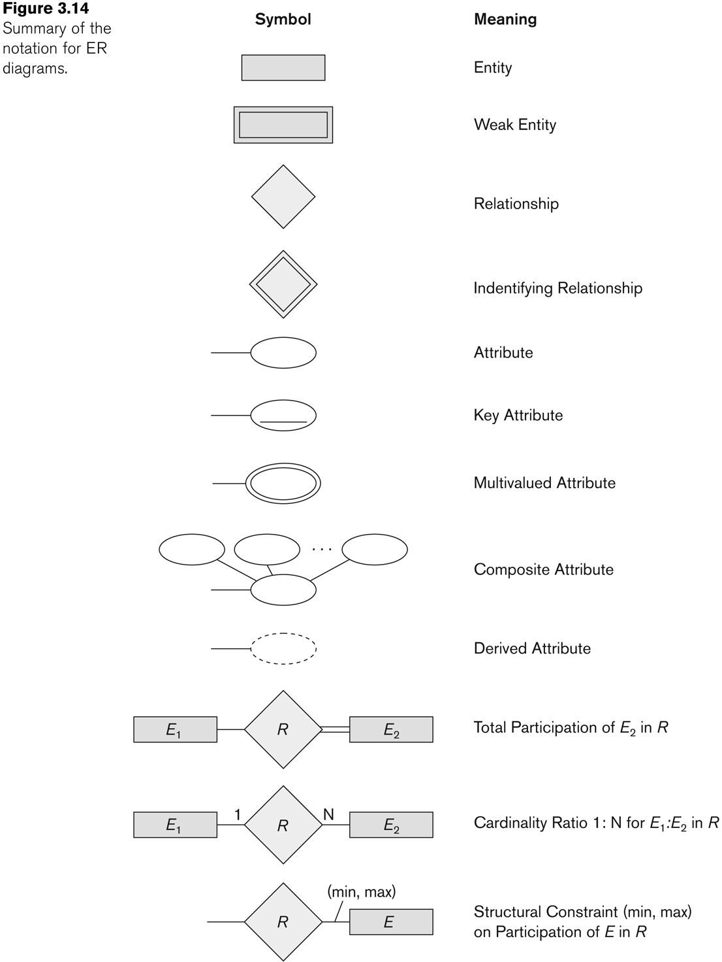
Summary of notation for ER diagrams

Slide 3
Relational Database Definitions
Table or entity: a collection of records
Attribute or Column or field: a Characteristic of an entity
Row or Record or tuble: the specific characteristics of one entity
Database: a collection of tables

Slide 4
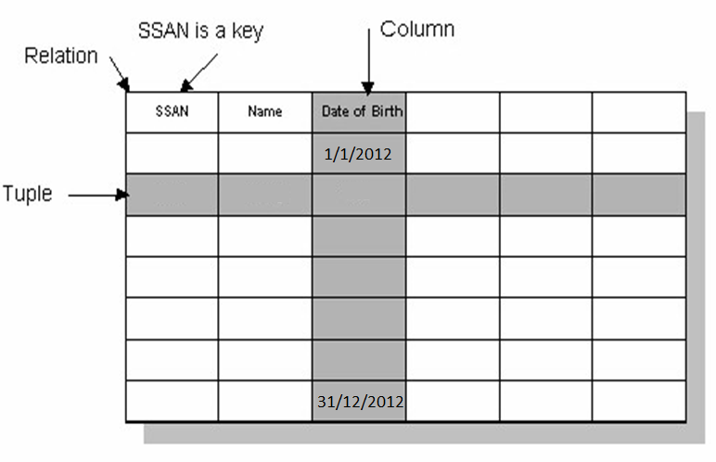
Relational Database

Slide 5
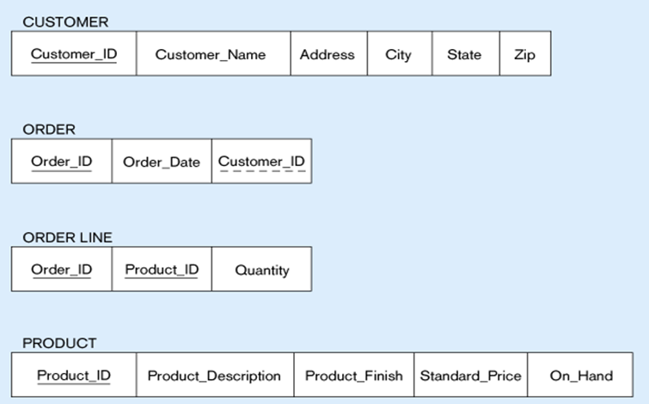
Mapping ->DB Tables
Primary Key
Foreign Key
composite primary key

Slide 6
ER-to-Relational Mapping
Step 1: Mapping of Regular Entity Types
Step 2: Mapping of Weak Entity Types
Step 3: Mapping of Binary 1:1 Relation Types
Step 4: Mapping of Binary 1:N Relationship Types.
Step 5: Mapping of Binary M:N Relationship Types.
Step 6: Mapping of N-ary Relationship Types.
Step 7: Mapping of Unary Relationship.

Slide 7
Step 1: Mapping of Regular Entity Types
Create table for each entity type -> if there is no 1-1 relationship mandatory from 2 sides
Choose one of key attributes to be the primary key

Slide 8
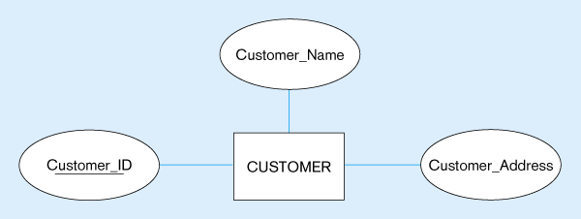
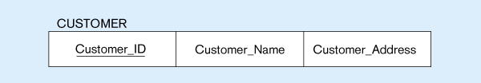
Mapping Regular entity
(a) CUSTOMER entity type with simple attributes
(b) CUSTOMER relation

Slide 9
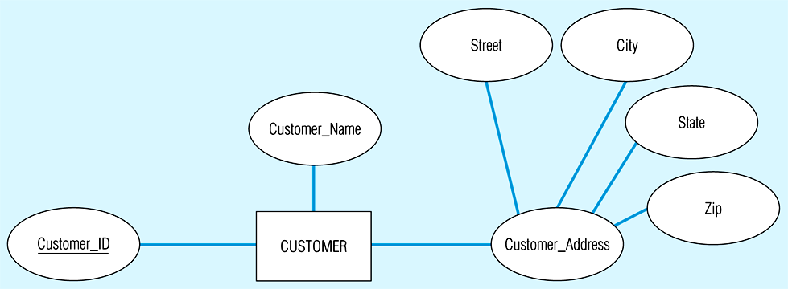
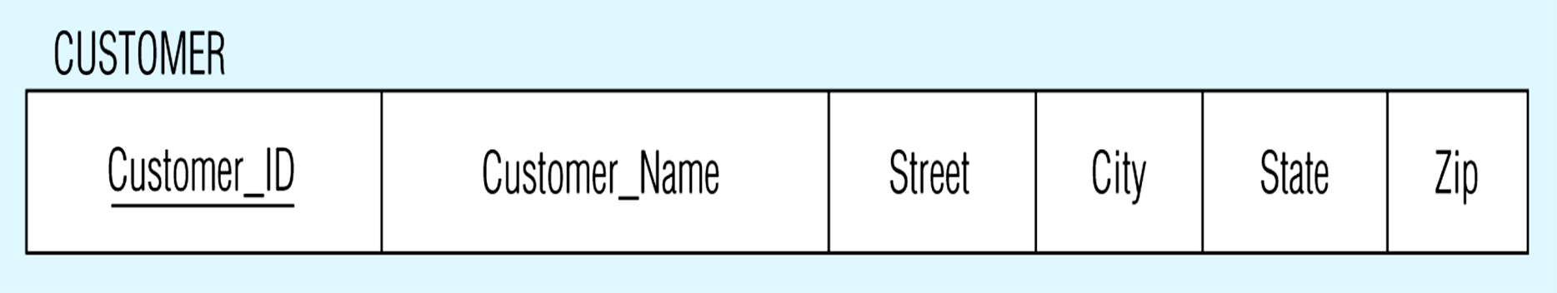
Mapping Composite attribute
CUSTOMER entity type with composite attribute
CUSTOMER relation with address detail

Slide 10
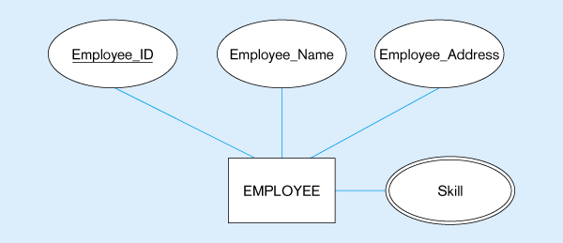
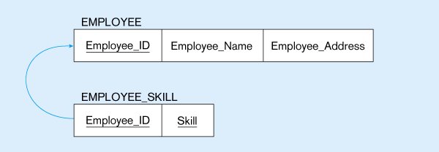
Mapping Multivalued Attribute
Multivalued attribute becomes a separate relation with foreign key
1 – to – many relationship between original entity and new relation

Slide 11
Mapping Derived & Complex
In the most cases Derived attribute not be stored in DB
Mapping Complex Like Mapping Multivalued attribute then including parts of the multivalued attributes as columns in DB

Slide 12
Step 2: Mapping of Weak Entity Types
Create table for each weak entity.
Add foreign key that correspond to the owner entity type.
Primary key composed of:
Partial identifier of weak entity
Primary key of identifying relation (strong entity)

Slide 13
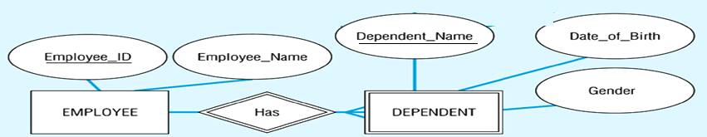
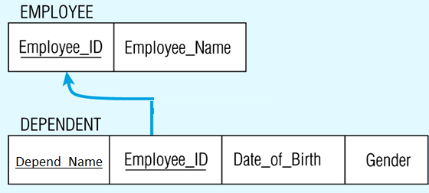
Mapping Weak entity
Composite primary key

Slide 14
Step 3: Mapping of Binary 1:1 Relation Types
Merged two tables if both sides are Mandatory.
Add FK into table with the total participation relationship to represent optional side.
Create third table if both sides are optional.

Slide 15
2 Mandatory
One-to-One
2 Mandatory
EID
EName
CID
CName
1
Has
1
Employee
Computer
1 table
tbl_xy (PK,….,…,….)
PK = PKx or PKy
Emp(EID, Ename, Cname, CID)

Slide 16
Optional-Mandatory
One-to-One
X optional – Y mandatory
EID
EName
CID
CName
1
Has
1
Employee
Computer
2 tables
tbl_x (PKx,….,…….)
tbl_y (PKy,….,….,PKx….)
Employee(EID, Ename)
Computer(CID, Cname, EID_FK)

Slide 17
2 Optional
One-to-One
2 Optional
EID
EName
CID
CType
1
own
1
Employee
Car
3 tables
tbl_x (PKx,….,…….)
tbl_y (PKy,….,…….)
tbl_xy (PKxy,….,…,FKxy,….)
PKxy = PKx or PKy
Employee(EID, Ename)
Car(CID, CType)
Emp_Car(EID, CID_FK)

Slide 18
Step 4: Mapping of Binary 1:N Relationship Types.
Add FK to N-side table if N-Side mandatory
Add any simple attributes of relationship as column to N-side table.

Slide 19
Many is Mandatory
One-to-Many
X whatever– Y mandatory
EID
EName
DID
DName
M
work
1
Employee
Department
2 tables
tbl_x (PKx,….,…….)
tbl_y (PKy,….,….,FKy….)
FKy= PKx
Department(DID, Dname)
Employee(EID, Ename,DID)

Slide 20
Many is Optional
One-to-Many
X whatever– Y Optional
EID
EName
PID
PName
M
1
Employee
Works_on
Project
3 tables
tbl_x (PKx,….,…….)
tbl_y (PKy,….,…….)
tbl_xy (PKxy,….,…….)
PKxy = PKy
Project(PID, Pname)
Employee(EID, Ename)
Proj_Emp(EID,PID_FK)

Slide 21
Step 5: Mapping of Binary M:N Relationship Types.
Create a new third table
Add FKs to the new table for both parent tables
Add simple attributes of relationship to the new table if any .

Slide 22
M:N
Many-to-Many
X whatever– Y whatever
SID
SName
CID
CName
M
take
M
Student
Course
3 tables
tbl_x (PKx,….,…….)
tbl_y (PKy,….,…….)
tbl_xy (PKx ,PKy, ….,…….)
PKxy= PKx+PKy
Student(SID, Sname)
Course(CID, Cname)
Stud_Course(SID, CID)

Slide 23
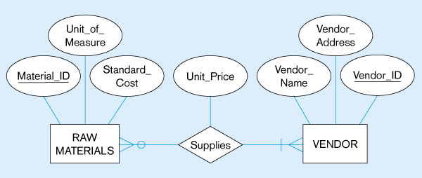
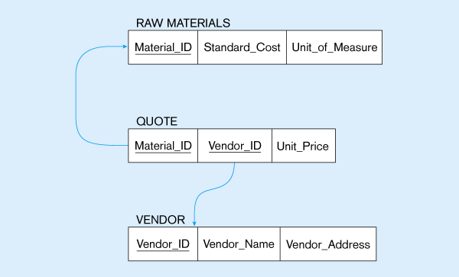
M:N with attribute
The Supplies relationship will need to become a separate relation
Foreign key
Composite primary key
Foreign key

Slide 24
Step 6: Mapping of N-ary Relationship Types.
If n > 2 then :
Create a new third table
Add FKs to the new table for all parent tables
Add simple attributes of relationship to the new table if any .

Slide 25
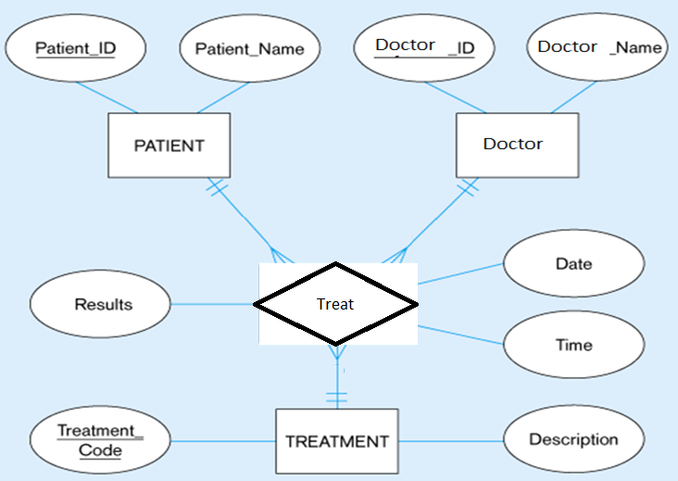
Step 6: Mapping of N-ary Relationship Types.

Slide 26
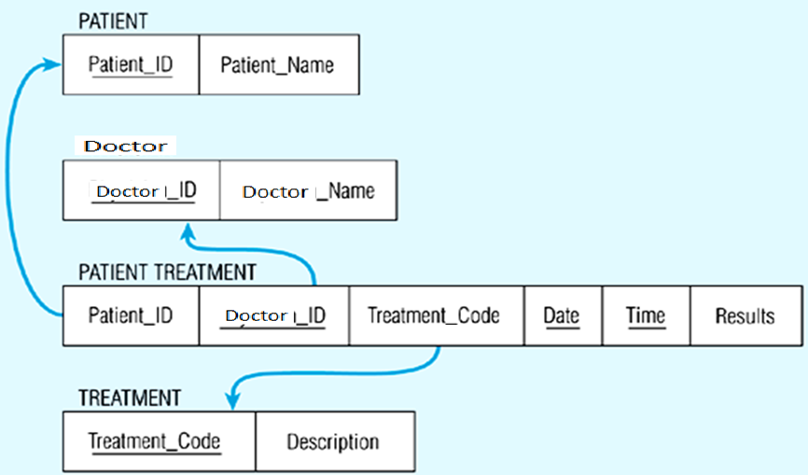
Step 6: Mapping of N-ary Relationship Types.

Slide 27
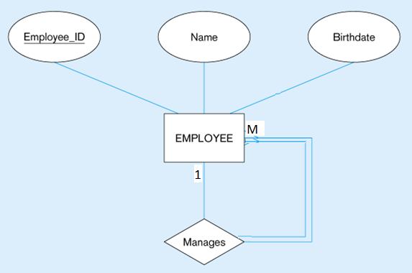

Step 7:Mapping Unary Relationship
(a) EMPLOYEE entity with Manages relationship
(b) EMPLOYEE relation with recursive foreign key

Slide 28
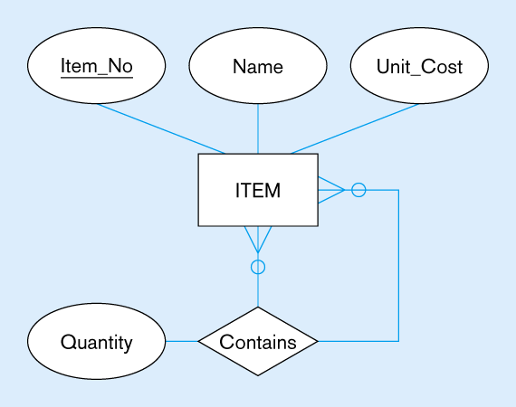
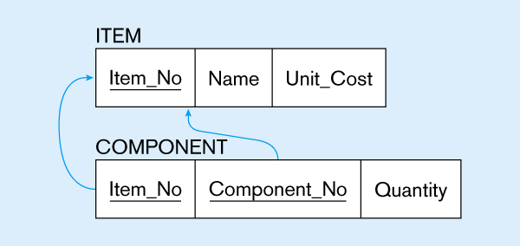
Mapping a unary M:N relationship
(a) Bill-of-materials relationships (M:N)
(b) ITEM and COMPONENT relations

Slide 29
Case Study

Slide 30
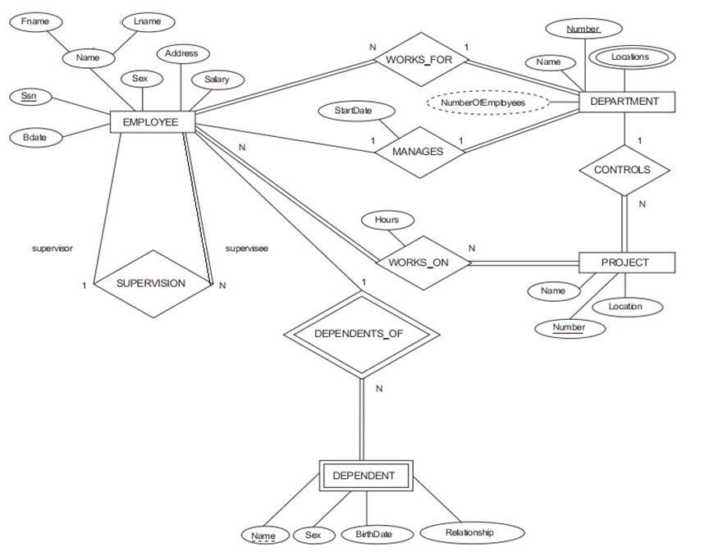

Slide 31
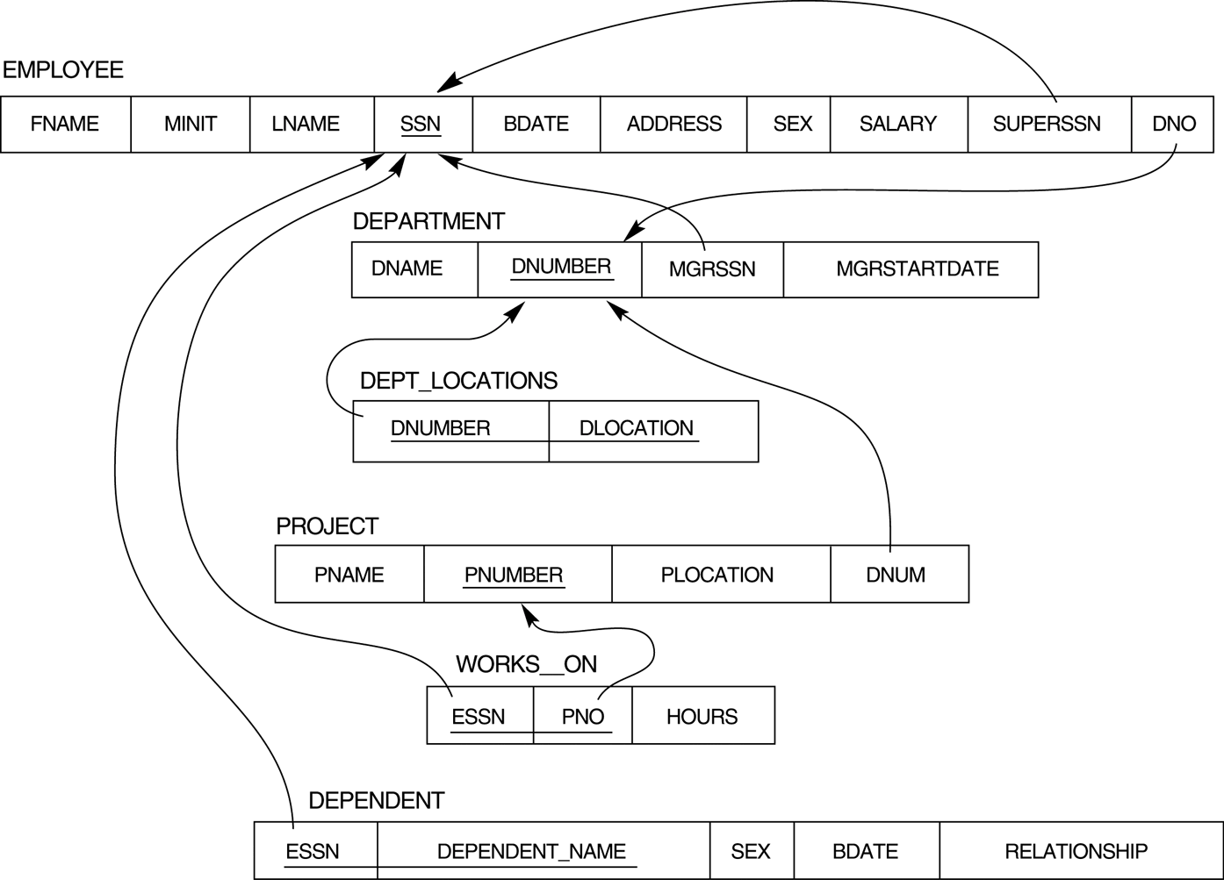
Mapping Result

Slide 32
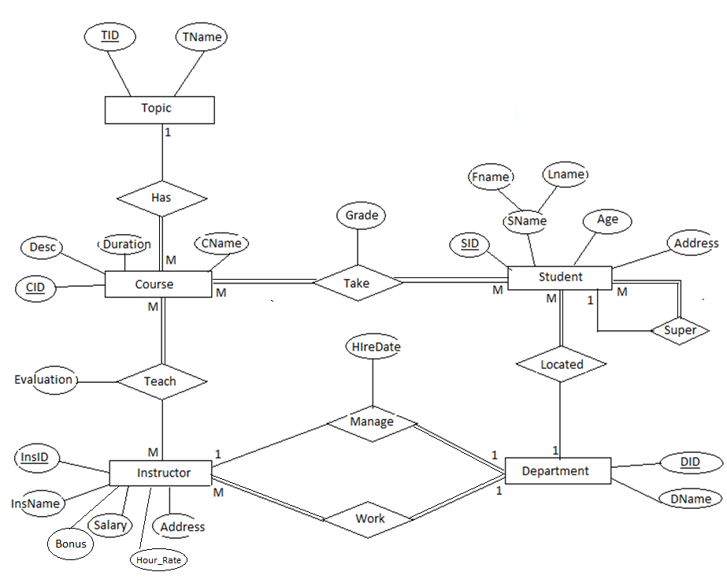

Slide 33
Mapping Result
Student(St_id,st_fname,st_Lname,st_age,st_super,Dept_ID)
Course(Crs_id.Crs_Name,Crs_Duration,Top_id)
Topic(Top_ID,Top_Name)
Stud_Course(St_ID,Crs_ID,grade)
Instructor(Ins_ID,ins_Name,Address,Salary,Dept_ID)
Ins_Course(Ins_ID,Crs_ID,Evalution)
Department(Dept_ID,Dept_Name,Manager_ID,HireDate)

Slide 34
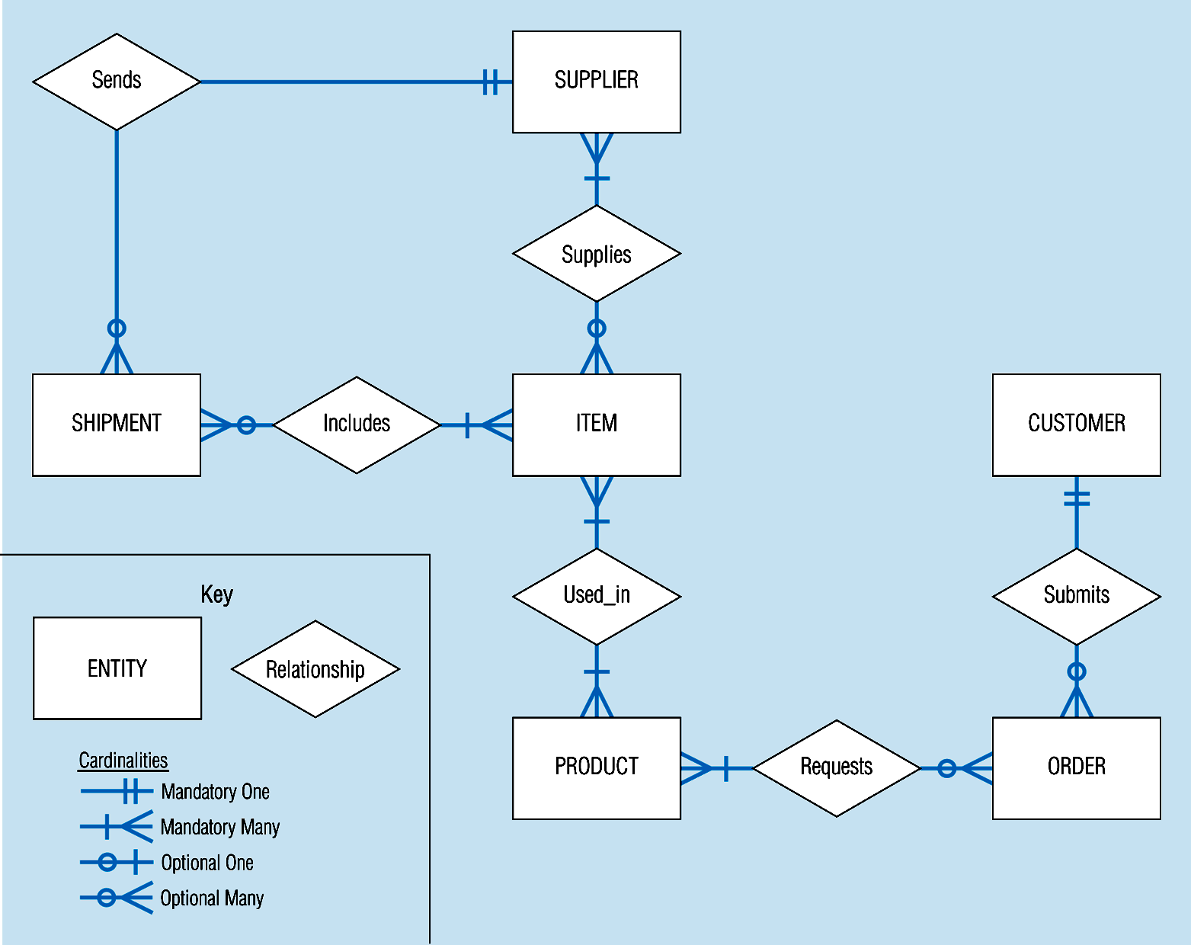
Sample E-R Diagram (figure 3-1)
Notes:
3

Slide 35
Thank You !!!

