Slide 1
TECHIE ACADEMY / CAPSTONE PROJECT
Northwind Business
Performance Analysis
Turning sales and operations data into clear business priorities.
Yekini Abdulroqeeb Ademola
Data Analyst
CEO PRESENTATION • 10–15 MINUTES
NORTHWIND TRADERS • CAPSTONE PROJECT
01 / 10

Slide 2
02
Executive summary
The data points to a strong core business, with clear opportunities to improve visibility and control.
01 | Revenue has clear leaders
THE HEADLINE
Côte de Blaye leads product revenue; Beverages leads category revenue; the USA is the strongest market.
$1.35M
02 | Different measures tell different stories
revenue across 830 orders
Camembert Pierrot leads by units, QUICK-Stop leads customer revenue, and Save-a-lot Markets places more orders.
The priority is not just to grow sales. It is to make performance easier to compare, protect valuable customer relationships, and investigate shipping exceptions.
03 | Operations are mostly on time—with exceptions
772 orders were shipped on or before the required date; 37 were late and 21 have no recorded shipped date.
Scope: historical Northwind order data, 4 Jul 1996 – 6 May 1998. Findings are descriptive, not proof of causation or profitability.
NORTHWIND TRADERS • CAPSTONE PROJECT
02 / 10

Slide 3
03
Business performance at a glance
A compact baseline for the CEO before looking at products, customers, people and operations.
$1.35M
830
$1.63K
TOTAL REVENUE
ORDERS
AVERAGE ORDER VALUE
93
77
8
CUSTOMERS
PRODUCTS
CATEGORIES
DATA PERIOD
4 Jul 1996 – 6 May 1998
1996 and 1998 are partial years—compare equivalent periods, not raw annual totals alone.
NORTHWIND TRADERS • CAPSTONE PROJECT
03 / 10

Slide 4
04
Sales performance
Revenue changes across the available period; comparisons need to account for incomplete years.
REVENUE SIGNALS
What happened
Total revenue is approximately $1.35M across 830 orders.
1996
1997
1998
Why it matters
Partial year
Highest year
Partial year
Demand and order values vary. A peak period deserves investigation, not an assumed cause.
Orders begin 4 July
≈ $660K revenue
Data ends 6 May
MONTHLY VIEW
What to do
April has the highest combined revenue across the April observations in the dataset: approximately $190K.
Track revenue, order count and average order value monthly; compare like-for-like periods.
Reporting caveat: the month chart aggregates the same calendar month across years; annual totals cover different lengths of time.
NORTHWIND TRADERS • CAPSTONE PROJECT
04 / 10

Slide 5
05
Product performance
Revenue, volume, category mix and inventory are complementary views—not interchangeable measures.
HIGHEST-REVENUE PRODUCT
HIGHEST-QUANTITY PRODUCT
TOP REVENUE CATEGORIES
Côte de Blaye
Camembert Pierrot
1. Beverages
≈ $150K in sales
Leads by units sold
2. Dairy Products
Revenue leader
Volume leader
Category leaders
Inventory review
Discontinued products & pricing
Compare available stock with recent sales velocity for high-revenue and high-volume products.
The current visuals show stock on hand, but do not establish stockout risk by themselves.
Eight products are flagged as discontinued. Check whether customers need suitable replacements.
Revenue alone does not prove profitability; pricing reviews need cost and margin evidence.
CEO takeaway: protect availability for important lines, but assess product performance using both revenue and quantity sold.
NORTHWIND TRADERS • CAPSTONE PROJECT
05 / 10

Slide 6
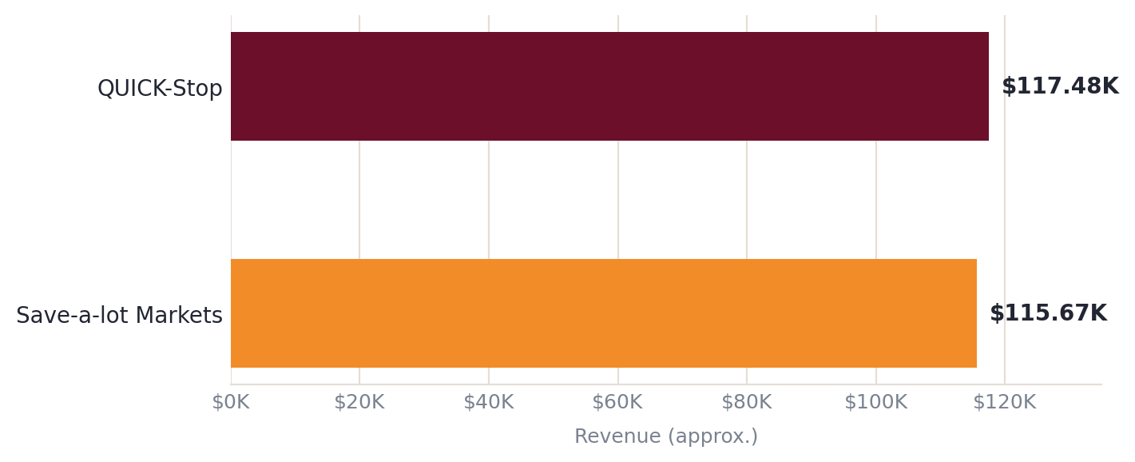
06
Customer & market performance
The strongest accounts and markets deserve attention, while lower-ranked markets should be assessed before expansion.
TOP CUSTOMER REVENUE
STRONGEST MARKETS
01
USA
Highest sales revenue
02
Germany
Second-highest
03
Austria
Third-highest
Save-a-lot Markets placed the most orders, even though QUICK-Stop generated slightly more revenue.
93 recorded customers
Monitor account revenue, repeat order frequency and average order value—not a single metric alone.
The figures identify leading accounts and markets; they do not by themselves prove retention risk or quantify dependence.
NORTHWIND TRADERS • CAPSTONE PROJECT
06 / 10

Slide 7
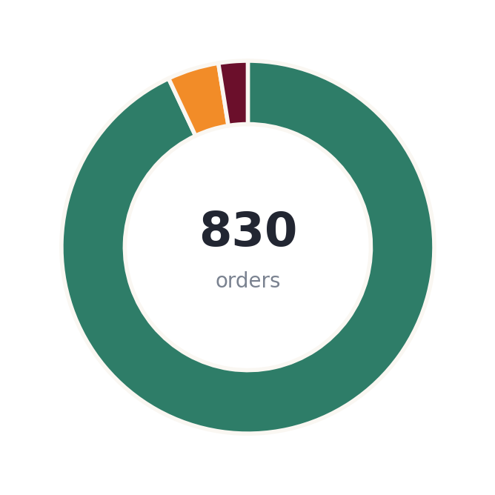
07
Employee & operational performance
Use balanced measures for people and distinguish shipment dispatch timing from actual delivery arrival.
EMPLOYEE-ASSOCIATED SALES
SHIPPING STATUS BY REQUIRED DATE
Margaret
772
≈156
On/before required date
93.01%
$250.19K
orders handled
18.47% of total revenue
37
Late
4.46%
ROBERT
Revenue alone does not prove productivity. Compare order volume, customer assignments and time period.
21
No shipped date
2.53%
≈ $1,950
Highest average order value
Review the 37 late records and 21 missing shipped dates. Compare carriers by freight per order and timeliness—not total freight alone.
Timing measure compares ShippedDate with RequiredDate; it is not a measure of actual delivery arrival.
NORTHWIND TRADERS • CAPSTONE PROJECT
07 / 10

Slide 8
08
Key business insights
Five evidence-led findings—each links what happened to why it matters.
01
Sales periods are not directly comparable
02
Revenue and volume identify different products
1997 is the highest annual total (~$660K), but 1996 and 1998 are partial years.
Côte de Blaye leads revenue; Camembert Pierrot leads units sold.
ACTION Use equivalent monthly or year-to-date comparisons before forecasting.
ACTION Monitor both leaders and align stock review to sales velocity.
03
Customer value differs from order frequency
04
Employee results depend on the metric
QUICK-Stop leads revenue (~$117.48K); Save-a-lot Markets places more orders.
Margaret leads employee-associated revenue; Robert has the highest average order value.
ACTION Track revenue, repeat frequency and average order value together.
ACTION Use balanced indicators and account for assignment and workload differences.
05
Shipping is strong but exceptions need review
772 orders are on/before required date; 37 are late and 21 lack a shipped date.
ACTION Investigate exceptions and compare carrier efficiency per order.
NORTHWIND TRADERS • CAPSTONE PROJECT
08 / 10

Slide 9
09
Recommendations to the CEO
A practical sequence of actions, each paired with a way to measure progress.
01
REPORTING
Standardize monthly performance reviews.
MEASURE Revenue, orders and average order value by equivalent periods.
02
CUSTOMERS
Protect high-value accounts and monitor changes.
MEASURE Account revenue, repeat order frequency and average order value.
03
OPERATIONS
Investigate late and missing shipment records.
MEASURE Late/missing counts, on-time proportion and freight per order.
04
PRODUCTS
Align inventory review with sales velocity.
MEASURE Stock on hand versus recent units sold; discontinued-item replacements.
05
WORKFORCE
Evaluate employee-associated sales fairly.
MEASURE Revenue, orders, average order value, customer assignments and time context.
Start with reporting and operational exceptions; these create a repeatable basis for the other reviews.
NORTHWIND TRADERS • CAPSTONE PROJECT
09 / 10

Slide 10
10
Conclusion | Turn evidence into action
Northwind has a strong foundation. The next step is more consistent management visibility.
Protect core revenue. Improve visibility. Act on exceptions.
PROTECT
MEASURE
IMPROVE
Core customers and leading products
Comparable performance over time
Shipping reliability and cost control
Monitor key accounts; plan stock around both revenue and volume leaders.
Review monthly revenue, orders and average order value on like-for-like periods.
Investigate late/missing records and compare carriers on a per-order basis.
PROPOSED NEXT STEP
Establish a monthly KPI review, a top-account review and a shipping-exception audit.
Expected value: better-informed decisions, clearer accountability and earlier visibility of business risks.
NORTHWIND TRADERS • CAPSTONE PROJECT
10 / 10

