Slide 1

01
Tadawul EDA PROJECT
Abdulsalam Alqarni
T5 Bootcamp 2021

Slide 2
02
How we work
Abdulsalam Alqarni
PHASE 1
PHASE 2
PHASE 3
PHASE 4
PHASE 5
Introduction
Questions
Data Description
Finding
Tools

Slide 3
03
This is the data of Saudi stock market companies, It was collected from Saudi Stock Exchange (Tadawul).
The Dataset has 395000 rows and 14 columns.
I do some Data analysis.
Introduction
Abdulsalam Alqarni

Slide 4
04
What is the most sectoer in the saudi stock market(Tadawul)?
What are the top ten companies in the Saudi Stock Market(Tadawul)?
What are the top ten companies which were the biggest exchanges?
What is the lowest and highest performance day in the Saudi Stock Market(Tadawul)?
In which sector was the most profitable in the Saudi Stock Market(Tadawul)?
Questions
Abdulsalam Alqarni

Slide 5
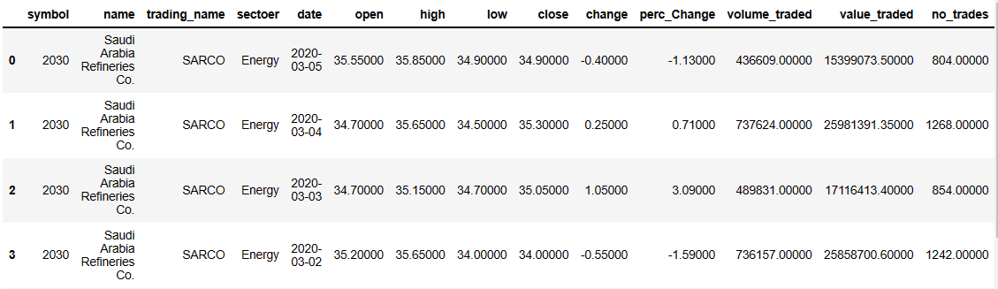
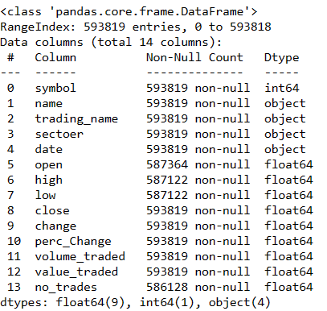
05
Data Description
Abdulsalam Alqarni

Slide 6
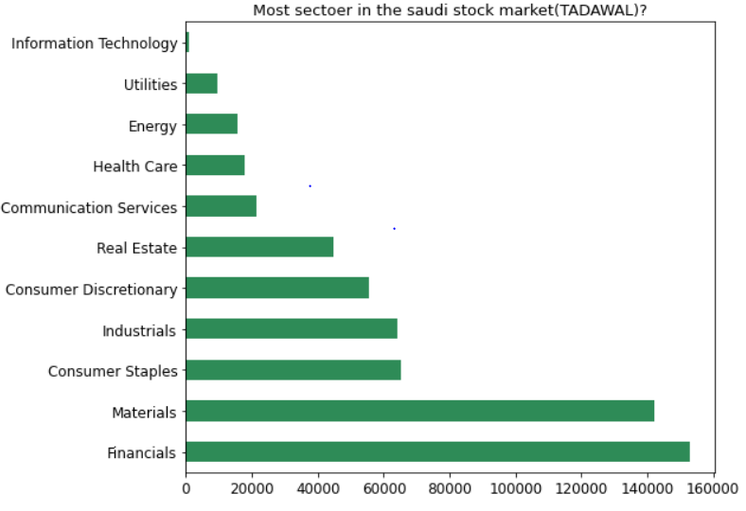
06
Q1) What is the most sector in the saudi stock market(Tadawul)?
Abdulsalam Alqarni

Slide 7
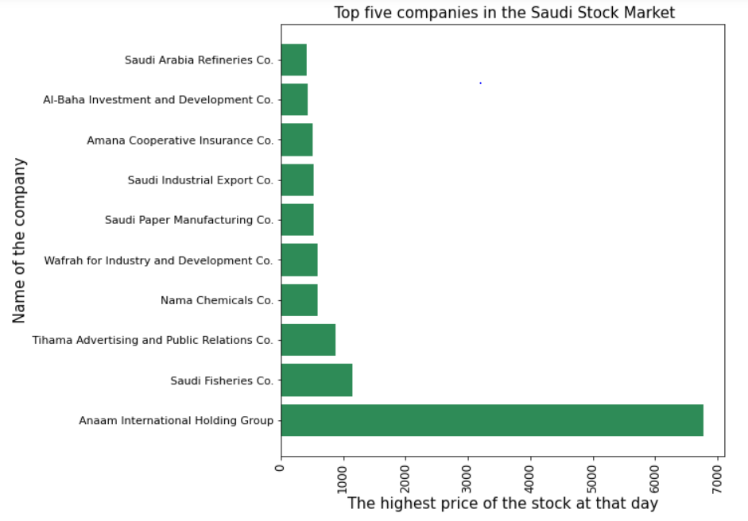
07
Q2) What are the top ten companies in the Saudi Stock Market(Tadawul)?
Abdulsalam Alqarni

Slide 8
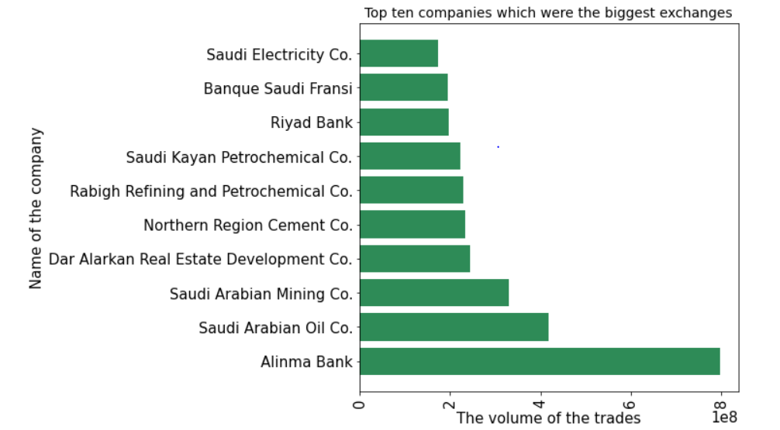
Q3) What are the top ten companies which were the biggest exchanges?
08
Abdulsalam Alqarni

Slide 9
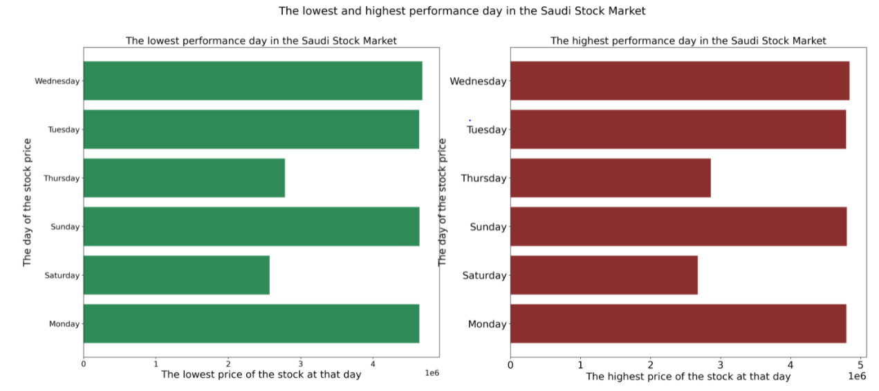
Q4) What is the lowest and highest performance day in the Saudi Stock Market(Tadawul)?
09
Abdulsalam Alqarni

Slide 10
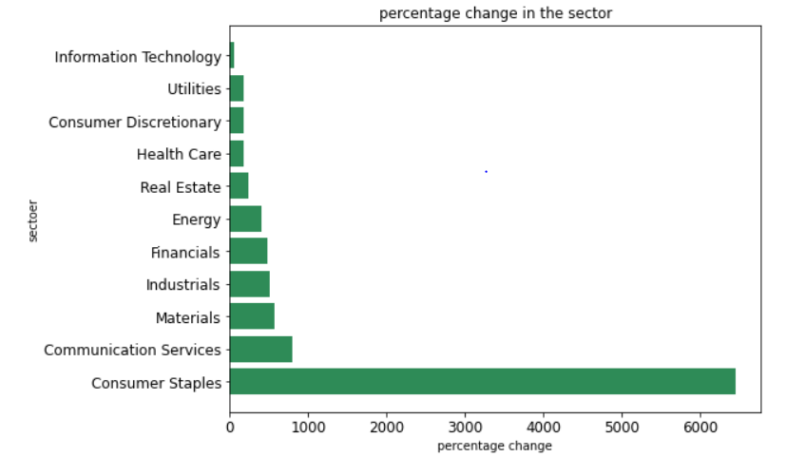
Q5) In which sector was the most profitable in the Saudi Stock Market(Tadawul)?
10
Abdulsalam Alqarni

Slide 11






11
Tools
Abdulsalam Alqarni

Slide 12
12
- What is the final result?
Conclusion
Abdulsalam Alqarni

Slide 13
13
Thanks for your time!
Abdulsalam Alqarni

