Slide 1
Data Structures & Algorithms
for beginners

Slide 2
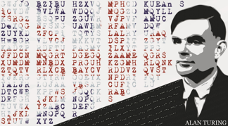
Time Complexity
and Big O notation
Notes:
https://adrianmejia.com/blog/2018/04/04/how-you-can-change-the-world-learning-data-structures-algorithms-free-online-course-tutorial/

Slide 3
measuring your code
Clock
Varies depending on Hardware/OS
Time complexity & Big O notation
Hardware/OS independent
Notes:
How do you do "measure" your code?
Would you clock "how long" it takes to run?
What if you are running the same program on a mobile device or a quantum computer? The same code will give you different results, right?

Slide 4
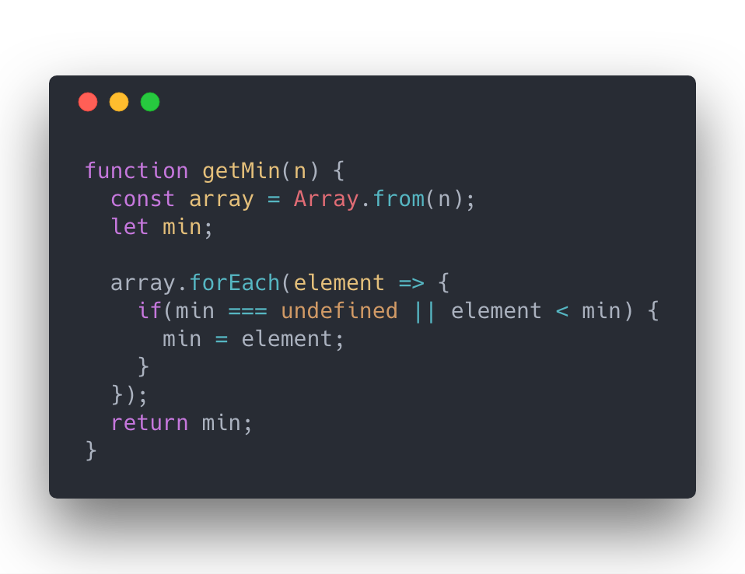
Time Complexity
Count lines of code in function of the input
Best, Average and Worst case scenario
Runtime:
2(n) + 3

Slide 5
Asymptotic analysis
Limit when the functions grows to the infinite.
Drop constants
Leave only the fastest growing expression
Examples:
2(n)+3 ➡ 2n
7n³+5n²+3n+2 ➡ n³
Notes:
Asymptotic analysis

Slide 6
Big o notation
O stands for order of the function
Worst-case scenario
Common Big O notation:
O(1), O(n), O(n²), O(2^{n})

Slide 7
BiG o comparison
Big O/ Input | 1 | n | n log(n) | n² | 2^{n} | n!
1 | <1sec | <1sec | <1sec | <1sec | <1sec | <1sec
10 | <1sec | <1sec | <1sec | <1sec | <1sec | ~4sec
10k | <1sec | <1sec | <1sec | ~2min | ~∞ | ~∞
100k | <1sec | <1sec | 1sec | ~3h | ~∞ | ~∞
1M | <1sec | 1sec | 20sec | ~12days | ~∞ | ~∞
Notes:
Assuming: 1 GHz CPU and that it can execute on average one instruction in 1 nanosecond (usually takes more time). Also, bear in mind that each line might be translated into dozens of CPU instructions depending on the programming language

