Slide 1

food detector
1605061 – Abdun Noor
1605072 – Binoy Kumar Sutradhar

Slide 2
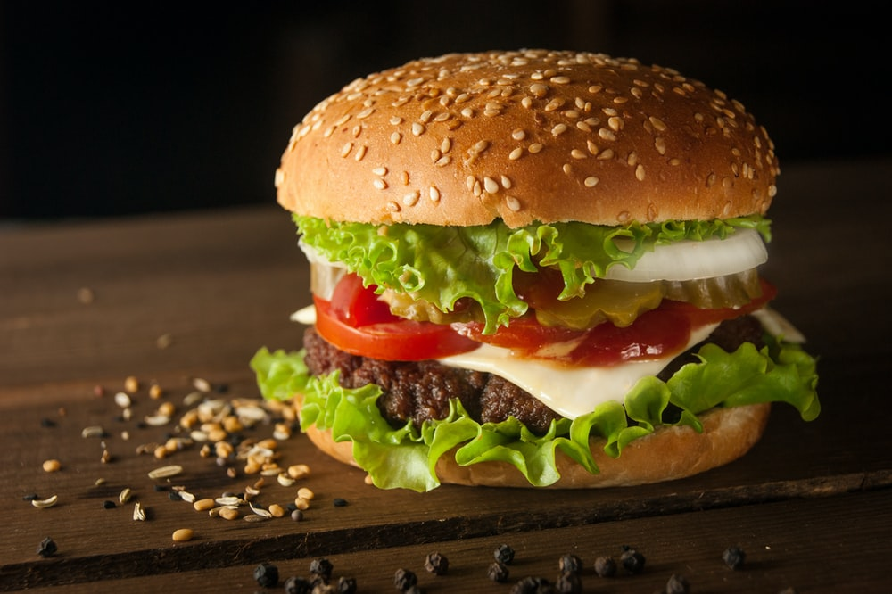
Food Detector
Detecting food type from food images
Especially Fast Food (Burger, Pizza etc.)
For future automated restaurants

Slide 3
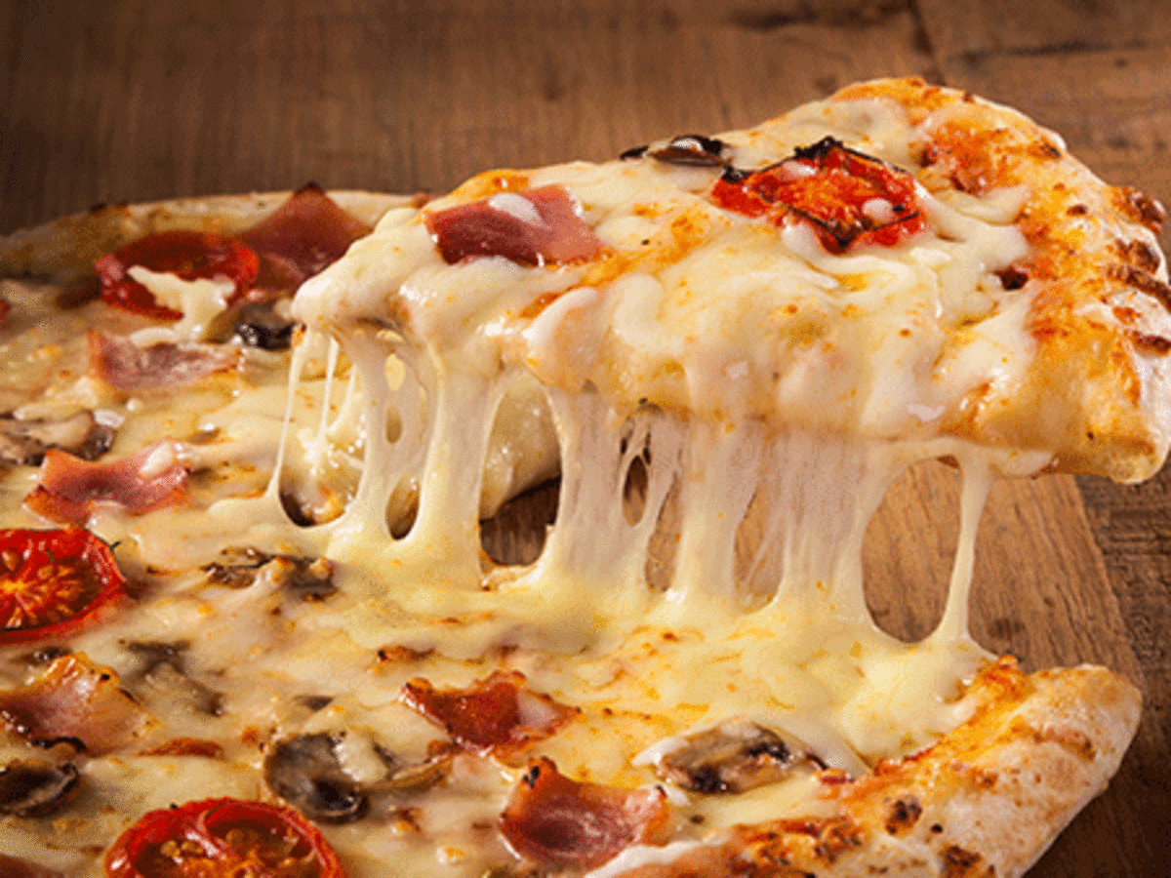
Food Detector
Dataset: Categorized Food images
Architecture: CNN
Evaluation: Accuracy, Precision, True Negative Rate

