Slide 1
SMAART INSTITUTE · DEPLOYMENT · 22 AUGUST 2026
How we put the websites live
End-to-end: what we had to do, the tools we used, the plan, what we did, and the proper way we deploy now.
Student site
Admin site
Server
Status
smaartinstitute.com
admin.smaartinstitute.com
AWS EC2 · Mumbai
LIVE on HTTPS
SMAART Institute · How we put it live
1 / 7

Slide 2
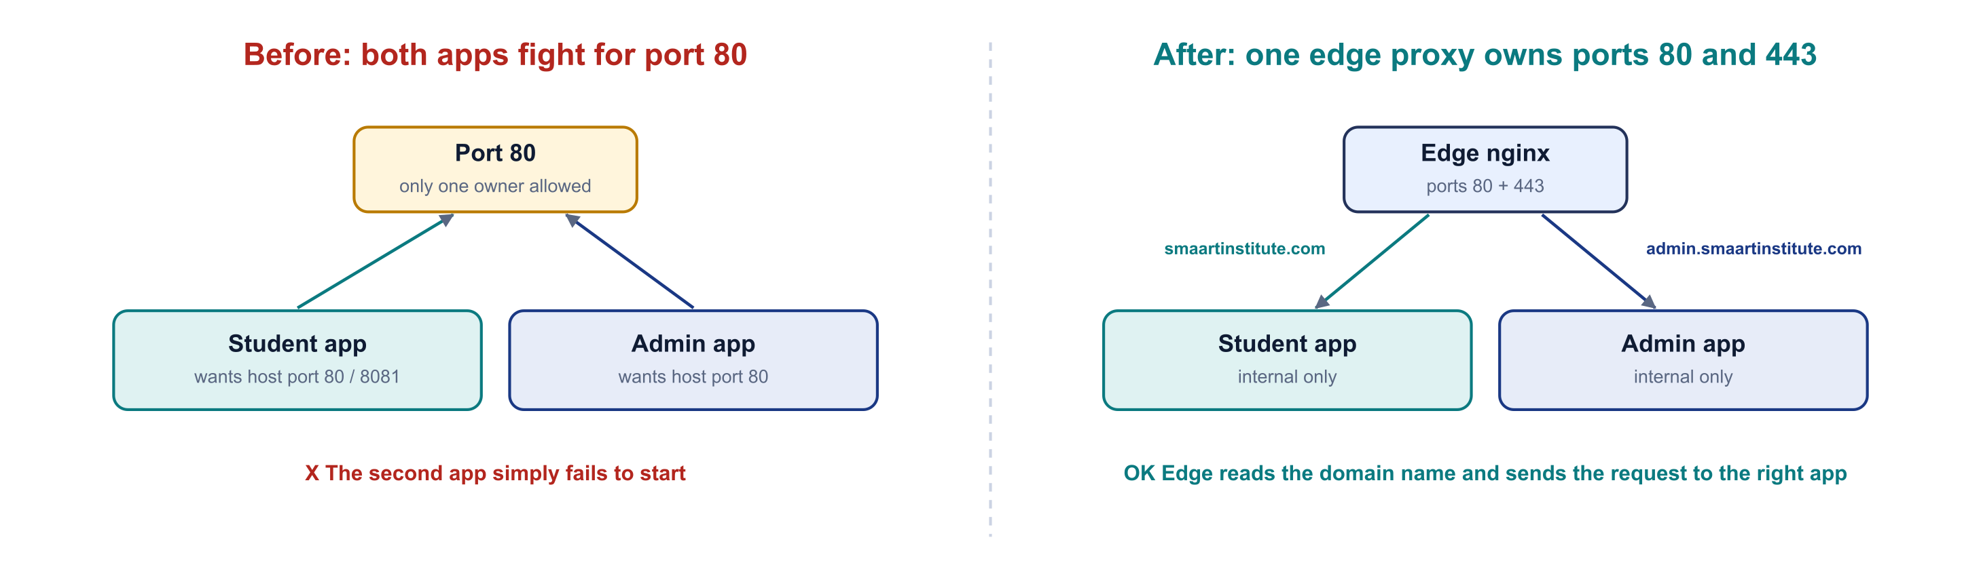


1. What we had to do
Two separate websites, from two separate code repositories, on one server
Student dashboard
smaartinstitute.com
Vite + React frontend · Express backend (port 5000)
Admin panel
admin.smaartinstitute.com
The problem: both apps wanted port 80
Create React App frontend · Express backend (port 5001)
Port 80 is the web port. Only one program can hold it, so running both apps as they came meant the second one simply failed to start.
Our answer: put one small "edge" nginx in front. It owns ports 80 and 443, reads the domain name in each request and sends it to the right app. The apps themselves are never exposed to the internet.
Both share one MongoDB Atlas database in the cloud.
SMAART Institute · How we put it live
2 / 7

Slide 3









2. Tools and software we used
Every tool has one clear job
AWS EC2 (Mumbai)
Ubuntu 26.04 LTS
Docker Engine + Compose
The rented virtual server. t3.medium, 40 GB disk, fixed Elastic IP 13.207.12.89
The operating system on the server. Supported until 2031
Packages each app so it runs the same everywhere. One file starts all 6 containers
nginx (the "edge")
Let's Encrypt + certbot
GitHub + deploy keys
Front door. Handles HTTPS and routes each domain to the right app
Free HTTPS certificate for both domains, renewed automatically
Code lives in two private repos. Read-only keys let the server clone them
GitHub Actions + GHCR
MongoDB Atlas
Hostinger DNS
Builds the Docker images automatically and stores them; one button deploys
The cloud database, shared by both apps
Points smaartinstitute.com and admin.smaartinstitute.com at the server
SMAART Institute · How we put it live
3 / 7

Slide 4
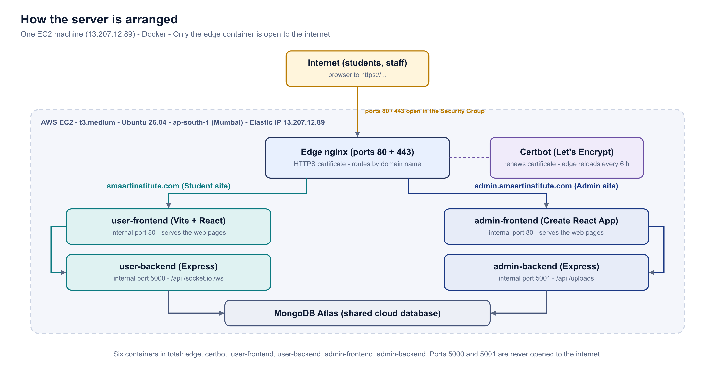




3. The plan: one server, one front door, six containers
Only ports 22, 80 and 443 are open. Ports 5000 and 5001 never touch the internet.
Edge nginx
The only public container. HTTPS + routing by domain name.
Two apps, four containers
Frontend + backend for student, frontend + backend for admin.
Certbot
Renews the certificate; the edge reloads every 6 h.
One compose file
docker-compose.prod.yml in the dashboard repo runs everything.
SMAART Institute · How we put it live
4 / 7

Slide 5
4. What we did, step by step
The exact order of the day — colour shows where each step was done
1
2
3
4
5
Launch EC2
Elastic IP
Install Docker
Deploy keys + clone
Copy .env files
AWS Console · Ubuntu 26.04, t3.medium
AWS Console · fixed address
on the server
on the server · both repos
from the laptop (scp)
6
7
8
9
10
DNS records
HTTPS certificate
First deployment
Fix uploads folder
Verify both sites
Hostinger · @ and admin
on the server · bootstrap.sh
on the server · compose up
on the server · chown
curl from anywhere · 200 OK
In the browser (AWS / Hostinger)
On the server (SSH)
From the laptop
SMAART Institute · How we put it live
5 / 7

Slide 6
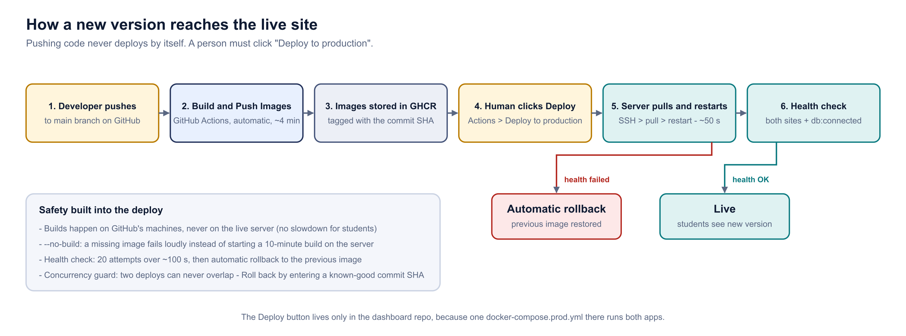



5. The proper way: how we deploy a new version now
Pushing code builds it automatically. Putting it live is a deliberate click by a person.
Never build on the live server
Builds run on GitHub's machines, so students are never slowed down.
Health check on every deploy
20 tries over ~100 s on both sites and the database.
To deploy
Merge code into main → images build on GitHub (~4 min).
Dashboard repo → Actions → "Deploy to production".
Grey "Run workflow ⌄" → keep "latest" → green "Run workflow".
Server pulls the images and restarts (~50 s).
Health check passes → live. Fails → automatic rollback.
Automatic rollback
A bad deploy restores the previous version by itself.
SMAART Institute · How we put it live
6 / 7

Slide 7



6. The result, and what comes next
End of day 22 August 2026
2
6
~4 min
~50 s
websites live on HTTPS
containers on one server
automatic build per push
one-click deploy
Done
Next
Both sites on HTTPS, certificate auto-renewing
Rotate the 4 leaked secrets. Database URI, JWT secret, Cloudinary secret, OpenRouter key are in Git history. ~20 minutes now; after launch it logs every student out.
Database connected, email / OTP login working
CI building both apps, one-click deploy proven
Watch the next deploy. It is the first to use the new rollback safety net — confirm "previous user-backend : sha256:…" appears in the log.
5 security bugs found and fixed before go-live
SMAART Institute · How we put it live
7 / 7

