Slide 1
DEPLOYMENT RECORD · 22 AUGUST 2026
Taking SMAART Institute Live
How the student site and the admin site were hosted on AWS — from an empty EC2 launch screen to two HTTPS websites with a one-click deploy pipeline, in one day.
Student site
Admin site
Server
Stack
smaartinstitute.com
admin.smaartinstitute.com
13.207.12.89 · ap-south-1
Docker · nginx · GitHub Actions
SMAART Institute · Hosting & Deployment · 22 Aug 2026
1

Slide 2




What we have now
The result of one day of work
2
6
~4 min
~50 s
websites live on HTTPS with auto-renewing certificates
Docker containers on one EC2 server (t3.medium)
automatic image build on every push to main
one-click deploy with health check and rollback
Both sites on HTTPS
Database connected
Email / OTP login works
5 security bugs fixed
HTTP redirects to HTTPS; one certificate covers both domains
Both apps share one MongoDB Atlas cluster
Proven with nodemailer.verify() inside the live container
Found in the code audit before going live
SMAART Institute · Hosting & Deployment · 22 Aug 2026
2

Slide 3
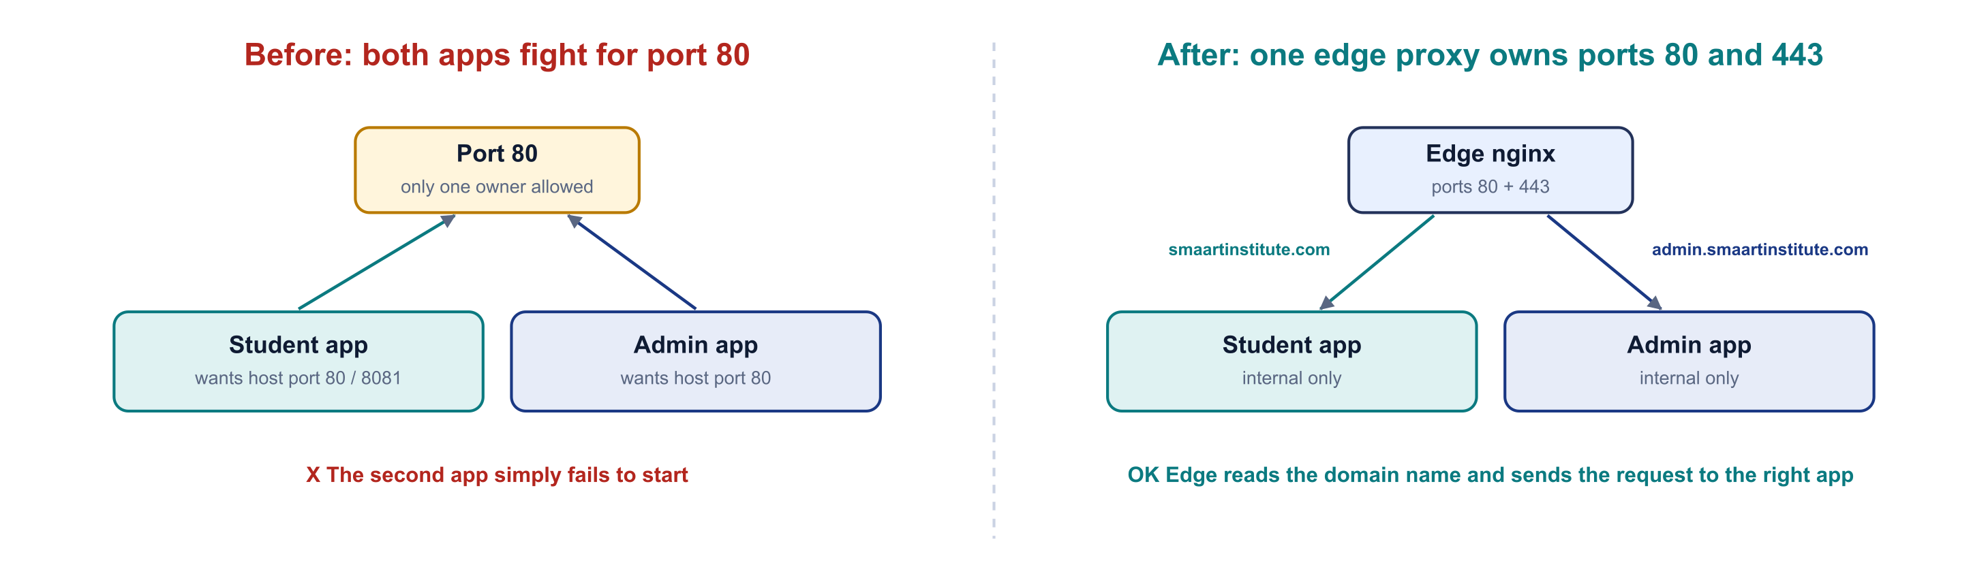
The problem: two apps, one port 80
Both the student dashboard and the admin panel had to run on the same instance, as separate sites
Why it fails
Each repo's docker-compose.yml assumes it owns the whole machine. Only one process can hold port 80, so the second app simply fails to start.
The fix: one small nginx container (the "edge") owns ports 80 and 443 and forwards each request by domain name. Every app container becomes internal-only.
 | Student dashboard | Admin panel
Frontend | Vite + React | Create React App
Backend | Express :5000 | Express :5001
Wanted host port | 8081 / 80 | 80
Database | MongoDB Atlas | same cluster
SMAART Institute · Hosting & Deployment · 22 Aug 2026
3

Slide 4
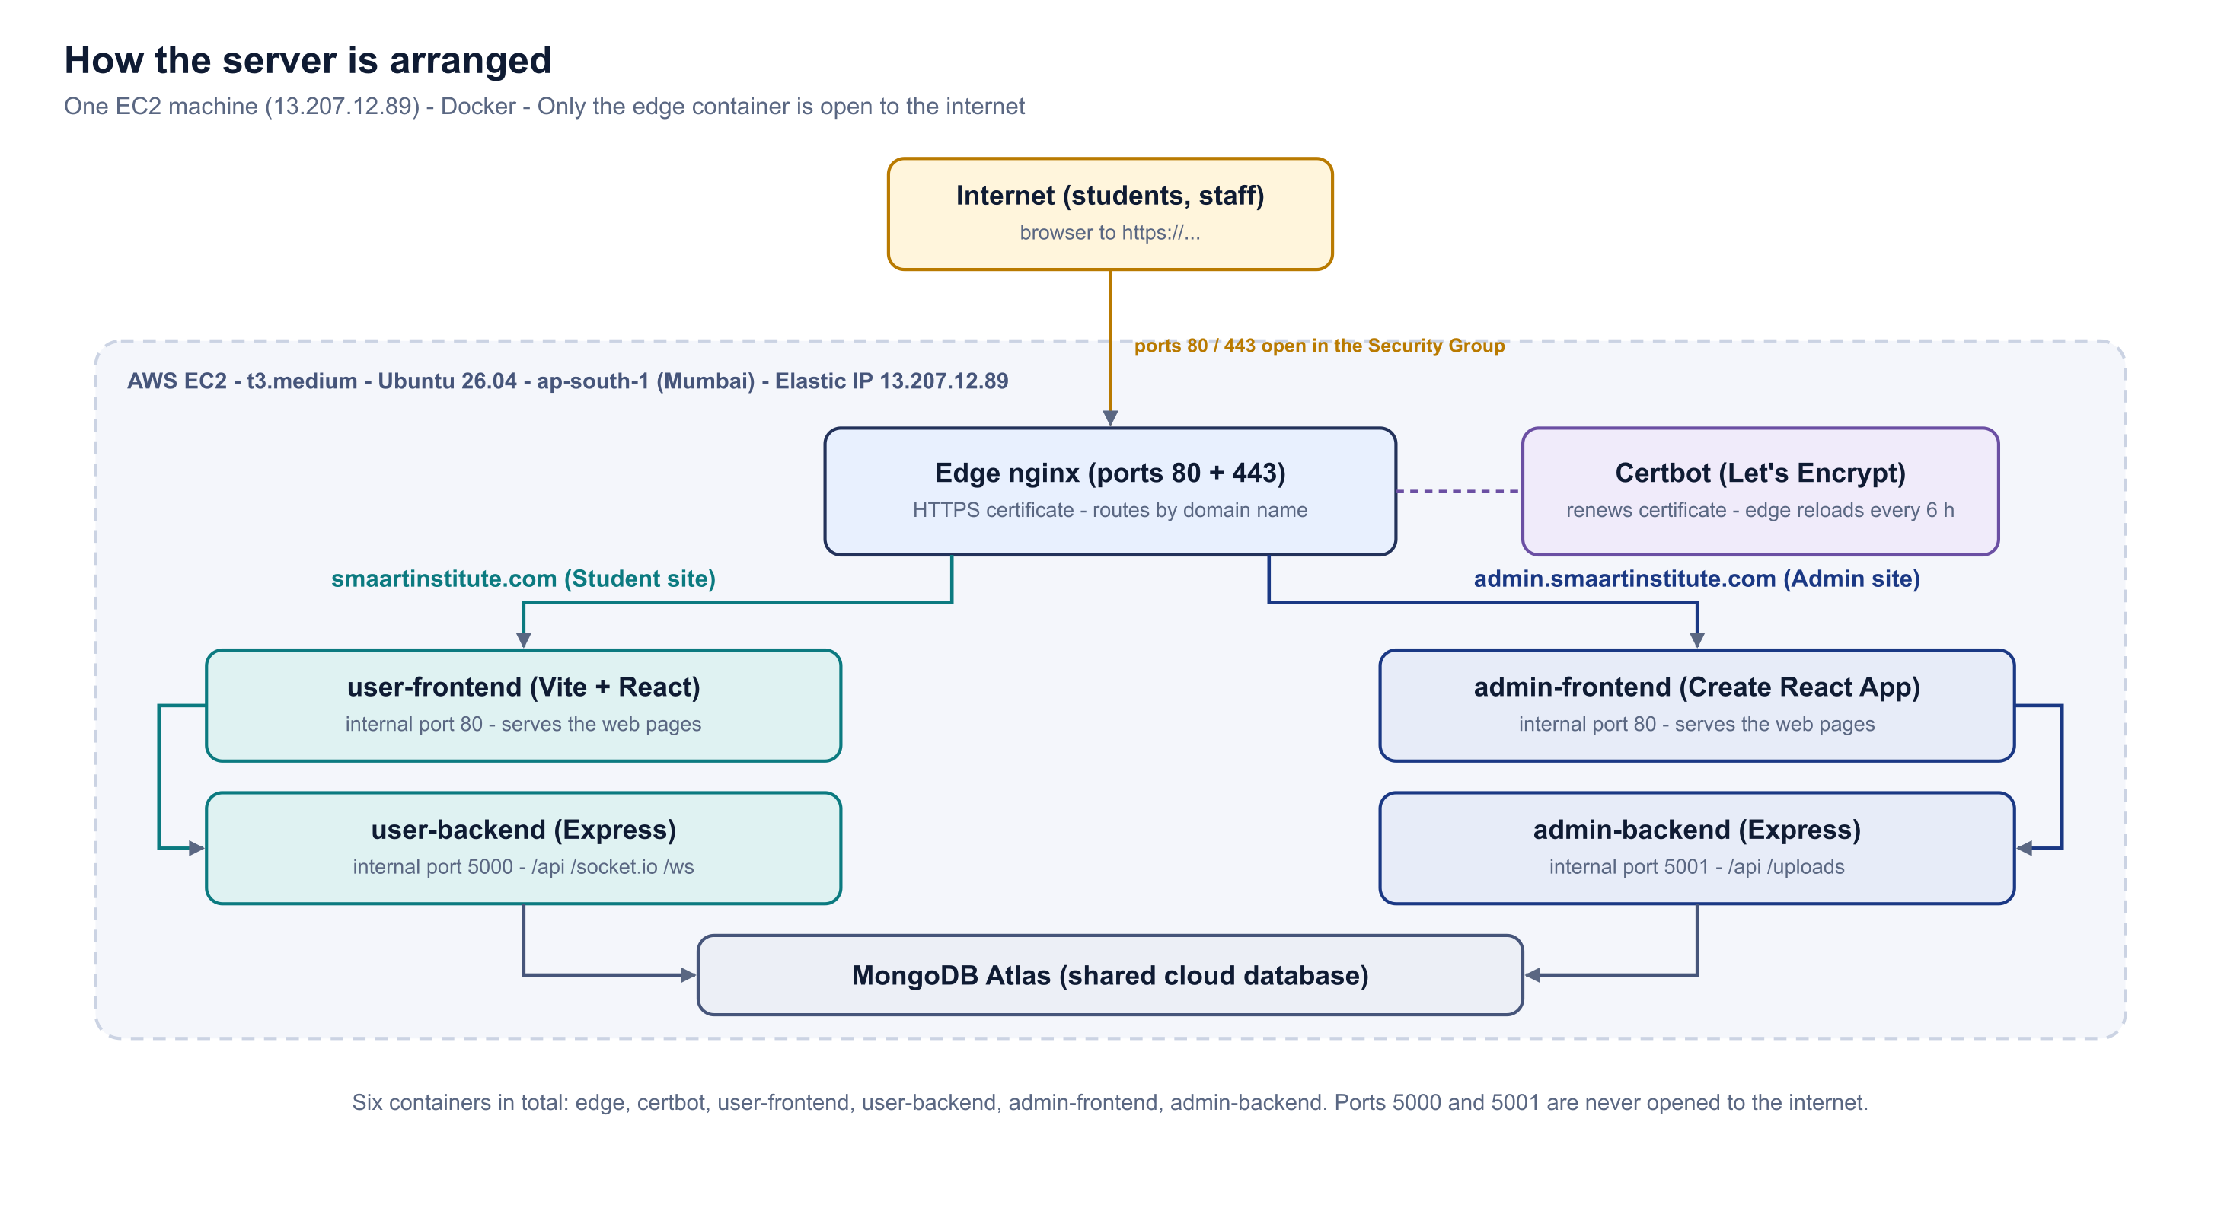




The architecture we built
One edge nginx in front; six containers; only ports 22, 80 and 443 open
Edge nginx
Only public container. Terminates HTTPS, routes by Host header.
Certbot
Renews the certificate; edge reloads every 6 h so it actually picks it up.
Internal only
Ports 5000 / 5001 are never opened in the security group.
Five files
docker-compose.prod.yml, edge.conf, bootstrap.sh, deploy.env.example, README.md
SMAART Institute · Hosting & Deployment · 22 Aug 2026
4

Slide 5






Before touching AWS: what the code audit found
Five issues that would have caused real problems in production — all fixed and syntax-checked before committing
OTP codes written to logs
Master secret in source
Privilege escalation, live
emailService.js printed every login code. Anyone reading the log could sign in as any student. Now gated behind development / LOG_OTP.
ADMIN_SYSTEM_SECRET hard-coded in an admin frontend file and sitting in Git history. Removed and rotated to a fresh 64-char value.
requireRole still honoured a dev bypass header in production — any student could become admin. Now disabled when NODE_ENV=production.
Vision Board would 404
Email "broken" — stale note
Still open: leaked secrets
imageModeration.js built /api/api/ocr/extract. Double /api corrected in three places.
Old note said Gmail SMTP failed. Account had already moved to smaart.sys@gmail.com with an App Password. Proven working.
MONGODB_URI, JWT_SECRET, CLOUDINARY secret and OPENROUTER key are in Git history and still live. Must be rotated.
SMAART Institute · Hosting & Deployment · 22 Aug 2026
5

Slide 6
Step 1–2: launching the server
AWS Console → EC2 → Launch instance, then attach an Elastic IP
Setting | Value | Why
AMI | Ubuntu 26.04 LTS | Supported to 2031; Docker packages verified on download.docker.com
Type | t3.medium (4 GB) | A t3.micro cannot complete a Create React App build
Storage | 40 GB gp3 | 218 MB face-api models + two node_modules + images
Ports | 22, 80, 443 | Never 5000 or 5001 — those stay behind the proxy
Elastic IP | 13.207.12.89 | Without it the IP changes on every stop/start
Caught at the launch screen
"Allow HTTP traffic" was unticked. Port 80 is not only for visitors — Let's Encrypt uses it to verify domain ownership. With it closed, no certificate is ever issued.
Ubuntu 26.04 was verified
The first recommendation was 24.04 in case Docker's repo lagged. Checking download.docker.com showed packages for "resolute" (26.04), updated three days earlier — two extra years of support.
SMAART Institute · Hosting & Deployment · 22 Aug 2026
6

Slide 7
The 10 steps, in order
Where each step runs: laptop or server
1
2
3
4
5
Launch EC2
Elastic IP
Install Docker
Deploy keys + clone
Copy .env files
AWS Console
AWS Console
server
server
laptop (scp)
6
7
8
9
10
DNS A records
HTTPS certificate
First deployment
Fix uploads perms
Verify both sites
Hostinger
server
server
server
anywhere (curl)
Browser (AWS / Hostinger)
On the server (SSH)
From the laptop
SMAART Institute · Hosting & Deployment · 22 Aug 2026
7

Slide 8

Step 3–5: Docker, deploy keys, cloning, .env files
Docker Engine on the server (no Desktop, no licence) · one read-only deploy key per private repo
Install Docker Engine (4 commands, one at a time)
Deploy keys + clone
# 1 prerequisites + Docker signing key
sudo apt-get install -y ca-certificates curl git ...
# 2 add repo (detects "resolute" = 26.04)
echo "deb [...] download.docker.com/linux/ubuntu \
$VERSION_CODENAME stable" | sudo tee .../docker.list
# 3 install
sudo apt-get install -y docker-ce docker-compose-plugin ...
# 4 docker group + 4 GB swap for the frontend builds
sudo usermod -aG docker $USER && sudo fallocate -l 4G /swapfile ...
ssh-keygen -t ed25519 -f ~/.ssh/dashboard_key -N ""
ssh-keygen -t ed25519 -f ~/.ssh/admin_key -N ""
# ~/.ssh/config: Host github-dashboard / github-admin
ssh -T git@github-dashboard; ssh -T git@github-admin
cd /opt/smaart
git clone git@github-dashboard:Abdur-Rahim-MyGit/\
SMAART-INSTITUE-USERDASHBOARD.git
git clone git@github-admin:Abdur-Rahim-MyGit/\
ADMIN-SMAART-INSTITUTE-26.git SMAART-INSTITUTE-ADMIN
Result: Docker 29.7.2 · Compose 5.5.0 · 4 GB swap. Reconnect after step 4 — the docker group applies on a fresh login.
Public keys added under each repo → Settings → Deploy keys, write access unticked. .env files copied from the laptop with scp (they are gitignored).
The folder name is not optional. The admin repo is ADMIN-SMAART-INSTITUTE-26 on GitHub but must land in a folder called SMAART-INSTITUTE-ADMIN — that is the path the compose file builds from. Drop it and the build fails with a confusing "path not found".
SMAART Institute · Hosting & Deployment · 22 Aug 2026
8

Slide 9





Step 6–7: DNS and the HTTPS certificate
The domain is smaartinstitute.com (not smaartminds.com, which older guides in the repo still mention)
DNS records in Hostinger
Let's Encrypt certificate
Type | Name | Value | Meaning
A | @ | 13.207.12.89 | smaartinstitute.com
A | admin | 13.207.12.89 | admin.smaartinstitute.com
chmod +x bootstrap.sh && sed -i 's/\r$//' bootstrap.sh && ./bootstrap.sh
Issued in about 20 seconds once both names resolved
One certificate covers both hostnames — /etc/letsencrypt/live/smaartinstitute.com/
Only the admin record existed
A query to Google DNS returned an Authority section but no Answer — meaning "this domain exists but has no A record". Not a propagation delay. The SOA named dns.hostinger.com, which told us where to add the @ record.
Expires 20 November 2026, renewed automatically by certbot
Edge nginx reloads every 6 h so the renewed file is actually served
curl -s "https://dns.google/resolve?name=smaartinstitute.com&type=A"
curl -s "https://dns.google/resolve?name=smaartinstitute.com&type=NS"
The sed strips Windows line endings — insurance against $'\r': command not found
SMAART Institute · Hosting & Deployment · 22 Aug 2026
9

Slide 10
Step 8–10: first deployment and verification
Run detached, because a browser terminal dropping mid-build would otherwise kill it
nohup docker compose -f docker-compose.prod.yml up -d --build > /tmp/build.log 2>&1 &
tail -f /tmp/build.log
Five of six containers started
All six up — verified
EACCES: permission denied, mkdir '/usr/src/app/uploads/proctoring'
HTTP/2 200 <- student site
{"status":"Server is running",
"db":"connected"} <- backend + Atlas
HTTP/2 200 <- admin site
HTTP/1.1 301 Moved Permanently <- http -> https
back-end/uploads/ is gitignored, so a fresh clone lacks it. Docker created the missing bind-mount as root; the student backend runs as the non-root "node" user and could not write there. (The admin backend runs as root, so it was fine — that asymmetry made it confusing.)
Both websites returning 200, the database connected, and plain HTTP redirecting to HTTPS. The sites were live.
IMG=smaart-prod-user-backend
CU=$(docker run --rm $IMG id -u):$(docker run --rm $IMG id -g)
sudo chown -R $CU .../back-end/uploads
docker compose -f docker-compose.prod.yml restart user-backend
SMAART Institute · Hosting & Deployment · 22 Aug 2026
10

Slide 11
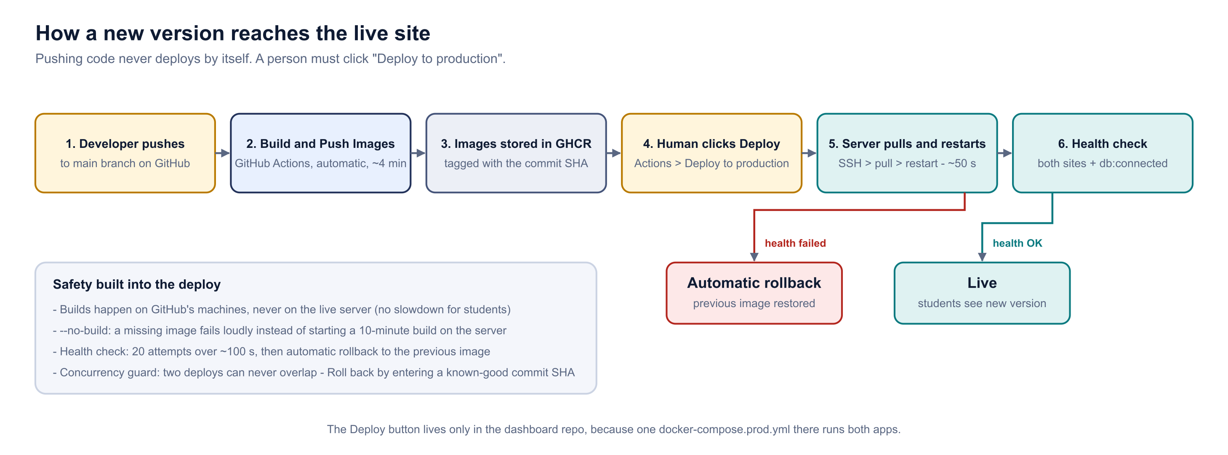
How a new version reaches the live site
Pushing never deploys. Building is automatic; going live is a human decision.
Why build on GitHub? The frontend build needed 4 GB of swap on an idle machine. Building on the live server while students are on it would make the site crawl and risk running out of memory.
SMAART Institute · Hosting & Deployment · 22 Aug 2026
11

Slide 12



Safety built into the deploy — and how to click it
Two legacy workflows that deployed on every push (rm -rf /var/www/html, pm2 restart) were disabled
--no-build
Health check
Automatic rollback
Concurrency guard
A missing image fails loudly instead of silently starting a 10-minute build on the live server.
20 attempts over ~100 s, testing both sites and "db":"connected".
On failure, the previous image is restored — by immutable digest / image ID, not a "latest" tag.
Two deploys can never overlap. The button lives only in the dashboard repo.
To deploy
To roll back on purpose
Push / merge to main → "Build & Push Images" runs by itself (~4 min, green tick).
Dashboard repo → Actions → Deploy to production.
Click the grey "Run workflow ⌄" — it opens a panel.
Leave both tags as latest → click the green "Run workflow" inside the panel.
Watch the health check pass (~50 s). Done.
Run the same workflow, but enter the commit SHA of a known-good build instead of "latest".
If GitHub is down: git pull both repos on the server and run docker compose up -d --build locally.
SMAART Institute · Hosting & Deployment · 22 Aug 2026
12

Slide 13






Every error, and how it was solved (1 of 2)
The section worth keeping — most of these will recur
1. ^[[200~ corrupting every paste
2. Pastes silently not registering
3. clip failing without a word
Bracketed-paste marker broke the first line of every pasted block; commands seemed to run. Fix: bind 'set enable-bracketed-paste off' (+ add to ~/.bashrc).
Biggest time cost of the day. SSH key and GHCR token "looked wrong" — the field was empty. Fix: read -rsp then echo ${#T} to count the characters received.
cat key | clip in Git Bash gave no error and no clipboard. Fix: PowerShell Get-Content -Raw | Set-Clipboard.
4. Two different .pem files
5. chmod 600 not taking on Windows
6. Laptop commands on the server
An older key from a previous instance gave Permission denied (publickey). Fix: compare with md5sum and date; install the right one as smaart-prod.pem.
Git Bash said OK but Windows uses ACLs. Fix: icacls … /inheritance:r /grant:r "$env:USERNAME:(R)".
/c/Users/... exists only on Windows. Rule: C:\ paths and git commits → laptop; docker compose → server. Read the prompt first.
SMAART Institute · Hosting & Deployment · 22 Aug 2026
13

Slide 14






Every error, and how it was solved (2 of 2)
GitHub Actions, secrets and the deploy pipeline
7. ssh: no key found vs [none publickey]
8. Secrets that were never secret
9. A rollback that would make things worse
Two look-alike failures: the key would not parse vs. parsed but rejected. Testing the same key from the laptop proved the key was fine — the problem was EC2_USER / EC2_HOST.
EC2_HOST / EC2_USER stored as secrets — a stray space gave the same error as a broken key, and secrets cannot be read back. Fix: hard-code both in the workflow.
Recorded tag "latest" = moving pointer; rollback would reinstall the broken image. Fix: record the registry digest, or local image ID when no digest exists.
10. ghcr.io/v2/: denied
11. "Run workflow" does nothing
12. Secret name would not save
Traced to an empty GHCR_PULL_TOKEN secret (the paste never landed). The token was valid — "Login Succeeded" on the server.
Two buttons share the name. The grey one opens a panel; the green one inside it starts the run.
"Only alphanumeric or underscores" — caused by a hyphen or a trailing space from pasting. Type GHCR_PULL_TOKEN by hand.
SMAART Institute · Hosting & Deployment · 22 Aug 2026
14

Slide 15
Day-to-day operations
Everything you need for a normal week
Connect (laptop)
After editing a .env
ssh -i /c/Users/dhars/.ssh/smaart-prod.pem ubuntu@13.207.12.89
docker compose -f docker-compose.prod.yml up -d --force-recreate
# restart is NOT enough - it reuses the old environment
Everyday checks (server)
Emergency: GitHub down
cd /opt/smaart/SMAART-INSTITUE-USERDASHBOARD/\
aws-deployment/single-instance
docker compose -f docker-compose.prod.yml ps # six Up
docker compose -f docker-compose.prod.yml logs -f user-backend
docker compose -f docker-compose.prod.yml restart user-backend
cd /opt/smaart/SMAART-INSTITUE-USERDASHBOARD && git pull
cd /opt/smaart/SMAART-INSTITUTE-ADMIN && git pull
cd .../aws-deployment/single-instance
docker compose -f docker-compose.prod.yml up -d --build
Health (anywhere)
Deploy
curl -sI https://smaartinstitute.com | head -1
curl -s https://smaartinstitute.com/api/health
curl -sI https://admin.smaartinstitute.com | head -1
Dashboard repo -> Actions -> Deploy to production
grey "Run workflow" -> keep latest -> green "Run workflow"
# roll back: enter a known-good commit SHA instead
SMAART Institute · Hosting & Deployment · 22 Aug 2026
15

Slide 16




What is still outstanding
Status at the end of 22 August 2026
Both sites live on HTTPS
Immutable rollback
Certificate auto-renewing
Pushed, not yet exercised. On the next deploy look for "previous user-backend : sha256:…" — values instead of <none> mean the safety net is armed.
Database connected
Email / OTP working
Delete Desktop\EC2_SSH_KEY.txt
CI building both apps
One-click deploy, proven
A plain-text copy of the deploy key is still on the laptop.
Legacy workflows disabled
Rotate the four leaked credentials. MONGODB_URI, JWT_SECRET, CLOUDINARY_API_SECRET, OPENROUTER_API_KEY are in Git history and still live. ~20 minutes now; after launch it logs every student out.
Runbooks in both repos
SMAART Institute · Hosting & Deployment · 22 Aug 2026
16

Slide 17
The 10 most important questions (1–5)
Short answers you can say out loud in a review or hand-over
Q1
Why an edge proxy instead of running both apps directly?
Both wanted port 80; only one program can hold it. The edge owns 80/443, routes by domain name, and keeps the apps off the internet.
Q2
Why Docker on the server rather than pm2 + nginx on the host?
Same build on laptop, GitHub and server; six containers start, stop and roll back as one unit; nothing leaks between the two apps.
Q3
Why does pushing to main NOT deploy?
It is a live student system. Push = build. A human click = deploy. The old legacy workflows deployed on every push with rm -rf — that was the real danger.
Q4
Why build on GitHub, not on the server?
The build needed 4 GB of swap on an idle machine. On a busy server it would crawl or run out of memory. The server only pulls images: ~50 s.
Q5
What happens if a deploy is broken?
Health check: 20 tries over ~100 s on both sites + db:connected. Failure → automatic rollback by immutable digest / image ID.
SMAART Institute · Hosting & Deployment · 22 Aug 2026
17

Slide 18
The 10 most important questions (6–10)
Short answers you can say out loud in a review or hand-over
Q6
How does HTTPS work and renew?
Let's Encrypt via bootstrap.sh (port 80 must be open). Certbot renews; the edge reloads every 6 h so the new file is actually served.
Q7
Why an Elastic IP?
Without it the IP changes on every stop/start, breaking both DNS A records and the MongoDB Atlas allow-list.
Q8
Why deploy keys instead of a personal token?
Read-only, scoped to one repo, revocable. A personal token would hand the server the whole GitHub account.
Q9
Most serious code issue found?
A privilege-escalation bypass still active in production: any student + a header + a hard-coded secret = admin. Disabled in production now.
Q10
What is still risky?
Four credentials in Git history are still live. JWT_SECRET alone forges admin sessions. Rotate now (~20 min) rather than after launch.
SMAART Institute · Hosting & Deployment · 22 Aug 2026
18

Slide 19



Both sites are live.
Two repositories · one instance · six containers · one deploy button
Next: rotate the 4 leaked secrets
Watch the next deploy log
Runbooks
The one thing that still blocks real students
Confirm "previous user-backend : sha256:…" appears
aws-deployment/single-instance/README.md · DEPLOY.md
Health check, from anywhere: curl -s https://smaartinstitute.com/api/health
SMAART Institute · Hosting & Deployment · 22 Aug 2026
19

