Slide 1

Python Project Presentation
Project Title : Calculator
Presented By
1. Abdur Rahman Apu 191-15-13025
2. Tahmid Hasan 191-15-12920
3. Mazharul Islam Ullash 191-15-13022
4. Tasnim Rhaman 191-15-13013
5. Tonny Roy 191-15-12650
6.Amir Hamza Ronobi 191-15-13026

Slide 2
Objective
We want to build a calculator by using python GUI (Tkinter).
Anyone can solve a simple mathematical problem. Suppose, two, three, four, five numbers addition, subtraction , etc. But, If anyone has100 numbers for his / her calculation, then he/she must need a calculator.
We do this project by using python GUI (Tkinter). We can do it in console. But, we want to know python’s GUI.
We have selected this project for implementing all types of mathematical operation which python’s are providing us. Because, python has many functions.
Python Project Presentation

Slide 3
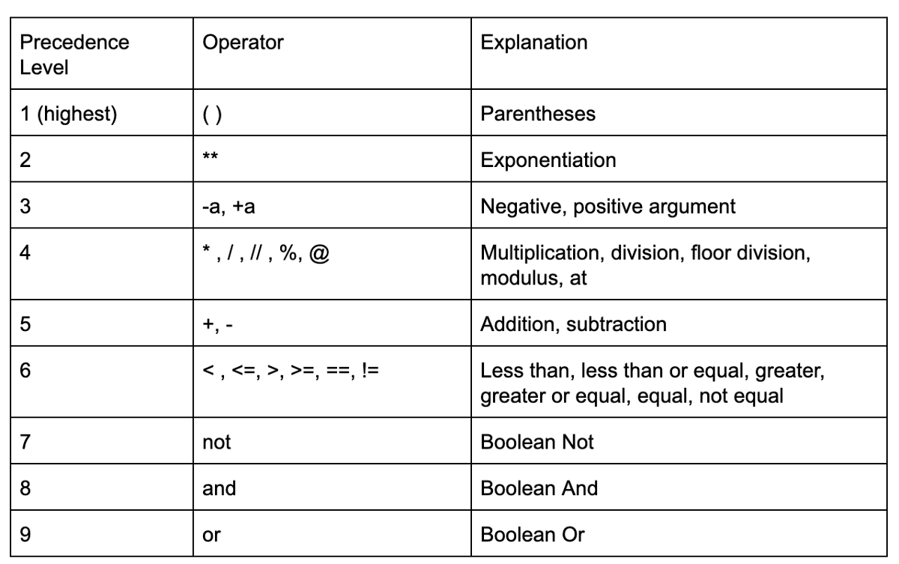


Working Procedure
We are using eval() method for calculation such as addition, subtraction, multiplication and division.
Precedence Table:
Example:
Python Project Presentation

Slide 4
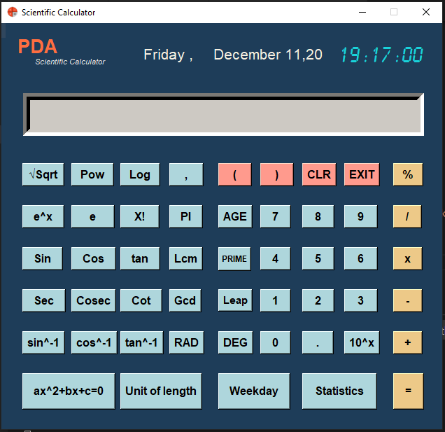
User interface
This is the user interface of our project.
User can show each & every function in our project.
User will able to calculate all function as their wish.
Python Project Presentation

Slide 5
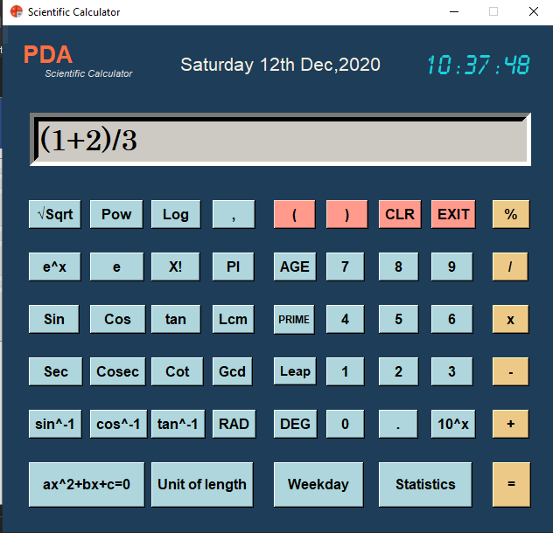
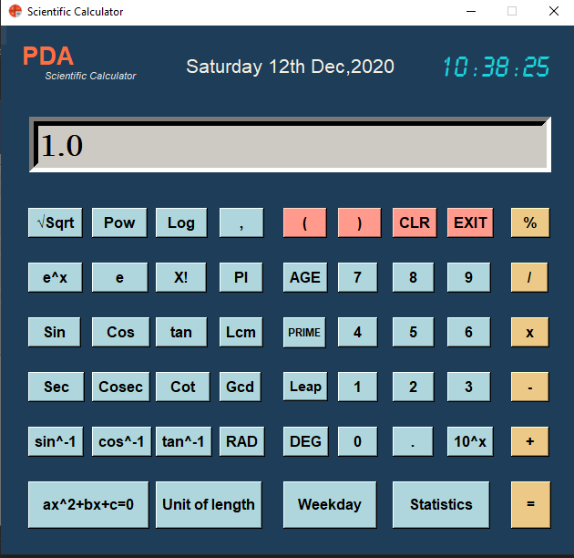
Input-Output Demo
INPUT:
OUTPUT:
Python Project Presentation

Slide 6
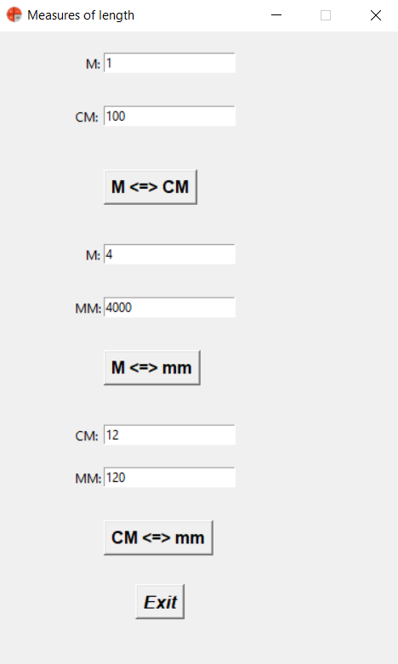
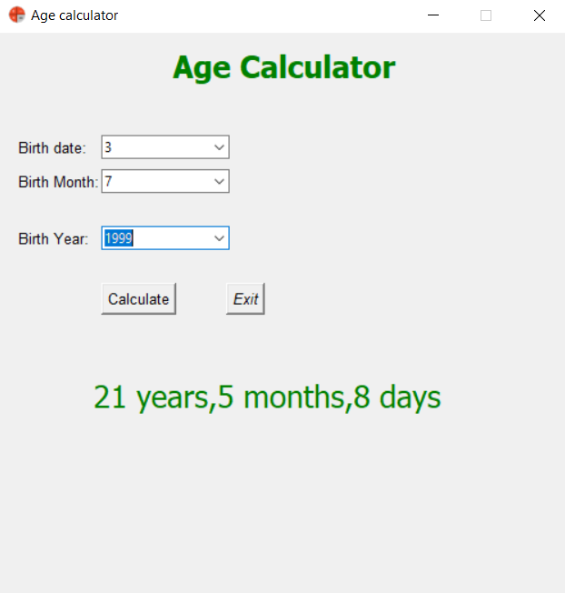
Input-Output Demo
Python Project Presentation

Slide 7
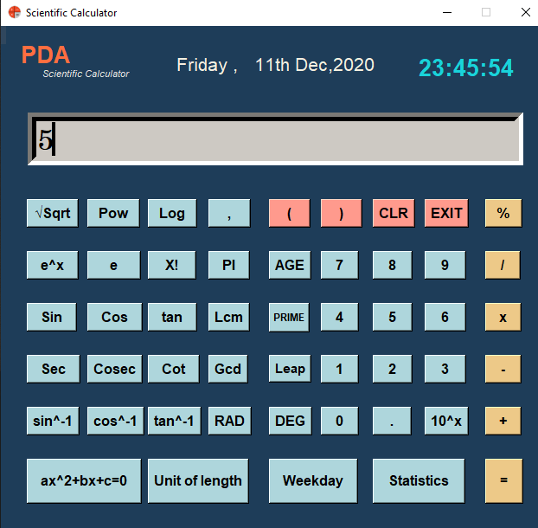
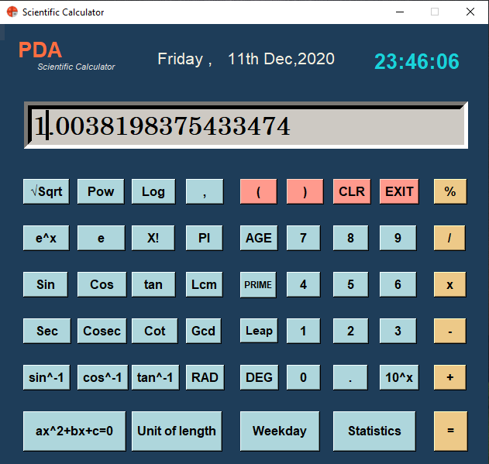
Input-Output Demo
SEC:
Python Project Presentation

Slide 8
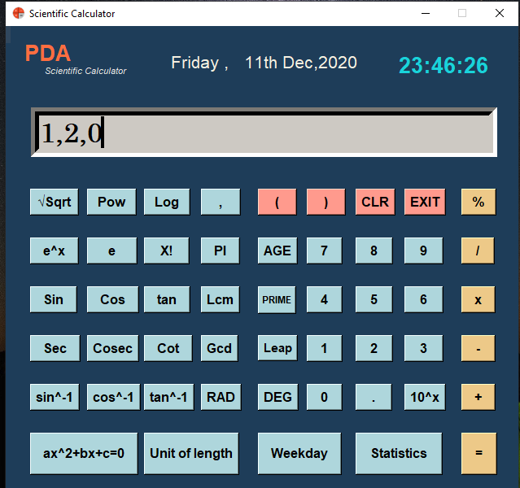
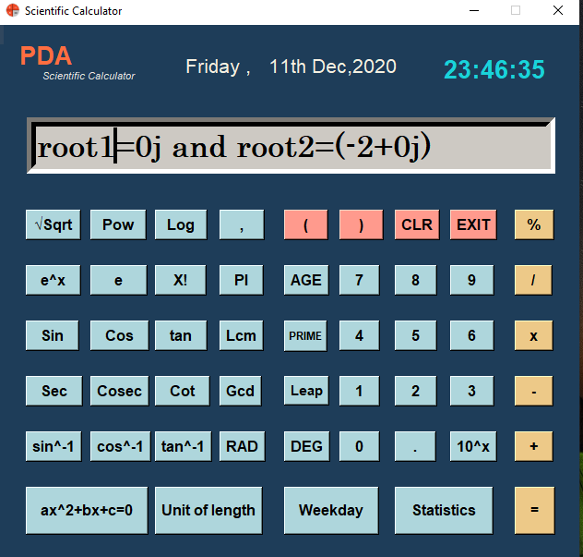
Input-Output Demo
Quadratic Equation:
Python Project Presentation

Slide 9
Expected Outcomes
By using our project(calculator), user can calculate-
Addition
Subtraction
Multiplication
Division
Power
Value of PI
Square root
Factorial of any number and many more.
Python Project Presentation

Slide 10
Conclusion
Thank you
Python Project Presentation

