Slide 1
RentalPro
Digital Rental Management System
IT401 Capstone Project Defense · Deliverables 1–6 Complete + Billing Engine + English/Shona/Arabic
Presented by: Abdurrahmaan Ali
Course: IT401 — IT Capstone I
Notes:
Hello. My name is Abdurrahmaan Ali, and today I'm presenting RentalPro, a Digital Rental Management System built as my IT401 capstone project. Over the next few minutes I'll walk through the problem this system solves, how it was designed and built, and the results of testing it — including a live demo of the working application. All six project deliverables — requirements, design, the working prototype, the full project report, 100% feature completion, and the final demo and presentation package — are finished, tested, and documented. Since then, I've also extended the system with a full billing engine, and made it more usable for Harare landlords and tenants, including a choice of English, Shona and Arabic — I'll cover both.

Slide 2
The Problem
Independent landlords and small property managers still run their business on spreadsheets, paper leases, and manual reminders.
Target Users
Property Owners
1
No single source of truth
Rent, leases, and maintenance history live in different spreadsheets and email threads.
Property Managers
Tenants
2
Missed rent and renewals
Nothing proactively flags overdue rent or an expiring lease before it becomes a problem.
Maintenance Staff
No accountability trail
Administrators
3
Verbal maintenance requests and cash payments leave no audit trail for disputes.
4
No self-service for tenants
Tenants have to call or email for basics: a balance, a receipt, a repair update.
“One system, five roles, zero spreadsheets.”
Problem Statement
2 / 18
Notes:
Small landlords and property managers are still running their business on spreadsheets, paper leases, and sticky notes. That creates four real problems: there's no single source of truth for rent and lease data; nothing proactively catches missed rent or an expiring lease; cash payments and verbal maintenance requests leave no accountability trail; and tenants have no way to self-serve — they have to call or email for a balance or a repair update. RentalPro is built for five kinds of users on one platform: Property Owners, Property Managers, Tenants, Maintenance Staff, and Administrators — replacing the spreadsheet with one accountable system.

Slide 3
Project Objectives
1
Centralize property & lease data
One record per property, unit, tenant, and lease — no duplicate spreadsheets.
2
Automate the reminders that get missed
Background jobs alert on lease expiry, rent due, overdue rent, and overdue maintenance.
3
Give every role a role-scoped view
RBAC + ownership checks so an Owner never sees another Owner’s portfolio.
4
Make every record auditable
Immutable payments and an append-only audit log — no silent edits.
5
Ship it fully tested, not just working
100% of SRS requirements implemented and covered by an automated test.
Objectives
3 / 18
Notes:
Five objectives guided the whole project. First, centralize property and lease data into one record instead of scattered spreadsheets. Second, automate the reminders landlords actually miss — lease expiry, rent due, overdue rent, and overdue maintenance all fire from background jobs, not a human remembering. Third, give every one of the five roles a scoped view, enforced by role-based access control plus ownership checks — one Owner literally cannot query another Owner's data. Fourth, make every record auditable: payments are immutable, and every state change writes to an append-only audit log. And fifth — the one I'll spend the most time proving today — ship it fully tested. Not just working, but 100% of the requirements implemented and covered by an automated test.

Slide 4
Requirements — Deliverable 1
The Software Requirements Specification defined 25 use cases across six functional areas.
Auth & RBAC
Property & Unit Mgmt
Tenant Lifecycle
2 use cases
3 use cases
4 use cases
Login, role-based access for 5 roles
Add/edit properties, units, dashboard
Onboarding, invites, leases, portal
Rent & Payments
Maintenance
Reporting
6 use cases
6 use cases
2 use cases
Recording, statements, alerts, history
Submit through close, cost tracking
Performance reports, PDF/JSON export
Requirements (D1)
4 / 18
Notes:
Deliverable 1 was the Software Requirements Specification — 25 use cases across six functional areas: authentication and RBAC, property and unit management, the full tenant lifecycle from onboarding to self-service, rent and payments including automated alerts, the six-stage maintenance lifecycle, and reporting. Every one of these 25 use cases — I'll show this again in the testing section — ended up with a route, a template, and at least one automated test behind it.

Slide 5
System Design — Deliverable 2
UML class model and a normalized relational schema — 13 tables, all linked by UUID foreign keys.
users
properties
units
tenants
tenant_invitations
password_resets
leases
rent_payments
maintenance_requests
maintenance_costs
maintenance_notes
notifications
audit_logs
Design decisions carried through to the build
UUID primary keys (identical schema on SQLite and PostgreSQL) • Naive UTC datetimes • Soft-status fields, never physical deletes • Immutable payments • JSON audit diffs
System Design (D2)
5 / 18
Notes:
Deliverable 2 turned those 25 use cases into a UML class diagram and a 13-table relational schema. Every table uses a UUID string primary key instead of an auto-increment integer, specifically so the identical schema runs unmodified on SQLite in development and test, and PostgreSQL in production. A few other decisions from this design carried straight through into the build: naive UTC timestamps to avoid timezone bugs across environments, soft status fields instead of physical deletes so history is never lost, rent payments that are only ever inserted and never edited, and JSON columns on the audit log so any entity's before-and-after state can be captured without a schema migration.

Slide 6
Architecture
A layered Flask application — five layers, each with a single responsibility.
PRESENTATION
38 Jinja2 templates, role-aware top navigation, English/Shona/Arabic menu
APPLICATION
10 Blueprints — auth, properties, tenants, rent, maintenance, admin, reports, portal, api
DOMAIN / SERVICE
security.py (RBAC, IDOR), i18n.py (English/Shona/Arabic), scheduler_jobs.py, services/ (pdf, excel, notifications, payments, storage)
DATA
18 SQLAlchemy models (13 designed + 5 billing), UUID keys, business logic on the model
INFRASTRUCTURE
PostgreSQL/SQLite · Redis · Docker Compose · dev-mode fallback for SendGrid/Twilio/Stripe
Architecture
6 / 18
Notes:
The application is a layered Flask monolith — deliberately simplified from Deliverable 2's more ambitious microservice sketch, because a single developer needed to build and verify it in the time available. Presentation is 38 Jinja2 templates behind a role-aware top navigation bar, with a language menu for English, Shona and Arabic. The application layer is 10 Flask Blueprints — one each for auth, properties, tenants, rent, maintenance, admin, reports, the tenant portal, and the REST API. Below that, the domain and service layer holds security.py for RBAC and IDOR protection, the five scheduler jobs, a small translation module for Shona and Arabic, which also turns Arabic pages right to left, and a services package for PDF generation, Excel export, notifications, and payments. Data is 18 SQLAlchemy models — the 13 from the design plus 5 for the billing engine — with UUID keys. And infrastructure is Docker Compose running PostgreSQL and Redis, with a dev-mode fallback for every paid external service — which is what let me build and test this entire system without a single paid account.

Slide 7
Key Features by Role
Owner
Manager
Tenant
Staff
Admin
Create & edit properties/units
Manage assigned properties
Self-service portal
Personal work queue only
User & role management
Configure late fees
Onboard & blacklist tenants
Pay rent online
Update ticket status
Create staff accounts
Full portfolio reports
Assign maintenance work
Submit requests with photos
Attach completion photos
Full data visibility
Features by Role
7 / 18
Notes:
Every screen in RentalPro is scoped to one of five roles. Owners create and edit properties and units, configure late fees, and see the full portfolio report. Managers work within properties an Owner already added — onboarding and, new in Deliverable 5, blacklisting tenants, and assigning maintenance work. Tenants get a self-service portal: pay rent online, and submit maintenance requests with photos. Staff see only their own assigned work queue — nothing else in the system is visible to them. And Administrators get full data visibility plus, again new in Deliverable 5, a dedicated console for managing every user's role and account status.

Slide 8
Deliverable 5 — 100% Feature Completion
Eight gaps closed against the SRS after the Deliverable 3 prototype — every one covered by an automated test.
✓
Photo uploads
✓
Configurable late fees
Property (≤10), unit (≤5), and maintenance (≤3) photos — JPEG/PNG validated by magic bytes, not extension
Fixed or percentage, applied automatically once rent is overdue
✓
Tenant blacklisting
✓
Tenant ID documents
Flag a tenant to block future leases without touching an existing one
Upload and securely serve a tenant’s identification
✓
Admin user console
✓
Staff self-service accounts
Role & status management with an “at least one active Owner” guard
Owner/Manager/Admin can create a Maintenance Staff login directly
✓
CSV rent history export
✓
Excel portfolio export
One-click spreadsheet export of a lease’s payment history
Two-sheet .xlsx workbook: portfolio summary + per-property breakdown
Deliverable 5 Highlights
8 / 18
Notes:
Deliverable 5 is where the project went from working to 100% complete against the original requirements. Eight gaps were identified and closed: photo uploads for properties, units, and maintenance tickets, all validated by their actual file content, not just the extension; configurable late fees, fixed or percentage, applied automatically once rent is overdue; tenant blacklisting, which blocks a future lease without touching an existing one; tenant ID document upload; the admin user console, with a safety guard that won't let you remove the last active Owner; self-service staff account creation; and one-click CSV and Excel export for rent history and portfolio reporting. Every one of these eight is covered by its own test module, which I'll show numbers for next.

Slide 9
Extended Scope — The Billing Engine
Eight further billing capabilities added after Deliverable 6, going beyond the original SRS — 79 additional tests, all passing.
✓
Operational & sundry charges
✓
Electricity metering
One-off charges beyond rent — cleaning, call-outs — billed straight to the lease
A per-property rate plus manual meter readings; consumption bills itself automatically
✓
Pro rata rent
✓
Variable / escalating rent
The first month prorates to a daily rate when a tenant moves in mid-month
A scheduled rent revision takes effect from a chosen date — past periods stay untouched
✓
Automated recurring billing
✓
Account statements by period
A daily scheduler job invoices every elapsed period exactly once, with a full paper trail
Opening balance, in-period activity, closing balance — plus full tenant self-service access
✓
Payment receipts
✓
Property expenses & net income
Every payment now has a real, downloadable PDF receipt, not just a receipt number
Owner-side operating costs feed a true net income estimate, not just rent collected
Extended Scope — Billing Engine
9 / 18
Notes:
Beyond the original five deliverables, I extended RentalPro with a full billing engine — eight more capabilities, each additive so the existing 124 tests never had to change. Operational and sundry charges bill one-off costs straight to a lease. Electricity metering bills consumption automatically from a configured rate. Pro rata rent prorates a partial first month instead of charging it in full. Variable rent lets a lease's rate change mid-term — an annual escalation — while past periods stay billed at their own rate. A daily scheduler job now bills each period automatically and idempotently. Account statements support a real date range with an opening and closing balance, and tenants can view their own. Every payment gets a real downloadable PDF receipt. And property expenses now feed a true net income estimate, not just rent collected minus maintenance. Seventy-nine new tests back all of it, and they're included in the testing numbers coming up.

Slide 10
Extended Scope — Usability & Localisation
Built for Harare: a clearer interface, two more languages and realistic local data — 27 more tests, all passing.
✓
Property map
✓
Top-bar redesign
Click-to-pin coordinates on every property, plus a portfolio map of all of them
The sidebar became a horizontal top bar with a soft blue-to-burgundy gradient
✓
Harare photography
✓
English, Shona & Arabic
A full-screen Harare skyline login, and a Harare photo behind each section of the app
A language menu in the top bar and on login; Arabic reads right to left; the choice is remembered
✓
Place names stay as entered
✓
Tenant-friendly unit labels
Only interface text is translated — a test fails if a Harare place name is ever altered
Tenants see “Avondale Heights · Unit 101”, not an internal unit code
✓
Logged-in redirect fix
✓
Harare demo portfolio
Opening the login page while signed in now goes to your dashboard, not a blank page
5 properties in Avondale, the CBD, Eastlea and Vainona — 16 units and 9 tenants
Extended Scope — Usability & Localisation
10 / 18
Notes:
The most recent round of work was about the people who would actually use RentalPro — landlords, managers and tenants in Harare. Every property can now carry map coordinates, set by clicking a map, and there's a portfolio map showing all of them. The interface moved from a sidebar to a horizontal top bar, and the login page and each section of the app now show photographs of Harare. The biggest change is language: a menu in the top bar and on the login page offers English, Shona and Arabic, and the choice sticks when you log in and out. My SRS originally described Arabic and English; both are now in, and because the users are in Harare, I added Shona as well. Arabic is written right to left, so an Arabic page mirrors the whole layout. Only interface text is translated — names and places stay exactly as entered, and a test fails if that ever changes. Tenants now see their unit as 'Avondale Heights, Unit 101' rather than an internal code, a blank-page bug for signed-in users is fixed, and the demo data is now a realistic Harare portfolio: five properties, sixteen units and nine tenants. Twenty-seven new tests cover this work.

Slide 11
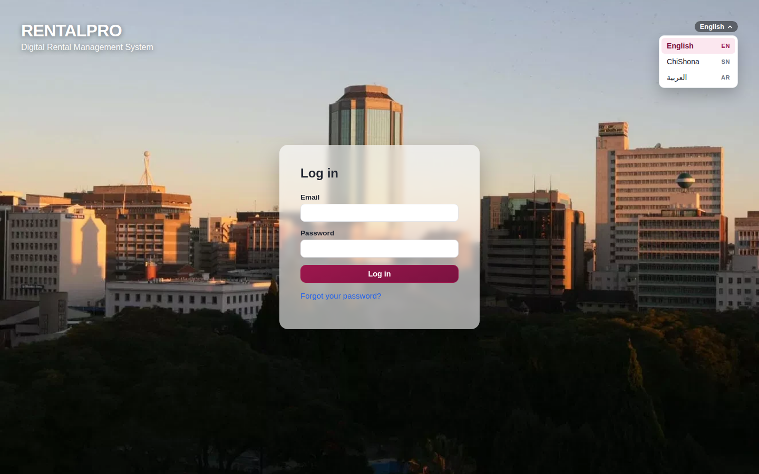
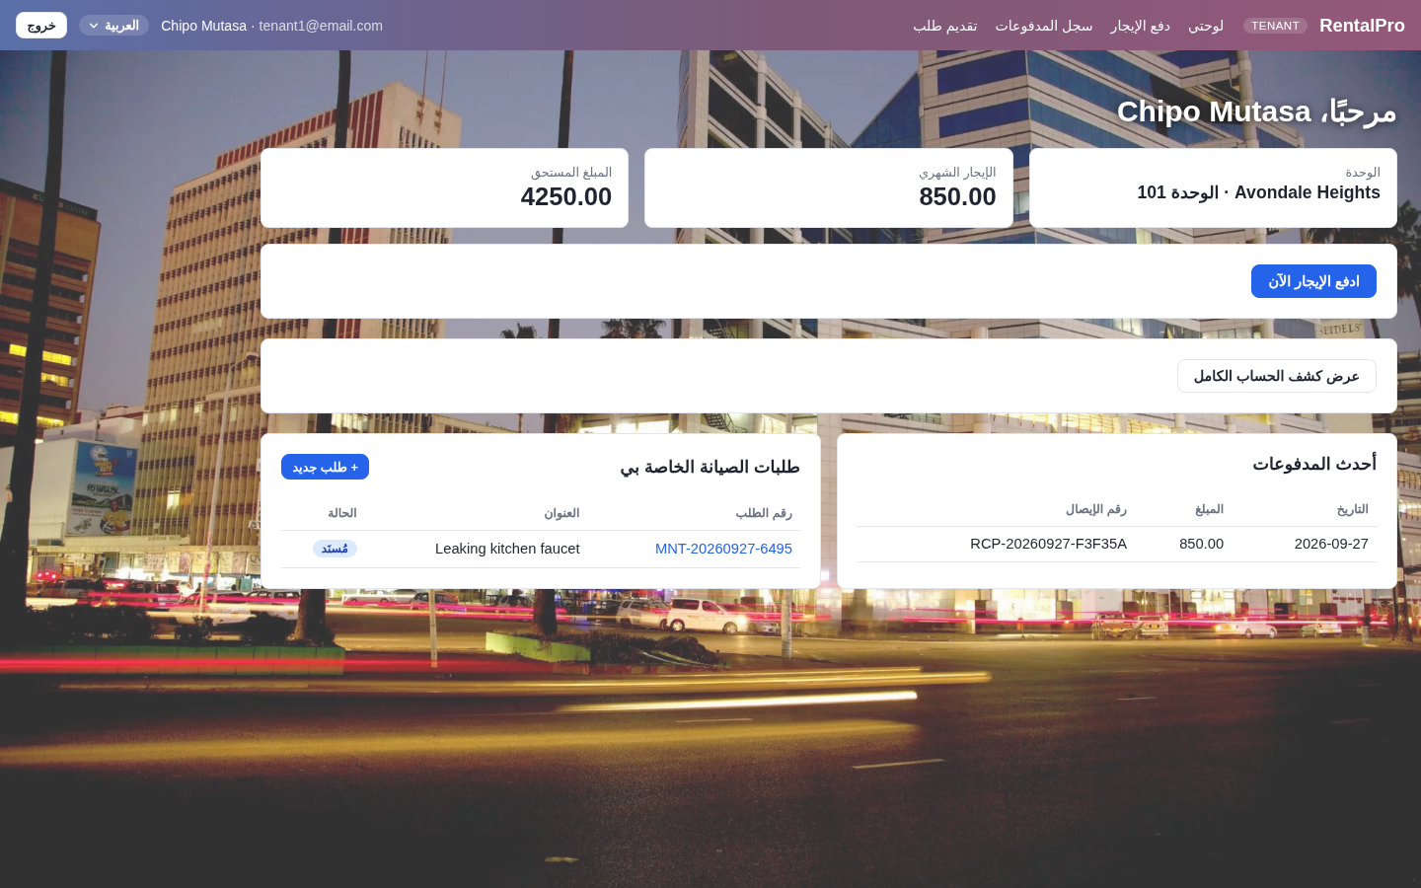
The New Look — Harare, Shona & Arabic
The Harare login page with its language menu, and the tenant portal in Arabic
Login
A full-screen Harare skyline, a translucent card, and the language menu open top-right
Tenant portal in Arabic
Laid out right to left — her name and “Avondale Heights” stay exactly as entered
The New Look
11 / 18
Notes:
Here's what that looks like. On the left is the login page: a full-screen photograph of the Harare skyline, a translucent sign-in card, and the language menu open in the corner, offering English, ChiShona and Arabic. On the right is a tenant's dashboard in Arabic. The whole layout reads right to left — the navigation starts on the right, and the cards and tables are mirrored — with a welcome, her unit, her balance, and the button to pay rent. Her name and 'Avondale Heights' stay exactly as entered, because they're data, not interface text.

Slide 12
Testing & Quality
231
0
82%
25/25
Automated Tests
Failures
Statement Coverage
Use Cases Covered
What the tests actually verify
Real HTTP requests through Flask’s test client — not isolated function calls
RBAC across all 5 roles × every management route
IDOR: a second Owner cannot view the first Owner’s property
Calendar edge cases: mid-month leases, day-31-in-February
Stripe HMAC signature verification — valid, tampered, expired
Testing & Quality
12 / 18
Notes:
This is the slide that backs up every claim in this presentation. 231 automated tests, zero failures, 82 percent statement coverage across the backend, and all 25 use cases from the SRS covered by at least one test. The chart breaks that down by module — 36 validation tests, 31 for Deliverable 5's feature gaps, 79 for the billing engine alone, the single largest block in the project, and 22 for the property map and the three languages. Importantly, these aren't unit tests calling isolated functions — they go through Flask's real test client, issuing actual HTTP requests through session handling, CSRF, RBAC, and the ORM. That's how a real security bug like cross-owner data access — one Property Owner querying another Owner's property — gets caught before it ships, not after.

Slide 13
Live Demo
A walkthrough of the running application
1
Owner: property & unit setup, photos, and a configured late fee
2
Owner: onboard a tenant, upload a lease, activate the tenancy
3
Owner: blacklist / unblacklist, record a rent payment
4
Tenant → Owner → Staff → Tenant: full maintenance lifecycle
5
Admin: user management and staff account creation
6
Billing engine, then the Harare map and the language menu
Live Demo
13 / 18
Notes:
Now let's see it running. I'll walk through six things: first, an Owner setting up a property and unit with photos and a configured late fee. Second, onboarding a new tenant, uploading their lease, and watching the unit activate. Third, the Deliverable 5 blacklist toggle and recording a rent payment. Fourth, a full maintenance ticket lifecycle rotating through four different role logins — tenant submits, owner assigns, staff completes, tenant confirms. Fifth, the admin console for user management and creating a new staff account. And finally, the billing engine end to end — charges, metering, pro rata, a rent revision, the automated billing job's paper trail, a filtered account statement, a downloaded payment receipt, and a property expense feeding into net income — and to finish, the Harare portfolio on the map and the whole interface switching to Shona, then to Arabic, laid out right to left, and back to English. [Switch to the recorded demo video or live application here.]

Slide 14
Challenges & Solutions
CHALLENGE
SOLUTION
Reconciling ambitious design docs with what one developer could actually build and verify
Simplified Deliverable 2’s microservice sketch to a layered monolith; corrected Deliverable 3’s overstated early numbers to the real, verified ones
CHALLENGE
SOLUTION
Calendar-accurate billing — a lease starting on the 31st, or a due day that doesn’t exist in February
Wrote the edge-case tests first (mid-month start, day-29 clipping) before trusting the due-date calculation
CHALLENGE
SOLUTION
Testing payments, email, and SMS without any live paid account
Built a dev-mode fallback pattern into every external service — the whole app runs and tests fully offline
Challenges & Solutions
14 / 18
Notes:
Three challenges stand out. The first was reconciling earlier, more ambitious design documents with what one developer could actually build and verify in the time available — I simplified Deliverable 2's microservice-style sketch into a layered monolith, and when I found Deliverable 3's original numbers had drifted from reality, I corrected the document rather than leaving the gap in place. Second, getting recurring billing correct at calendar edges — a lease starting on the 31st, or a due day that doesn't exist in February — meant writing the edge-case tests before trusting the calculation, not after. Third, testing payments, email, and SMS without a live paid account of any kind — solved with a dev-mode fallback pattern applied consistently across every external integration, which is also exactly what let this whole demo run offline today.

Slide 15
Security Controls
Password hashing
RBAC
•
pbkdf2:sha256, 600,000 iterations
•
role_required() on every protected route, 5 roles
IDOR protection
CSRF protection
•
assert_owner() / assert_tenant_self() — resource-level, not just route-level
•
Flask-WTF on every form; explicit exemption only for the signed Stripe webhook
Account lockout
Upload validation
•
5 failed logins locks the account for 15 minutes
•
Magic-byte checks — PDF, JPEG, PNG — regardless of file extension
Audit log
Webhook verification
•
Immutable, append-only record of every state-changing action
•
Manual HMAC check, 300-second replay window, independent of the SDK
Security
15 / 18
Notes:
Security wasn't bolted on — eight controls run through every request. Passwords are hashed with 600,000 rounds of PBKDF2. Every protected route carries a role check, and every sensitive lookup also carries an ownership check at the resource level — the combination is what stops a second Property Owner from viewing the first Owner's data even though they share a role. CSRF protection covers every form, with one deliberate, documented exemption for the Stripe webhook, which instead carries its own manual HMAC verification with a replay window. Five failed logins locks an account for 15 minutes. Every file upload is validated by its actual magic bytes, not its claimed extension — so a ZIP renamed to .pdf, or a non-image file renamed to .jpg, gets rejected. And every state-changing action writes to an immutable audit log.

Slide 16
Conclusion
RentalPro was carried from requirements through design, a working prototype, a full project report, 100% feature completion, and a localised Harare interface — every claim in this deck backed by a running, tested system.
✓
25 / 25 use cases implemented, each with a route and a covering test
✓
13-table database design implemented exactly as specified
✓
231 automated tests, 0 failures, 82% statement coverage
✓
8 feature gaps closed in Deliverable 5, a billing engine, and an English/Shona/Arabic interface
✓
Runs fully offline — zero paid external accounts required to build or test
“A claim in this project should be a fact about the running system, not a target for it.”
Conclusion
16 / 18
Notes:
To wrap up: RentalPro went from a requirements document, through design, to a working prototype, a full seven-chapter project report, 100% feature completion, an extended billing engine, and now a localised interface for Harare — and every number on this slide was produced by actually running the code, not estimated. 25 of 25 use cases, each with a route and a covering test. The 13-table design implemented exactly as specified. 231 tests, zero failures, 82 percent coverage. Eight feature gaps closed in Deliverable 5, eight more billing capabilities added since, and an interface in English, Shona and Arabic. And the whole thing runs fully offline, with zero paid external accounts required to build or test it. That discipline — that a claim in the report is a fact about the system, not a target for it — is, I'd argue, as much a deliverable of this capstone as the application itself.

Slide 17
Future Work
Scoped for IT Capstone Part 2 (IT402):
1
Cloud file storage
Swap local uploads/ for S3-compatible storage — already isolated behind a storage.py interface
2
Mobile-optimized tenant portal
Tenants are the role most likely to use the system from a phone
3
Alembic schema migrations
Replace the create_all() bootstrap with a real migration path for production data
4
Live third-party verification
End-to-end tests against real Stripe, SendGrid, and Twilio sandbox accounts
5
Complete the translations
Translate the remaining forms and messages into Shona and Arabic, and have native speakers check the wording
Future Work
17 / 18
Notes:
Looking ahead to Part 2 of the capstone: cloud file storage is the natural next step — and because photo and document storage is already isolated behind a small storage.py interface, that swap needs no changes to routes or templates. A mobile-optimized tenant portal is next, since tenants are the role most likely to use this from a phone. Alembic-based schema migrations would replace the create_all() bootstrap I used during development, which is fine pre-launch but not for a live database holding real tenant data. And finally, end-to-end verification against live Stripe, SendGrid, and Twilio sandbox accounts, on top of the offline test suite that's carried the project so far. And last, finishing the Shona and Arabic translations for the remaining screens and messages, and having native speakers review the wording.

Slide 18
Thank You
Questions?
RentalPro — Digital Rental Management System · IT401 Capstone
Notes:
Thank you. That's RentalPro — a fully-implemented, fully-tested digital rental management system covering all six deliverables from requirements through the final demo and presentation package, plus an extended billing engine on top. I'm happy to take any questions — about a specific design decision, the test suite, the security model, or anything you'd like to see demonstrated again.

