Slide 1

Stacks
REM COLLIER

Slide 2
Focus Shift…
Data Type: a mechanism for classifying the type of data that a variable (or parameter) may hold.
  E.g. int, double, boolean, …
Data Structure: A composite data type that consists of fields and which represents data in a program (in OOP, this is part of a class).
  E.g. Student, Module, Course, …
Abstract Data Type: a generalized approach to representing and manipulating certain types of data.
  ADT = Data Structure + Algorithms

Slide 3
Abstract Data Types
ADTs are concepts not implementations.
  Normally described as a functional specification.
  Underpinned by multiple implementation strategies.
They identify:
  the characteristics of the data that may be stored within the data structure, and
  the associated operations that may be applied to that data structure (e.g. addition / removal of items)
Key Issues:
  Understanding what potential implementation strategies exist.
  Knowing which strategy to use for a given problem.

Slide 4
My Approach
Conceptual Overview
  What problem is the ADT trying to solve
  What concepts underpin the problem
Functional Specification
  What operations exist w.r.t. the ADT
  How should those functions work
Implementation Strategies
  What approaches exist?
  What are their benefits / limitations?

Slide 5
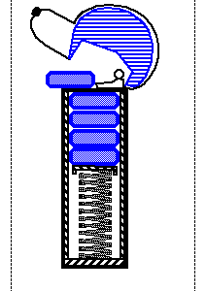
Stacks: Concept
A stack is a container of objects / values.
Insertion and removal based on the last-in-first-out (LIFO) principle.
  Objects can be inserted at any time, but only the last (the most-recently inserted) object can be removed.
Terminology:
  Items are “Pushed” onto the stack (insertion).
  Items can be “Popped” off the stack (removal).
  The “Top” of the stack is the last item pushed
A PEZ® dispenser as an analogy…

Slide 6
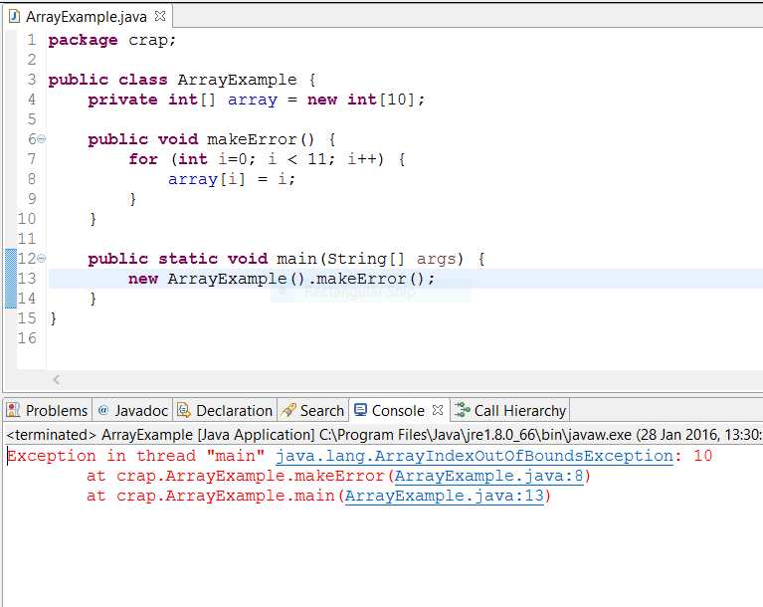
Example: Program Execution…
When executing code Java uses a program stack to keep track of the current execution context…

Slide 7
Example: Word Reversal
Insert the letters in first to last order and remove the letters to get the reverse order…
  -> push(D)
  D -> push(O)
  D O -> push(G)
  D O G -> pop() and print G
  D O -> pop() and print O
  D -> pop() and print D
  -> ALL DONE!

Slide 8
Stacks: Functional Specification
Stacks should work with objects.
Core Operations:
  push(o): Inserts object o onto top of stack
  pop(): Removes the top object of stack and returns it
Support Operations:
  size(): Returns the number of objects in stack
  isEmpty(): Return a boolean indicating if stack is empty.
  top(): Return the top object of the stack, without
  removing it

Slide 9
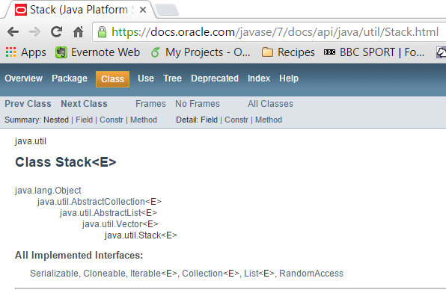
Stacks in Java

Slide 10
Stacks: Impl. Strategies
Array-based Implementation:
  Array holds the objects pushed onto the stack
    Insertion begins at index 0.
    Auxiliary value needed to keep track of the “top” of the stack.
  Finite Capacity
Link-based Implementation:
  Objects stored in special “nodes”
  Nodes maintain ordering information
    Link to the next object in the stack.
  Infinite Capacity

Slide 11

Array-Based Stack
Create a stack using an array by specifying a maximum size N for our stack, e.g., N = 1000.
The stack consists of:
  an N-element array S and
  an integer variable t, the index of the top element in array S.
Illustration:

Slide 12
Array-Based Stack
Algorithm push(o):
t ← t + 1
S[t] ← o
Algorithm size():
return t +1
Algorithm isEmpty():
return t < 0
Algorithm pop():
e ← S[t]
S[t] ← null
t ← t-1
return e
Algorithm top():
return S[t]

Slide 13
Array-Based Stacks: Dry Runs
View operations as atomic
  Show the state of the array, S, and top element index, t, after each operation
Example:
operation | t | 0 | 1 | 2 | 3 | 4 | 5 | 6 | 7 | 8 | 9
Initial State | -1
Push(H) | 0 | H
Push(A) | 1 | H | A
Push(A) | 2 | H | A | A
Pop() | 1 | H | A
Push(P) | 2 | H | A | P
Push(P) | 3 | H | A | P | P
Push(Y) | 4 | H | A | P | P | Y

Slide 14
Array-Based Stacks: Impl.
Class name: ArrayStack
  Fields:
    An array of objects, S
    An integer, N (array size)
    An integer, t (top index)
  Constructors
    Default Constructor (sets N to 1000)
    Constructor with 1 integer parameter (used to set value of N)
  Methods:
    1 per operation: methods names should match operation names – except for naming conventions (lower case first letter)
    Implement methods based on pseudo code

Slide 15
Array-Based Stacks: Analysis
Operation Running Times:
Issues:
  What happens if we pop from an empty stack?
  What happens if we push onto a full stack?
Operation | Running Time
Push(o) | O(1)
Pop() | O(1)
Top() | O(1)
IsEmpty() | O(1)
Size() | O(1)

Slide 16
Insert: Working with Objects
Note: Stacks works with Objects, and not primitive data types…
  This means that we cannot use int, long, char, double, …
Java has object equivalents for all primitive data types:
  Integer == int, Double == double, Long == long, Character == char
Conversing to objects:
  E.g. Integer year = new Integer(2008);
Extracting values from objects:
  E.g. int intYear = year.intValue();

Slide 17
Insert: Working with Objects
When you declare a parameter of type object, this means that you can pass any object as an argument.
  For example, if we had a variable stack that holds a reference to an ArrayStack object, then we can do the following:
    stack.push(“Hello World”);
    stack.push(new Integer(55));
    stack.push(new URL(“http://www.google.com”));
Finally, when you declare a return value of type object, this means that the method can return any type of object.
  So, when we get the return value, we must convert it to be a reference to the appropriate kind of object (this is known as casting):
    URL url = (URL) stack.pop();
    Integer integer = stack.pop ();

Slide 18
Array-Based Stacks
Array-based implementations => Finite Capacity.
  Memory (Mis-)management issues.
  Application Logic issues.
Possible Solution: Use an “extendable array”
  Creating a new larger array and copying the existing values into it.
  Running time – O(n) => Pop / Push running times become O(n)
Are there any other implementation strategies?
YES! We can use the Linked List data structure.

Slide 19
Linked Lists
In a Linked List, the objects are stored in nodes.
  Each node also maintains a reference to the next node in the list (this is the link).
  The link of the last node in the list is set to null.
We also store references to “key” nodes / entry points.
  These provide us with a way of accessing the list
element
next
“Rome”
Null means “end of list”

Slide 20
Link-Based Stack
Auxiliary Data Structure: Node
  A reference to the object being stored in the stack
  A link to the next node in the stack (this is the link).
Key Nodes / Data:
  The “top” node of the stack
  The link of the bottom node in a non-empty stack is set to null.
  Need to keep track of the “size” of the stack
top
∅
top
∅
Empty Stack
Stack of size 2
Ireland
France

Slide 21
Link-Based Stack
Algorithm push(o):
node ← new Node(o)
node.next ← top
top ← node
size ← size + 1
Algorithm size():
return size
Algorithm isEmpty():
return size = 0
Algorithm pop():
e ← top.element
top.element ← null
top ← top.next
size ← size-1
return e
Algorithm top():
return top.element

Slide 22
Link-Based Stacks: Dry Runs
View operations as atomic
  Show the state of the Linked List after each operation
push(“France”)
top
top
∅
∅
push(“Ireland”)
France
top
∅
top
∅
Ireland
France
push(“Scotland”)
Scotland
Ireland
France

Slide 23
Link-Based Stacks: Impl.
Class name: LinkedStack
  Fields:
    An inner class Node (see Worksheet)
    An integer, size (number of objects in the stack)
    A Node field, top (references top node in stack)
  Constructors
    Default Constructor (sets top to null and size to 0)
  Methods:
    1 per operation: methods names should match operation names
    Implement methods based on pseudo code

Slide 24
Interlude: Inner Classes
A class that is declared as part of another class.
  The inner class is in effect part of implementation of the outer class.
Why use one?
  Logically groups code that is only used in one place
  Increases readability and maintainability
Example:
    public class LinkedStack {
    public class Node {
    …
    }
    …
    }

Slide 25
Link-Based Stacks: Analysis
Operation Running Times:
Issues:
  What happens if we pop from an empty stack?
Which Implementation Strategy is better?
Operation | Running Time | ABS Running Time
push(o) | O(1) | O(1)
pop() | O(1) | O(1)
top() | O(1) | O(1)
isEmpty() | O(1) | O(1)
size() | O(1) | O(1)

Slide 26
Interfaces & Exceptions

Slide 27
Public Interfaces
Public Interface: the parts of your code that are accessible from outside the class
  i.e. everything that is declared public
  Defines what you can do, not how it does it
Programming to Interfaces (Best Practices in SE):
  Identify the public interface early, define it, and publish it (to your colleagues)
  Now, think about implementation
  Colleagues write code that conforms to the interface and not your implementation.

Slide 28
Interfaces in Java
In Java, Interfaces are a concrete concept:
  Declared via the interface keyword
  Consists of a set of public method signatures - no implementations
Classes can implement interfaces:
  Declared via the implements keyword
  All interface methods must be implemented
Interfaces are types:
  Interface type variables, fields, parameters can reference any class that implements the interface
Interfaces constrain what you can do to an object:
  Only interface declared methods can be invoked with interface types

Slide 29
Interface Example
public interface MyInterface {
public void hello();
}
public class MyClass implements MyInterface {
public void hello() {
System.out.println(“Hello World!”);
}
public void goodbye() {
System.out.println(“Goodbye World!”);
}
}
public class Test {
public static void main(String[] args) {
MyInterface iface = new MyClass();
iface.hello();
iface.goodbye();
}
}

Slide 30
Interfaces & ADTs
public interface Stack {
public void push (Object element);
public Object pop();
public int size();
public boolean isEmpty();
public Object top();
}
public class ArrayStack implements Stack { … }
public class LinkedStack implements Stack { … }
public static void main(String[] args) {
Stack stack = new ArrayStack();
stack.push(“England”);
stack.push(“France”);
…
String s = (String) stack.pop();
}

Slide 31
Exceptions
An exception is an event, which occurs during the execution of a program, that disrupts the normal flow of the program's instructions.
Exceptions:
  Stop execution of the current method.
  Force the Java interpreter to enter exception handling mode
  Are represented in Java as object.
Exception are generated by creating and throwing an Exception object.
Exception Handling Mode = the search for an exception handler
  It checks the current method for an appropriate handler.
  No handler => throw exception to the invoking method and return to 1.
  If no method handles the exception, then the program stops.
Exceptions are handled by the Java try … catch statement.

Slide 32
Exception Example
public class Test {
public static void main(String[] args) {
try {
test();
} catch (Exception e) {
e.printStackTrace();
}
System.out.println(“Yipee!”);
}
public static void test() throws Exception {
throw new Exception("An exception");
}
}
Example Output:
java.lang.Exception: An exception
at Test.test(Test.java:22)
at Test.main(Test.java:15)
Yipee!

Slide 33
Unchecked Exceptions
Checked Exceptions:
  All methods must explicitly declare that they throw the exception
  Corresponding method invocations must:
    Either be nested within a try…catch statement
    Or declare that they will throw the exception
  Are used for handling recoverable, anticipated errors
    E.g. trying to open a file that does not exists
Unchecked Exceptions:
  Methods do not need to explicitly declare that they throw the exception.
  Corresponding invocations do not need to declare or handle the exception
  Are used for non-recoverable, unexpected errors
    E.g. trying to access an index that is outside the bounds of the array

Slide 34
Exception Example
public class Test {
public static void main(String[] args) {
test();
System.out.println(“Yipee!”);
}
public static void test() {
throw new RuntimeException("An exception");
}
}
Example Output:
Exception in thread "main" java.lang.RuntimeException: An exception
at Test.test(Test.java:19)
at Test.main(Test.java:14)

Slide 35
Meaningful Exceptions
Exception and RuntimeException are not very instructive in helping you understand what happened.
  They rely on the developer providing a meaningful message (often this does not happen)
  Some methods may throw multiple different types of exception depending on what goes wrong
A better approach is to create your own exception types:
  This is done by extending the Exception or RuntimeException class and creating a new exception class that has a meaningful name.
Examples:
  Java uses the FileNotFoundException class to indicate that you tried to open a file that does not exist.
  An unchecked ArrayIndexOutOfBoundsException is thrown whenever you try to access an array position that is outside its declared range.
Some help on exceptions:
  http://java.sun.com/docs/books/tutorial/essential/exceptions/index.html

Slide 36
Exceptions & ADTs
public class StackEmptyException extends Exception {}
public interface Stack {
public void push (Object element);
public Object pop() throws StackEmptyException;
public int size();
public boolean isEmpty();
public Object top();
}
public class ArrayStack implements Stack {
public Object pop() throws StackEmptyException {
if (top = -1) throw new StackEmptyException();
…
}
…
}
public static void main(String[] args) {
Stack stack = new ArrayStack();
try {
String s = (String) stack.pop();
} catch (StackEmptyException e) {}
}

